Slide 1
Deep learning model
Ioan Croitor Catargiu

Slide 2
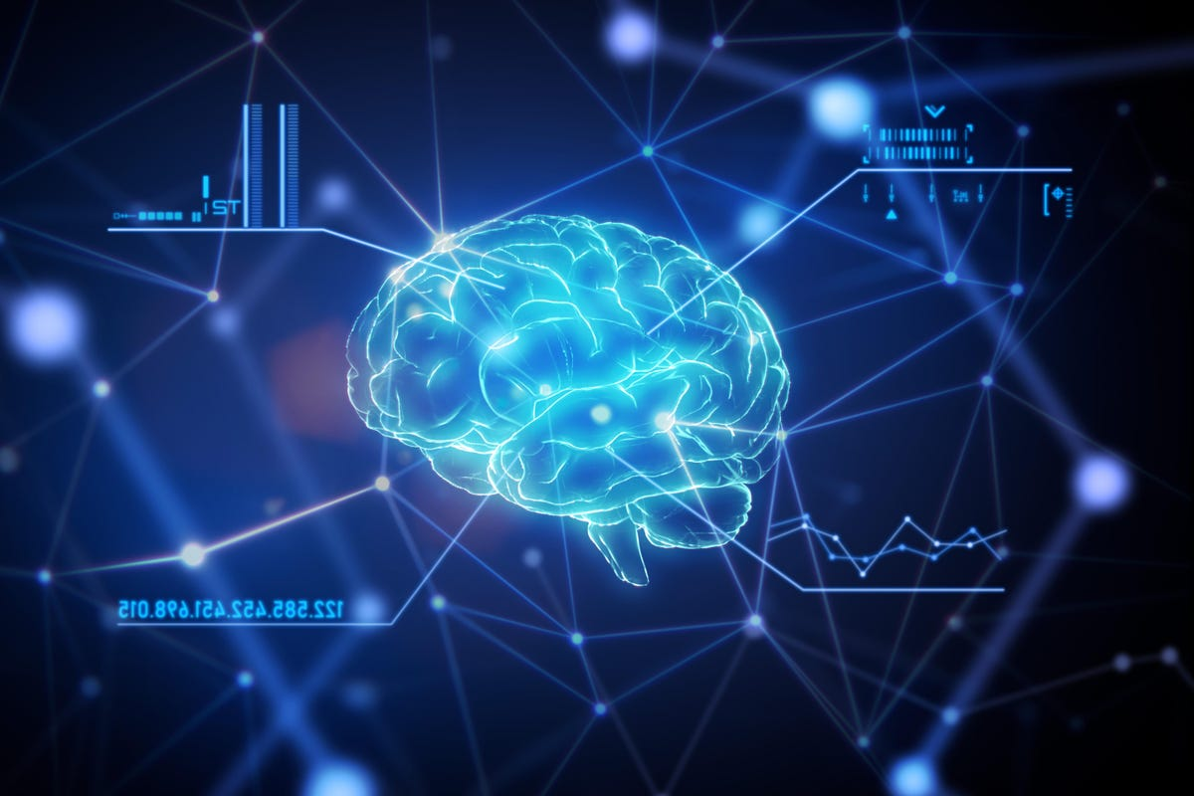
Introduction
Theory
Implementation
Conclusion

Slide 3

Introduction
In this presentation, I will summarize both the thinking and the process I followed in order to complete the second requirement of the task assigned to me, which is the development of a deep learning model that is able to distinguish between images of cats and dogs.

Slide 4
theory

Slide 5
Neural Network Design
General
"It is a subset of machine learning and is at the 'heart' of deep learning algorithms."
Formation
They consist of node layers that contain input, multiple other layers, and output. Each node (neuron) is connected to another, creating a network. After processing by the neurons of a layer, the data is sent to the next layer.
Deep Learning
Deep learning is part of neural networks and refers to the "depth" of the layers (a large number of layers).
Notes:
dfbdfgbfsdbsfgbsfgbndfgfnty

Slide 6
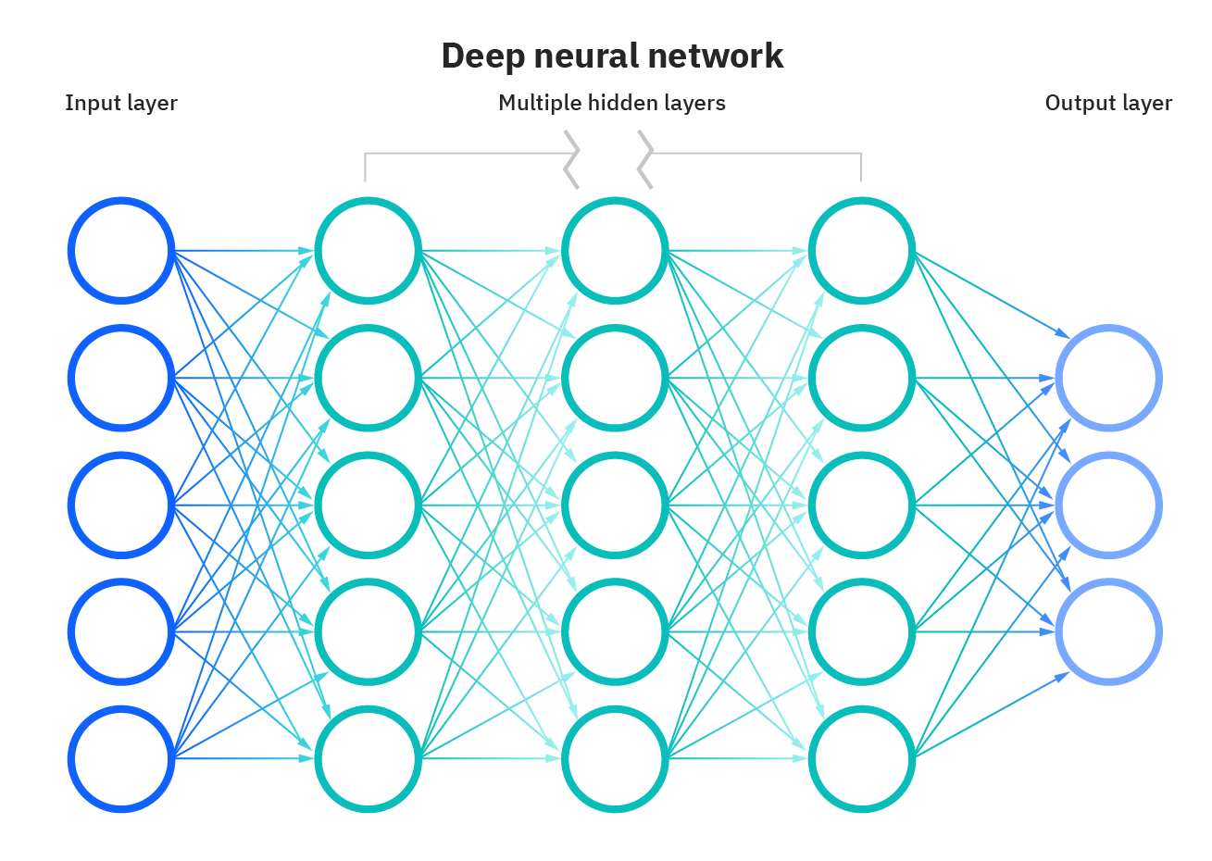

Slide 7
implementation

Slide 8
Initialization
Programming Language
Data
Jupyter Notebook (Python)
Kaggle dataset with phots of dogs (12500) and cats(12500)
Libraries
tensorflow (for model’s training)
numpy (for mathematical computations)
matplotlib (for showing statistical data)
os (for file management)
cv2 (modification & image management)

Slide 9
Program
 | Step 1 | Step 2 | Step 3 | Step 4
 | Load the training data | Scale Data & Batch | Model Creation | Model Training
 | Formation of 2 classes (dogs & cats with 0 & 1 correspondingly) | For optimizing the runtime of the program & Creation of Data Batches | Sequential model with multiple layers (Conv2D, MaxPooling2D, Flatten, Dense) | Through fit function where the training epochs are defined (4) and the rest parameters
Step 5
Evaluation
Through predict function I evaluate the ability of the model by providing it a random dog image (out of the dataset)

Slide 10
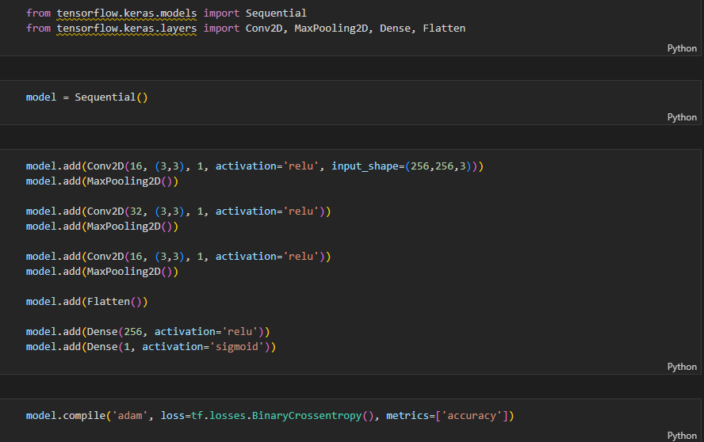

Slide 11
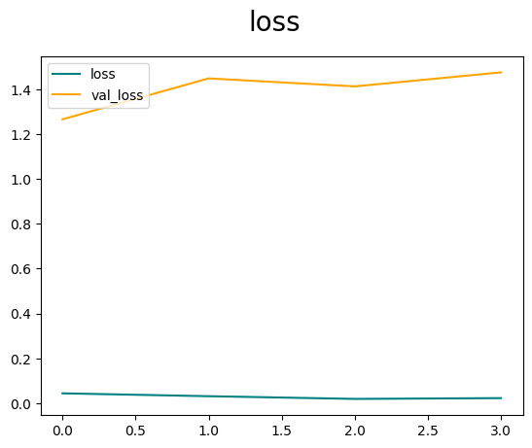
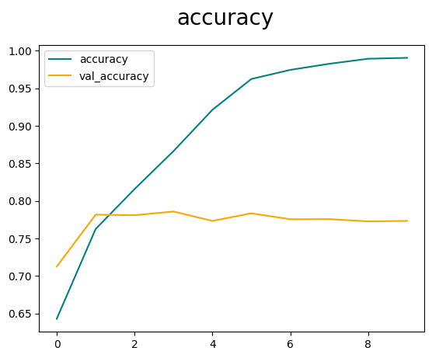
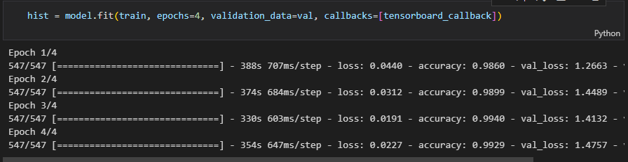

Slide 12
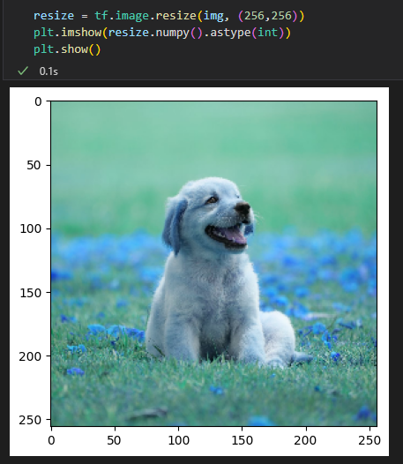
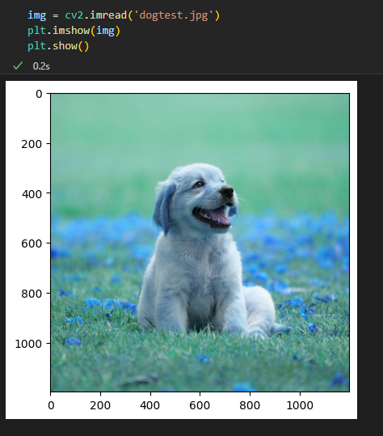
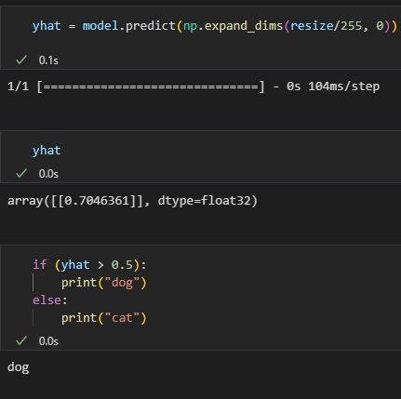
Evaluation

Slide 13
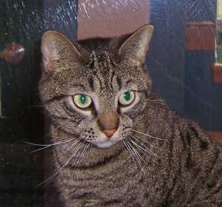
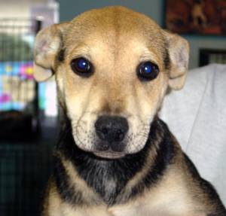
Conclusion
In summary, I achieved a model with an accuracy of about 0.9929 (~99%) with almost zero losses, which is capable of distinguishing a dog from a cat after being trained for 4 epochs on a sample of 25,000 photos.

Slide 14

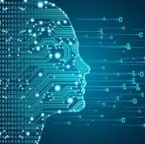
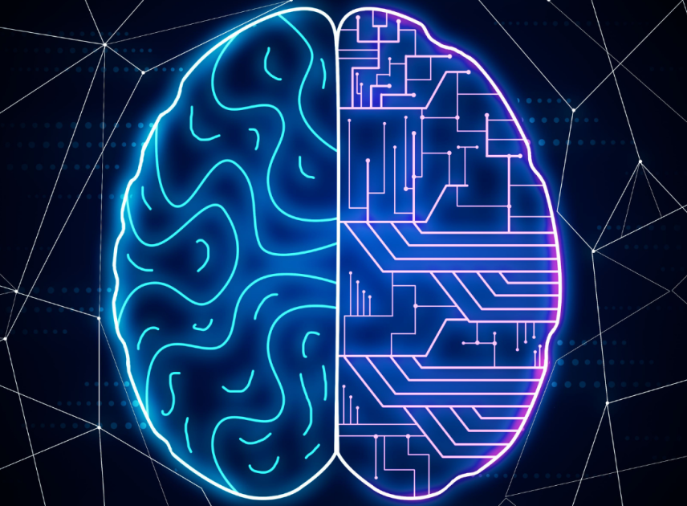
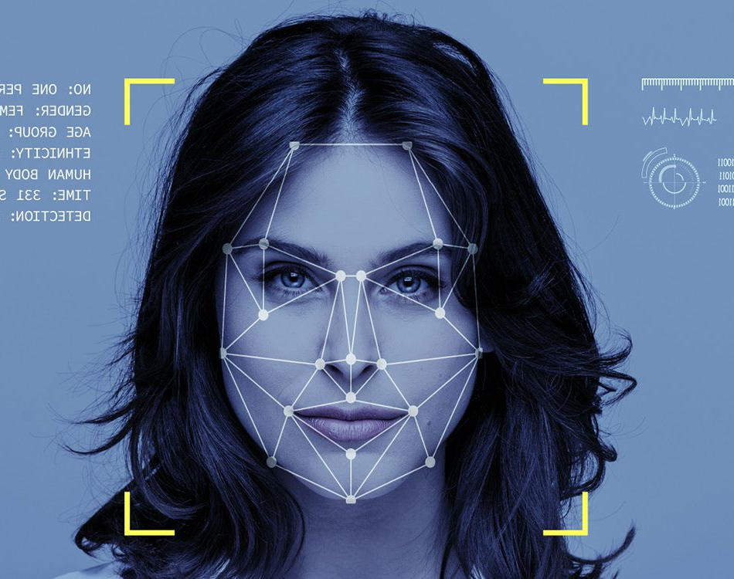
THANK you
Ioannis Croitor Catargiu
ioanniscatargiu@gmail.com

