Slide 1
Health Monitoring System
Project Components & Connections

Slide 2
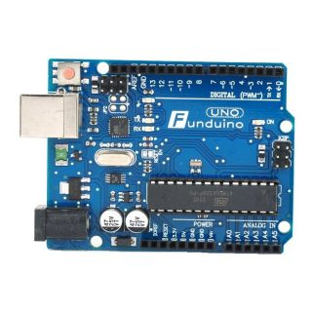
Arduino Uno Rev3
Microcontroller: ATmega328
Input Voltage (recom.): 7-12V
Input Voltage (max.): 6-20V
Digital I/O Pins: 14
Analog Input Pins: 6
Clock Speed: 16MHz
Flash Memory: 32KB
EEPROM: 1KB
SRAM: 2KB

Slide 3
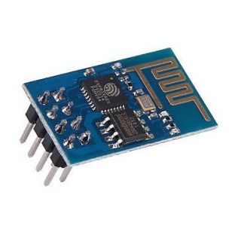
ESP8266 WiFi Module (1/3)
802.11 b/g/n
WiFi Direct (P2P), soft-AP
Built-in TCP/IP protocol stack
Built-in TR switch, balun, LNA, power amplifier and matching network
Build-in PLL, voltage regulator and power management components
802.11b mode + 19.5dBm output power
Built-in temperature sensor
Support antenna diversity
Off leakage current < 10uA
Built-in low-power 32-bit CPU
SDIO 2.0, SPI, UART
STBC, 1x1 MIMO, 2x1 MIMO
2ms, connect and transfer data packets
Standby power consumption < 1.0mW

Slide 4
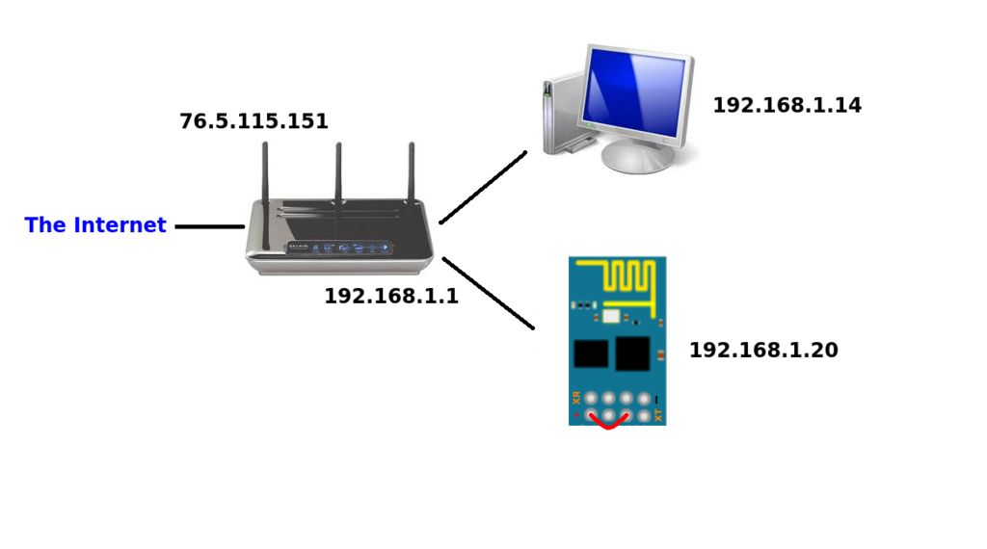
ESP8266 WiFi Module (2/3)

Slide 5
ESP8266 WiFi Module (3/3)
ESP8266 offers a complete and self-contained WiFi networking solution, allowing it to either host the application or to offload all WiFi networking functions from another application processor.
When ESP8266 hosts the application, and when it is the only application processor in the device, it is able to boot up directly from an external flash. It has integrated cache to improve the performance of the system in such applications, and to minimize the memory requirements.
Alternately, serving as a WiFi adapter, wireless internet access can be added to any microcontroller-based design with simple connectivity through UART interface or the CPU AHB bridge interface.
Sophisticated system-level features include fast sleep/wake context switching for energy-efficient VoIP, adaptive radio biasing for low-power operation, advance signal processing, and spur cancellation and radio co-existence features for common cellular, Bluetooth, DDR, LVDS, LCD interference mitigation.

Slide 6
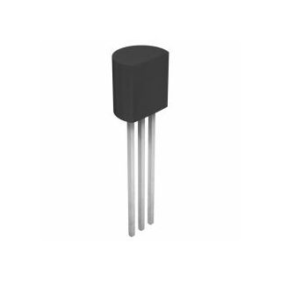
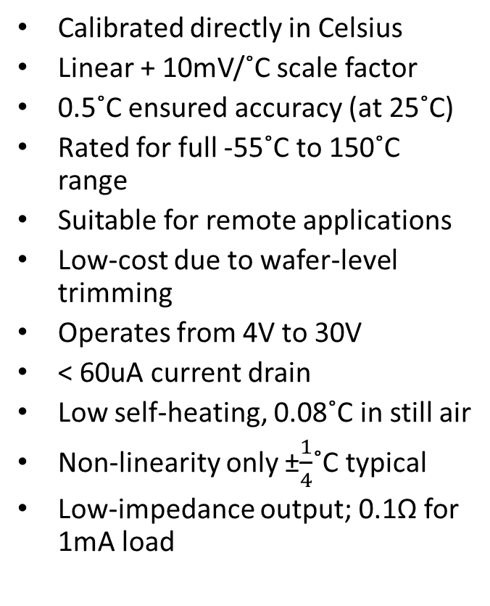
Temperature Sensor LM35D (1/2)
Calibrated directly in Celsius
Linear + 10mV/˚C scale factor
0.5˚C ensured accuracy (at 25˚C)
Rated for full -55˚C to 150˚C range
Suitable for remote applications
Low-cost due to wafer-level trimming
Operates from 4V to 30V
< 60uA current drain
Low self-heating, 0.08˚C in still air
Non-linearity only ±$\frac{1}{4}$˚C typical
Low-impedance output; 0.1Ω for 1mA load

Slide 7
Temperature Sensor LM35D (2/2)
The LM35 series are precision integrated-circuit temperature devices with an output voltage linearly-proportional to the Centigrade temperature.
The LM35 device has an advantage over linear temperature sensors calibrated in Kelvin, as the user is not required to subtract a large constant voltage from the output to obtain convenient Centigrade scaling.
Lower cost is assured by trimming and calibration at the wafer level.
The low-output impedance, linear output, and precise inherent calibration of the LM35 device makes interfacing to readout or control circuitry especially easy.

Slide 8
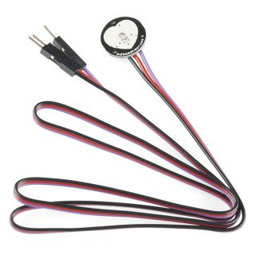
Pulse Sensor Amped (1/3)
Input voltage range: 3.3-5VDC
Operating current: 3-4mA
Operating temperature range: -40˚C to +85˚C

Slide 9
Pulse Sensor Amped (2/3)
Heart rate data can be really useful whether you are designing an exercise routine, studying your activity or anxiety levels or just want your shirt to blink with your heart beat. The problem is that heart rate can be difficult to measure.
The Pulse Sensor Amped is a plug-n-play heart rate sensor for Arduino. It essentially combines a simple optical heart rate sensor with amplification and noise cancellation circuitry making it fast and easy to get reliable pulse readings.
The sensor clips onto a fingertip or earlobe and plugs right into Arduino. It also includes an open-source monitoring app that graphs your pulse in real time.

Slide 10
Pulse Sensor Amped (3/3)
The front of the sensor is covered with the heart shape logo. This is the side that makes contact with the skin.
On the front you see a small round hole, which is where the LED shines through from the back, and there is also a little square just under the LED. The square is an ambient light sensor, exactly like the one used in cellphones, tablets, and laptops, to adjust the screen brightness in different light conditions.
The LED shines light into the fingertip or earlobe, or other capillary tissue, and sensor reads the amount of light that bounces back. That’s how it calculates the heart rate.

Slide 11
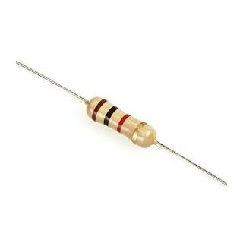
Resistor Carbon 1/4W 5% 10KΩ

Slide 12
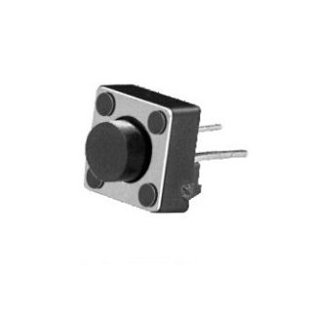
Tact Switch – Push Button

Slide 13
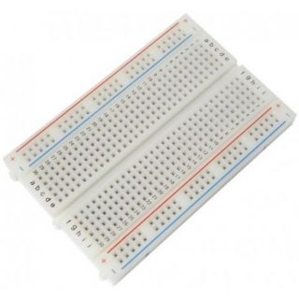
Breadboard

Slide 14
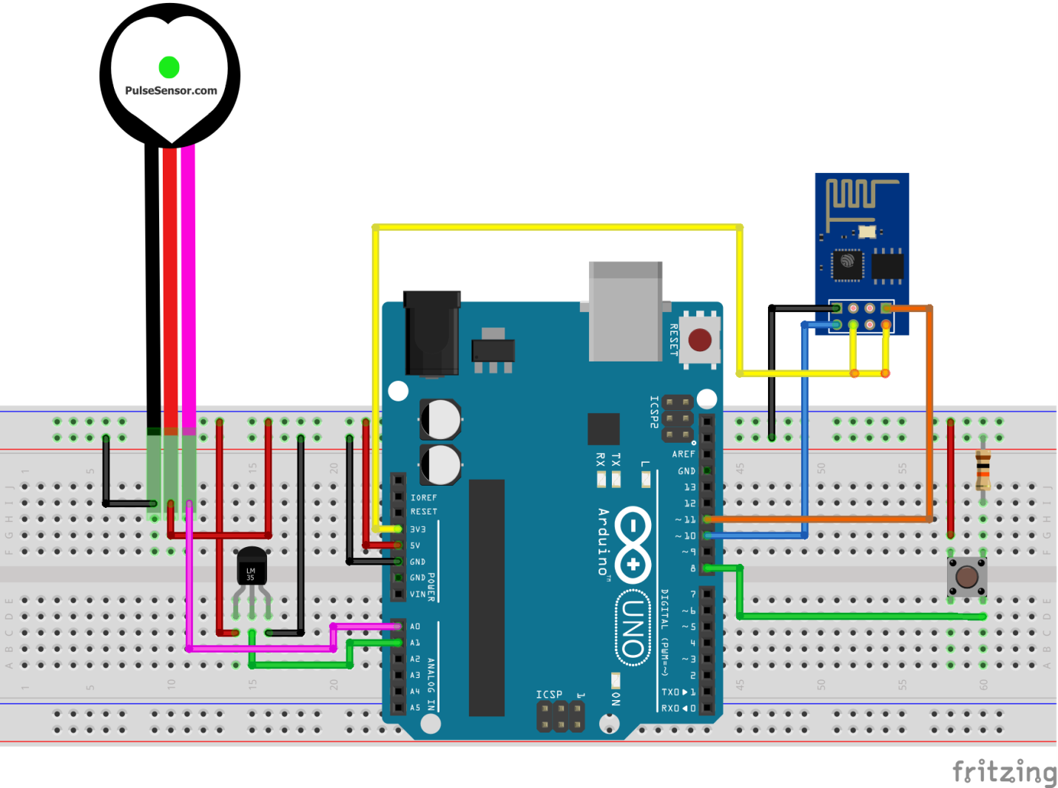
Circuit/Schematic Diagram

Slide 15
Connections
ESP8266 (Tx): Arduino (pin10)
ESP8266 (Rx): Arduino (pin11)
ESP8266 (CH_PD): Arduino (3.3V)
ESP8266 (Vcc): Arduino (3.3V)
ESP8266 (GND): Arduino (GND)
LM35 (Vout): Arduino (A1)
Pulse Sensor (Signal): Arduino (A0)
Pulse Sensor (Vcc): Arduino (5V)
Pulse Sensor (GND): Arduino (GND)
Push Button: Arduino (Digital pin8)

