Slide 1
ScanApp, ScanService Description

Slide 2
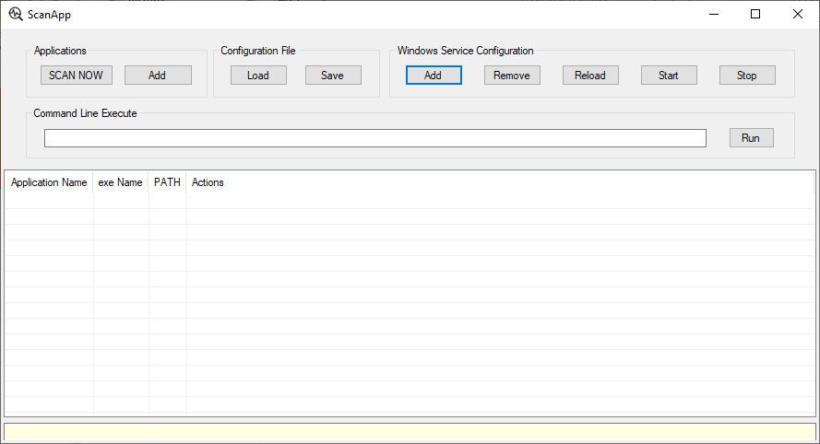
“ScanApp” UI

Slide 3
1. StartUp
It scans the Steam Game installed path. If it was installed, the history is remained.
If it is existed, the ScanApp scans the applications inside that folder.
And it adds every applications path, name, icon, etc to the list.

Slide 4
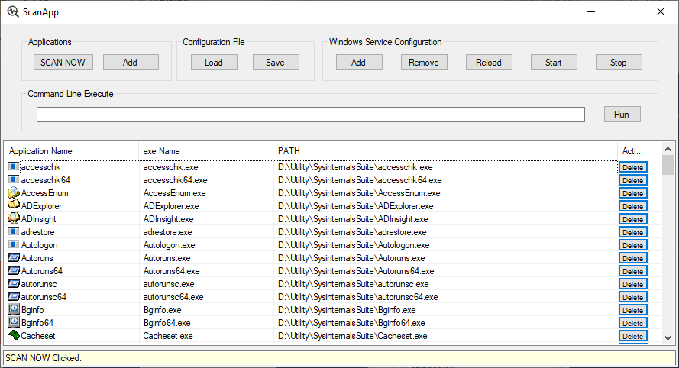
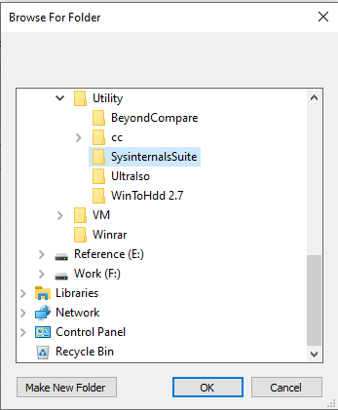
2. Add applications(“SCAN NOW”)
If there are applications in selected folder, the “ScanApp” adds the applications inside that folder to the list as above.

Slide 5
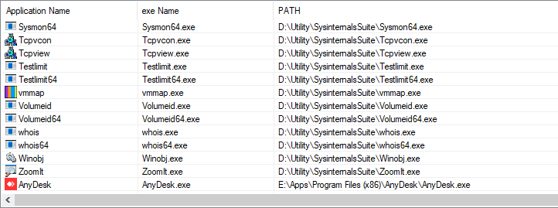
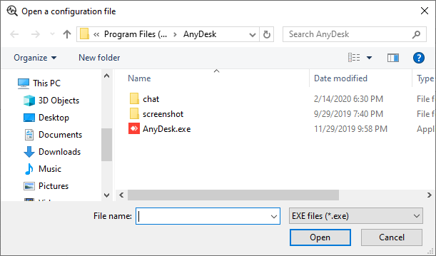
2. Add applications(“Add”)
If the user indicated the application, it is added to the last line.
Like this, the user can add the one application.

Slide 6
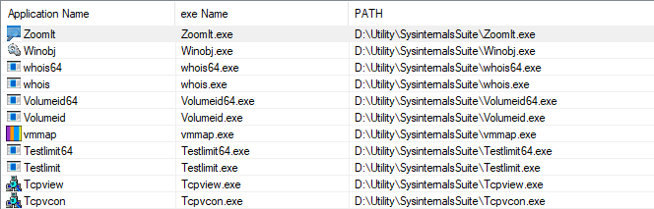
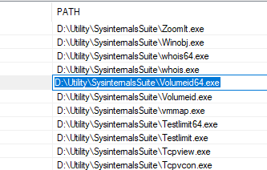
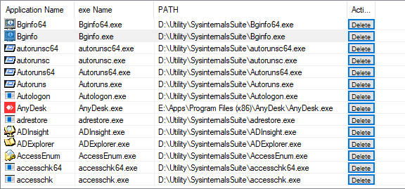
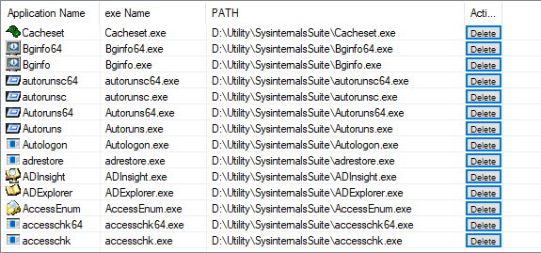
3. Edit/Delete App on the list

Slide 7
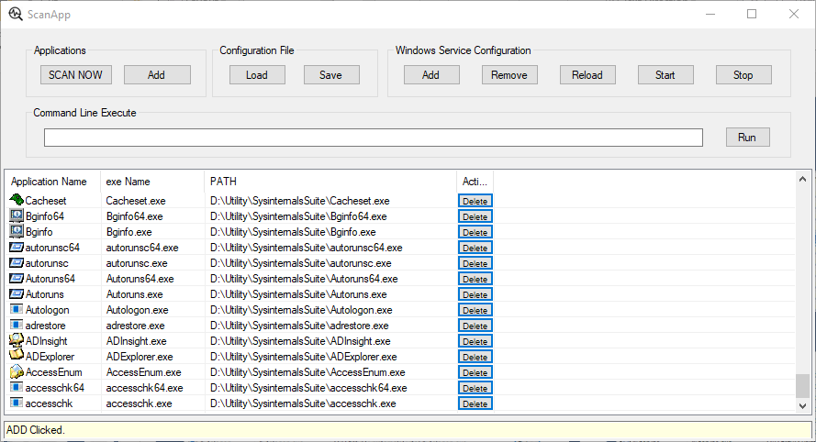
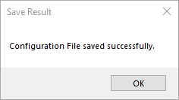
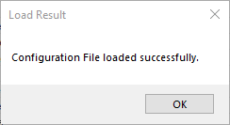
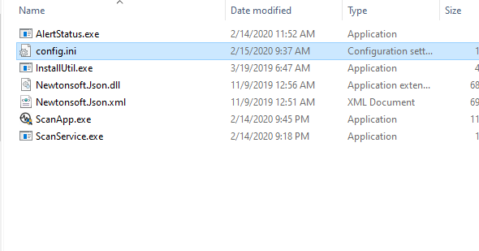
4. Load/Save App list

Slide 8
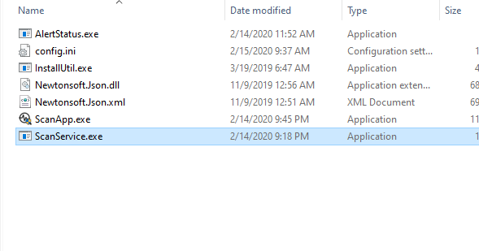
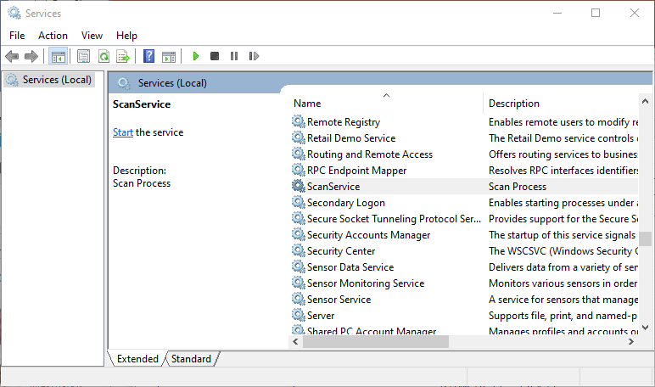
5. Windows Service
Install
Uninstall
Restart
Start
Stop

Slide 9
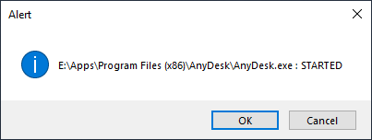
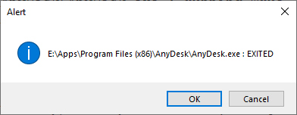
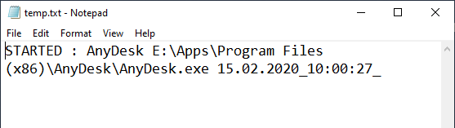
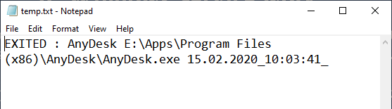
6. Windows Service work (3 functions)
When the user clicks the “Start” button, the ScanService is started and it watches the applications of the app list file. (User has to save the app list into file.)
When the app is started
When the app is started
Alert
Notepad
Run cmdline
c:\blah\blah.exe -k 100 -n 20 E:\Apps\Program Files (x86)\AnyDesk\AnyDesk.exe

Slide 10
6. Windows Service work
?
In this case, if user clicks the “Cancel” button, the operation is reverted.
- If the app was exited, the app is started again.
- If the app was started, the app is exited.
I am not sure if this is needed.
Now, if the GUI app is exited or started, it no affects the ScanService.
Although the GUI app is exited, the ScanService is still remained or running.
I want to clarify this point. Does the GUI app stop the ScanService when it is exited?
I want you to check the 3 functions that is run when the application is started or exited.

