Slide 1
Agent API Summary

Slide 2
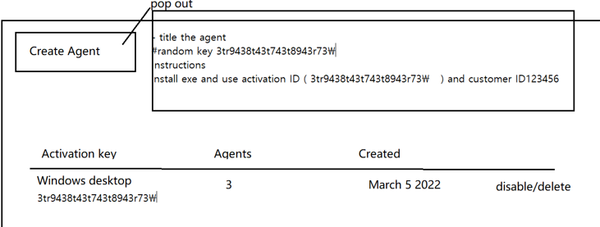
User Log in Success
Request
Response
{
"userid": "testuser1",
"password": "password1"
}
{
"actkeys": [
{
"actkey": "activationkey1",
"agents": 3,
"created": "created1",
"status": "2",
"title": "Windows Desktop device"
},
{
"actkey": "activationkey2",
"agents": 10,
"created": "created2",
"status": "1",
"title": "Windows 2016 servers"
},
……
],
"cusid": "customer1",
"password": "password1",
"status": "Sign In Success",
"userid": "testuser1"
}
POST: /api/auth
1. Log in to Web Page with valid Credential(userid and password).
2. Get a response including the user’s activation keys, Customer ID, Password, User ID, Status(2: Enabled, 1: Disabled, 0: Deleted).

Slide 3
User Log in Failed
POST: /api/auth
Request1
Response1
{
"actkeys": [],
"cusid": "",
"password": "password",
"status": "Password Wrong",
"userid": "testuser1"
}
{
"userid": "testuser1",
"password": "password1"
}
1. Log in to Web Page with an invalid Credential(userid and password).
2. Get a response including the user’s activation keys, Customer ID, Password, User ID, Status.
Request2
Response2
{
"actkeys": [],
"cusid": "",
"password": "password",
"status": "No User",
"userid": "testuser"
}
{
"userid": "testuser",
"password": "password"
}

Slide 4
Activation Check
Request1
Response1
POST: /api/activate
{
"cusid": "customer1",
"actkey": "activationkey1"
}
2
1. Check activation with Customer ID and Activation Key.
2. If it is activated, return “2”. It means that Registered customer, Activated key.
3. If Customer ID is existed and Activation Key is invalid, return “1”. It means that Registered customer, Un activated key.
3. If Customer ID does not exist, return “0”. It means that Unregistered cutomer.
Request2
Response2
{
" cusid": "customer1",
"actkey": "activationkey"
}
1
Request3
Response3
{
"cusid": "customer",
"actkey": "activationkey"
}
0

Slide 5
Submit Device Data
{
"osInfo": "Microsoft Windows 11 Pro 64bit (6.2.9200.0) Microsoft Windows 10.0.22621",
"machineName": "DESKTOP-K8E4OJQ",
"auth": {
"cusid": "customer1",
"actkey": "activationkey1"
},
"installedApps": [
{
"displayName": "Ava 1.7.9",
"installationLocation": "",
"displayVersion": "1.7.9",
"publisher": "Ava"
}, {
"displayName": "Grammarly for Windows",
"installationLocation": "",
"displayVersion": "1.0.33.520",
"publisher": ""
},
{
"displayName": "Zoom",
"installationLocation": "",
"displayVersion": "5.14.0 (13888)",
"publisher": "Zoom Video Communications, Inc."
}
]
}
POST: /api/submit
Submit device data to the server.
Submitted data contains OS info, Machine Name, and Installed Third-Party applications.
It returns the following result.
{
“msg": “Data submitted successfully",
“status": “success"
}

Slide 6
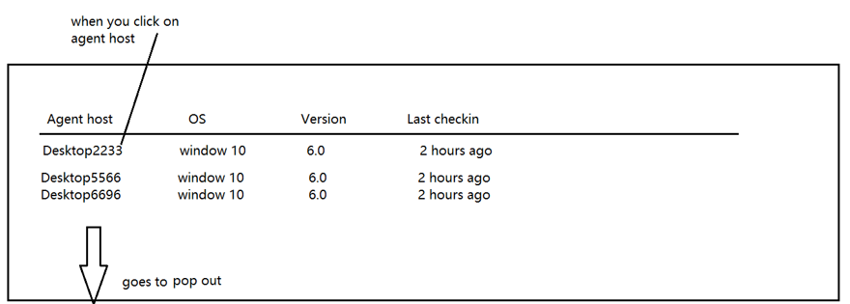
Get Agents
Response
GET: /api/agents?cusid=customer1&actkey=activationkey1
{
"actkey": "activationkey1",
"agents": 3,
"created": "created2",
"cusid": "customer1",
"machines": [
{
"Computer Name": "DESKTOP-6X37DB",
"OS info": "Windows 11 64bit",
"id": 123
},
{
"Computer Name": "DESKTOP-5G37VS",
"OS info": "Windows 10 32bit",
"id": 124
},
{
"Computer Name": "DESKTOP-3H37S3",
"OS info": "Windows 11 64bit",
"id": 125
}
],
"status": "2",
"title": "Windows Desktop device"
}
1. Submit Customer ID and Activation Key.
2. Here, the server has to check the validity of Customer ID and Activation Key. I think that it can be resolved with Laravel middleware.
3. It returns the devices that has the Activation Key.

Slide 7
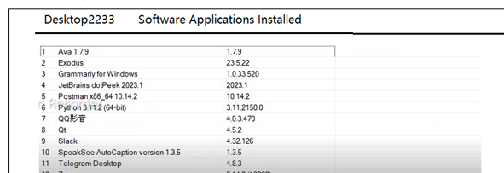
Get Device Info
Response
GET: /api/device?cusid=customer1&actkey=activationkey1&id=124
{
"actkey": "activationkey1",
"computername": "DESKTOP-3H37S3",
"cusid": "customer1",
"deviceid": "124",
"installedapps": [
{
"name": "Postman",
"version": "10.14.2"
},
{
"name": "Notepad++",
"version": "8.5.3"
},
{
"name": "Ava",
"version": "1.7.9.0"
}
],
"osinfo": "Windows 11 64bit"
}
1. Submit Customer ID, Activation Key, Device ID
2. Here, the server has to check the validity of Customer ID and Activation Key. I think that it can be resolved with Laravel middleware.
3. It returns the data(installed apps, OS info, Machine name, etc) of the indicated device.

