Slide 1
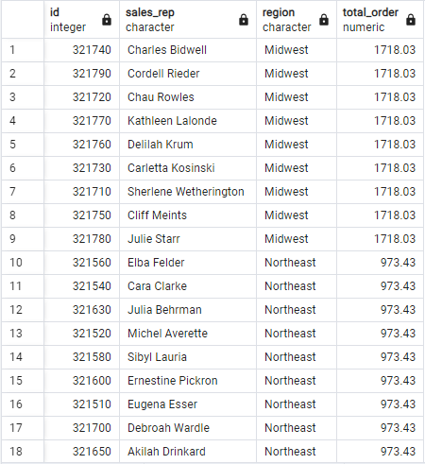
Performance in Sales by Sales Representatives
Top-Performing Sales Representatives
Insight:
You can easily identify which sales reps are generating the most revenue for the company, providing an opportunity to reward top performers or analyze their methods for potential replication across the team.
2. Regional Performance
Insight:
This insight helps identify high-performing regions and potential underperforming areas where marketing efforts or additional resources might be required.
You can assess if certain regions are driving significant sales or if there's a need to expand efforts into underperforming regions.

Slide 2
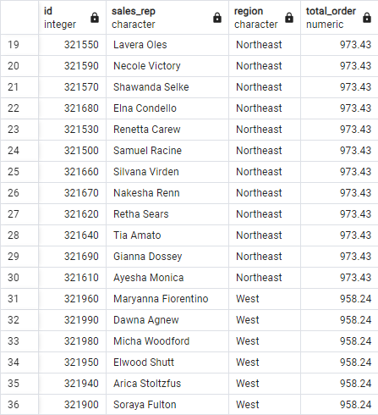
3. Sales Rep and Region Correlation
Insight:
Understanding the correlation between sales reps and regions can help in optimizing the allocation of sales personnel. For example, high-performing sales reps in strong regions might be tasked with helping underperforming areas.
4. Revenue Distribution
Insight:
A balanced or diversified revenue distribution is healthier for the company, reducing risks tied to individual performance or regional issues.

Slide 3
