Slide 1

Operation manual
NanoTracker2 / MicroManager integration

Slide 2
System summary
Force Detectors
(not used)
Standard NanoTracker2
Hg lamp
XYZ stage
Steering
PC
(linux)
Vortis
(OT controller)
Camera
Zyla 4.2p
LASER
laptop PC
(Windows)
USB3.0
USB/serial
Trigger box
Digital OUT8
Digital IN0
Digital OUT
(TTL)
Digital IN1
Digital I/O
Customized imaging parts

Slide 3
Launch system.
1. Turn on PC for NanoTracker(Desktop PC) and MicroManager (Laptop PC)
2. Turn on water circulator underneath table.
3. Turn on Hg lamp underneath table.
4. Turn on a Vortis controller and a LASER box at right side of table.
5. Turn on Zyla camera at left port of microscope.
6. Login Desktop PC and Laptop PC
Hg lamp power
!Use minimum power of the lamp!
Higher intensity of the lamp will break green filter in a illumination tube.
Trigger box
Arduino is in the black box connected to Vortis. Power for it is supplied from laptop PC. FIrmware starts automatically after the power is supplied.
Zyla camera
If internal temperature of the camera rises, it stops automatically with continuous beep.One tends to forget to turn off when experiments finished. Don't forget ;)

Slide 4
Launch software.
[NanoTracker]
Launch controller software by double-clicking "NT Desktop" icon or input command of "jpknt" from terminal.
[Micromanager] (MM)
1. Launch "Micromanager in ProgramFiles" on the Desktop.
2. If the MM asks device, choose "None".
3. Software should run a startup script.
* If the script is not set or not loaded,
1. Open "Tools/Script panel...".
2. Load or Run the latest Initialization script.
Launching from Terminal
Some of people dislike CUI, but it is useful for troubleshooting. By launching from terminal, you can check error messages and force-quit by CTRL+C from on the terminal when the software is stuck.
"Device" of MM
MM can operate wide variety of hardware such as microscope, stage, optical shutter, AOTF.. etc. One can set configuration of devices as a file to read on launching. Devices can be loaded by scripts.
Startup script
One can set a script set by options... menu. Software will run the script after process of loading devices.

Slide 5
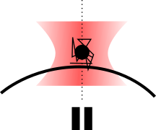
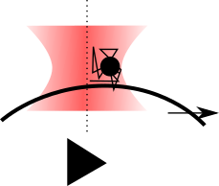
Flow of experiments
Preparation
* Enhance gold nano particle (GNP) image
*Snap background image for subtraction
*Adjust contrast and offset
* Set up scanning conditions
* Search cells
* Trap a GNP
ForceSpectroscopy
by RampDesigner
TTL to low, Pause
Extend (movement), TTL to high
Retract (inverse movement)
Trigger TTL 0
Trigger TTL 1
Micro-manager
on WinPC
Live view
Live
Acquisition – stationary
Save
Acquisiton – moving
Save
Live
Snap a background image to register
Acquisition of defined frames

Slide 6
System summary
Force Detectors
(not used)
Standard NanoTracker2
Hg lamp
XYZ stage
Steering
PC
(linux)
Vortis
(OT controller)
Camera
Zyla 4.2p
LASER
laptop PC
(Windows)
USB3.0
USB/serial
Trigger box
Digital OUT8
Digital IN0
Digital OUT
(TTL)
Digital IN1
Digital I/O
Customized imaging parts

Slide 7
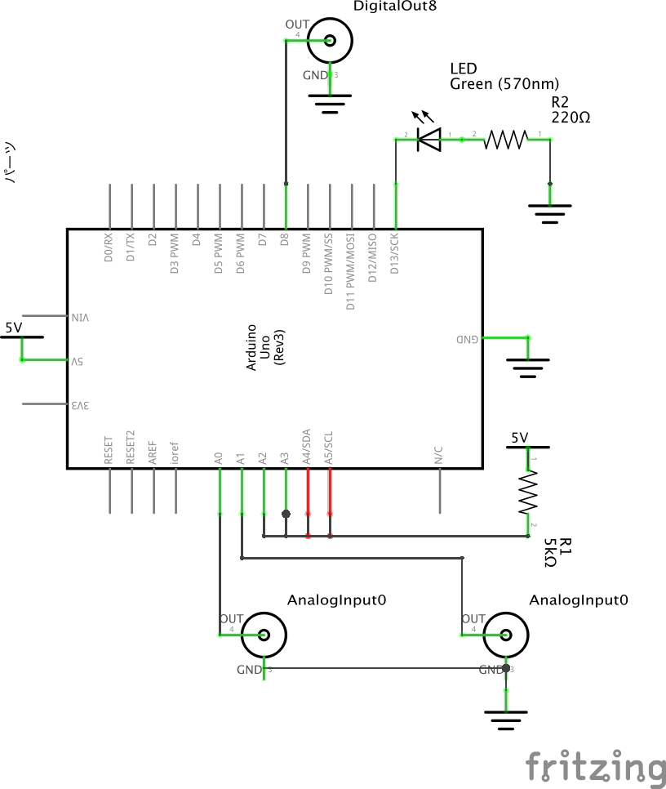
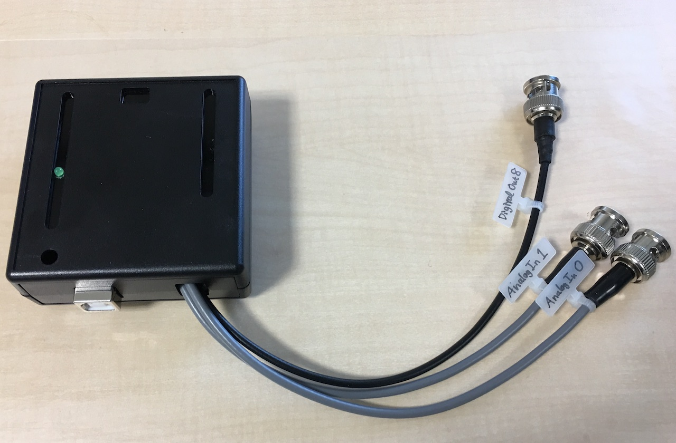
USB trigger box
* Micro-Manager device adapter for Arduino is available.
* Digital IN x 2 (pin 0, pin 1)
* Digital OUT x 1 (pin 8)
* LED OUT (pin13)
* Based on Ardino Uno R3 compatible board
(16MHz, ATmega328P, USB power driven)

Slide 8
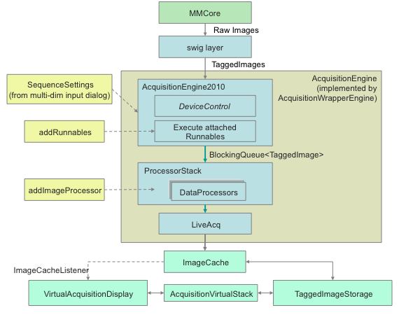
Software for recording
Micro-manager (MM) can record multidimensional images from various commercial camera.
MM benefits
* Multi dimensional acquisition (MDA)
* Many cameras and devices are supported.
* Source codes are available
* Writes OME-TIFF format, standard file type.
(OME: Open Microscopy Environment)
* ImageJ
* MM is actually one of ImageJ plugin.
* Many pixel types are supported.
* Various file types are supported.
* Java source codes are open to everyone
ImageJ source codes
https://github.com/imagej/ImageJA
MicroManager source codes
https://github.com/micro-manager/micro-manager
OME-TIFF file format
https://docs.openmicroscopy.org/ome-model/5.6.1/ome-tiff/index.html

Slide 9
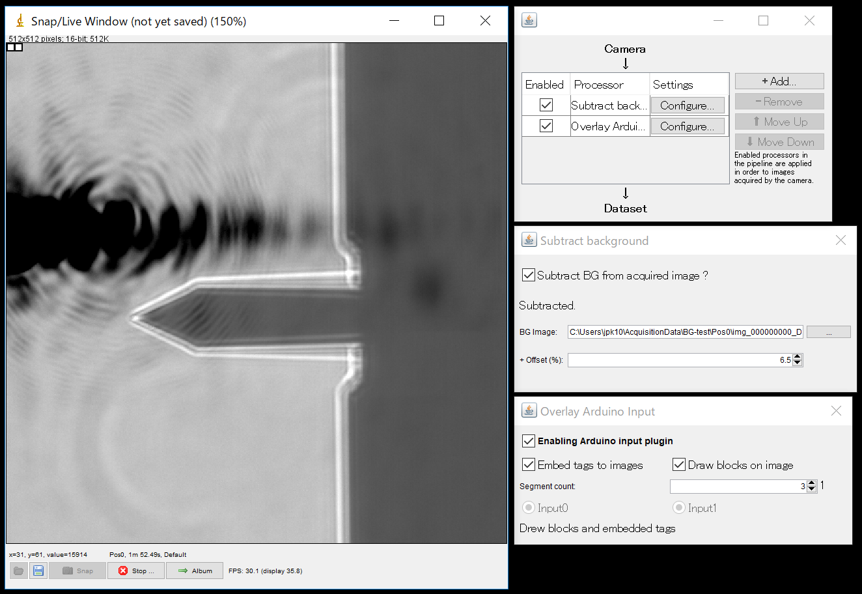
Developed Plugins for the system
[SubtractBackground plugin]
This is based on MultiChannelShading plugin extends DataProcessor. It subtract image with additional offset in real-time.
https://github.com/iobataya/micromanager-subtractbackground-plugin
[MMStartup.bsh]
It is a beanshell script which is called automatically on launching MM. It initialize devices (Andor Zyla and Arduino) and configure all parameters such as bitdepth, pixel size, exposure. Then this configure DataProcessors to acquisition. (dev in process)
https://github.com/iobataya/micromanager-beanshell-scripts
[OverlayArduino plugin]
This embed tag and/or visible blocks of TTL signal input from Arduino to images in real-time.
https://github.com/iobataya/micromanager-overlayarduino-plugin
[Acq by TTL plugin]
Plugin to manage triggering to start acquisition and snap a background image to register to SubtractBackground plugin.
(dev in process)
The GitHub repositories are not open to public now.
In order to access, please tell us your GitHub account name.
Image] Windows after running MMStartup.bsh is called. Camera is loaded with specific parameters, and image processors are added to pipeline.

Slide 10
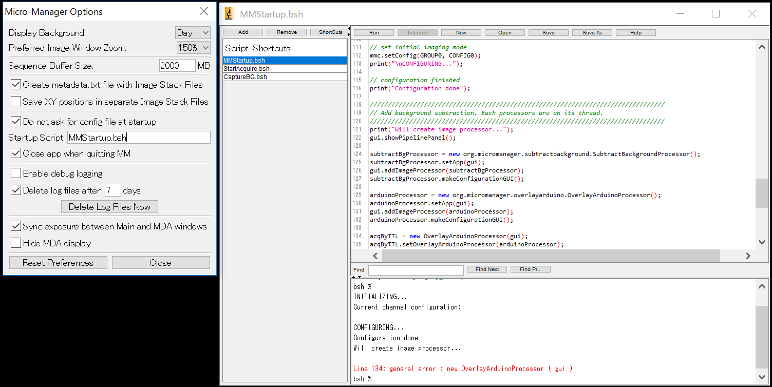
Settings for automatic launching with MMStartup.bsh

