Slide 1
# of records
# of species
# of redlist

Slide 2
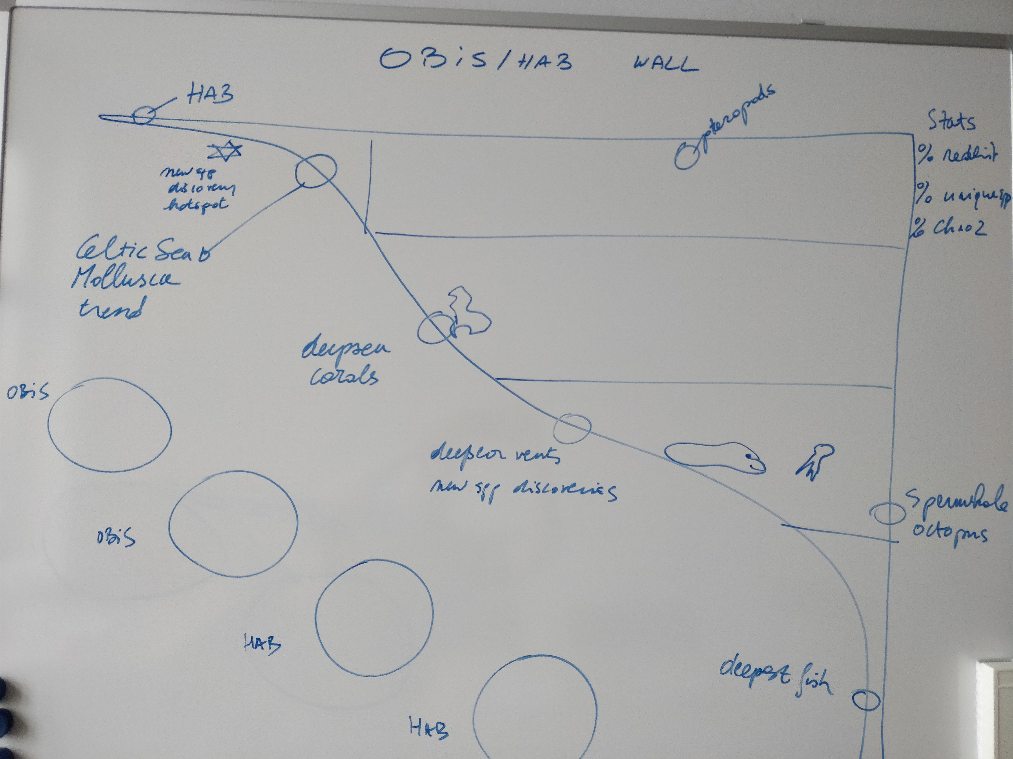

Slide 3
Nice quotes / Text ideas
The most commonly reported sources of species occurrence data were the Ocean Biogeographic Information System (OBIS) and Fish Base.
Freer, Jennifer J., et al. "Predicting ecological responses in a changing ocean: the effects of future climate uncertainty." Marine biology 165.1 (2018): 7.

