Slide 1
Advanced integration testing with Fuse Fabric
Ioannis Canellos
*

Slide 2
about me
Principal Software Engineer @ Red Hat
Open source contributor
Apache Karaf
Apache Camel
Apache ServiceMix
Apache Jclouds
Fuse Fabric
*

Slide 3
overview
What are integration tests anyway?
“a phase in testing where individual modules are combined & tested as a group”
*

Slide 4
overview
Fabric is not:
“yet another testing framework”
Fabric is used for:
Creating
Provisioning
Managing “Distributed Containers”
Fabric focuses:
Karaf based containers
But can also support external clients
*

Slide 5
agenda
Why bother with integration testing?
Tools of the trade
Pax-Exam
Using Fuse Fabric inside tests
*

Slide 6

why bother?
*

Slide 7

why bother?
Usually it’s a little more
complex than this
*

Slide 8

why bother?
Do my modules fit together?
…and what are those
unique constraints violations?
*

Slide 9
why bother?
Distributed computing challenges
Services are not always collocated
*

Slide 10


why bother?
Test
Code
Deploy
Build
*

Slide 11

Now what ?
*

Slide 12


OSGi testing tools
Container agnostic
Rich Tooling
Mostly JEE
Container agnostic
Mostly OSGi
Excellent Karaf Support
*

Slide 13

Pax-Exam
An OPS4J project
ASL 2.0 license
Current version: 3.0.3
Focus on : 2.6.0
*

Slide 14
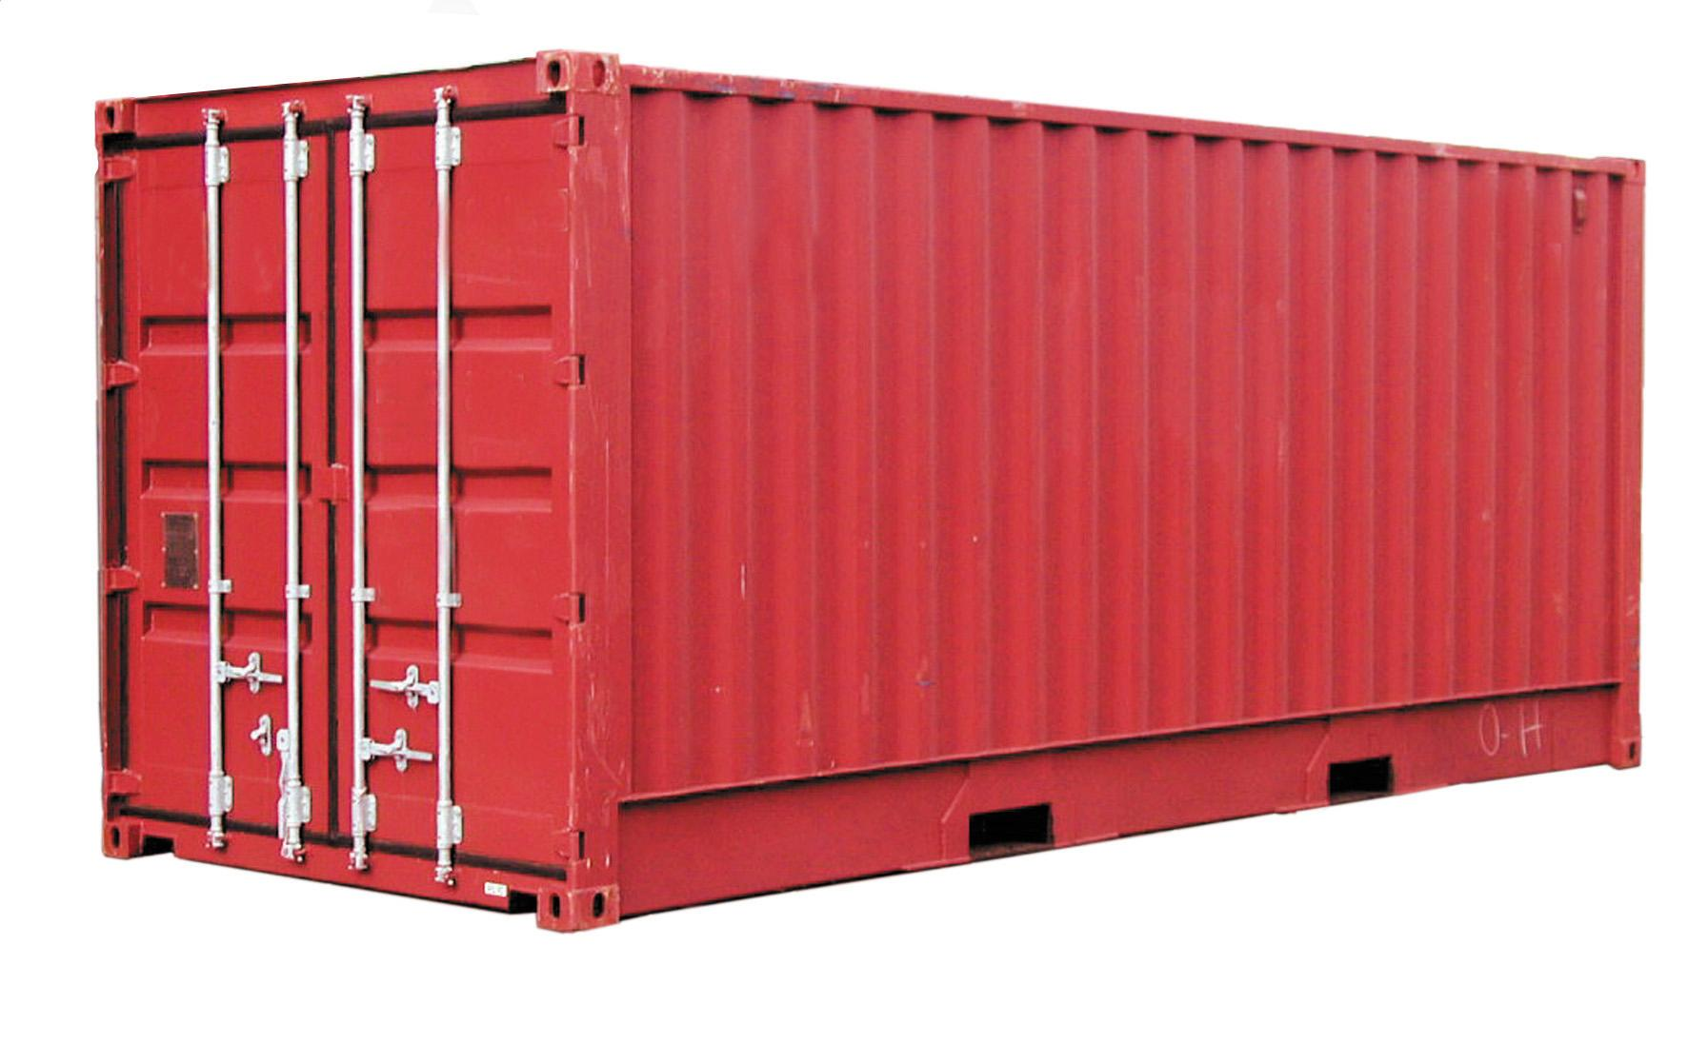
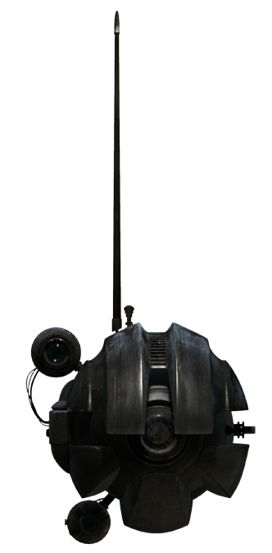
Pax-Exam: “Concepts”
The container
The Probe
*

Slide 15
Pax-Exam: “Container”
The application container
Location
Configuration
Deployments
*

Slide 16
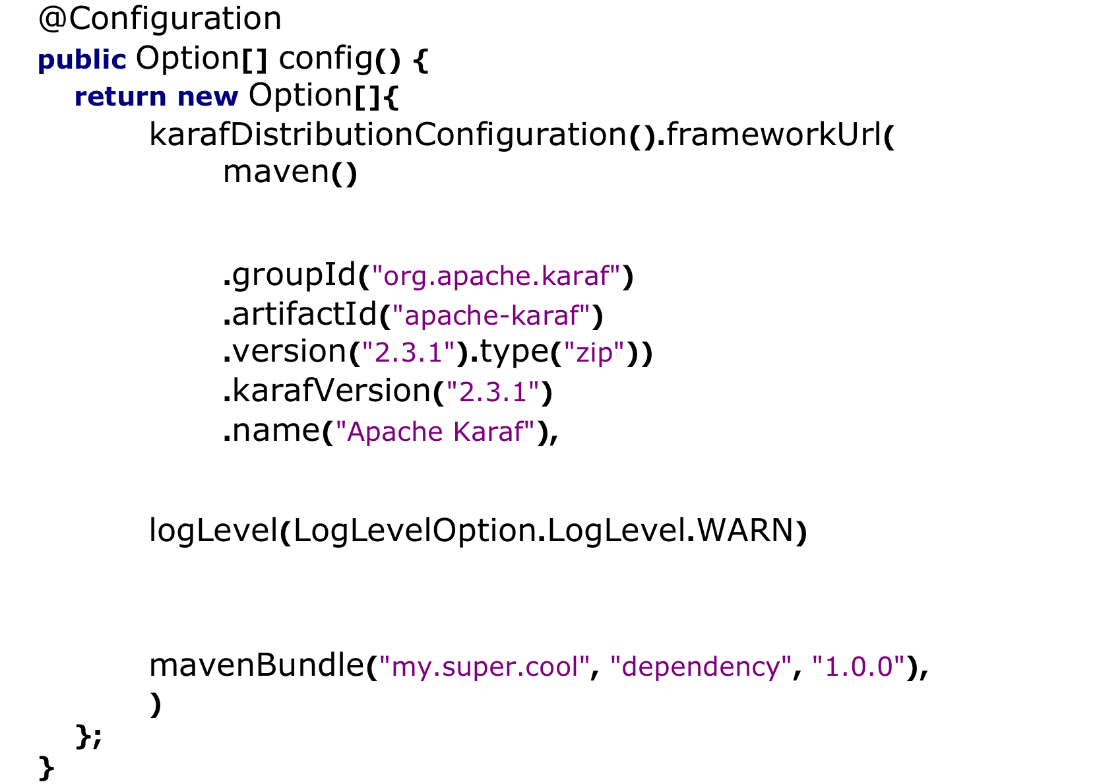
Pax-Exam: “Container”
Location
Configuration
Deployments
*

Slide 17
Pax-Exam: “Probe”
The test artifact
Test Classes
Test Resources
*

Slide 18
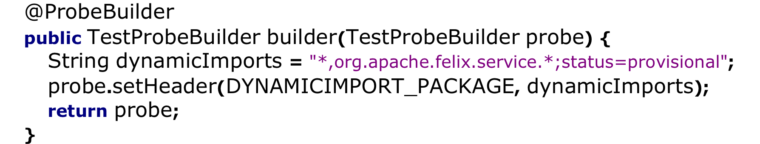
Pax-Exam: “Probe”
*

Slide 19
Pax-Exam: “The test”
Typical junit test
@Inject support
Bundled inside the probe
Probe is deployed to the container
*

Slide 20
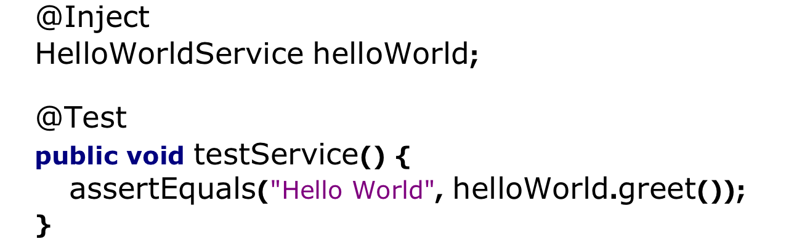
Pax-Exam: “The test”
*

Slide 21
Things to remember
Maven lifecycle
Install phase is after the test phase
Test dependencies
The “probe” is a bundle too
Ensure runtime dependencies are
part of the container configuration
Isolation
The test methods runs in an other jvm
*

Slide 22
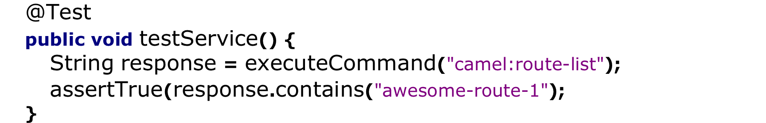
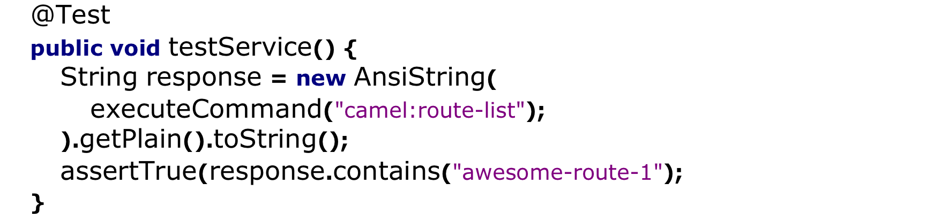
Apache Karaf shell
Caution: Ansi escaped response!
*

Slide 23
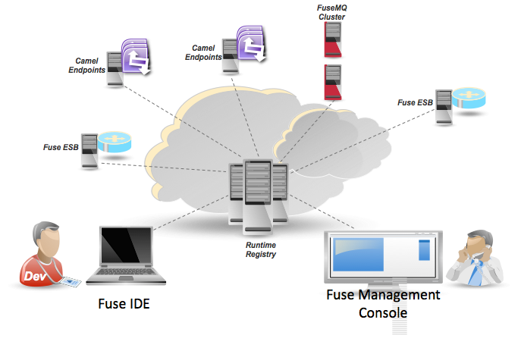
Fuse Fabric
*

Slide 24
Fuse Fabric
A distributed service
configuration
management
provisioning
coordination
Mostly targets Karaf based Runtimes
Integrates with Camel, ActiveMQ, CXF
*

Slide 25
Fuse Fabric “registry”
Backed by Apache Zookeeper
configuration data
runtime data
Configuration
“provisioning information”
Runtime
Network addresses & ports
Clustered Services
Running applications
*

Slide 26
Fuse Fabric “profiles”
Fabric Profiles
Provisioning information
Hierarchical structure
Versioned “rolling upgrades”
Using Fabric Profiles
Assign profiles to containers
Containers provision themselves
according to the profile
*

Slide 27
Fuse Fabric “profiles”
Out of the box profiles
Karaf
Camel
CXF
MQ
DOSGi
Example profiles for
Camel
CXF
MQ
*

Slide 28
Fuse Fabric “agent”
A service that provisions containers
Reads the assigned profiles
Resolves “dependencies”
Downloads requirements
Removes obsolete artifacts
Installs new artifacts
*

Slide 29
Fuse Fabric “weaving”
Fabric can weave itself
Fabric can install containers
locally aka “child containers”
via SSH aka “ssh containers”
via IAAS aka “cloud containers”
*

Slide 30
Fuse Fabric
So what’s the role of Fabric in testing?
Create multiple distributed containers
Provision remote services
Discover services
Coordinate
*

Slide 31
FabricTestSupport
A default “container” configuration
A set of convenience methods
Executing Shell commands
Looking up Fabric services
Interacting with containers
and more…
*

Slide 32
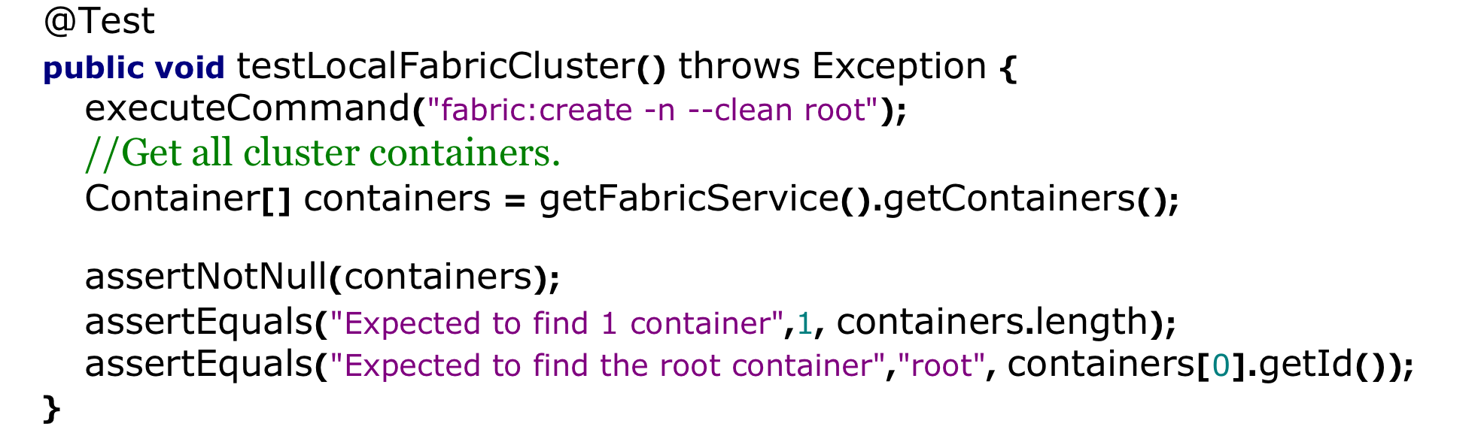
Creating a Fabric
Will create a fabric
and “assert” the cluster members
*
Notes:
@Test
public void testLocalFabricCluster() throws Exception {
executeCommand("fabric:create -n --clean root");
//Get all cluster containers.
Container[] containers = getFabricService().getContainers();
assertNotNull(containers);
assertEquals("Expected to find 1 container",1, containers.length);
assertEquals("Expected to find the root container","root", containers[0].getId());
}
*

Slide 33
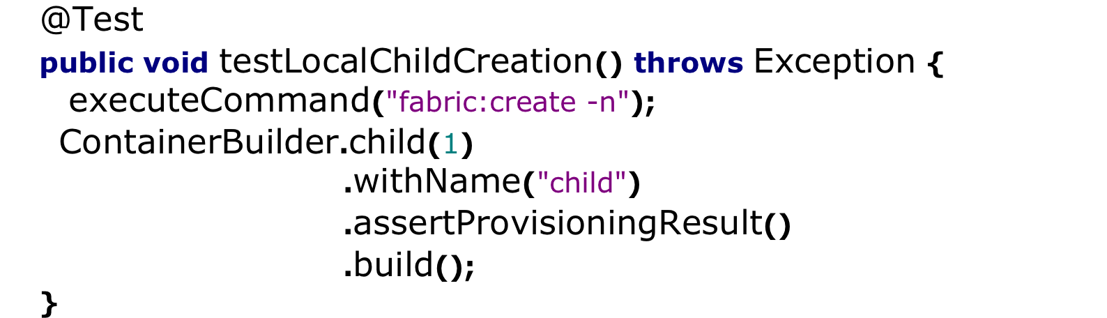
Creating a child container
Will create a child container
and “assert” the status
*
Notes:
@Test
public void testLocalFabricCluster() throws Exception {
executeCommand("fabric:create -n --clean root");
//Get all cluster containers.
Container[] containers = getFabricService().getContainers();
assertNotNull(containers);
assertEquals("Expected to find 1 container",1, containers.length);
assertEquals("Expected to find the root container","root", containers[0].getId());
}
*

Slide 34
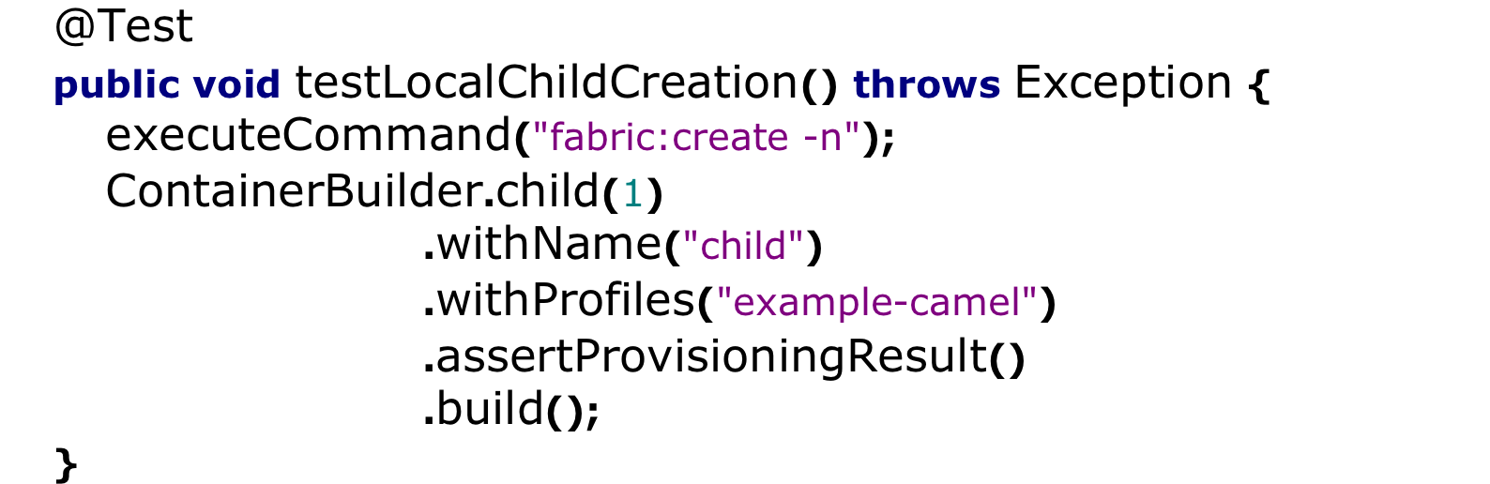

Provisioning containers
Sets a provisioning profile
*
Notes:
@Test
public void testLocalFabricCluster() throws Exception {
executeCommand("fabric:create -n --clean root");
//Get all cluster containers.
Container[] containers = getFabricService().getContainers();
assertNotNull(containers);
assertEquals("Expected to find 1 container",1, containers.length);
assertEquals("Expected to find the root container","root", containers[0].getId());
}
*

Slide 35
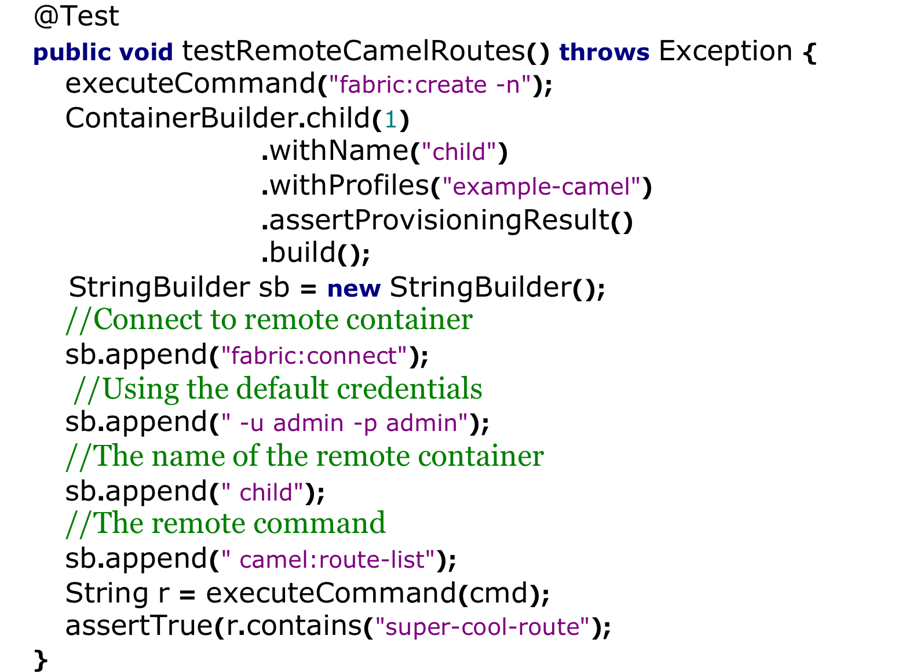
Provisioning containers
*
Notes:
@Test
public void testLocalFabricCluster() throws Exception {
executeCommand("fabric:create -n --clean root");
//Get all cluster containers.
Container[] containers = getFabricService().getContainers();
assertNotNull(containers);
assertEquals("Expected to find 1 container",1, containers.length);
assertEquals("Expected to find the root container","root", containers[0].getId());
}
*

Slide 36
Not only commands
Remote commands is one option …
Each container registers:
JMX URL
HTTP port
All webapp URLs
You can get info via JMX
You can get info via Rest
You can even run Selenium
*
Notes:
@Test
public void testLocalFabricCluster() throws Exception {
executeCommand("fabric:create -n --clean root");
//Get all cluster containers.
Container[] containers = getFabricService().getContainers();
assertNotNull(containers);
assertEquals("Expected to find 1 container",1, containers.length);
assertEquals("Expected to find the root container","root", containers[0].getId());
}
*

Slide 37
Using multiple containers
Why don’t I just use the root container?
Services are not always co-located
Message Brokers
Camel Routes
Web Services
Web Applications
Can be spread across multiple hosts!
And we need to test this !!!
*
Notes:
@Test
public void testLocalFabricCluster() throws Exception {
executeCommand("fabric:create -n --clean root");
//Get all cluster containers.
Container[] containers = getFabricService().getContainers();
assertNotNull(containers);
assertEquals("Expected to find 1 container",1, containers.length);
assertEquals("Expected to find the root container","root", containers[0].getId());
}
*

Slide 38
Using discovery
Fabric provides discovery for:
ActiveMQ brokers
Camel endpoints
Distributed OSGi services
And you can use it in your tests !
*
Notes:
@Test
public void testLocalFabricCluster() throws Exception {
executeCommand("fabric:create -n --clean root");
//Get all cluster containers.
Container[] containers = getFabricService().getContainers();
assertNotNull(containers);
assertEquals("Expected to find 1 container",1, containers.length);
assertEquals("Expected to find the root container","root", containers[0].getId());
}
*

Slide 39
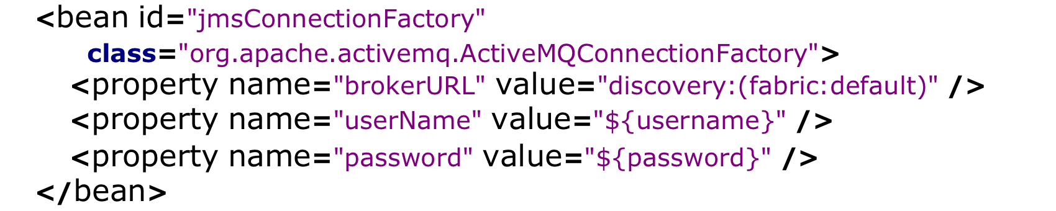
Discovering a broker
Discovery is as simple as using the url:
“discovery:(fabirc:default)”
*
Notes:
@Test
public void testLocalFabricCluster() throws Exception {
executeCommand("fabric:create -n --clean root");
//Get all cluster containers.
Container[] containers = getFabricService().getContainers();
assertNotNull(containers);
assertEquals("Expected to find 1 container",1, containers.length);
assertEquals("Expected to find the root container","root", containers[0].getId());
}
*

Slide 40
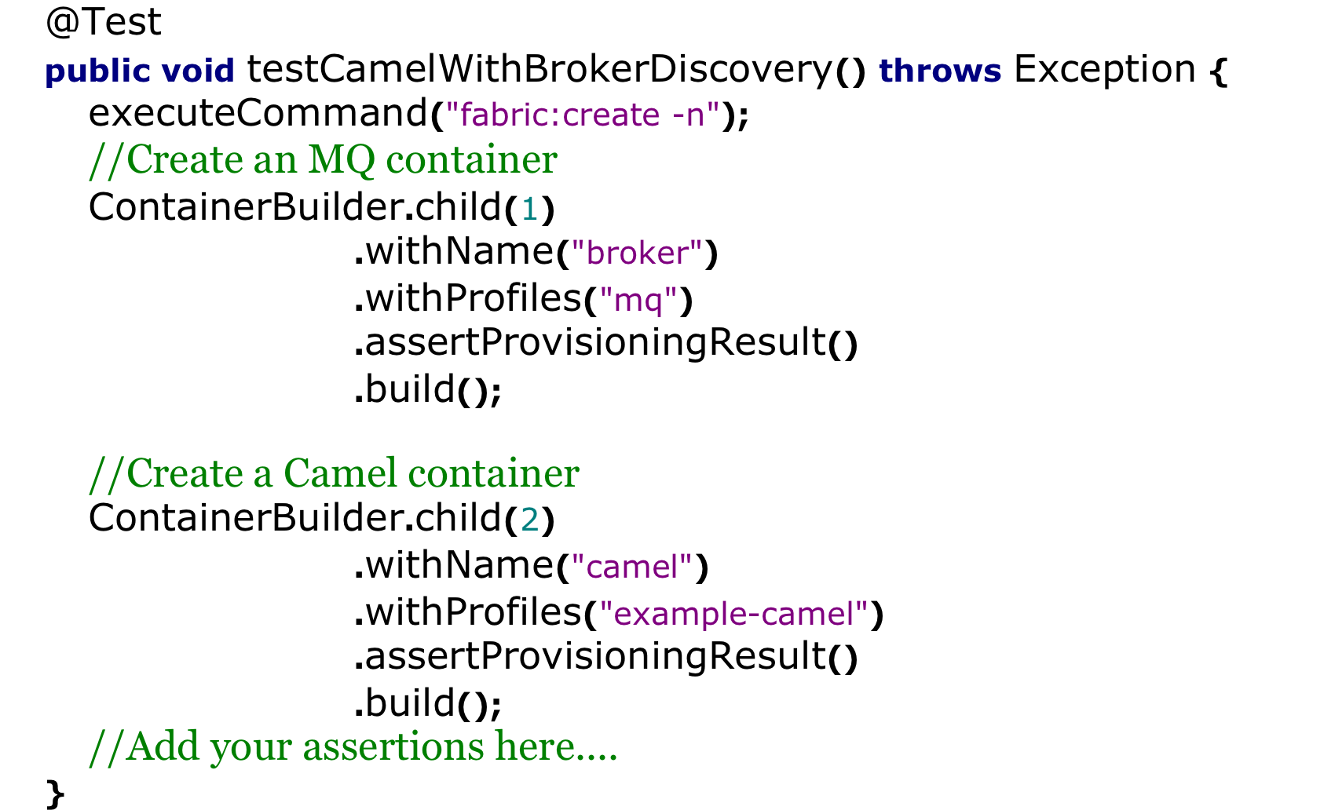
Using it inside the test
*
Notes:
@Test
public void testLocalFabricCluster() throws Exception {
executeCommand("fabric:create -n --clean root");
//Get all cluster containers.
Container[] containers = getFabricService().getContainers();
assertNotNull(containers);
assertEquals("Expected to find 1 container",1, containers.length);
assertEquals("Expected to find the root container","root", containers[0].getId());
}
*

Slide 41
ContainterBuilder
Not just “child” containers
Supports “remote” containers
Supports variable number & type
Supports environment configuration
*
Notes:
@Test
public void testLocalFabricCluster() throws Exception {
executeCommand("fabric:create -n --clean root");
//Get all cluster containers.
Container[] containers = getFabricService().getContainers();
assertNotNull(containers);
assertEquals("Expected to find 1 container",1, containers.length);
assertEquals("Expected to find the root container","root", containers[0].getId());
}
*

Slide 42
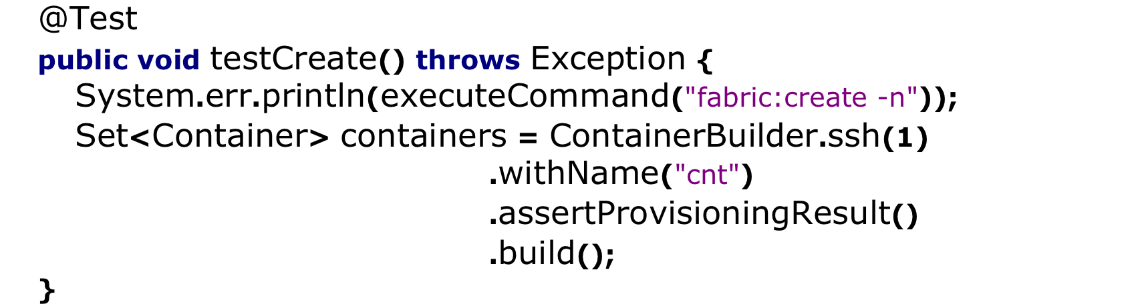
ContainterBuilder via ssh
Uses env to retrieve ssh configuration
Can support any number of containers
*
Notes:
@Test
public void testLocalFabricCluster() throws Exception {
executeCommand("fabric:create -n --clean root");
//Get all cluster containers.
Container[] containers = getFabricService().getContainers();
assertNotNull(containers);
assertEquals("Expected to find 1 container",1, containers.length);
assertEquals("Expected to find the root container","root", containers[0].getId());
}
*

Slide 43

ContainterBuilder
Both type and conf are found in env.
Without changes in the source:
Devs can use say 3 “child” containers
Jenkins/Hudson can use 10 “remote”
*
Notes:
@Test
public void testLocalFabricCluster() throws Exception {
executeCommand("fabric:create -n --clean root");
//Get all cluster containers.
Container[] containers = getFabricService().getContainers();
assertNotNull(containers);
assertEquals("Expected to find 1 container",1, containers.length);
assertEquals("Expected to find the root container","root", containers[0].getId());
}
*

Slide 44

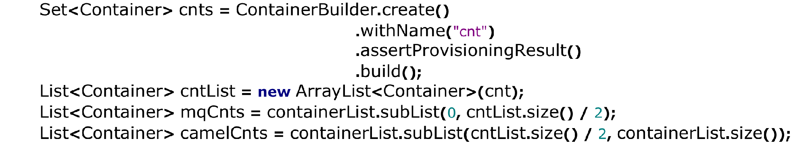
ContainterBuilder Tips
Don’t forget to cleanup
Build all containers at once
Assign containers later
*
Notes:
@Test
public void testLocalFabricCluster() throws Exception {
executeCommand("fabric:create -n --clean root");
//Get all cluster containers.
Container[] containers = getFabricService().getContainers();
assertNotNull(containers);
assertEquals("Expected to find 1 container",1, containers.length);
assertEquals("Expected to find the root container","root", containers[0].getId());
}
*

Slide 45
Resources
Fuse Fabric
http://fuse.fusesource.org/fabric/
https://github.com/jboss-fuse/fuse
Pax-Exam
https://ops4j1.jira.com/wiki/display/paxexam/Pax+Exam
*
Notes:
@Test
public void testLocalFabricCluster() throws Exception {
executeCommand("fabric:create -n --clean root");
//Get all cluster containers.
Container[] containers = getFabricService().getContainers();
assertNotNull(containers);
assertEquals("Expected to find 1 container",1, containers.length);
assertEquals("Expected to find the root container","root", containers[0].getId());
}
*

Slide 46
Questions ?
*
Notes:
@Test
public void testLocalFabricCluster() throws Exception {
executeCommand("fabric:create -n --clean root");
//Get all cluster containers.
Container[] containers = getFabricService().getContainers();
assertNotNull(containers);
assertEquals("Expected to find 1 container",1, containers.length);
assertEquals("Expected to find the root container","root", containers[0].getId());
}
*

