Slide 1
RISK STUDY · APPLE
Extending the Equifax score
from e-commerce to stores
Applying the Apple Online grid to Apple Stores gains acceptance and lowers risk at the same time. Store risk is still an estimate, but its level is now anchored to the delinquency stores have actually had: the only assumption left is that the score ranks the same way, not how much risk there is.
Risk · 14 Oct 2026 · scope: Apple Propio (own channel, no APRS)

Slide 2
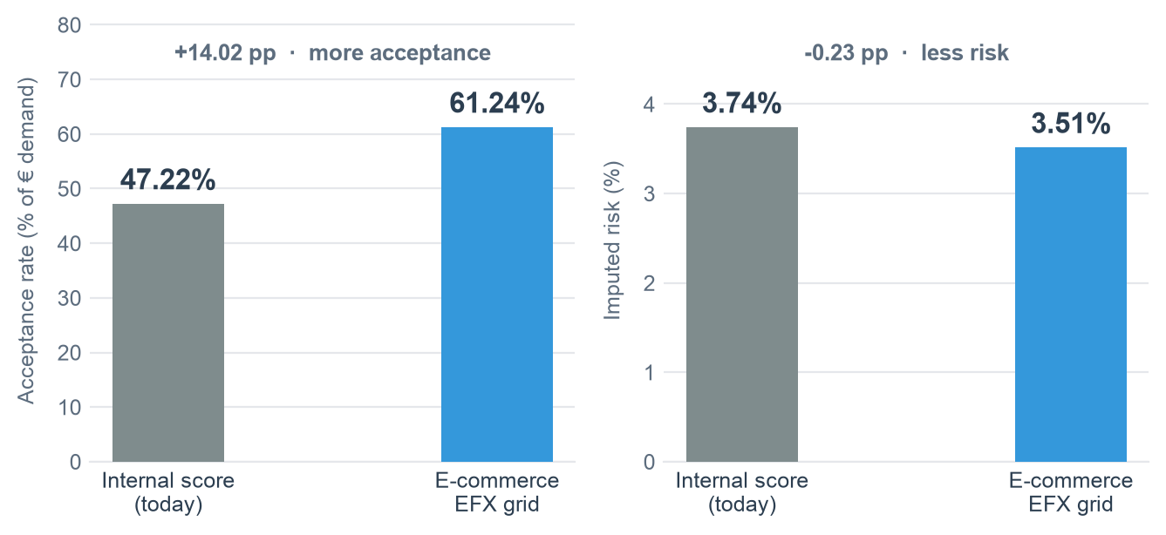
EXECUTIVE SUMMARY
Online Mar 2025 – Feb 2026 · stores Aug–Sep 2026
What the study says
Apple Online realized risk
Online acceptance rate
Stores with the EFX grid
Stores imputed risk
4.18%
20.9%
61.2%
3.51%
measured on the mature book
on € demand
acceptance, from 47.2% today
from 3.74% today
Global Apple risk scenarios
Stores: the e-commerce grid improves both
Scenario | Cutoff | Eff. acc. | Production
Today (measured) | current policy | 29.5% | €15.3M/mo
Online grid in both channels | current | 32.7% | €18.5M/mo
2.5% | > 62 | 21.6% | €12.2M/mo
3% | > 51 | 26.5% | €15.0M/mo
3.5% | > 38 | 30.8% | €17.4M/mo
4% | > 27 | 32.5% | €18.4M/mo
Store risk: curve shape taken from e-commerce; level anchored to stores' realized 3.74%. Not a measurement.
Window: 12 months of mature originations (4.18% vs 3.92% over 26 months).
With reject inference: thinly accepted bins carry an uplift (up to 2.4x). It barely moves the cutoffs: where the decision sits, Online already accepts 84-97%.

Slide 3
DEFINITIONS
Online Mar 2025 – Feb 2026 · stores Aug–Sep 2026
How acceptance is measured
Where each € of demand ends up | Online Mar 25 – Feb 26 | Stores Mar 25 – Feb 26 | Stores Aug–Sep 26
booked (= acceptance rate) | 20.9% | 58.7% | 47.2%
approved, then cancelled (unfinished demand) | 27.9% | 7.0% | 9.6%
approved, rejected downstream | 3.1% | 2.6% | 2.0%
rejected by the engine: score | 6.9% | 11.3% | 21.1%
rejected by the engine: other rules | 41.2% | 20.3% | 20.1%
Total demand | 100.0% | 100.0% | 100.0%
Engine approval (first three rows) | 51.9% | 68.3% | 58.8%
Take-up: booked / approved | 40% | 86% | 80%
Acceptance rate (effective). € booked / € applied for, over every application that comes through the door — rejected, cancelled and booked alike. The first row of the table. Point 1 and every scenario use it.
Score acceptance. € above the score cutoff and not rejected by another rule, over € demand. Comparable with the engine's approval rate, not with the effective one; shown only in the scenario table.
Unfinished demand. Approved by the engine, then cancelled by the customer. It counts in the denominator and not in the numerator, like a rejection. In the scenarios every accepted application converts at the actual take-up of its decision, so cancellations are assumed to behave as today: a looser grid does not recover them.
Approved, rejected downstream. Approved by the engine, rejected at a later step (no reason in the extract). Treated like unfinished demand.
Reject inference. Neither state enters the per-bin acceptance rate — booked / (booked + score-rejected) — so they do not inflate the uplift.

Slide 4
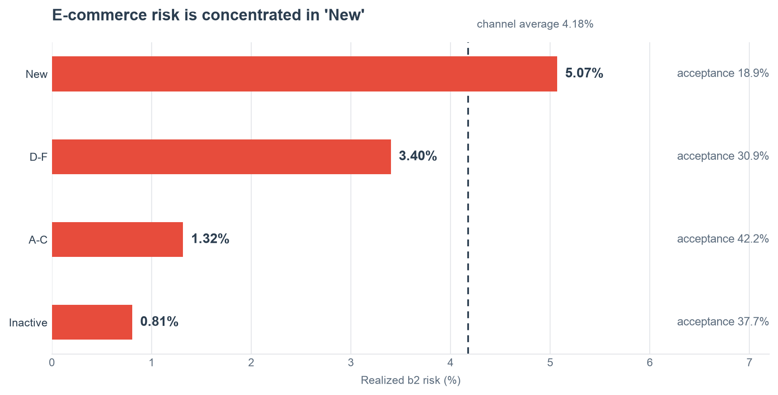
POINT 1 · MEASURED
Originations Mar 2025 – Feb 2026
Apple Online today
Realized risk on originations with 6 months on book. No assumptions.

Slide 5
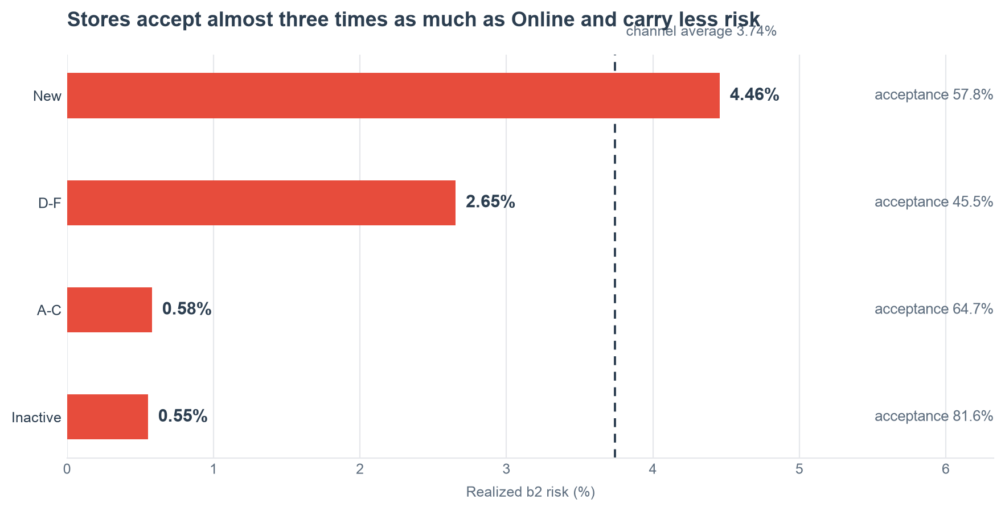
POINT 1 · MEASURED
Originations Mar 2025 – Feb 2026
Apple Stores today
Measured on stores' own history, same window as Online: describing where they stand today needs no imputation. They accept almost three times as much as Online and carry less risk. Warning: their acceptance rate is falling (58.7% over Mar 2025 – Feb 2026, 47.2% in Aug–Sep 2026), so the baseline is moving.

Slide 6
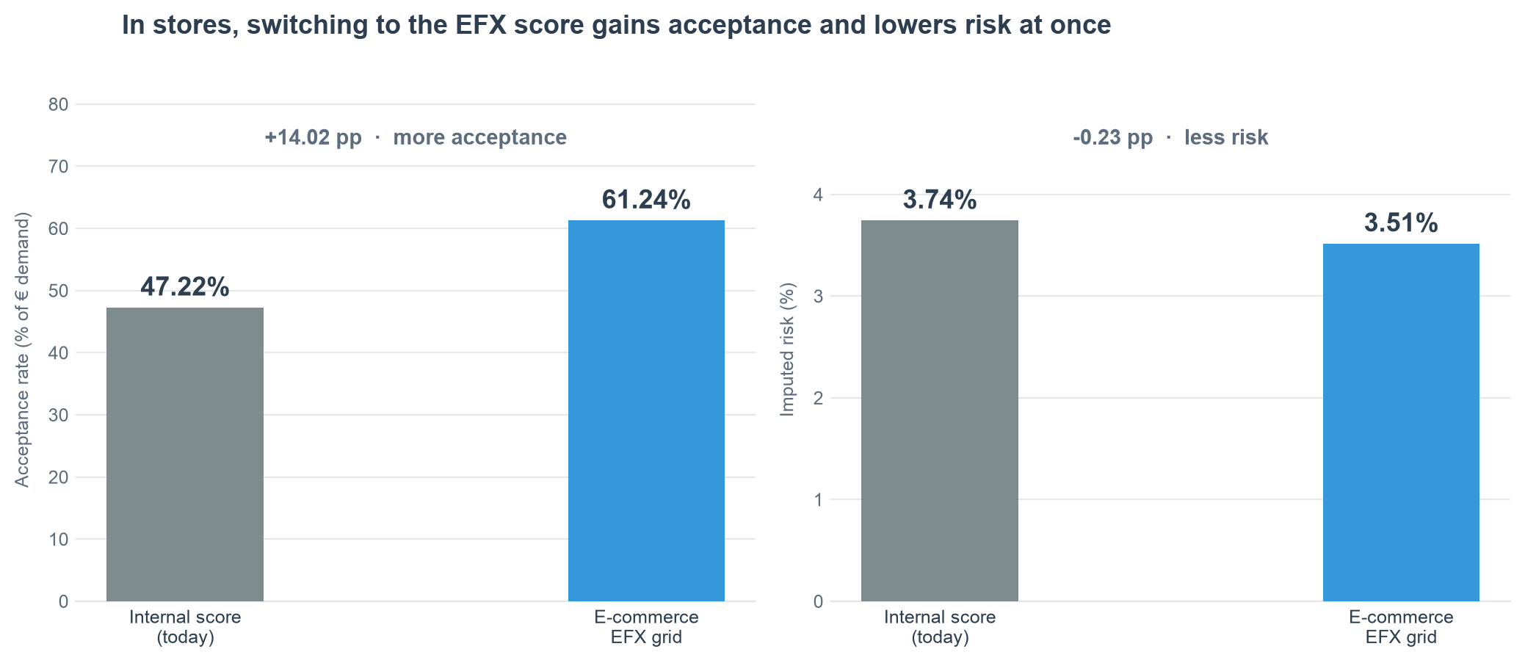
POINT 2 · ESTIMATED RISK
Stores Aug–Sep 2026
Stores with the e-commerce grid
Both columns measure the same population —Aug–Sep 2026, the only period with an EFX score in stores— which is why 'today' here is 47.2% and on the previous slide 58.7%. Only the score rule is swapped; stores' other rules stay. Risk is imputed from the Online curve, with the level anchored to stores' realized figure.

Slide 7
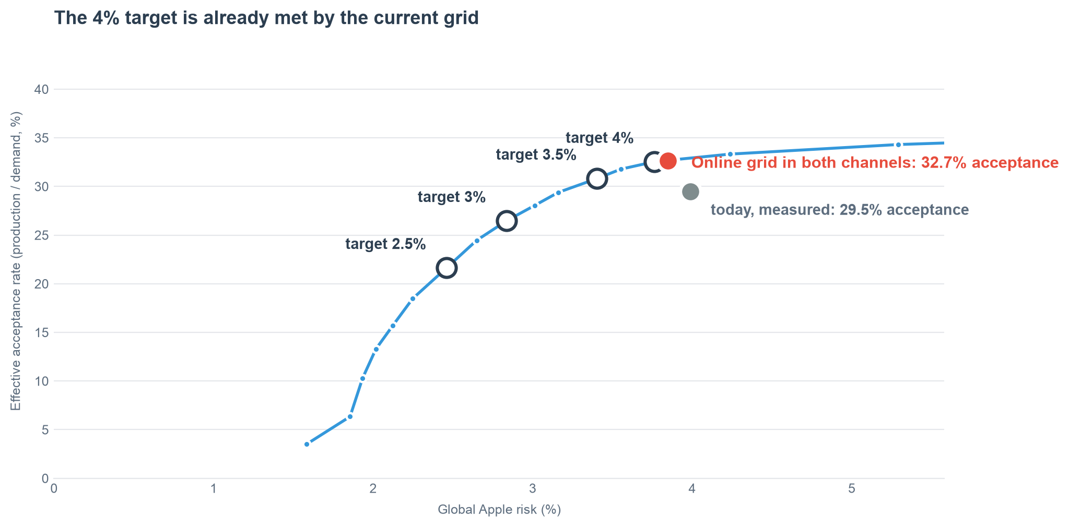
POINT 3 · SCENARIOS
Online Mar 2025 – Feb 2026 · stores Aug–Sep 2026
What each risk target costs
Scenario | Cutoff | Score acc. | Eff. acc.
Today (measured) | current policy | — | 29.5%
Today, current demand | current policy | — | 28.5%
Online grid (both) | current | 58.9% | 32.7%
2.5% · single | > 62 | 38.1% | 21.6%
2.5% · shifted | +36p | 38.2% | 21.7%
3% · single | > 51 | 47.0% | 26.5%
3% · shifted | +23p | 48.8% | 27.5%
3.5% · single | > 38 | 55.2% | 30.8%
3.5% · shifted | +10p | 56.0% | 31.2%
4% · single | > 27 | 58.6% | 32.5%
4% · shifted | +0p | 58.9% | 32.7%
Score acc.: demand above the cutoff.
Eff. acc.: production / demand, the same base as point 1. The two are not comparable.
Shifting the current grid keeps its shape —looser where the group is good— and gives slightly more acceptance at the same risk.
Scenario risks carry the reject-inference uplift, a conservative margin that also falls on Online's own book (+0.08 pp vs realized); the two 'today' rows are realized. Like for like, the current grid moves risk by -0.21 pp.
Why the model produces more than what was measured
The current grid replicates Online's actual decisions (it accepts 51.8% of demand; the engine approved 51.9%: swap-in 0.6%, swap-out 0.6%) and every accepted application converts at the take-up rate of its actual decision. Modelled and measured Online coincide: the gap between €18.5M and €15.3M per month is stores. That gap has two parts: the grid (+€2.3M/mo on the same base, €16.2M → €18.5M) and volume (+€0.9M: store demand in Aug–Sep 2026 runs 40% above the average of the 'today' window).

Slide 8
POINT 4 · GRIDS
Policy — no period
What grid each scenario implies
REJECT threshold by group: applications above the value are accepted.
Single cutoff for all of Apple
Group | Today | 2.5% | 3% | 3.5% | 4%
New | > 27 | > 62 | > 51 | > 38 | > 27
Inactive | > 22 | > 62 | > 51 | > 38 | > 27
A-C | > 16 | > 62 | > 51 | > 38 | > 27
D-F | > 22 | > 62 | > 51 | > 38 | > 27
>=G | reject | reject | reject | reject | reject
Current grid, shifted
Group | Today | 2.5% | 3% | 3.5% | 4%
New | > 27 | > 63 | > 50 | > 37 | > 27
Inactive | > 22 | > 58 | > 45 | > 32 | > 22
A-C | > 16 | > 52 | > 39 | > 26 | > 16
D-F | > 22 | > 58 | > 45 | > 32 | > 22
>=G | reject | reject | reject | reject | reject
A single cutoff is simpler to operate; shifting the grid keeps its shape —looser where the group is good— and gives slightly more acceptance at the same risk. '>=G' is always rejected in both.

Slide 9
METHODOLOGY · RISK
Online Mar 2025 – Feb 2026 · stores Aug–Sep 2026
How store risk is estimated
1
Realized risk by score bin, in Apple Online
MEASURED
For each of the 20 EFX bins, the observed delinquency of contracts with 6 months on book. The only part of the study that comes straight from the data.
2
Selection correction (reject inference)
CORRECTED
Booked contracts in a bin also passed every other rule: they are a selected sample and their delinquency understates that of applicants rejected today. The pipeline's parceling is applied, with an uplift driven by the acceptance rate: 2.4x where only 3% get in, 1.0x where 100% do.
3
That curve is carried over to the store population
ASSUMED
Each store application is assigned the risk of the EFX bin it falls in. This is the underlying assumption: that the score ranks store applicants the same way it ranks e-commerce ones.
4
The level is anchored to stores' actual delinquency
MEASURED
The Online curve predicts 3.93% on the book stores actually wrote; the observed figure is 3.74%. The curve is rescaled by 0.952 to reproduce the data. The level is no longer an assumption: only the ranking power remains assumed.
What this means in practice: if EFX ranks store applicants worse than it ranks Online ones, the scenario cutoffs fall short. What can no longer be wrong is the height of the curve, because it is calibrated against the delinquency stores have actually had.

Slide 10
METHODOLOGY · STORE DEMAND
Online Mar 2025 – Feb 2026 · stores Aug–Sep 2026
Store demand Aug–Sep 2026: from applications to risk
Each € of store demand | Share | Exp. production | Imputed risk
kept: approved today, above the cutoff | 56.8% | €10.9M | 3.3%
swap-in: rejected by score, above cutoff | 19.3% | €3.7M | 4.1%
swap-out: approved today, below cutoff | 2.0% | €0.4M | 47.6%
rejected by both scores (today, and by EFX) | 1.8% | €0.4M | 41.6%
untouched: rejected by other rules | 20.1% | €3.9M | 8.0%
Accepted by the grid (kept + swap-in) | 76.0% | €14.6M | 3.51%
Today's book, valued the same way | 47.2% | €11.3M | 3.74%
Monthly run-rate | Online | Stores | Apple
Effective months | 12.00 | 1.45 | —
Demand, €M/mo | 40.1 | 16.5 | 56.6
Exp. production, €M/mo | 8.4 | 10.1 | 18.5
Share of exp. H6 exposure | 45% | 55% | 100%
Risk (b2) | 4.26% | 3.51% | 3.85%
Risk blends by expected H6 exposure, the base of b2: stores are 29% of demand but 55% of exposure, because they convert 61% of what they are asked for and Online 21%. Online's 4.26% carries the reject-inference uplift on its own book (realized 4.18%).
1 · Score and bin. Every application gets its EFX score and one of the 20 bins of the Online curve.
2 · Apply the Online grid. Accepted if above its group's reject threshold and not rejected by another rule — only the score rule is swapped; the engine's other rules stay.
3 · Expected production. € applied for × the actual take-up of its engine decision (stores: approved 82%, referred 18%); cancellations are assumed to behave as today.
4 · Impute risk. Each accepted € takes its bin's Online risk (reject-inference blended), weighted by expected H6 exposure; the level is rescaled by 0.952 so that today's store book reproduces its realized 3.74%.
5 · What the grid leaves out. The swap-out is 2.0% of demand with 48% imputed risk (median EFX 19): the octroi's weakest approvals. The swap-in brings 19.3% of demand at 4.1%.

Slide 11
METHODOLOGY · SEASONALITY
Full years 2024 and 2025
How months are annualised
1
The problem: stores only have the score for Aug–Sep 2026
MEASURED
The EFX score went live in stores in Aug 2026. Comparing 2 months on their own against a twelve-month average requires knowing what each month is worth.
2
August and September: no average month, and each channel has its own
MEASURED
Index for Aug and Sep: 0.49 / 2.03 in Online and 0.76 / 0.69 in stores. Online concentrates demand around the iPhone launch (Sep 2.03) and stores around Christmas (Dec 1.70). The correlation between the two profiles is 0.39: not the same pattern.
3
Effective months instead of calendar months
CORRECTED
The run-rate is divided not by the number of months but by the sum of the seasonal index over the months covered. A full calendar year sums to 12.00 and changes nothing; the stores window (Aug–Sep 2026) sums to 1.45 and corrects for falling in weak store months.
4
Effect on stores' weight in Apple Total
MEASURED
Uncorrected, stores appeared to be 23% of demand. With their own seasonality they are 29%. Had Online's profile been applied —the only option before stores' history was available— we would have said 19%, and every scenario would show less production than there really is.
The index averages complete calendar years, so year-on-year volume growth is not mistaken for seasonality. What remains open is whether the Aug–Sep 2026 mix in stores is representative of the year.

Slide 12
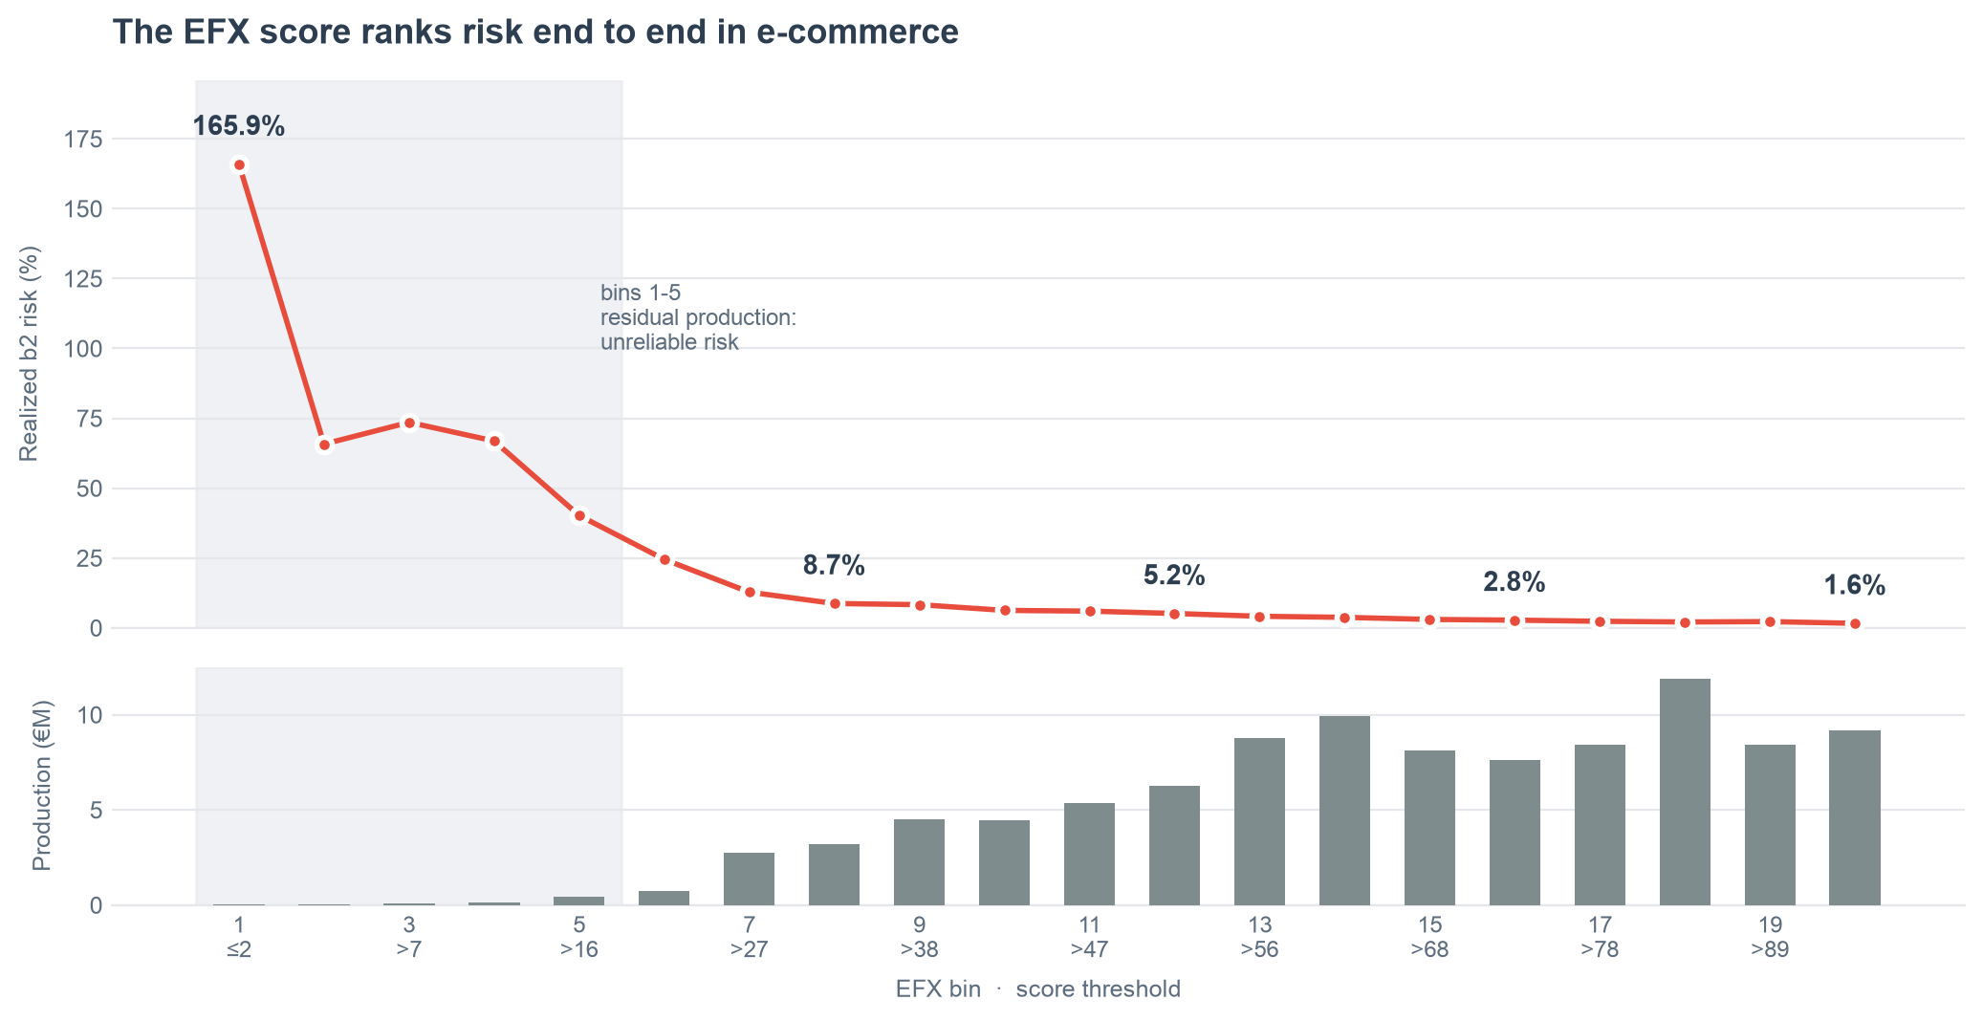
APPENDIX · THE ENGINE OF THE STUDY
Originations Mar 2025 – Feb 2026
The EFX score ranks risk in e-commerce
The risk curve by bin is the only measured piece of the study. Everything else —store risk, the scenarios— derives from it.

Slide 13
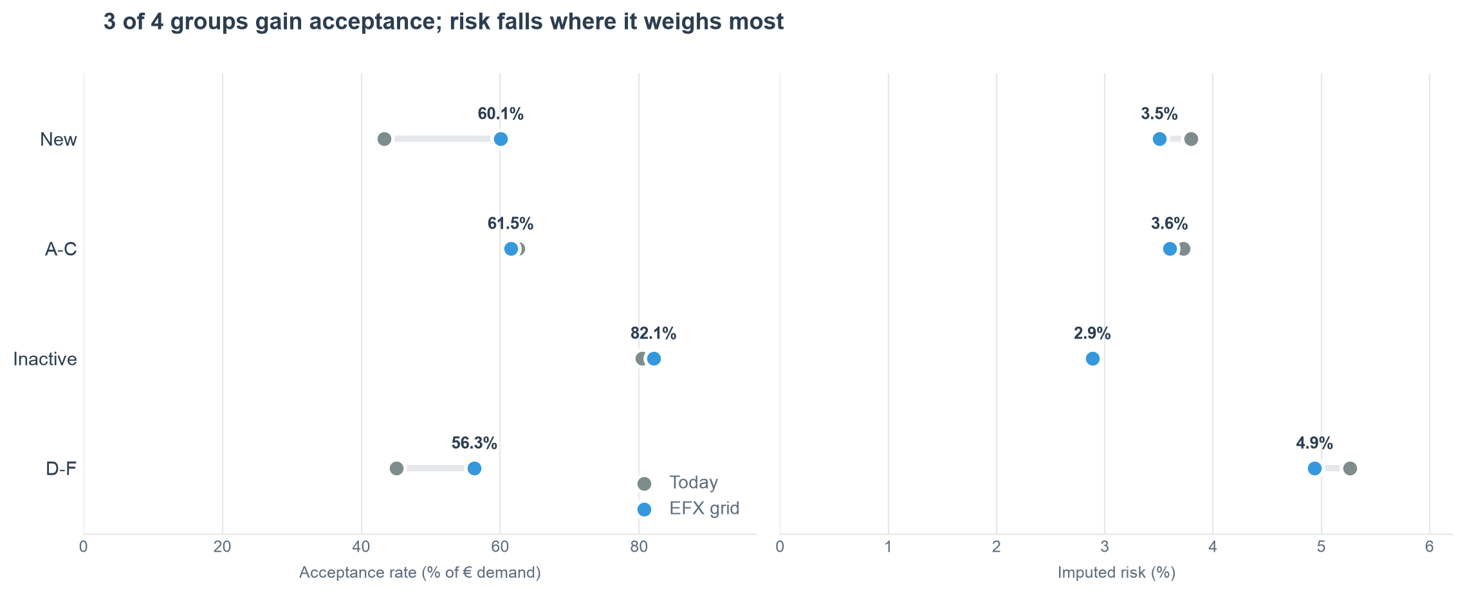
APPENDIX · BREAKDOWN BY SEGMENT
Stores Aug–Sep 2026
Where the stores improvement comes from
'New' is 81% of store demand and where risk falls. Take-up is measured by segment and by engine decision (approved / referred). '>=G' is absent: it is always rejected, so it has neither acceptance nor risk.

Slide 14
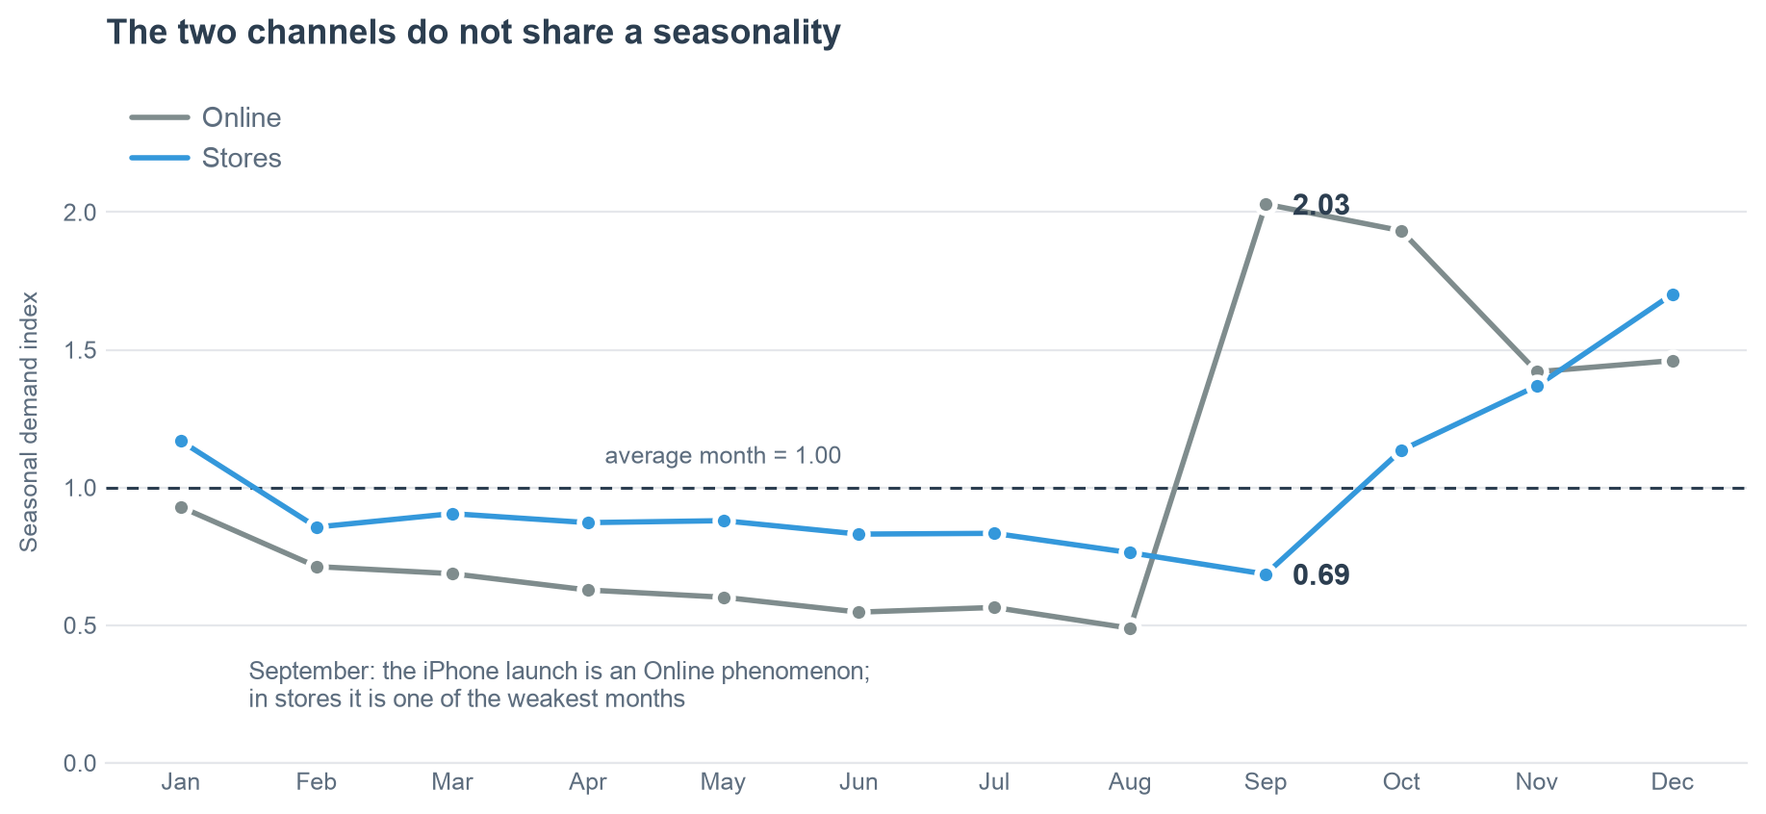
APPENDIX · ANNUALISATION
Full years 2024 and 2025
The two channels do not share a seasonality
Stores only have the score for Aug–Sep 2026, so their weight in Apple depends on how it is annualised. Stores peak in December and September is their weakest month, the opposite of Online: using Online's curve would have cut their weight to 19% when with their own seasonality it is 29%.

Slide 15
LIMITATIONS AND NEXT STEPS
What is missing and what needs deciding
Study limitations
Next steps
Store risk is estimated. Store contracts with EFX are 0–2 months old and have no observable performance yet. H3 around Dec 2026, H6 around Mar 2027.
Conditional comparison. The internal score and EFX are compared with EFX's yardstick. It does not prove EFX is better in stores: it assumes it. What is checked is the risk level, not the ranking power.
Weak low bins. Bins 1-5 carry under 0.5% of production each, and that is where the selection uplift weighs most (2.4x). They are the ones that open the loosest scenario.
Only Aug–Sep 2026 in stores. Their own seasonality is already measured, but a 2-month mix may not be representative, and store demand runs 40% above the average of the 'today' window: part of the improvement versus what was measured is volume, not grid.
Extraction. Refresh Online through Sep 2026, EFX score in stores and their performance history to anchor the risk level.
Business decision. Global risk target, and whether the cutoff is single or by segment.
Validation. Rerun with the full pipeline: reject inference, confidence intervals and swap-in / swap-out audit.
Measurement. Review in Dec 2026 with H3 and in Mar 2027 with actual store H6.

