Slide 1
Selection Bias Analysis
Score Discriminance Under Range Restriction
Credit Risk Scoring Pipeline | 12 Complementary Analyses
March 2026
Selection Bias Analysis
1 / 35

Slide 2
Executive Summary
•
Risk Score RF: genuine 14-19% attenuation. Corrected Gini 0.41-0.53; RI-imputed 0.45-0.72.
•
Score RF in 'known' (Gini 0.23): NOT primarily selection bias. Thorndike recovers only 2 pts.
•
Score RF has high Selection Gini (0.56-0.67) but low Outcome Gini -- classic selection-bias signature.
•
Most rejection is non-score-based (77-100% baseline). Effective score-based acceptance is 42%, not 15%.
•
Combined logistic score (Gini 0.37-0.64) outperforms both. Scores weakly correlated (r ~ 0.25).
Selection Bias Analysis
1 / 35

Slide 3
Core Analyses
Distribution, Thorndike, Simulation, Temporal, Rejection, Cross-Group
Selection Bias Analysis
2 / 35

Slide 4
1. Distribution Truncation
u = SD(booked) / SD(demand). u < 1 indicates range restriction.
Group | Score | Accept Rate | u ratio | SD demand | SD booked | KS stat
known | Score RF | 15.4% | 0.921 | 28.64 | 26.39 | 0.200
known | Risk Score RF | 15.4% | 0.845 | 26.71 | 22.57 | 0.199
others | Score RF | 2.4% | 1.262 | 22.52 | 28.41 | 0.514
others | Risk Score RF | 2.4% | 0.834 | 28.94 | 24.13 | 0.374
total | Score RF | 7.1% | 0.988 | 27.16 | 26.84 | 0.416
total | Risk Score RF | 7.1% | 0.792 | 28.98 | 22.94 | 0.328
Risk Score RF consistently truncated (u = 0.79-0.85). Score RF in 'others' has u > 1 -- selection is not score-based there.
Selection Bias Analysis
3 / 35

Slide 5
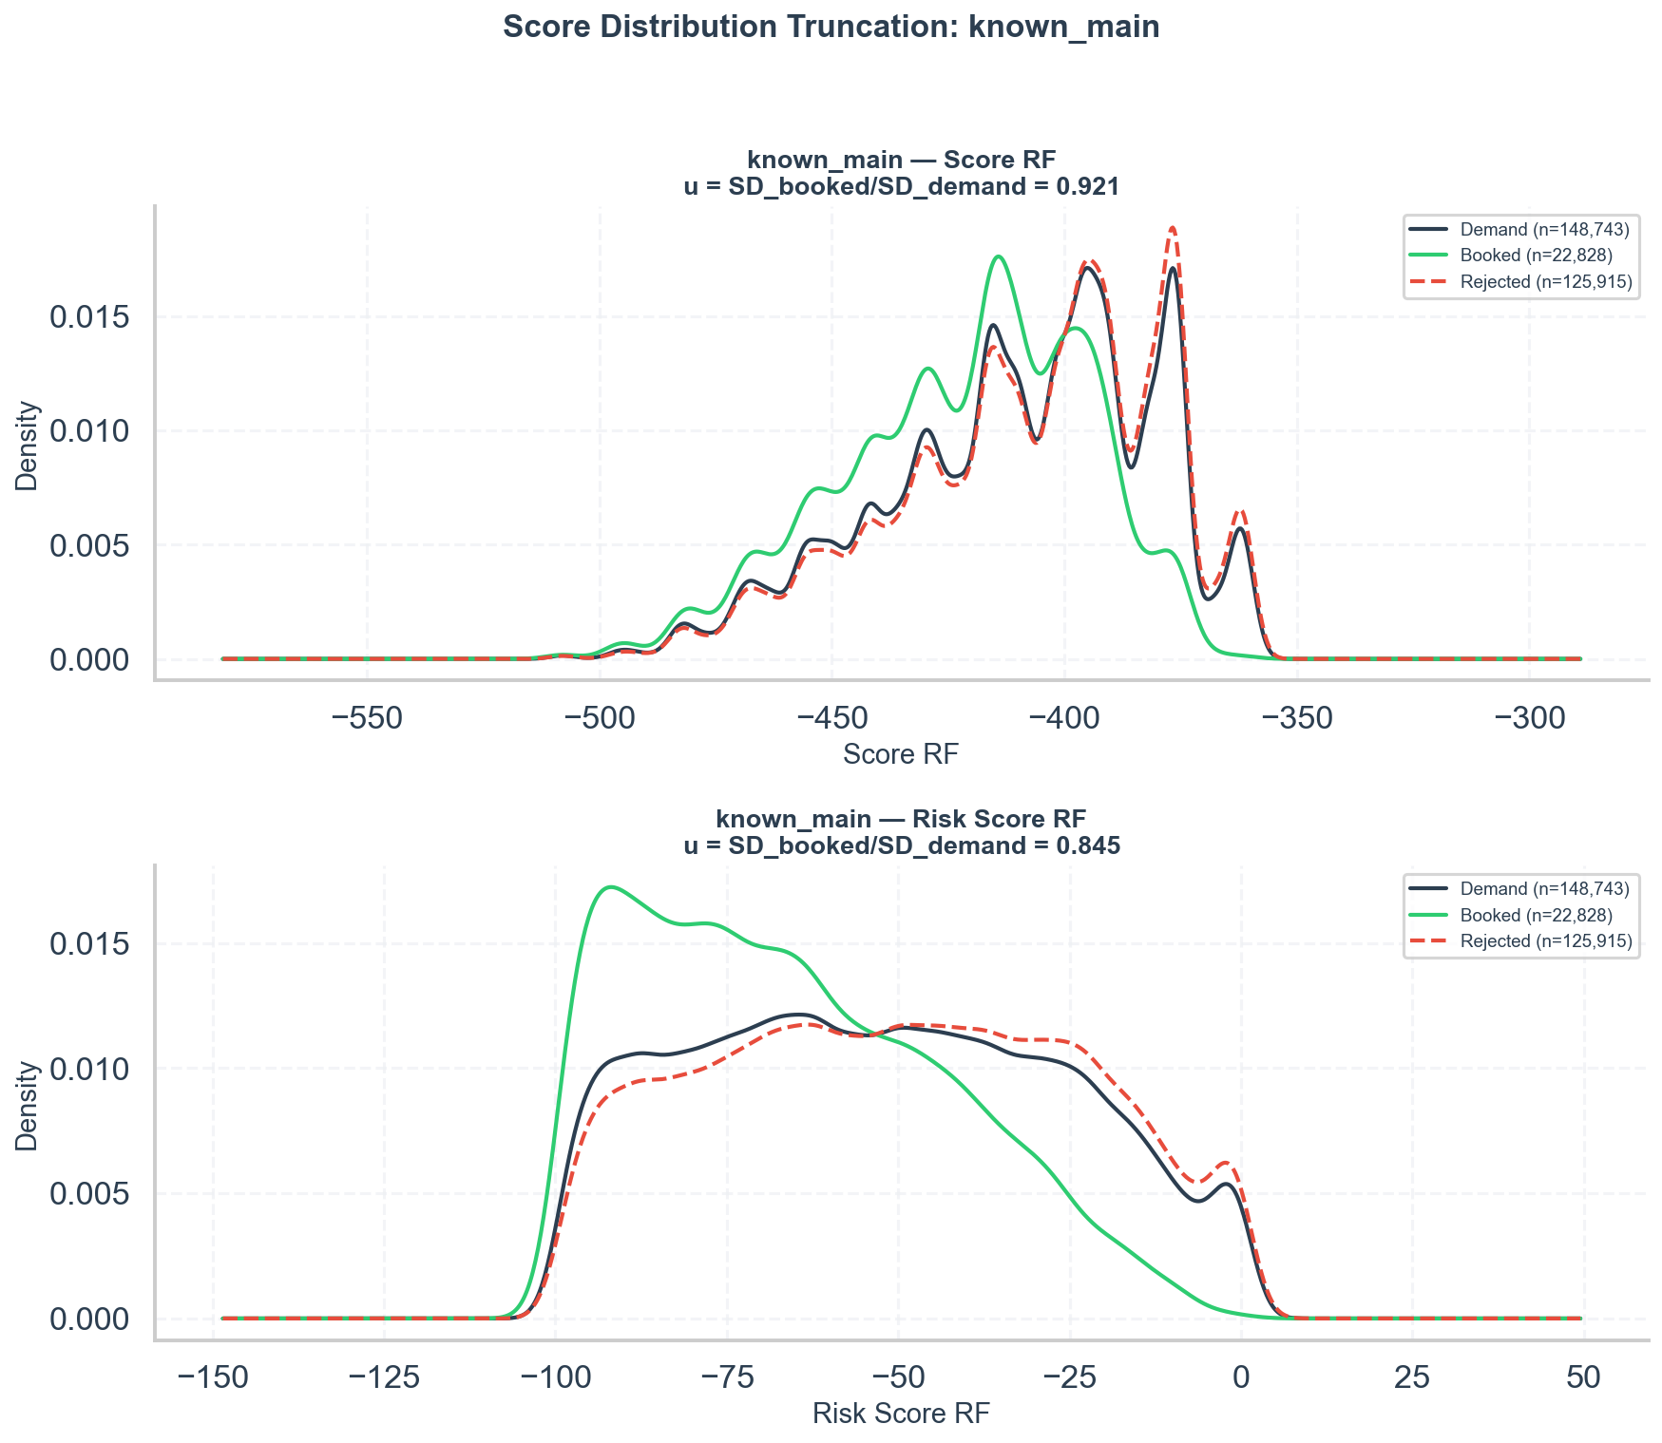
Distribution Truncation: Known
Booked KDE (green) is narrower than demand, especially for Risk Score RF.
Selection Bias Analysis
4 / 35

Slide 6
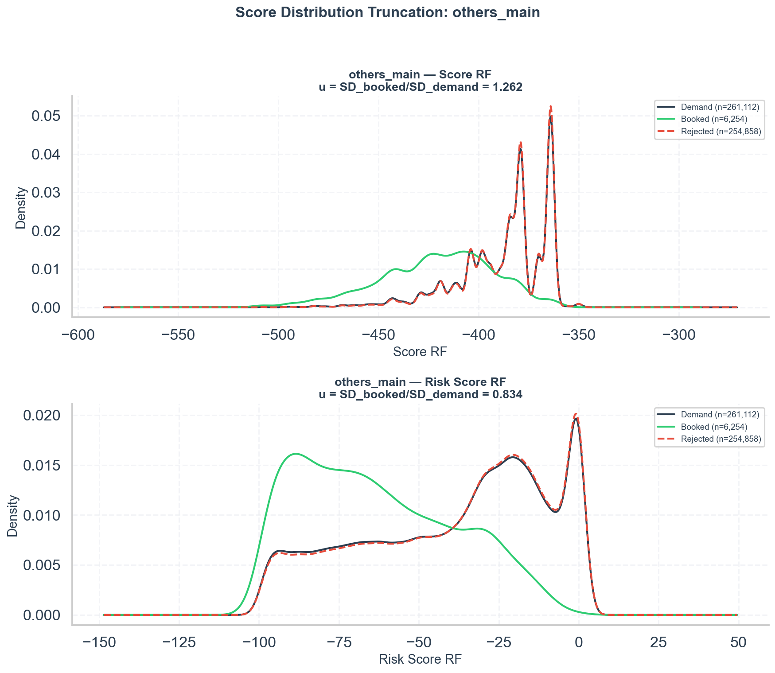
Distribution Truncation: Others
Score RF booked (green) is wider than demand (u > 1); Risk Score RF shows clear truncation.
Selection Bias Analysis
5 / 35

Slide 7
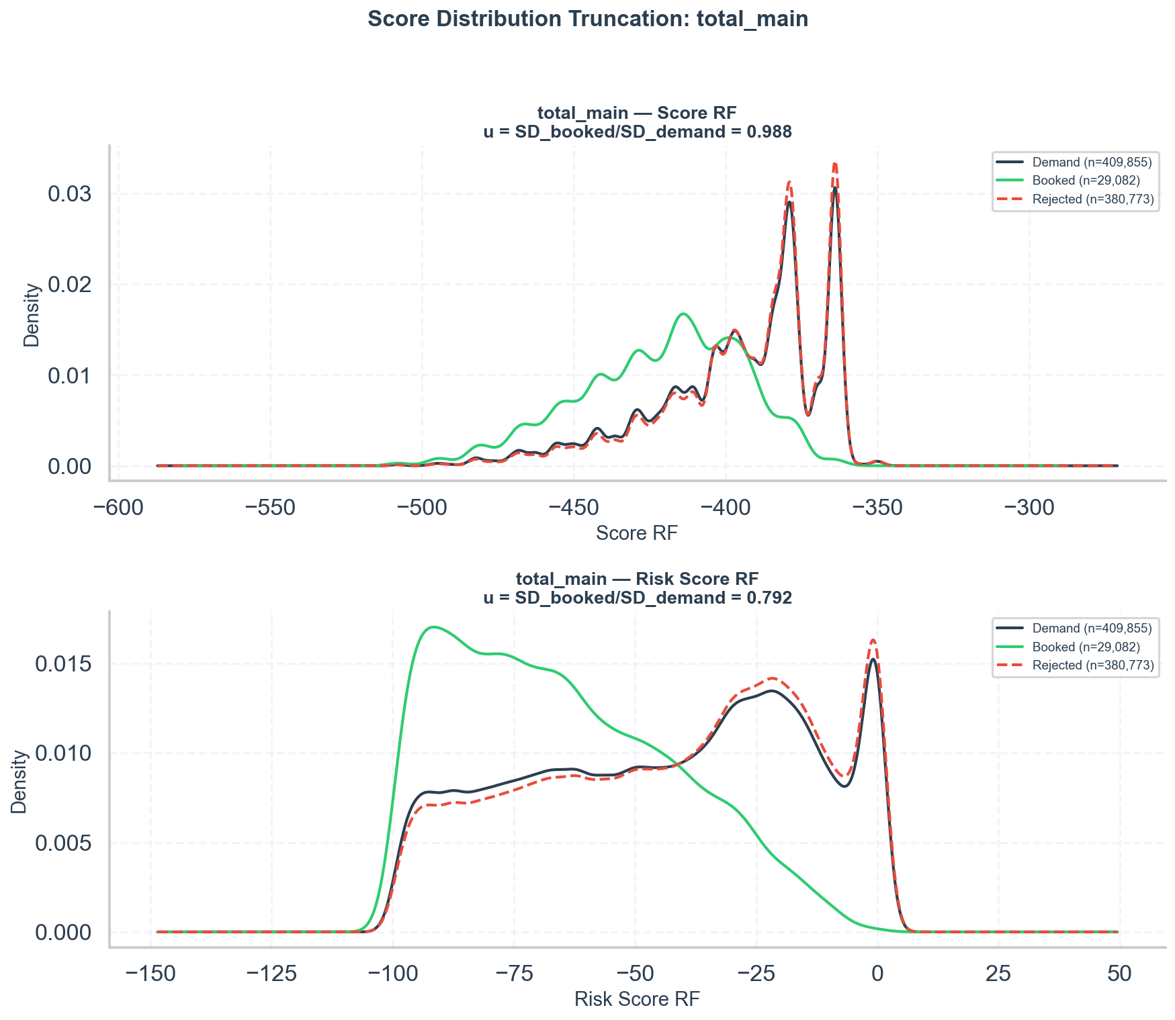
Distribution Truncation: Total
Selection Bias Analysis
6 / 35

Slide 8
2. Thorndike Case 2 Correction
Group | Score | Observed Gini | u ratio | Corrected Gini | Attenuation
known | Score RF | 0.227 | 0.921 | 0.246 | 7.6%
known | Risk Score RF | 0.349 | 0.845 | 0.407 | 14.4%
others | Score RF | 0.432 | 1.262 | 0.432 | 0.0%
others | Risk Score RF | 0.450 | 0.834 | 0.526 | 14.5%
total | Score RF | 0.287 | 0.988 | 0.290 | 1.1%
total | Risk Score RF | 0.380 | 0.792 | 0.469 | 19.0%
Risk Score RF: 14-19% attenuation. Score RF: minimal correction -- low Gini is genuine.
Selection Bias Analysis
7 / 35

Slide 9
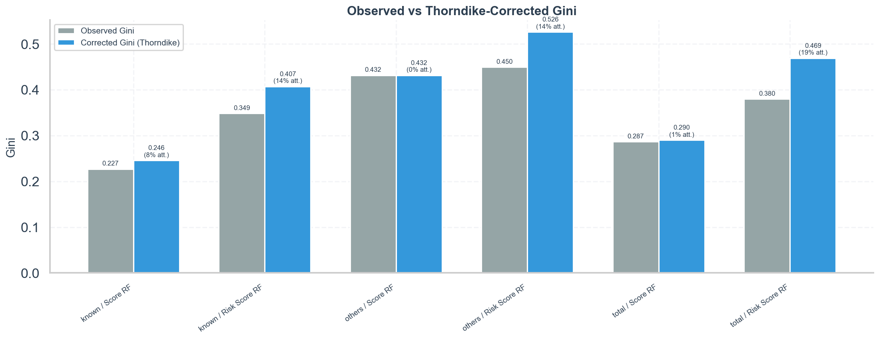
Thorndike Correction
Selection Bias Analysis
8 / 35

Slide 10
3. Simulated Range Restriction
Group | Score | Gini @100% | Gini @50% | Drop
known | Score RF | 0.227 | 0.144 | 36.5%
known | Risk Score RF | 0.349 | 0.305 | 12.5%
others | Score RF | 0.432 | 0.220 | 49.0%
others | Risk Score RF | 0.450 | 0.458 | -1.9%
total | Score RF | 0.287 | 0.172 | 40.1%
total | Risk Score RF | 0.380 | 0.354 | 6.9%
Score RF: 36-49% Gini loss -- relies on tails. Risk Score RF: robust (7-13% loss).
Selection Bias Analysis
9 / 35

Slide 11
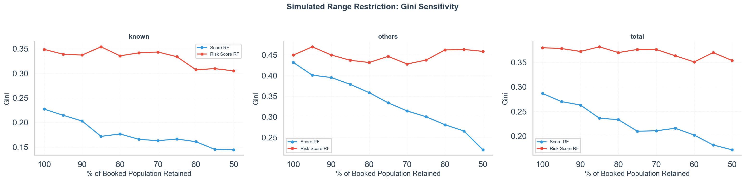
Simulated Restriction: Gini Sensitivity
Selection Bias Analysis
10 / 35

Slide 12
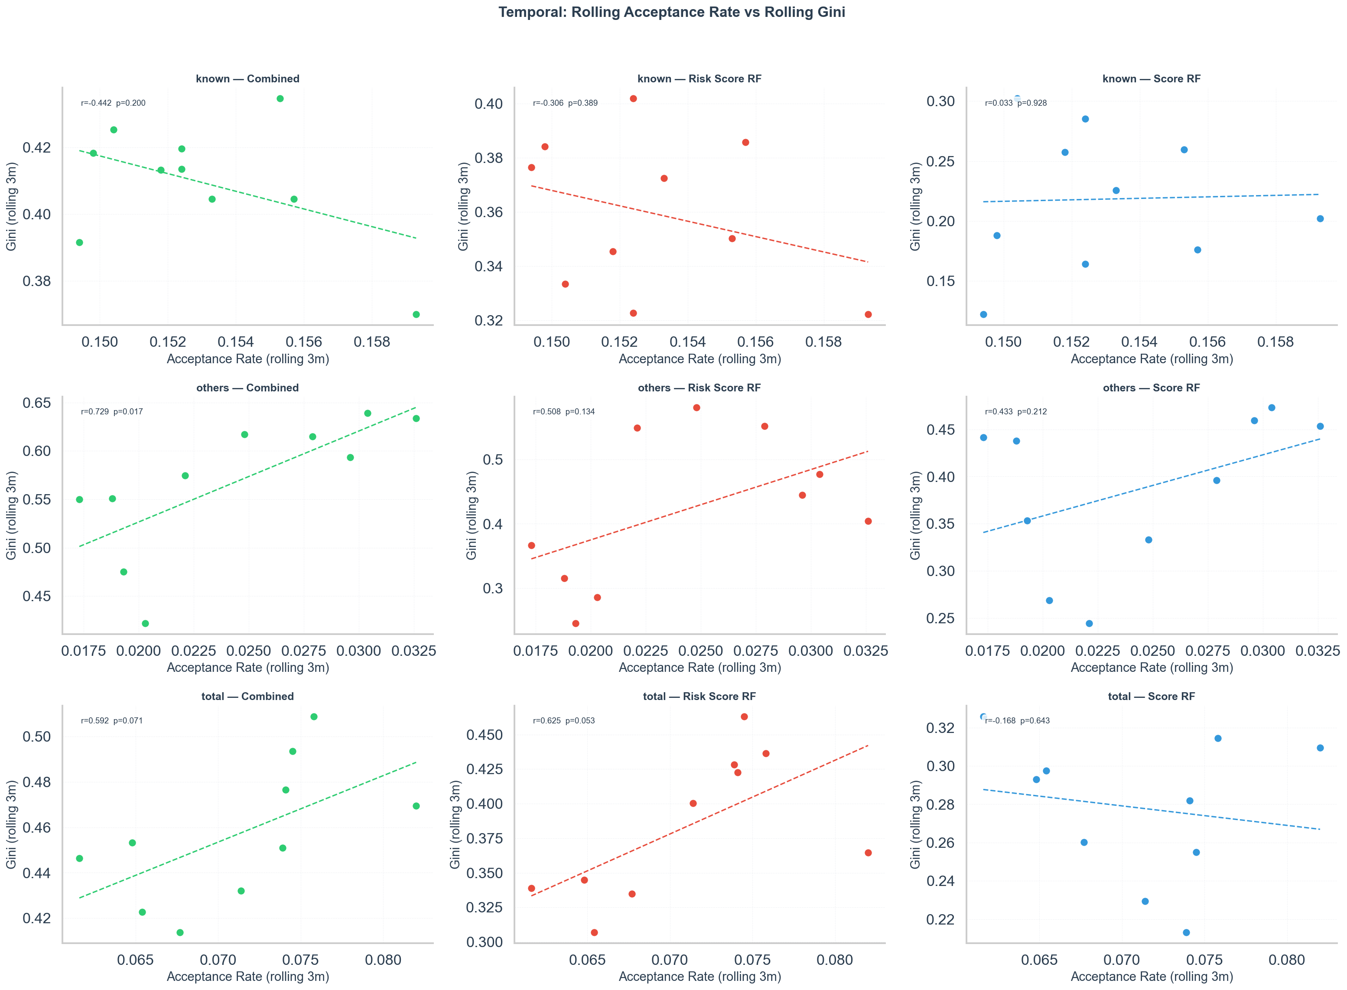
4. Temporal: Rolling Acceptance Rate vs Gini
Inconclusive: acceptance rate barely varies in 'known'; too-small samples in 'others'.
Selection Bias Analysis
11 / 35

Slide 13
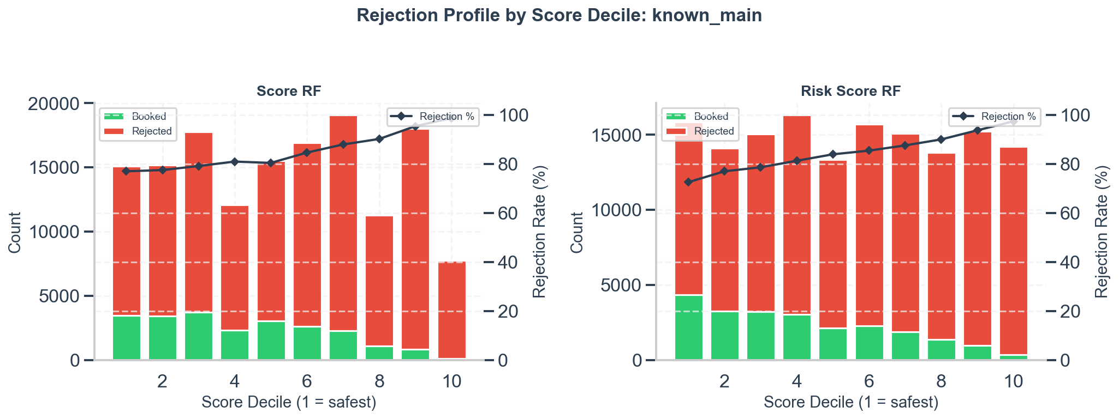
5. Rejection Profile: Known
77% to 99% gradient, but even the safest decile has 77% rejection (non-score-based).
Selection Bias Analysis
12 / 35

Slide 14
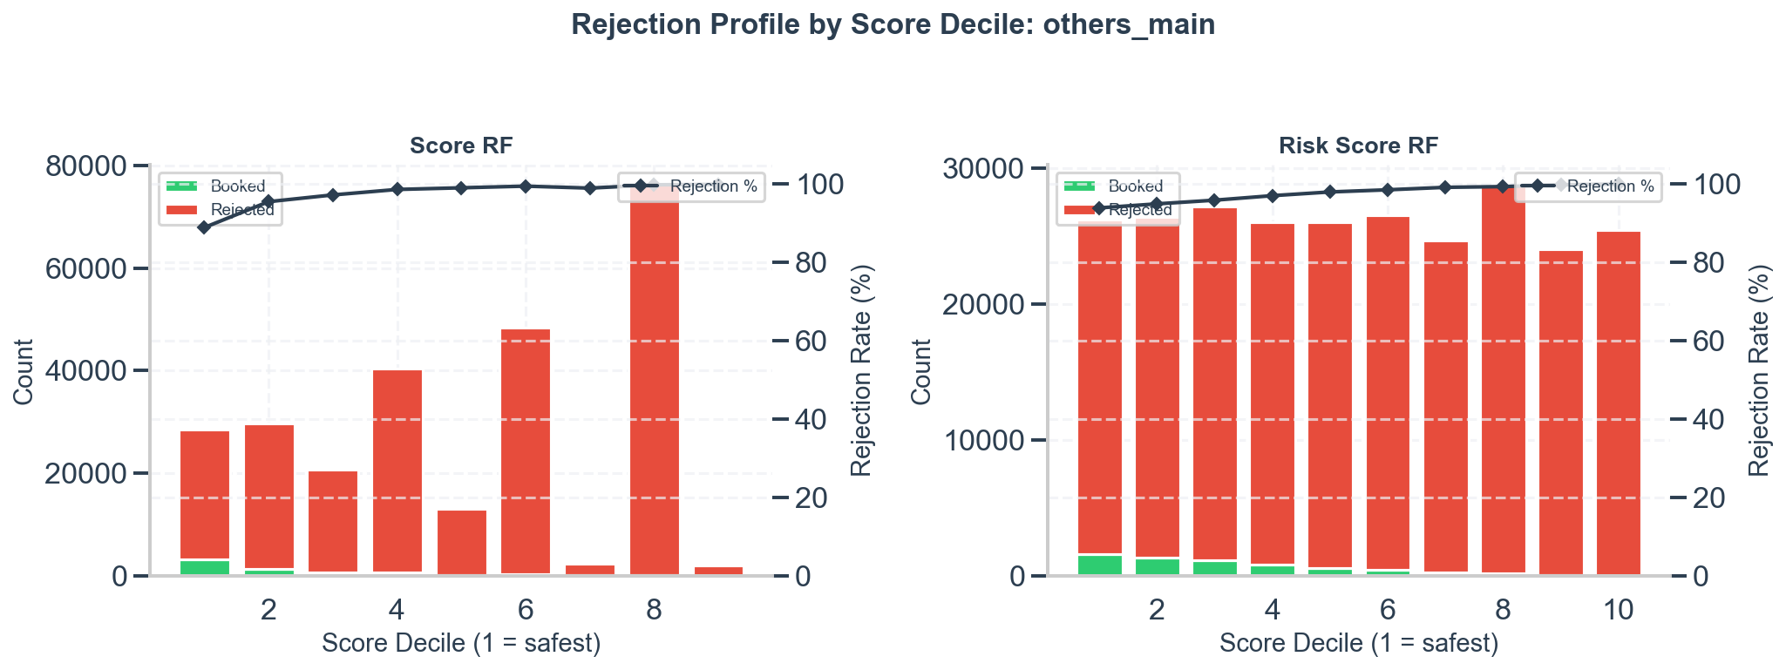
5. Rejection Profile: Others
89-100% rejection across ALL deciles. Selection is overwhelmingly non-score-based.
Selection Bias Analysis
13 / 35

Slide 15
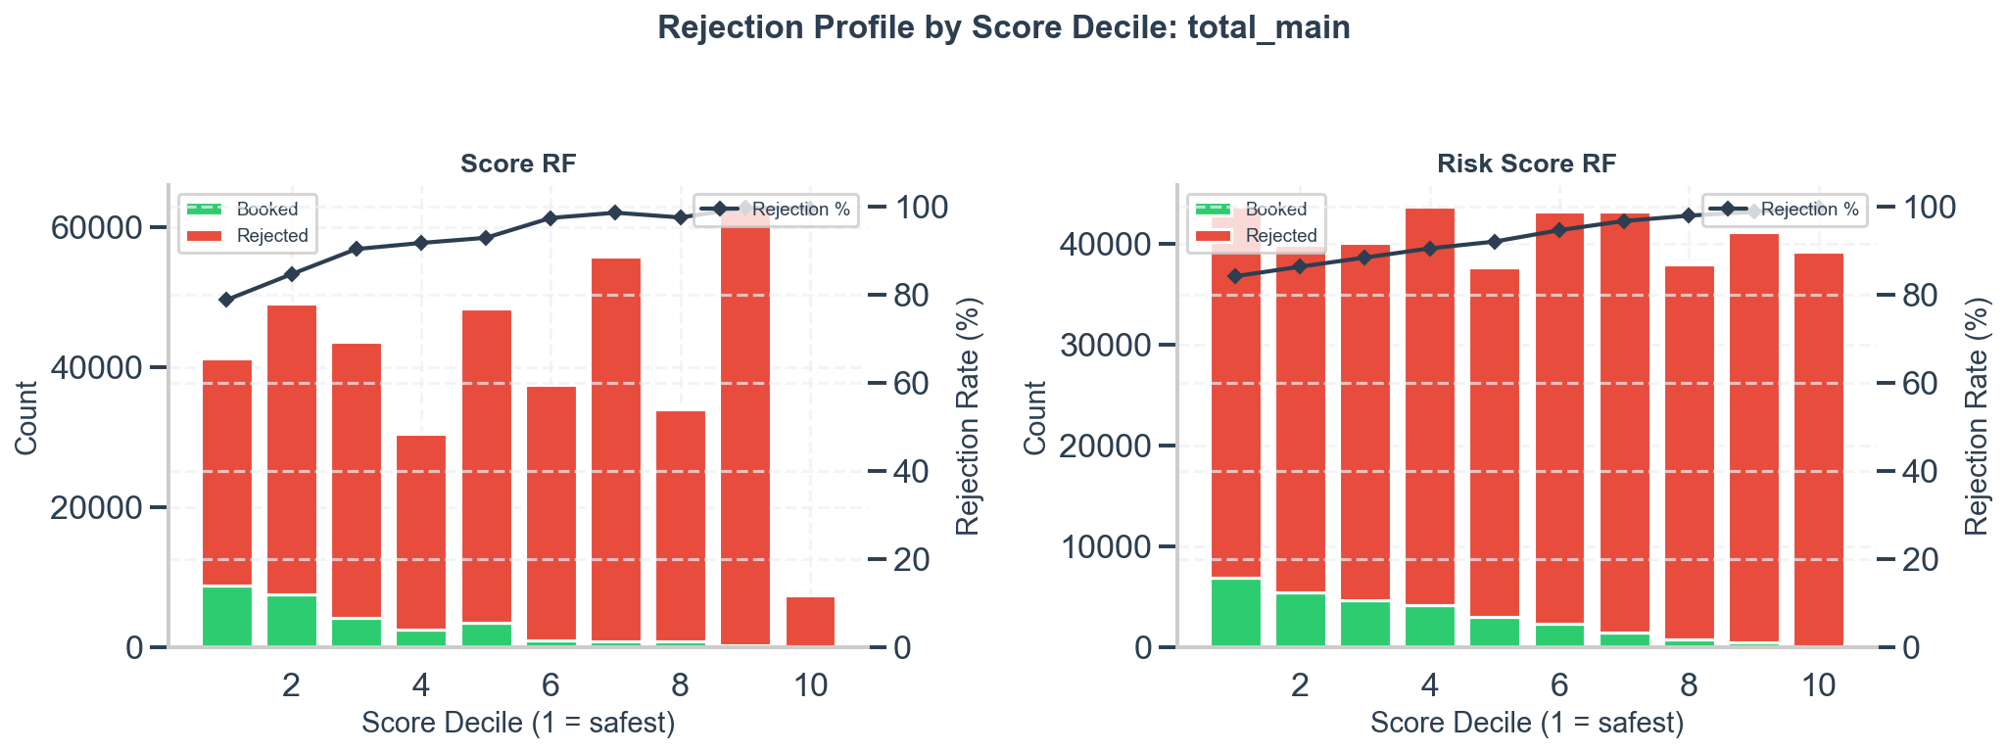
5. Rejection Profile: Total
Selection Bias Analysis
14 / 35

Slide 16
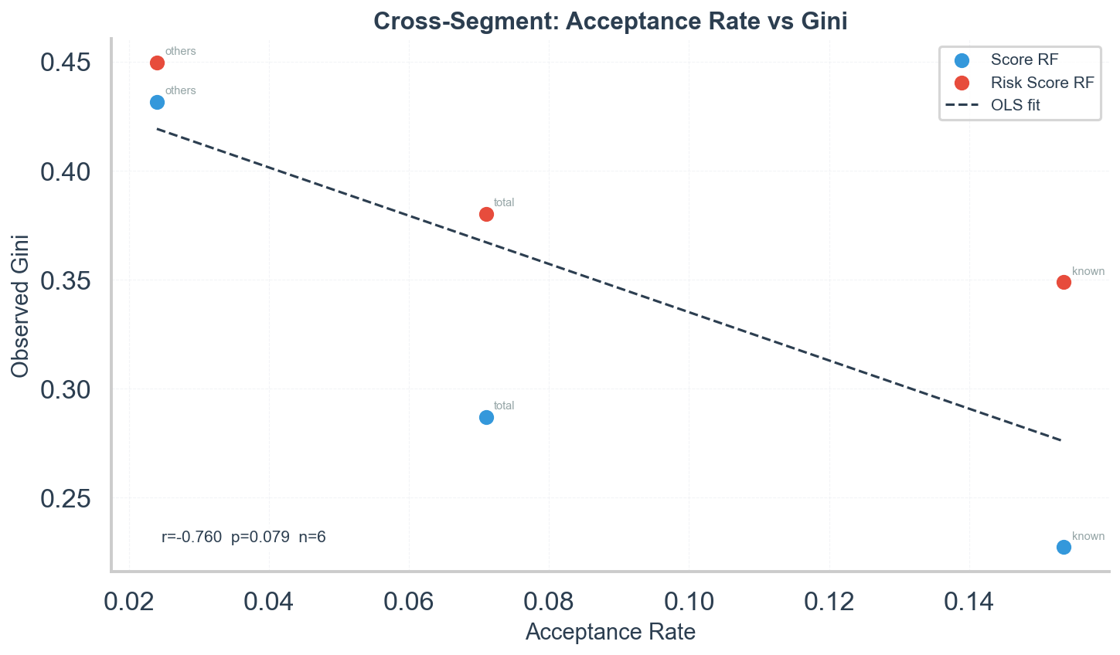
6. Cross-Group: Acceptance Rate vs Gini
Inverted pattern (lower acceptance = higher Gini). Confounded by population differences -- supplementary only.
Selection Bias Analysis
15 / 35

Slide 17
Extended Analyses
Selection Gini, Score-Only Truncation, Bad Rate, Correlation, RI Gini, PSI
Selection Bias Analysis
16 / 35

Slide 18
7. Selection Gini vs Outcome Gini
Selection Gini = ability to separate booked from rejected (no early_bad needed).
Group | Score | Selection Gini | Outcome Gini | Gap
known | Score RF | 0.290 | 0.227 | +0.063
known | Risk Score RF | 0.327 | 0.349 | -0.022
others | Score RF | 0.674 | 0.432 | +0.242
others | Risk Score RF | 0.488 | 0.450 | +0.038
total | Score RF | 0.563 | 0.287 | +0.276
total | Risk Score RF | 0.456 | 0.380 | +0.076
Score RF: high Selection Gini but low Outcome Gini -- classic selection-bias signature. Risk Score RF: outcome exceeds selection in 'known'.
Selection Bias Analysis
17 / 35

Slide 19
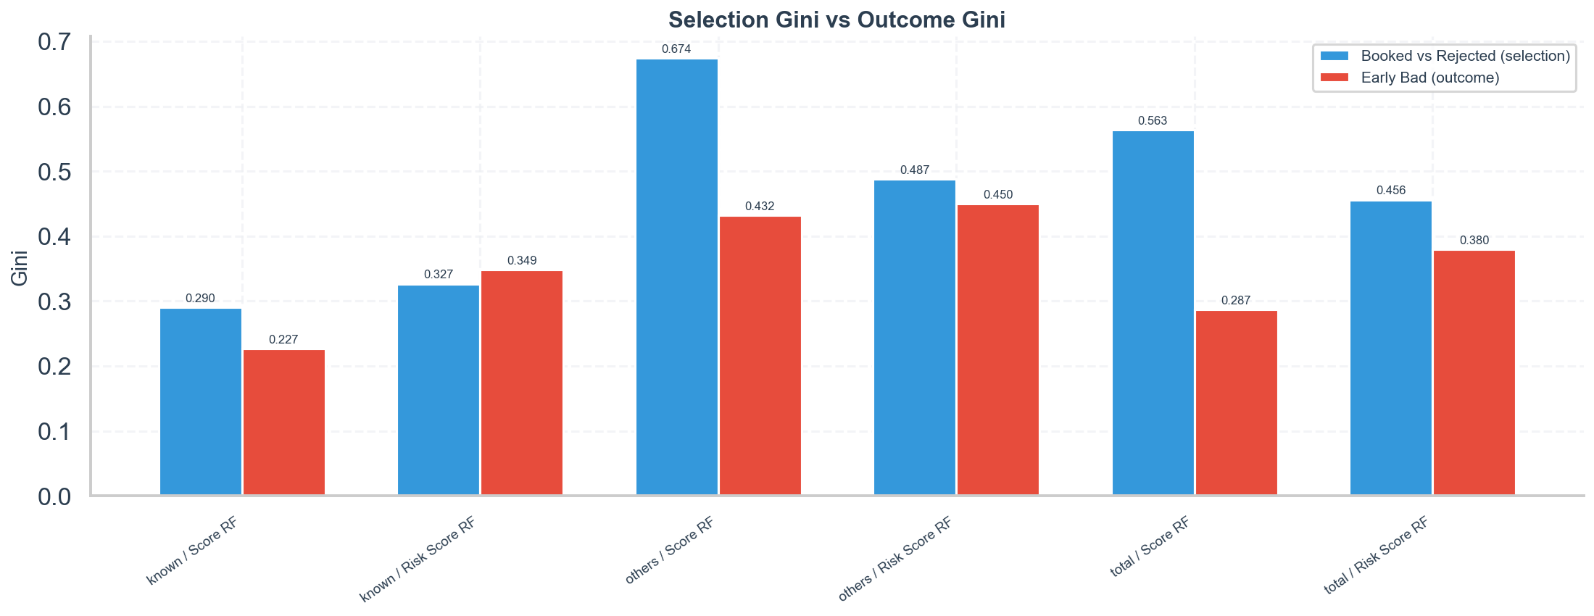
Selection Gini vs Outcome Gini
Selection Bias Analysis
18 / 35

Slide 20
8. Score-Rejection-Only Truncation
Demand filtered to booked + score-rejected only (excluding policy rejections).
Group | Score | u (all demand) | u (score-only) | Score-only Accept
known | Score RF | 0.921 | 0.981 | 41.9%
known | Risk Score RF | 0.845 | 0.882 | 41.9%
others | Score RF | 1.262 | 1.501 | 4.9%
others | Risk Score RF | 0.834 | 0.906 | 4.9%
total | Score RF | 0.988 | 1.157 | 15.9%
total | Risk Score RF | 0.792 | 0.862 | 15.9%
Effective score-based acceptance is 42% (not 15%). Truncation is much milder than raw rates suggest.
Selection Bias Analysis
19 / 35

Slide 21
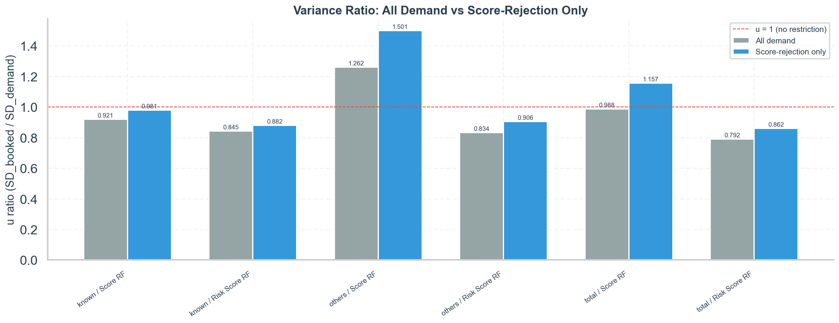
Variance Ratio: All Demand vs Score-Rejection Only
Selection Bias Analysis
20 / 35

Slide 22
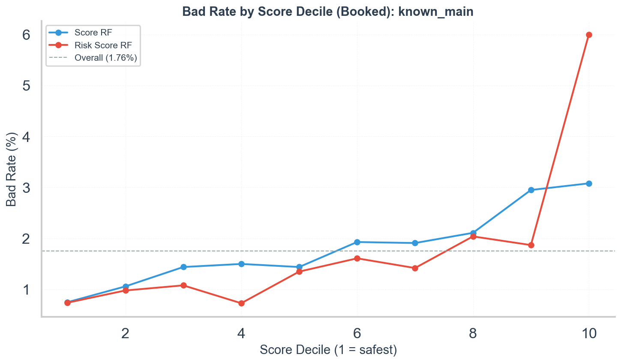
9. Bad Rate by Score Decile: Known
Score RF: ~4x gradient (0.75% to 3.08%). Risk Score RF: ~8x gradient (0.74% to 6.00%).
Selection Bias Analysis
21 / 35

Slide 23
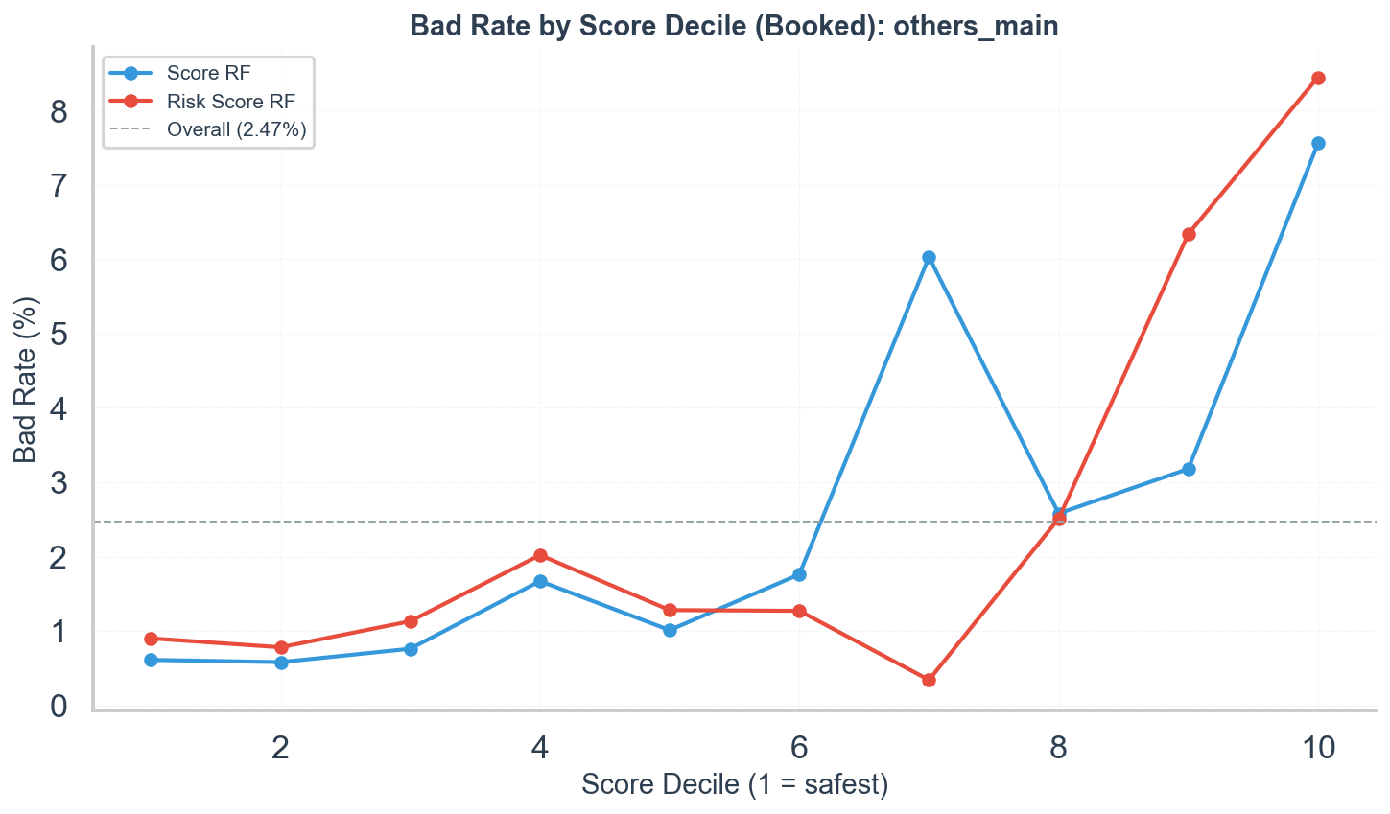
9. Bad Rate by Score Decile: Others
Both scores show strong gradients in 'others' (~10-12x).
Selection Bias Analysis
22 / 35

Slide 24
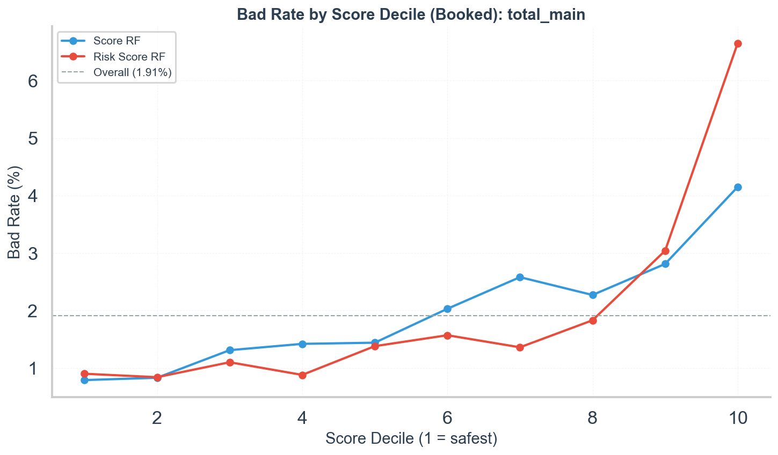
9. Bad Rate by Score Decile: Total
Selection Bias Analysis
23 / 35

Slide 25
10. Score-to-Score Correlation (Full Demand)
Group | Pearson r | Spearman r | n records
known | 0.248 | 0.249 | 148,743
others | 0.270 | 0.256 | 261,112
total | 0.324 | 0.328 | 409,855
Weakly correlated (r ~ 0.25). Selection on one does NOT truncate the other. Explains why Combined outperforms.
Selection Bias Analysis
24 / 35

Slide 26
11. Reject Inference Gini (Full-Population Estimate)
Outcomes imputed for rejected using per-decile bad rates x 1.5 uplift (50 bootstrap replicates).
Group | Score | Observed | Thorndike | RI Gini | RI 95% CI
known | Score RF | 0.227 | 0.246 | 0.281 | [0.269, 0.292]
known | Risk Score RF | 0.349 | 0.407 | 0.453 | [0.443, 0.463]
others | Score RF | 0.432 | 0.432 | 0.332 | [0.326, 0.340]
others | Risk Score RF | 0.450 | 0.526 | 0.718 | [0.714, 0.721]
total | Score RF | 0.287 | 0.290 | 0.412 | [0.404, 0.418]
total | Risk Score RF | 0.380 | 0.469 | 0.603 | [0.597, 0.607]
Risk Score RF RI Gini: 0.45-0.72. Confirms strong unrestricted power. Note: RI is circular -- treat as upper bound.
Selection Bias Analysis
25 / 35

Slide 27
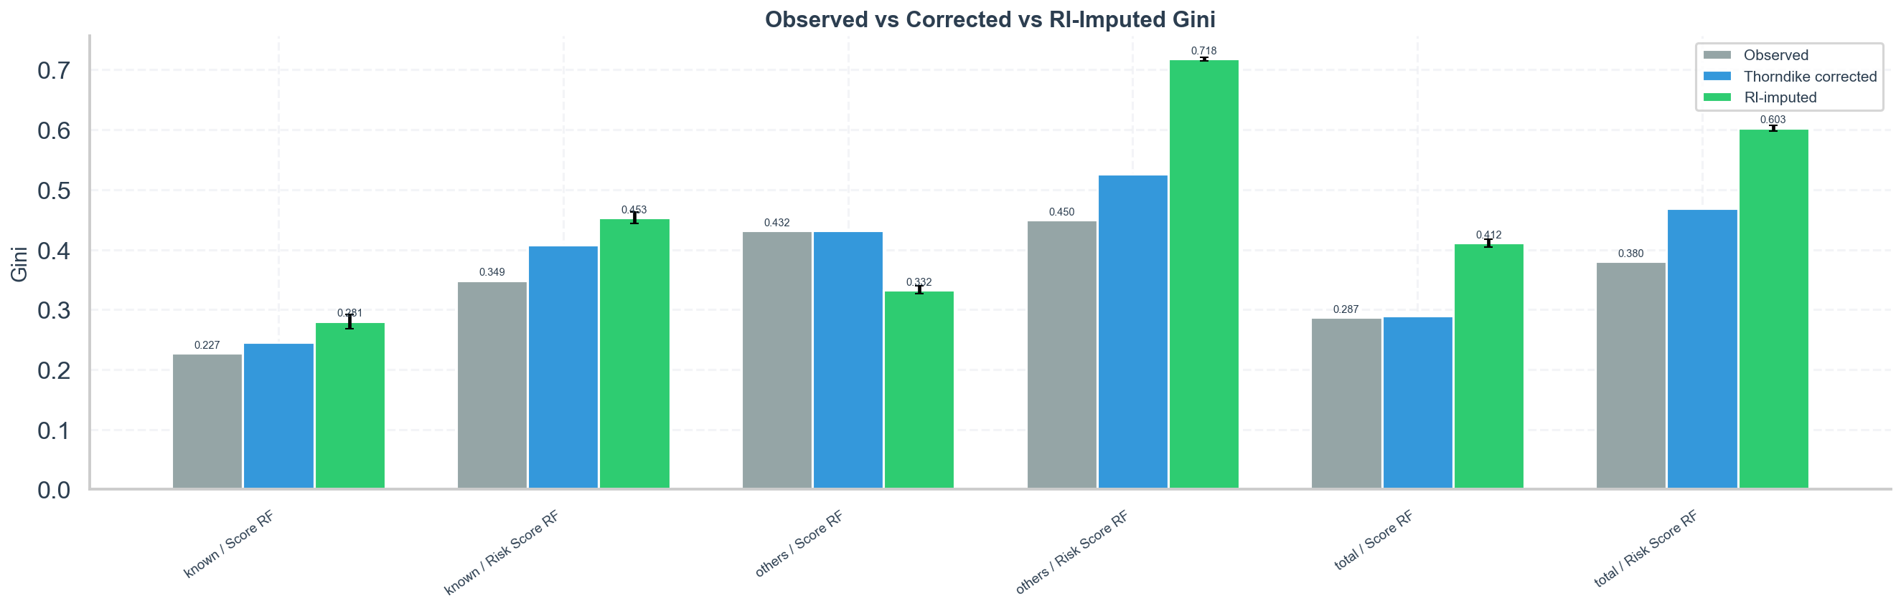
Observed vs Corrected vs RI-Imputed Gini
Selection Bias Analysis
26 / 35

Slide 28
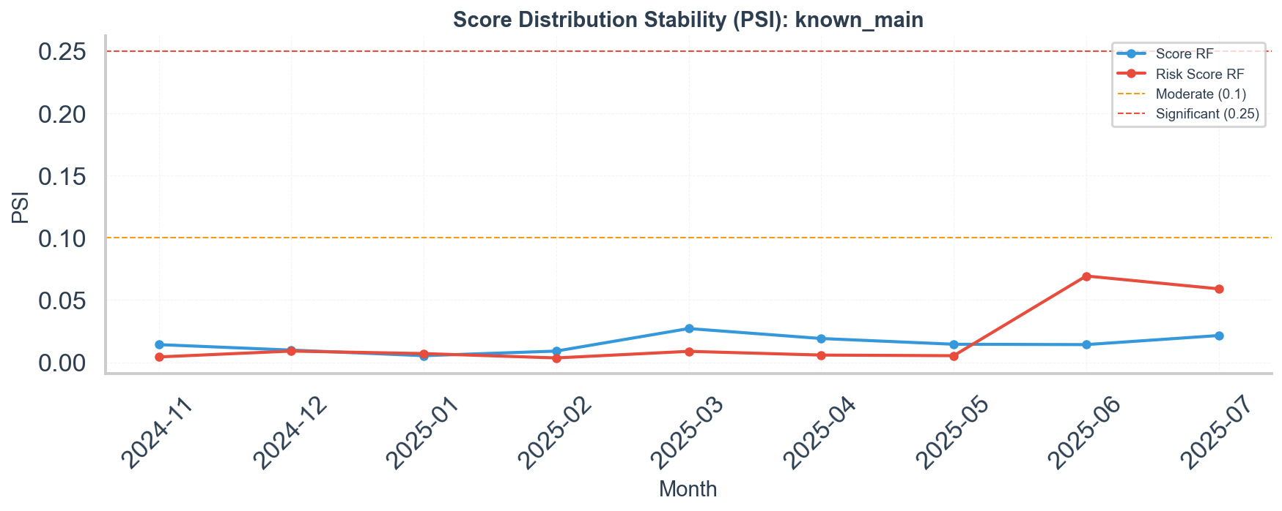
12. Score Stability (PSI): Known
Both scores stable (PSI < 0.07). Gini fluctuations are not driven by score distribution drift.
Selection Bias Analysis
27 / 35

Slide 29
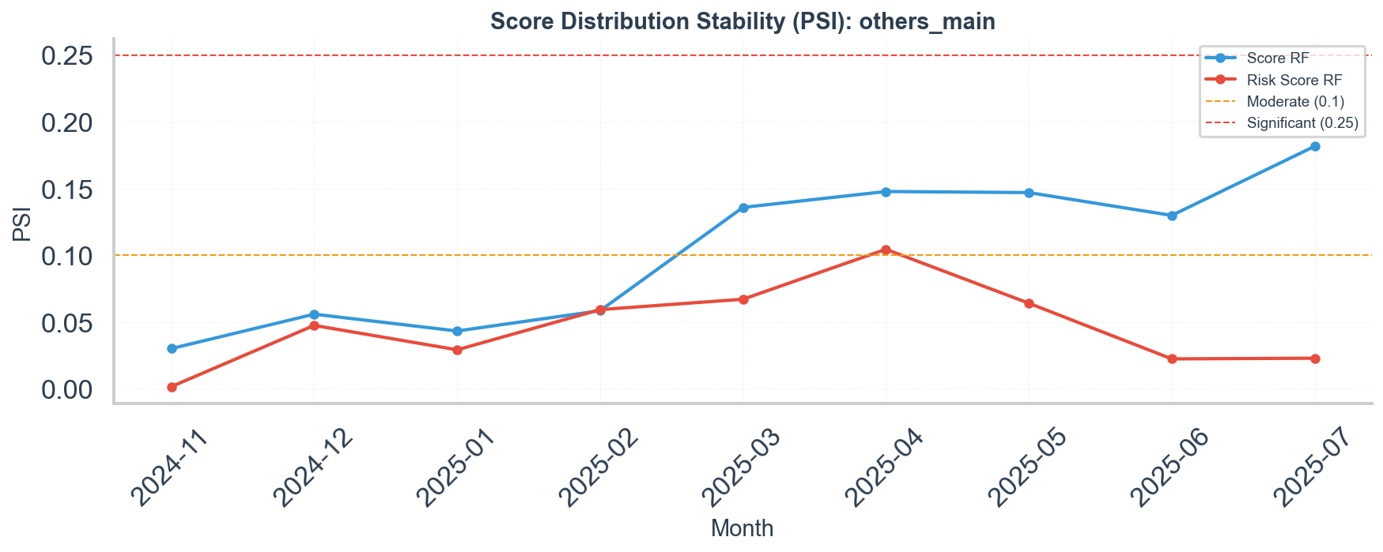
12. Score Stability (PSI): Others
Score RF: moderate shift (PSI 0.13-0.18 from Mar 2025). Population composition is changing.
Selection Bias Analysis
28 / 35

Slide 30
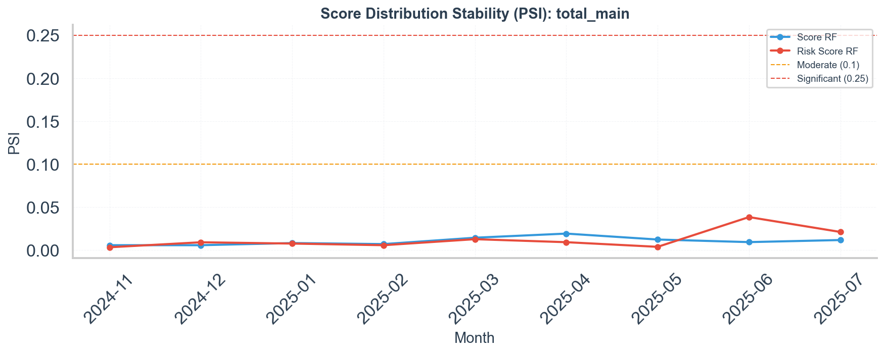
12. Score Stability (PSI): Total
Both scores stable at aggregate level (PSI < 0.04).
Selection Bias Analysis
29 / 35

Slide 31
Conclusions
Summary of findings and recommendations
Selection Bias Analysis
30 / 35

Slide 32
What Selection Bias Explains
•
Risk Score RF loses 14-19% of discriminance. Corrected Gini: 0.41-0.53 (Thorndike), 0.45-0.72 (RI).
•
Risk Score RF is truncated consistently (u = 0.79-0.85), even after isolating score-based rejections.
•
Score RF has very high Selection Gini (0.56-0.67) but low Outcome Gini -- power consumed by acceptance.
Selection Bias Analysis
31 / 35

Slide 33
What Selection Bias Does NOT Explain
•
Score RF's low Gini in 'known' (0.23): all corrections modest (Thorndike 0.25, RI 0.28). Weak ~4x bad-rate gradient.
•
Gap between scores: Risk Score RF outperforms even after corrections (RI 0.45 vs 0.28 in 'known').
•
Temporal instability: Score RF Gini varies 0.12-0.30 while PSI < 0.03 and acceptance stable.
•
Scores are weakly correlated (r ~ 0.25). Selection on one does not truncate the other.
Selection Bias Analysis
32 / 35

Slide 34
Recommendations
•
Interpret Risk Score RF with +20-60% correction when comparing to unrestricted benchmarks.
•
Score RF's low discriminance in 'known' is genuine -- investigate feature relevance / retraining.
•
Prefer Combined logistic score (Gini 0.37-0.64) for monitoring. Weak correlation confirms complementarity.
•
Monitor PSI monthly in 'others'. Moderate shift (PSI 0.13-0.18) may signal population drift.
•
Decompose by reject_reason before attributing low Gini to selection bias.
Selection Bias Analysis
33 / 35

Slide 35
Caveats and Limitations
•
Thorndike assumes bivariate normality. Corrections are approximate upper bounds.
•
RI Gini is circular: score informs both selection and imputation. Treat as upper bound.
•
early_bad only observed for booked. No direct unrestricted Gini is possible.
•
Cross-group scatter has 3 data points with heavy population confounding.
•
Temporal analysis limited by stable acceptance ('known') and small samples ('others').
Selection Bias Analysis
34 / 35

Slide 36
Thank You
12 analyses | 19 plots | Full methodology in selection_bias.md

