Slide 1

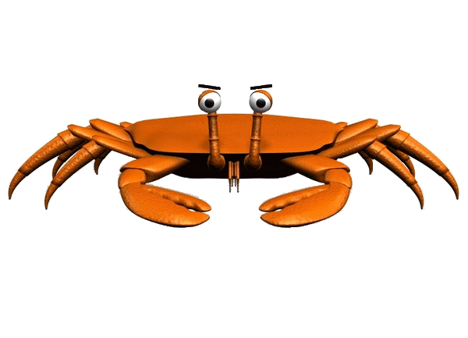

Computers and Neurons (and crabs)
Jannetta s. Steyn
Supervisors: Dr. Peter Andras,
Dr. Jennifer Hallinan

Slide 2

WARNING
This research might not be suitable for the faint of heart or vegetarians. Faint hearted vegetarians should seriously brace themselves if they decide to stay for this presentation.
Notes:
This research might not be suitable for the faint of heart or vegetarians. Faint hearted vegetarians should seriously brace themselves if they decide to stay for this presentation.

Slide 3
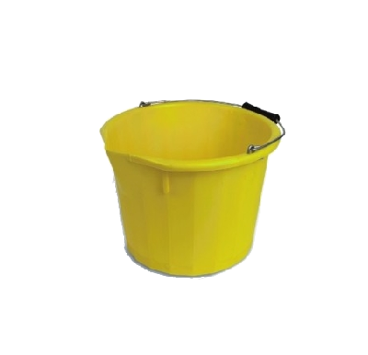
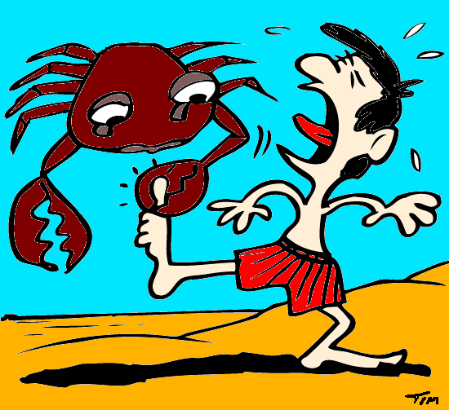
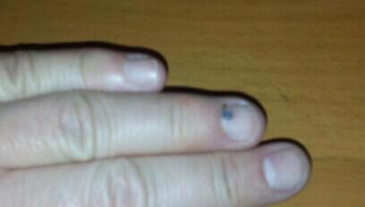
WARNING
Fig 1: Inconspicuous yellow bucket
!£$@$%*!”?
Fig 3: Violent Explosion of Vocabulary
Fig 2: Serious Injury
Notes:
That said; my research starts with a rather inconspicuous yellow bucket. However, once you reach into the bucket, things are not so innocent any more and could lead to serious injury which in turn could result into a violent explosion of vocabulary enhancements …

Slide 4
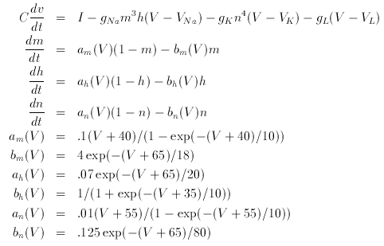
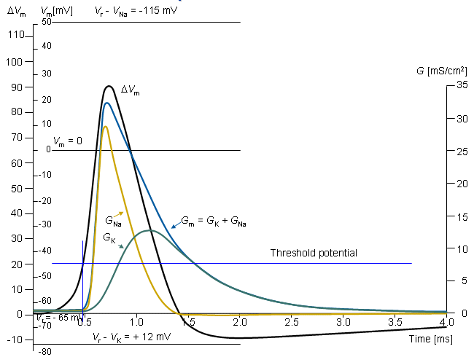
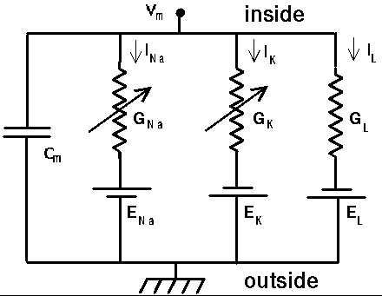
Neuroinformatics/ Computational Neuroscience
Notes:
Organisation and analysis of neuroscience data by the application of computational models and analytical tools. It links various disciplines such as computer science Mathematics, electrical engineering, physics etc.

Slide 5
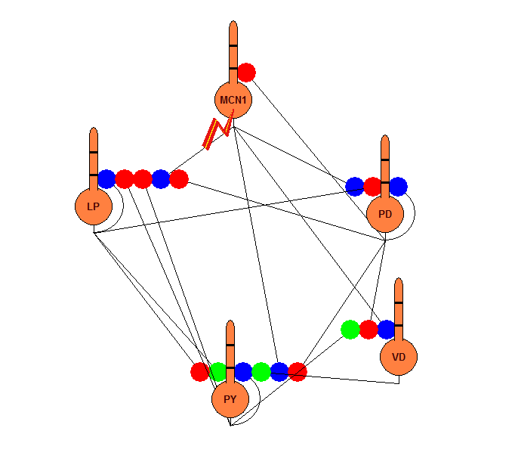
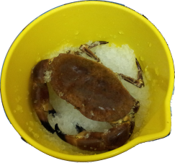
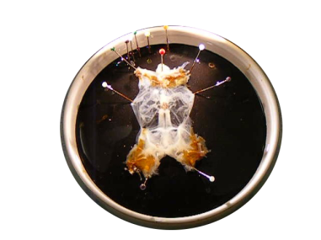
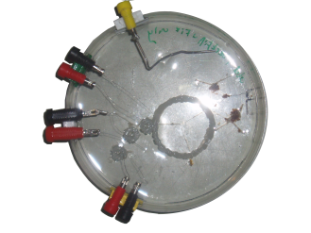
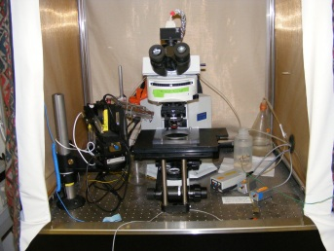
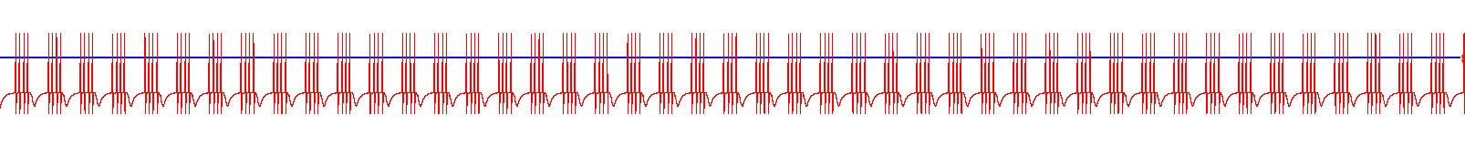
Overview
Notes:
If you liked disassembling things as a child, this is the research for you. We start by anaesthetising a crab on ice. The stomach is then removed and opened up to what resembles a cow hide. The stomatogastric nervous system is removed and placed on a petri dish. Vaseline wells are made into which electrodes can be placed. This gives us traces such as the yellow trace with the top trace being extra cellular and the bottom trace being intracellular. We then try and create models that resemble the biological systems.

Slide 6

Why
Crabs?
People won’t let me disassemble them
The crustacean Stomatogastric Ganglion (STG) is a well researched neural system about which we know many details
Contains two Central Pattern Generators.
The crab STG is almost flat, with large neurons and little overlap between them
Notes:
People won’t let me disassemble them
The STG is well know. All neurons are known as well as the connectome.
CPGs have rhythmic patterns – control automated rhythmic processes such as walking, swallowing, blinking.
The crab STG is almost flat, with large neurons and little overlap between them

Slide 7
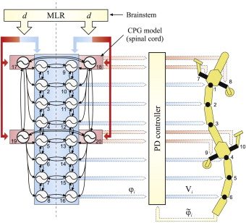
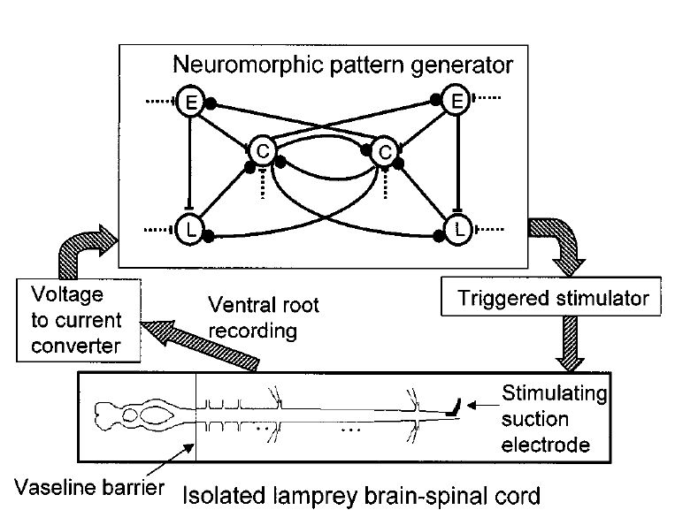
Why
Applications
Spinal Chord Injury
Parkinson’s Disease
Robotics
etc.
Salamander CPG model tested with an amphibious salamander-like robot.
Neuromorphic electronic circuit-spinal cord interface.
Auke Jan Ijspeert, Central pattern generators for locomotion control in animals and robots: A review, Neural Networks, Volume 21, Issue 4, May 2008, Pages 642-653
Jung, R., Brauer, E.J., Abbas J.J., Real-time interaction between a neuromorphic electronic circuit and the spinal cord, Neural Systems and Rehabilitation Engineering, IEEE, Volume 9, Issue 3, 2001, Pages 319-326
Notes:
There are applications for this research in spinal chord injury, diseases such as parkinson’s disease robotics etc. And then last but not the least you get Free Lunch!!

Slide 8
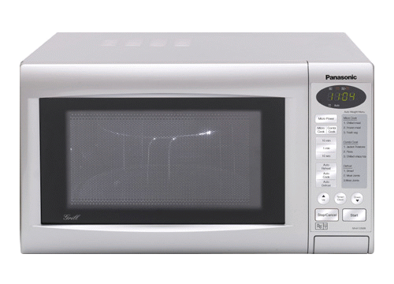
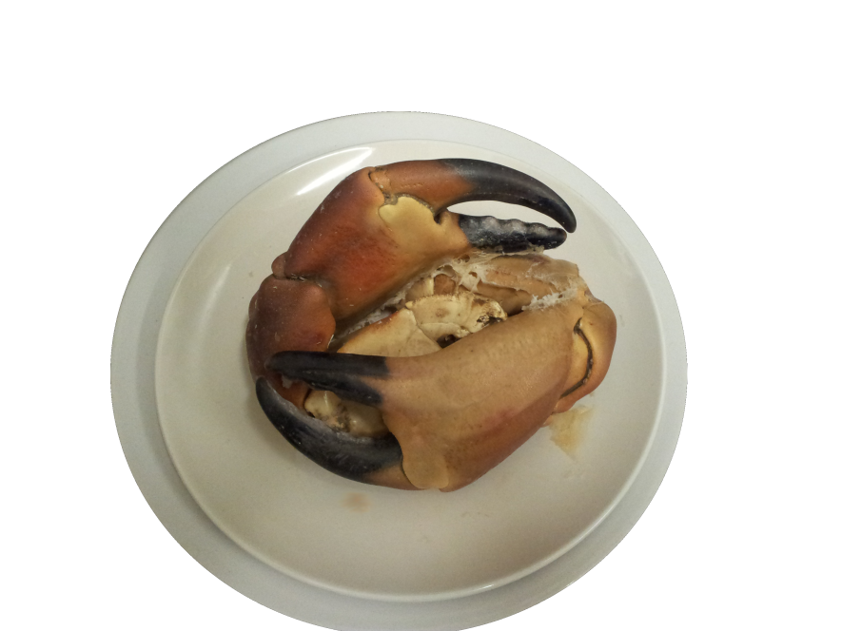
Lunch
Notes:
The best thing of all – you get free lunch

Slide 9
Computers and Neurons (and crabs)
Jannetta s. Steyn
Supervisors: Dr. Peter Andras,
Dr. Jennifer Hallinan

