Slide 1
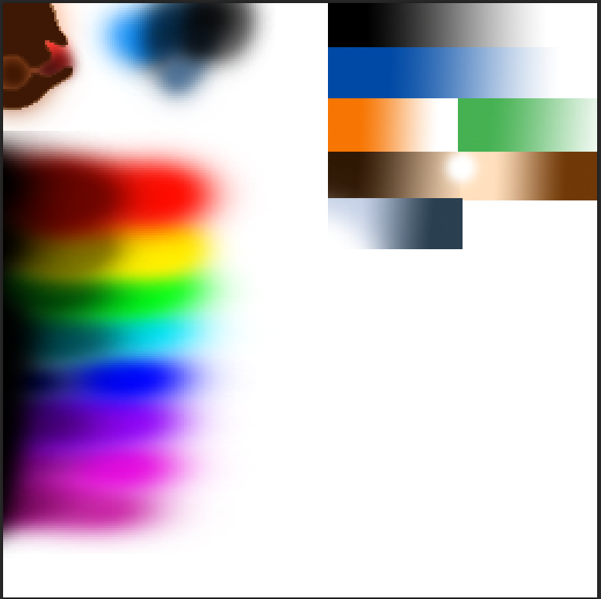
Skin color
Pants color
Hair color
Tshirt color
Beard color
Shoes color

