Slide 1
The Router Game
interactive session
Roberto Polli, Solutions Architect
EuroPython - Bilbao, 18.07.2016

Slide 2
Who? What? Why?
Roberto Polli - Solutions Architect @ par-tec.it. Loves writing in C, Java and Python. Red Hat Certified Engineer and Virtualization Administrator.
Par-Tec – Proud sponsor of this talk ;) provides expertise in IT Infrastructure & Services and Business Intelligence solutions + Vertical Applications for the financial market. Contributes to various FLOSS.
Play and learn the basics of a LAN
Notes:
HI everybody! My name is Roberto Polli, solutions architect @par-tec. I love writing free software and I got a couple of RH certification.
I'm very happy to be here - in a way or in an other ;) a concrete sign that pycon.it is more than a conference. It's community and friendship.
Before beginning I'd like to thank the proud sponsor of this talk - par-tec - that is present here with 4 people.
Par-Tec provides expertise in IT infrastructures, BI solutions and Applications for the financial market.

Slide 3
Agenda
Who? What? Why?
Communication basics: sender, receiver, media, broadcast and unicast
The hub game (no arp)
The switch game: a hub with a cache (no arp)
The IP protocol: ARP ties MAC and IP
The router game
Notes:
Today I'll speak about using tox to document projects with code.
We'll start introducing CI and how it's addressed in the java world, which includes an overview on project description.
Then we'll show how to isolate python projects with virtualenv and how to use tox for testing and project description: from python versions, to dependencies and code style.
Finally a fast glance on using tox with Docker and Jenkins and an example of a travis.io file.

Slide 4




Communication 101
Communication is made of ...
Sender, Receiver
Medium
Content
Adapt content to the medium (identification, encapsulation, fragmentation & co)
Notes:
CI is the practice of merging developer works several times a day.
All this merge work requires “runnable” project descriptions, and a high degree of isolation, so that every step is reproducible and deterministic.
We should test automatically that the “merge” works.

Slide 5
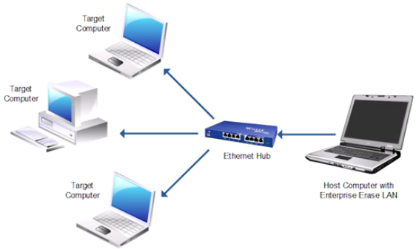
Between two computers
Medium Access Control
Anatomy of a MAC address
hub broadcasts everything
Notes:
CI is the practice of merging developer works several times a day.
All this merge work requires “runnable” project descriptions, and a high degree of isolation, so that every step is reproducible and deterministic.
We should test automatically that the “merge” works.

Slide 6
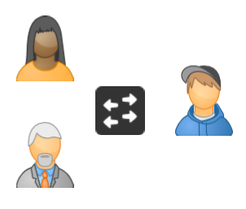
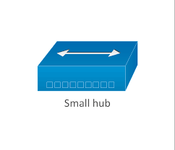
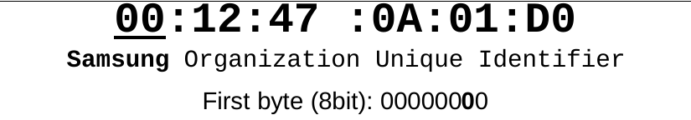
The hub game
Create teams of 4 people:
  3 devices
  1 hub
Each device is given a MAC address
Each team is given many message flyers
Notes:
CI is the practice of merging developer works several times a day.
All this merge work requires “runnable” project descriptions, and a high degree of isolation, so that every step is reproducible and deterministic.
We should test automatically that the “merge” works.

Slide 7
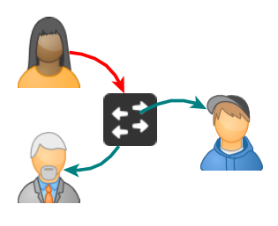
The hub game - 5 minutes
Send message to the other players connected to the hub.
Write the receiver and the sender MAC address on the flyer and give it to the hub.
The hub writes down and delivers a copy of the message for each connected device.
Notes:
CI is the practice of merging developer works several times a day.
All this merge work requires “runnable” project descriptions, and a high degree of isolation, so that every step is reproducible and deterministic.
We should test automatically that the “merge” works.

Slide 8
The hub game - questions
Did you cheat in some way?
Does this approach scale?
Which are the issues?
Notes:
CI is the practice of merging developer works several times a day.
All this merge work requires “runnable” project descriptions, and a high degree of isolation, so that every step is reproducible and deterministic.
We should test automatically that the “merge” works.

Slide 9
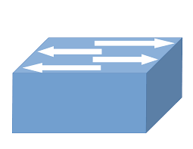
The switch game
Switch = Hub + Cache
Reduce flooding (broadcast)
Improve privacy
Topology 1
  1 switch, 4 devices
Topology 2
  1 switch, 1 hub with 4 devices each
Notes:
CI is the practice of merging developer works several times a day.
All this merge work requires “runnable” project descriptions, and a high degree of isolation, so that every step is reproducible and deterministic.
We should test automatically that the “merge” works.

Slide 10
IP Addresses
L2 networks
  subject to flooding even with switches
  require direct visibility
The IP protocol improves separation
L3 packets are encapsulated into L2 frames
IP can change, MAC is fixed
ARP allows IP address discovery
Notes:
CI is the practice of merging developer works several times a day.
All this merge work requires “runnable” project descriptions, and a high degree of isolation, so that every step is reproducible and deterministic.
We should test automatically that the “merge” works.

Slide 11
ARP Guesswork
Every team should try to re-invent an ARP protocol
Topology 1
  1 switch, 1 hub with 3 devices each
  exchange IP messages
Notes:
CI is the practice of merging developer works several times a day.
All this merge work requires “runnable” project descriptions, and a high degree of isolation, so that every step is reproducible and deterministic.
We should test automatically that the “merge” works.

Slide 12
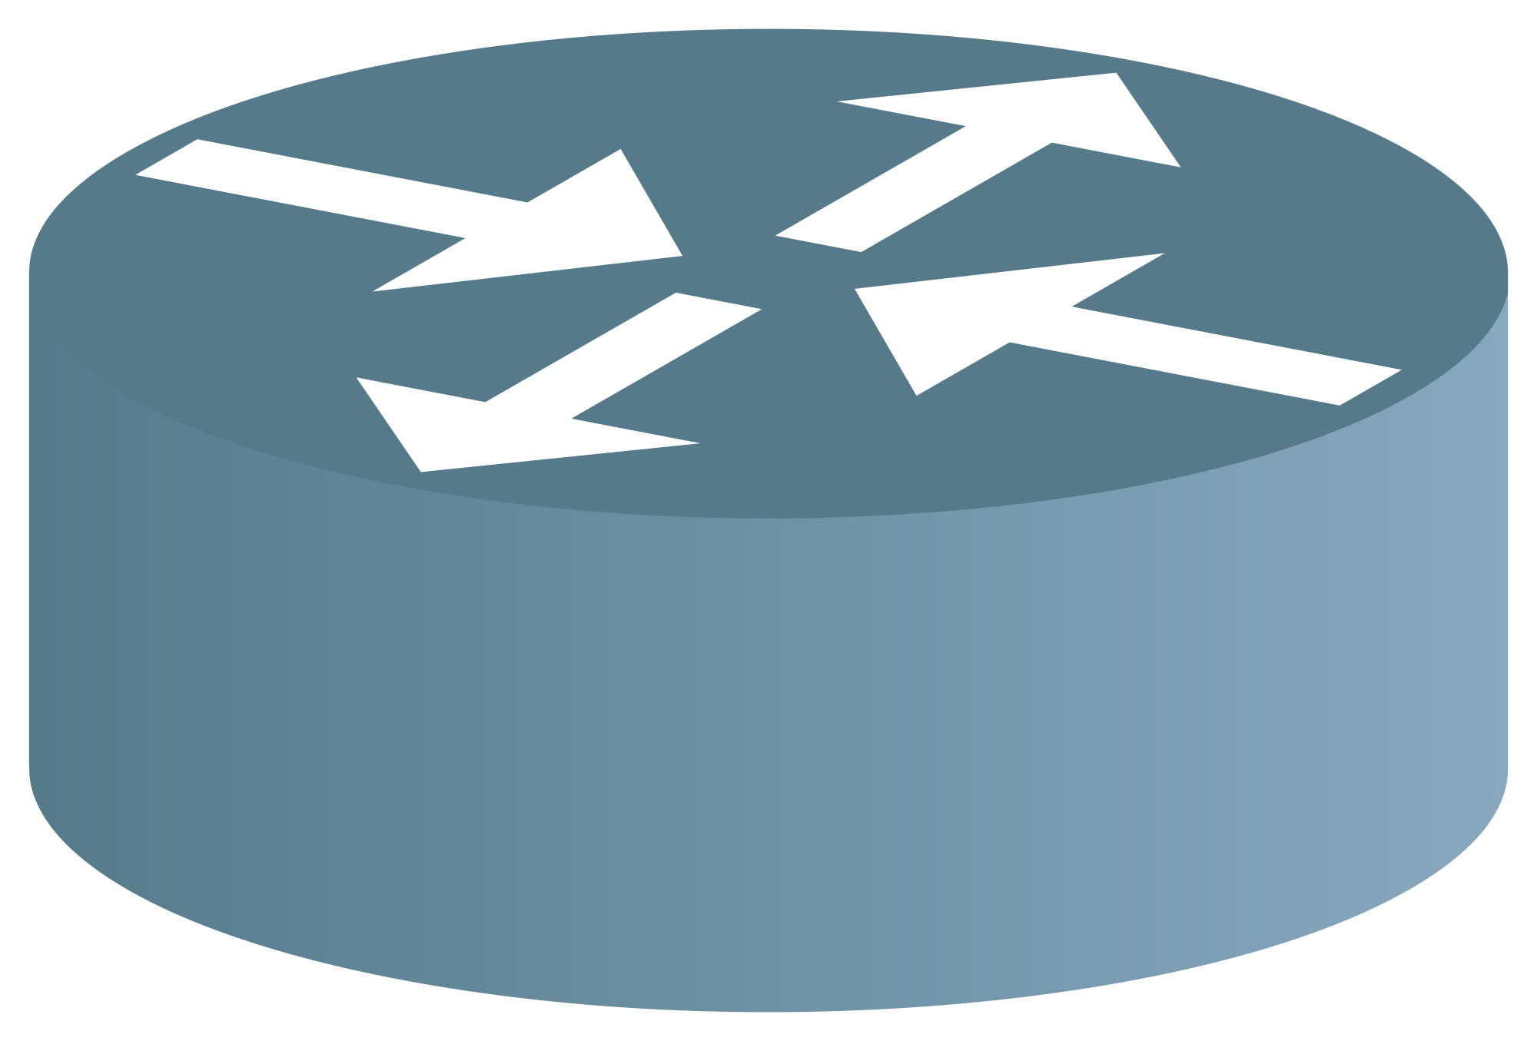
Routing
ARP discovery works only if devices are L2-visible
Different networks communicates via routers
Switches maps MAC addresses to ports
Routers maps ip ranges to ports
Notes:
CI is the practice of merging developer works several times a day.
All this merge work requires “runnable” project descriptions, and a high degree of isolation, so that every step is reproducible and deterministic.
We should test automatically that the “merge” works.

Slide 13

Routing
Topology 1
  2 switches connected to a router
  4 devices for each switch
10.0.1.0/24
A B
10.0.2.0/24
Notes:
CI is the practice of merging developer works several times a day.
All this merge work requires “runnable” project descriptions, and a high degree of isolation, so that every step is reproducible and deterministic.
We should test automatically that the “merge” works.

Slide 14
Wrap up
There's more than meets the eye with IP addresses
Hubs are prone to flooding, a cache can fix it
Switches are smarter hubs, cache should be maintained and sometimes secured against spoofing.
As the LAN grows, flooding remains an issue due to arp discovery, this is usually true even for vlan: at a certain point you have to segment your network and use routing
Sending to a router means sending an L3 packet with a different L2 destination

Slide 15
Thank you!
roberto.polli@par-tec.it

