Slide 1
EE254/DP274
Engineering Electromagnetics II
Notes:
In Semester 1, the discussion was restricted to static or time invariant EM fields.
In static EM fields, electric and magnetic fields are independent of each other.
In this semester, the focus is on dynamic or time-varying EM fields.

Slide 2
Mode of Delivery
Course Weight: 2 Units
Lecture: 2 hours per week (Tuesday, 07:00-08:55 hrs)
Tutorial: 1 hour per week (Monday, 11:00-11:55 hrs)
Prerequisite: EE253/DP273
Course Assessment:
Test One (20%)
Test Two (20%)
University Exam (60%)
Course Instructor: Prof. B. M. Mwinyiwiwa, Omary, Prisca

Slide 3
Course Outline
Introduction to Time Varying EM Fields
Maxwell’s equations
Wave equation
Power flow in electromagnetic wave propagation
Plane waves at media boundaries
Transmission Lines and Waveguides
Transmission Line Parameters and Line Equations
Input impedance, SWR and Power
Smith Chart
Applications of Transmission Lines
Waveguides
Notes:
In this semester, the focus is on dynamic or time-varying EM fields.
In dynamic fields, the two fields are interdependent. That is a time varying electric field necessarily involves a time-varying magnetic field
Additionally, time-varying EM fields are of more practical value than static EM fields.

Slide 4
Course Outline
Antennas
Common Antenna Types
Antenna Radiation Analysis
Antenna Characteristics
Effective Area and Friis Equation
Radar Equation

Slide 5
Text/Reference Books
Hayt, W. H., “Engineering Electromagnetics”, 8th edition, McGraw Hill Book Company, 2012.
Edminister, J. A., “Engineering Electromagnetics”, second edition, McGraw-Hill Book Company, 1994.
Wangsness, R. K., “Electromagnetic Fields”, second edition, John Wiley and Sons Book Company, 2004.

Slide 6
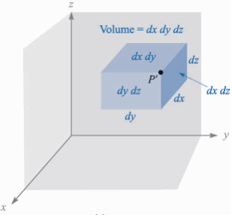
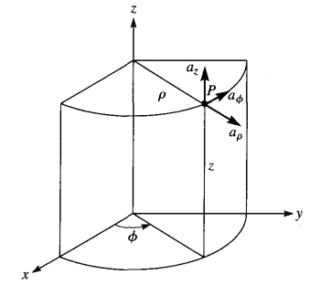
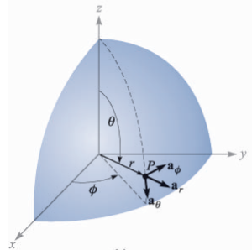
Semester I Recap…
Coordinate system transformation
Cartesian
Cylindrical
Spherical

Slide 7
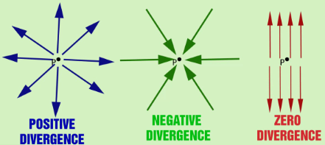
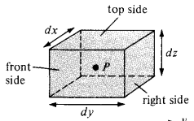

Semester I Recap…
Divergence of a vector field:
Is the outflow of flux from a small closed surface per unit volume as the volume shrinks to zero
$$Divergence of A=divA=\lim_{∆ν→0}{\frac{\oint_{s}{A∙dS}}{∆ν}}$$
Notes:
Is a measure of how much the field diverges or emanates from a point.
Divergence merely tells us how much flux is leaving the small volume on a per-unit-volume basis, no direction is associated with it.
It can also be viewed as simply the limit of the field’s source strength per unit volume (source density)

Slide 8
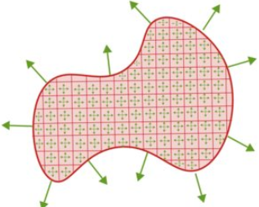
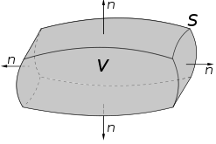
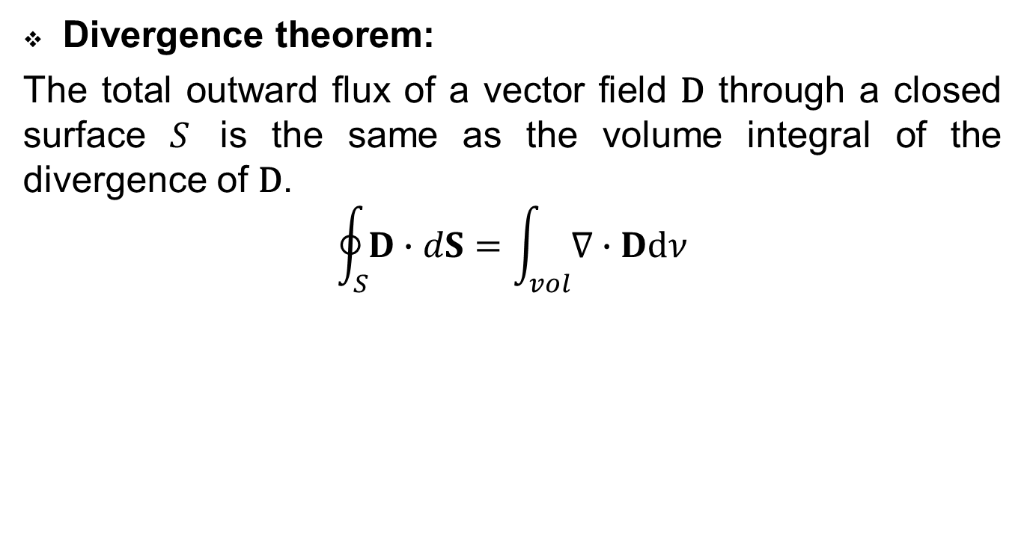
Semester I Recap…
Divergence theorem:
The total outward flux of a vector field $\text{D}$ through a closed surface $S$ is the same as the volume integral of the divergence of $\text{D}$.
$$\oint_{S}{D∙dS}=\int_{vol}{\text{∇}∙Ddν}$$
Notes:
Divergence theorem helps us to transform surface integral to a volume integral (and vice versa)
Usually volume integrals are easier to evaluate than surface integrals.
For this reason, to determine the flux of a vector field D though a closed surface we simply prefer the RHS of the equation.

Slide 9
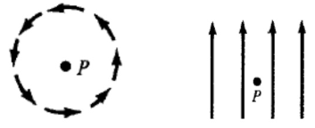
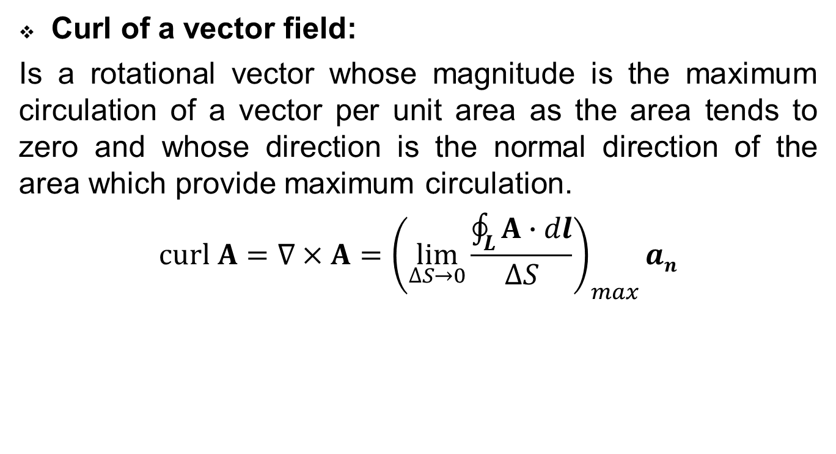
Semester I Recap…
Curl of a vector field:
Is a rotational vector whose magnitude is the maximum circulation of a vector per unit area as the area tends to zero and whose direction is the normal direction of the area which provide maximum circulation.
$$curl A=\text{∇}×A={\left(\lim_{∆S→0}\frac{\oint_{L}{A∙dl}}{∆S}\right)}_{max}an$$
Notes:
The curl of a vector field at a point P may be regarded as the measure of the circulation/rotation or how much the field curls around P.
It provides maximum value of the circulation (line integral) of the field per unit area, and indicates the direction along which this maximum value occurs.
Curl/Rotation can be used to measure the uniformity of the field, the more non-uniform the field, the larger the value of curl
Divergence of the curl of a vector field vanishes. That is div(curl (A)) = 0

Slide 10
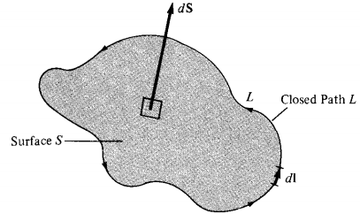
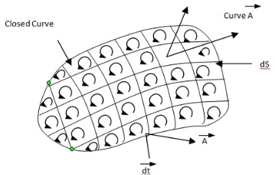

Semester I Recap…
Stokes’ Theorem:
The circulation of a vector field A around a closed path L is equal to the surface integral of the curl of A over the open surface S bounded by L.
$$\oint_{L}{Α∙dl=\int_{S}{\left(\text{∇}×Α\right)∙dS}}$$
Notes:
Stokes theorem enables us to transform line integral of the vector field to surface integral.
Stokes’ theorem relates a line integral (circulation) to a surface integral

Slide 11
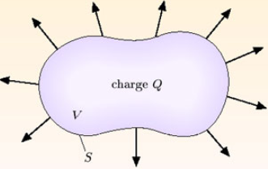
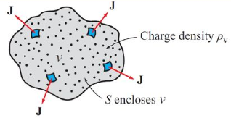

Semester I Recap…
Continuity Equation:
The net outward current flow through a closed surface must be equal to the time rate of decrease of charge within a volume.
$Ι=\oint_{s}{J∙dS=−\frac{d𝓠in}{dt}}$ (a)
Notes:
Principle of conservation of charge requires that, charges can neither be created not destroyed
Although equal amounts of +ve and –ve charges may be simultaneously created, obtained by separation or lost be recombination
The outward flow of current (charges) must be balanced by an equal decrease of +ve charges

Slide 12
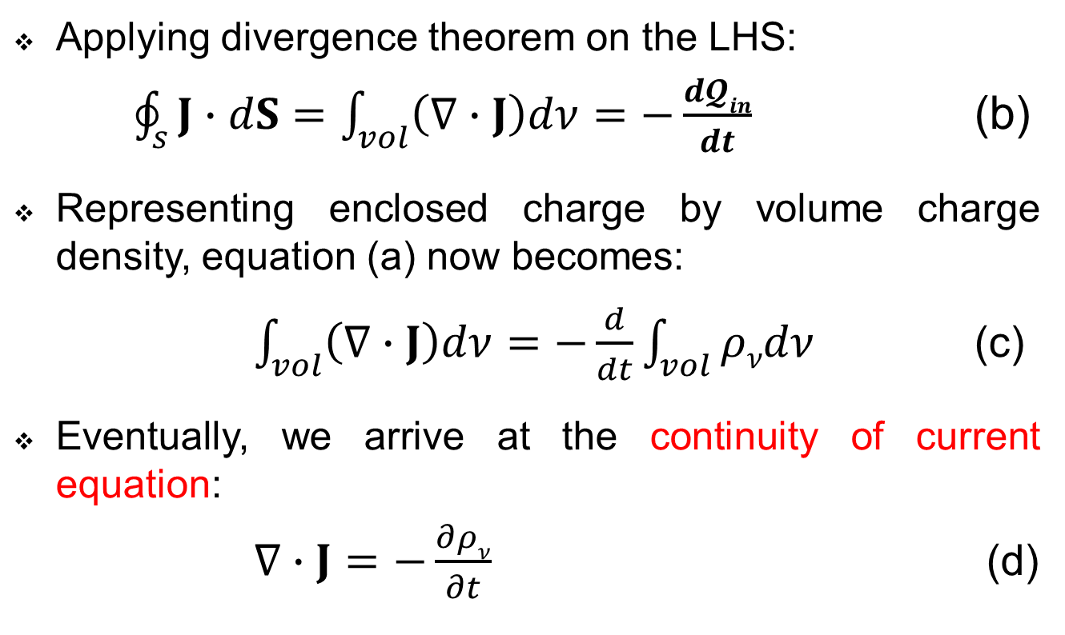
Semester I Recap…
Applying divergence theorem on the LHS:
$\oint_{s}{J∙dS=\int_{vol}{\left(\text{∇}∙J\right)dν}=−\frac{d𝓠in}{dt}}$ (b)
Representing enclosed charge by volume charge density, equation (a) now becomes:
$\int_{vol}{\left(\text{∇}∙J\right)dν=−\frac{d}{dt}\int_{vol}{ρνdν}}$ (c)
Eventually, we arrive at the continuity of current equation:
$\text{∇}∙J=−\frac{∂ρν}{∂t}$ (d)
Notes:
If we agree to keep the surface constant, the derivatives become a partial derivative and may appear within the integral
Continuity equation indicates that, current/charge diverging from a small volume is equal to the time rate of decrease of charge per unit volume at every point
The equation is derived from the principle of conservation of charge, and essentially states that there can be no accumulation of charges at any point.
For steady currents, ${∂ρv}/{∂t=0}$ and hence $∇∙J=0$, showing that the total charge leaving the volume is the same the total charge entering it (Kirchhoff's current law).

Slide 13
Semester I Recap…
Electro-statics
Coulomb’s law
Gauss’ law
Magneto-statics
Biot-Savart Law
Ampere’s circuital law
Boundary conditions for EM fields

