Slide 1


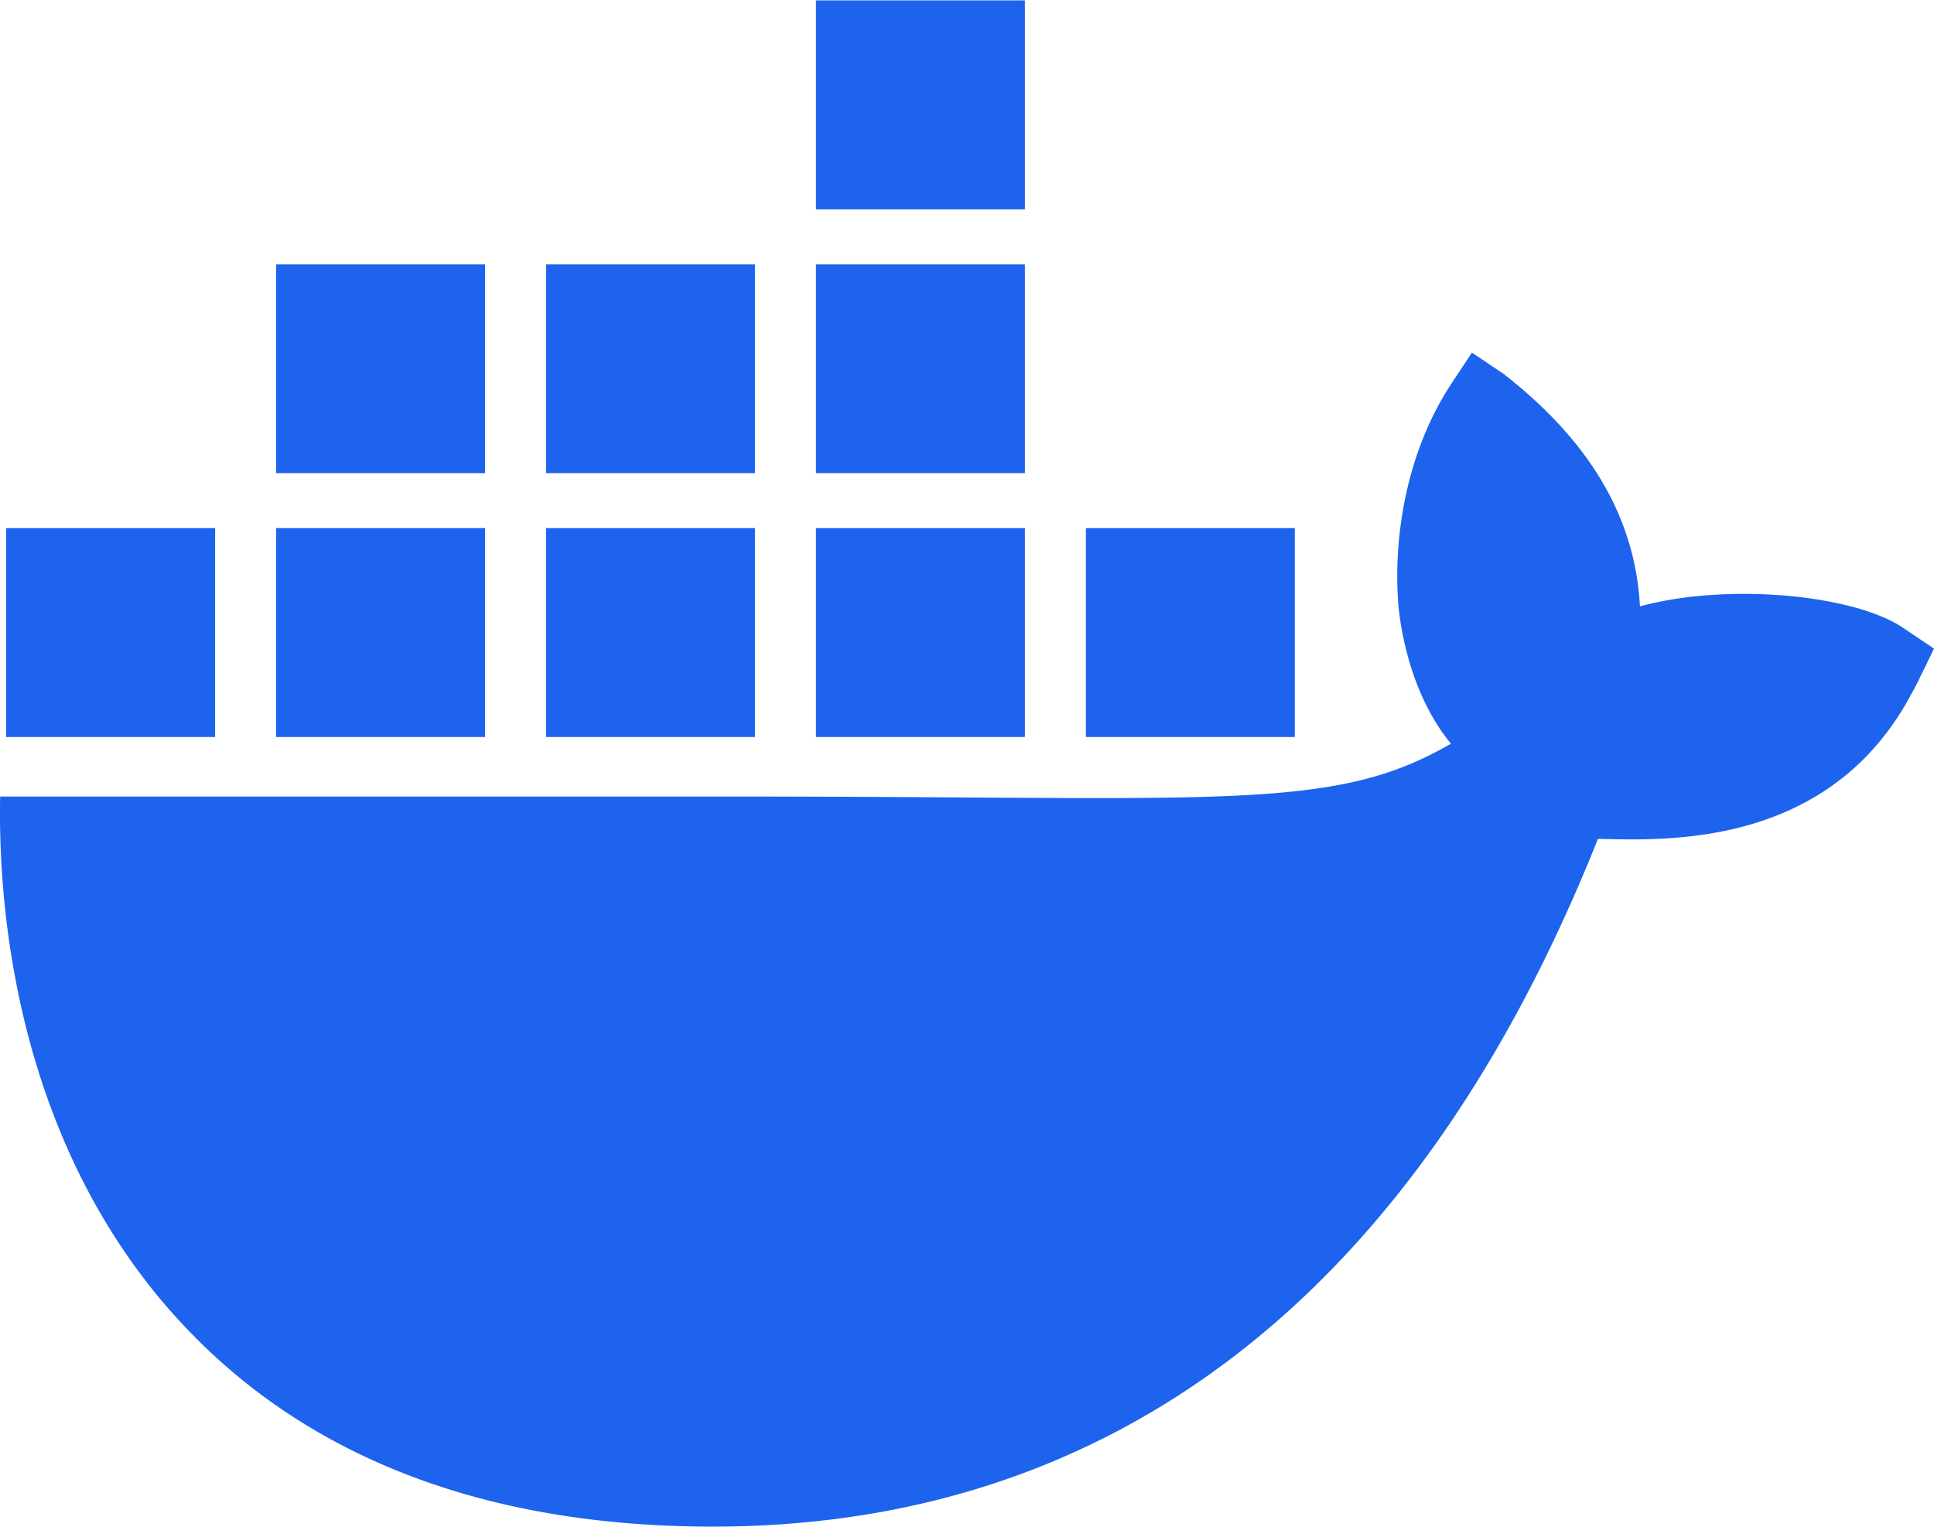

Resource Group
Container Apps Environment
Containers App
LiteLLM Docker Container
Azure Database for PostgreSQL
LiteLLM Database

