Slide 1
Using data to counter cognitive biais
How accurate are our views of the world?

Slide 2
The questions you just replied to were selected because…
Most people are wrong about them!
Their responses illustrate how cognitive bias can take us away from factual truth!
Generalization
Binary Thinking
Manifest Destiny
Single Perspective
Fear Factor
Exaggeration
Dramatization
In average, the respondent in this group got only 57% of the questions correct!

Slide 3
Bias 1: Generalization
Making broad assumptions based on limited information, which can lead to stereotypes or misconceptions.
Sample Representation: Is our sample representative of the entire population we’re studying? Are there any groups that are underrepresented or over-represented?
In all low-income countries across the world today, how many girls finish
primary school?
Assumptions about gender and education in low-income countries can lead people to
generalize negatively, without accounting for real improvements.
40 percent
50.0%
60 percent
33.3%
20 percent
16.7%
0%
10%
20%
30%
40%
50%
Answers (% from total response) from XXXX.
The green bar represent the correct answer and its average percentage within the survey sample from Gapminder

Slide 4
Bias 2: Binary Thinking
The tendency to divide things into two opposing groups, often assuming a huge gap exists between them, like rich and poor, or good and bad.
Distribution Analysis: Are we analyzing the full distribution of our data rather than just focusing on the extremes?
Where does most of the world population live?
The cliché of “developed” Vs “developing” countries prevents us to realise that most of
the world’s population lives in middle-income countries, not in “rich” or “poor” nations.
Middle-income countries
50.0%
Low-income countries
50.0%
0%
10%
20%
30%
40%
50%
Answers (% from total response) from XXXX.
The green bar represent the correct answer and its average percentage within the survey sample from Gapminder

Slide 5
Bias 3: Manifest Destiny
Believing that certain characteristics, traits or condition are unchangeable and destined to remain the same over time.
Remember that change happens: Avoid thinking in terms of “manifest destiny” by looking for signs of transformation in data over time. Cultures, countries, and people can and do change.
In the last 20 years, the proportion of the world population living in extreme
poverty has…
Many believe that poverty levels are static or worsening, reflecting a view that it’s a
permanent condition, whereas poverty has been declining steadily.
Almost halved
33.3%
Remained more or less the same
33.3%
Almost doubled
33.3%
0%
10%
20%
30%

Slide 6
Bias 4: Single Perspective
Being overly focused on one point of view can simplify complex decisions, but it can also lead to a narrow understanding of issues.
Alternative Hypotheses: Have we explored alternative hypotheses and explanations for our findings? Use multiple perspectives and with different viewpoints to avoid narrow thinking
What is the life expectancy of the world today?
Focusing on isolated challengesand specific issues can lead people to miss broader global
health gains that have improved life expectancy overall.
70 years
66.7%
60 years
33.3%
0%
20%
40%
60%
Answers (% from total response) from XXXX.
The green bar represent the correct answer and its average percentage within the survey sample from Gapminder

Slide 7
Bias 5: Fear Factor
Focusing on things that seem dangerous skews our perception of what is risky. Constant exposure to frightening news stories heightens a sense of immediate threat.
Likelihood vs. Impact: Are we balancing the likelihood of a risk with its potential impact to make sure we’re not overestimating its significance?
How did the number of deaths per year from natural disasters change over the
last hundred years?
As most societies have gotten much richer, they have become better at predicting disasters
and huge resources have been invested in preparing for them.
Decreased to less than half
83.3%
More than doubled
16.7%
0%
20%
40%
60%
80%

Slide 8
Bias 6: Exaggeration
Overestimating the importance of single, isolated, individual figures without putting them into context and pay attention to the size or scale of things.
Always get things in proportion: Instead of looking at large figures in isolation, contextualize numbers to understand their true size and avoid overreaction to single, out-of-context statistics.
How many of the world’s 1-year-old children today have been vaccinated against
some disease?
People often underestimate vaccination rates, focusing on isolated cases or regions
without seeing the global trend that a high percentage of children are vaccinated.
80 percent
83.3%
20 percent
16.7%
0%
20%
40%
60%
80%
Answers (% from total response) from XXXX.
The green bar represent the correct answer and its average percentage within the survey sample from Gapminder

Slide 9
Bias 7: Dramatization
We tend to neglect success and conform to “white knight” or “missionary syndrom” stereotype. In addition, when believing that humans have no chance of protecting themselves, we might step back from our responsibility to help.
Watch for your own personal and professional bias: When working on a specific subject, we may tend to focus mostly on the bad side of things.
In 1996, tigers, giant pandas, and black rhinos were all listed as endangered.
How many of these three species are more critically endangered today?
Conservation can work! Learning from - rather than neglecting - successes can actually
drive more and better Nature protection
Two of them
66.7%
None of them
16.7%
One of them
16.7%
0%
20%
40%
60%
Answers (% from total response) from XXXX.
The green bar represent the correct answer and its average percentage within the survey sample from Gapminder

Slide 10
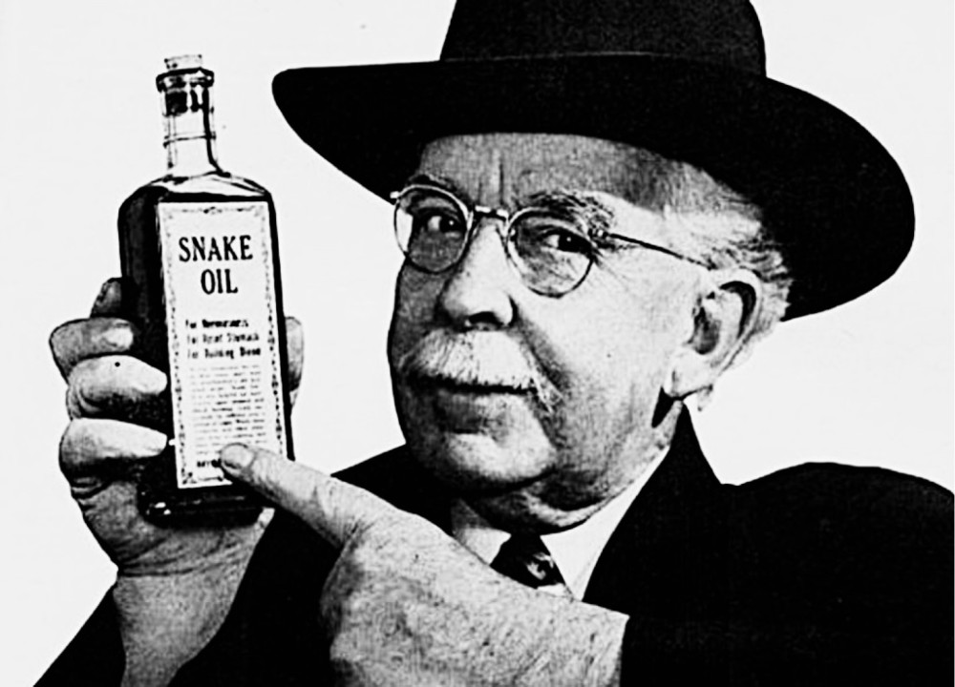
Truth without Evidence: Quackery & the Pure Food and Drug Act of 1906

Slide 11
Take-away: Data Insights are to elevate our own perception
After this session:
You understand the extent of human biases in decision making
You have seen examples of when they are likely to appear
You have some rules of thumb and approaches to address them
You know that challenging an assumption with data can have a significant impact
You are aware that getting this right will impact IOM capacity to generate outcomes

