Slide 1

Global Profiles for Internal Displacements (GPID)
Harmonised demographic, socio-economic, and land use contexts for 349 million internal displacements worldwide
Methodology, analysis, and visualisation: https://dtm.iom.int/global-profiles-for-internal-displacement/gpid/index.html
Data download: https://data.humdata.org/dataset/iom-global-profiles-for-internal-displacement-gpid

Slide 2
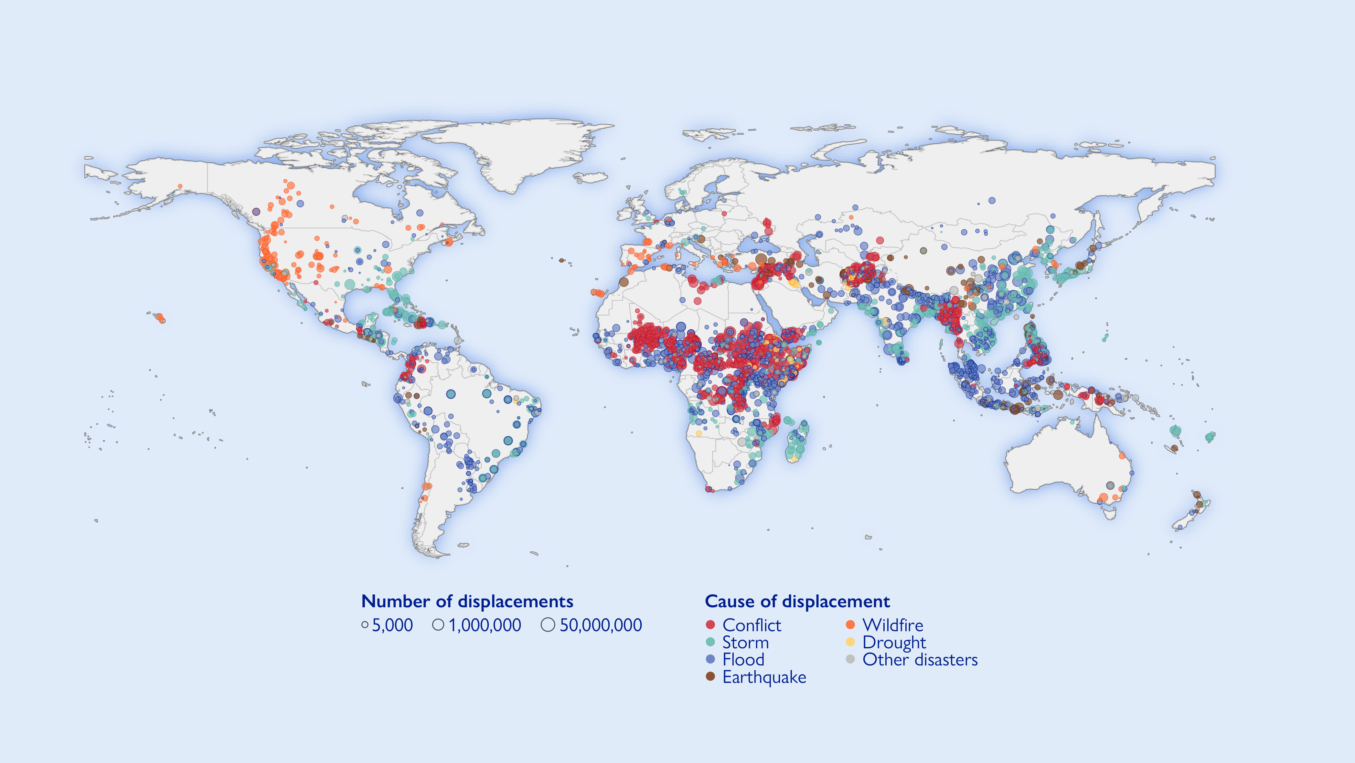
Internal displacements worldwide (2018–2024)
Internal displacements occur in all parts of the world, though, some are more affected than others.
Source: Internal Displacement Monitoring Centre

Slide 3
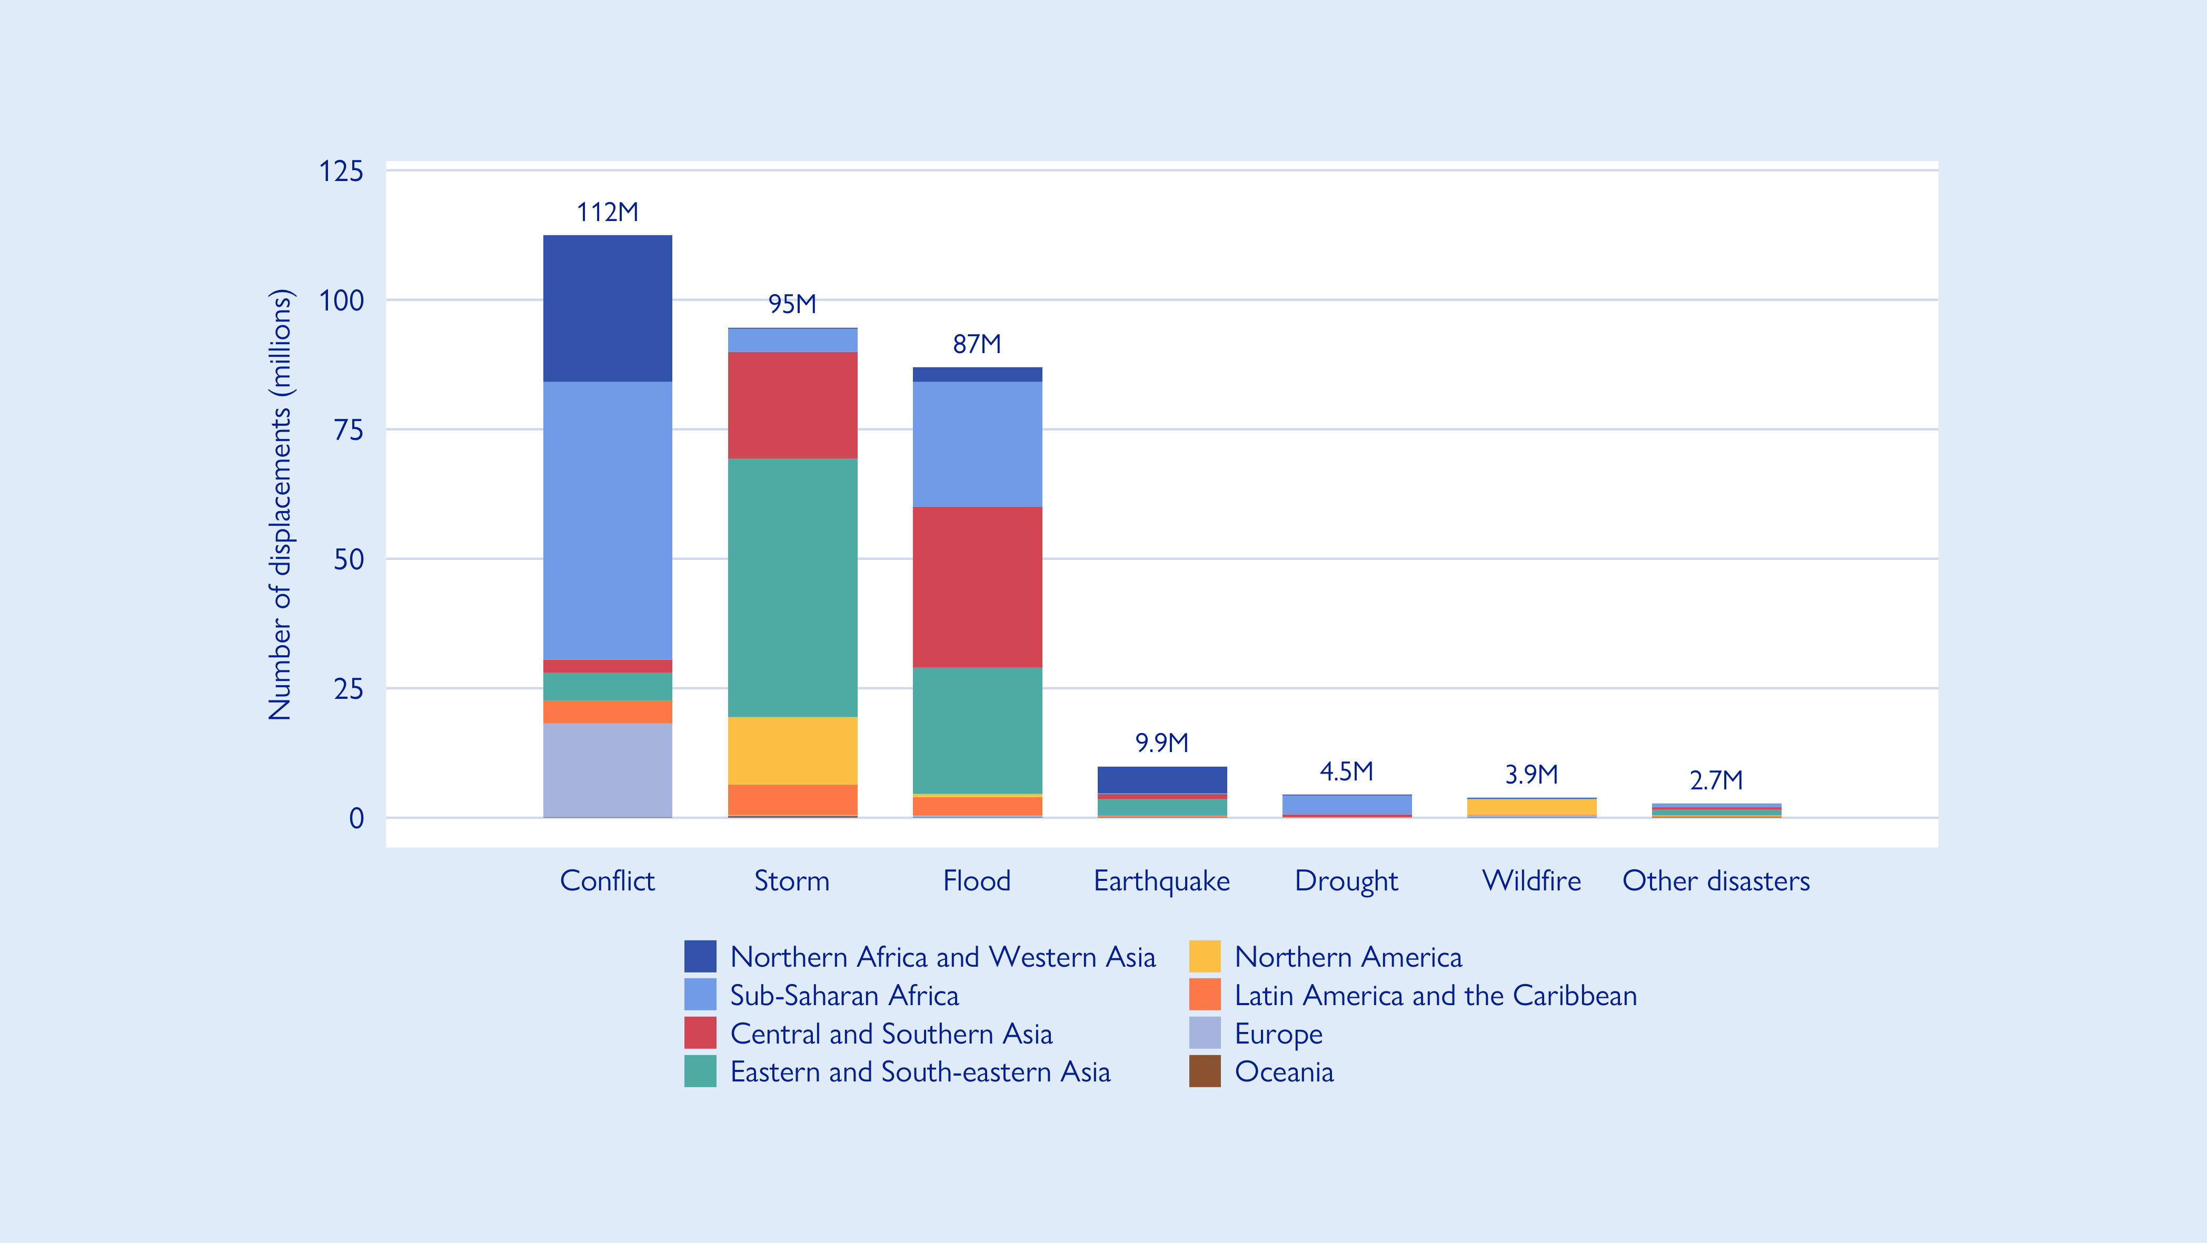
Displacements by cause and geographic region (2018–2024)
Storms caused 30% of internal displacements worldwide in 2018–2024. 52% of all storm displacements occurred in Eastern and South-eastern Asia.
Floods caused 28% of internal displace-ments worldwide in 2018–2024.
Earthquakes, wildfires, droughts, and other disasters caused 3.1%, 1.4%, 1.2%, and 0.8%, respectively, of internal displacements in 2018–2024.
Conflict and violence caused 36% of internal displacements worldwide in 2018–2024. 48% of conflict displacements occurred in Sub-Saharan Africa,
Source: Internal Displacement Monitoring Centre

Slide 4
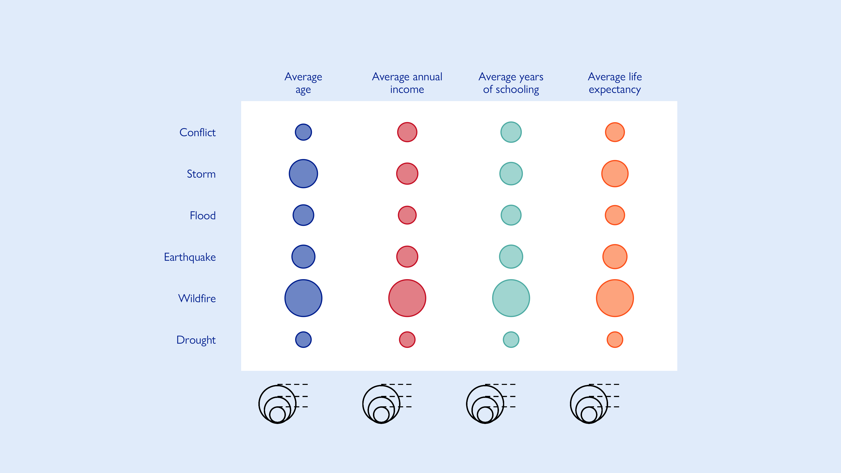
Demographic and socio-economic profiles of populations in areas of displacement by cause
Along with drought, populations in areas of conflict displace-ment are disproportionally young, with an average age of only 19.6 years.
Populations in areas of wildfire displacement are overall the least vulnerable, with an average 35.7 years age, $79,000 annual income, 12.6 schooling years, and 79.8 years life expectancy.
Populations in areas of drought displacement are overall the most vulnerable, with an average 18.0 years age, $2,400 annual income, 3.0 schooling years, and 61.0 years life expectancy.
35.7
79,200
13.3
80.1
26.9
40,800
8.0
71.3
18.0
2,400
2.6
62.5
Years
U.S. dollars
Years
Years

Slide 5
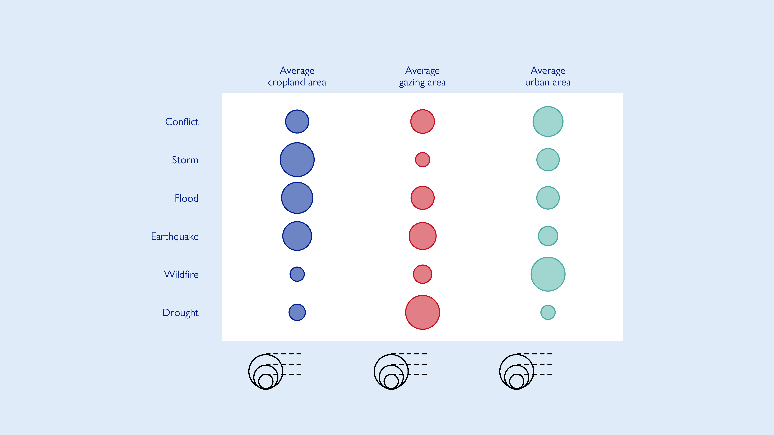
Land use profiles of populations in areas of displacement by cause
Conflict and wildfire displacement most strongly impact urban populations
Storm and flood displace-ment most heavily impact farming populations, with 44% and 36%, respectively, of land in relevant displacement areas being used for crops.
Drought displacement disproportionally affect pastoral communities
51.9
40.5
75.6
28.3
22.5
38.2
4.7
4.5
0.8
Per cent of local area
Per cent of local area
Per cent of local area

Slide 6
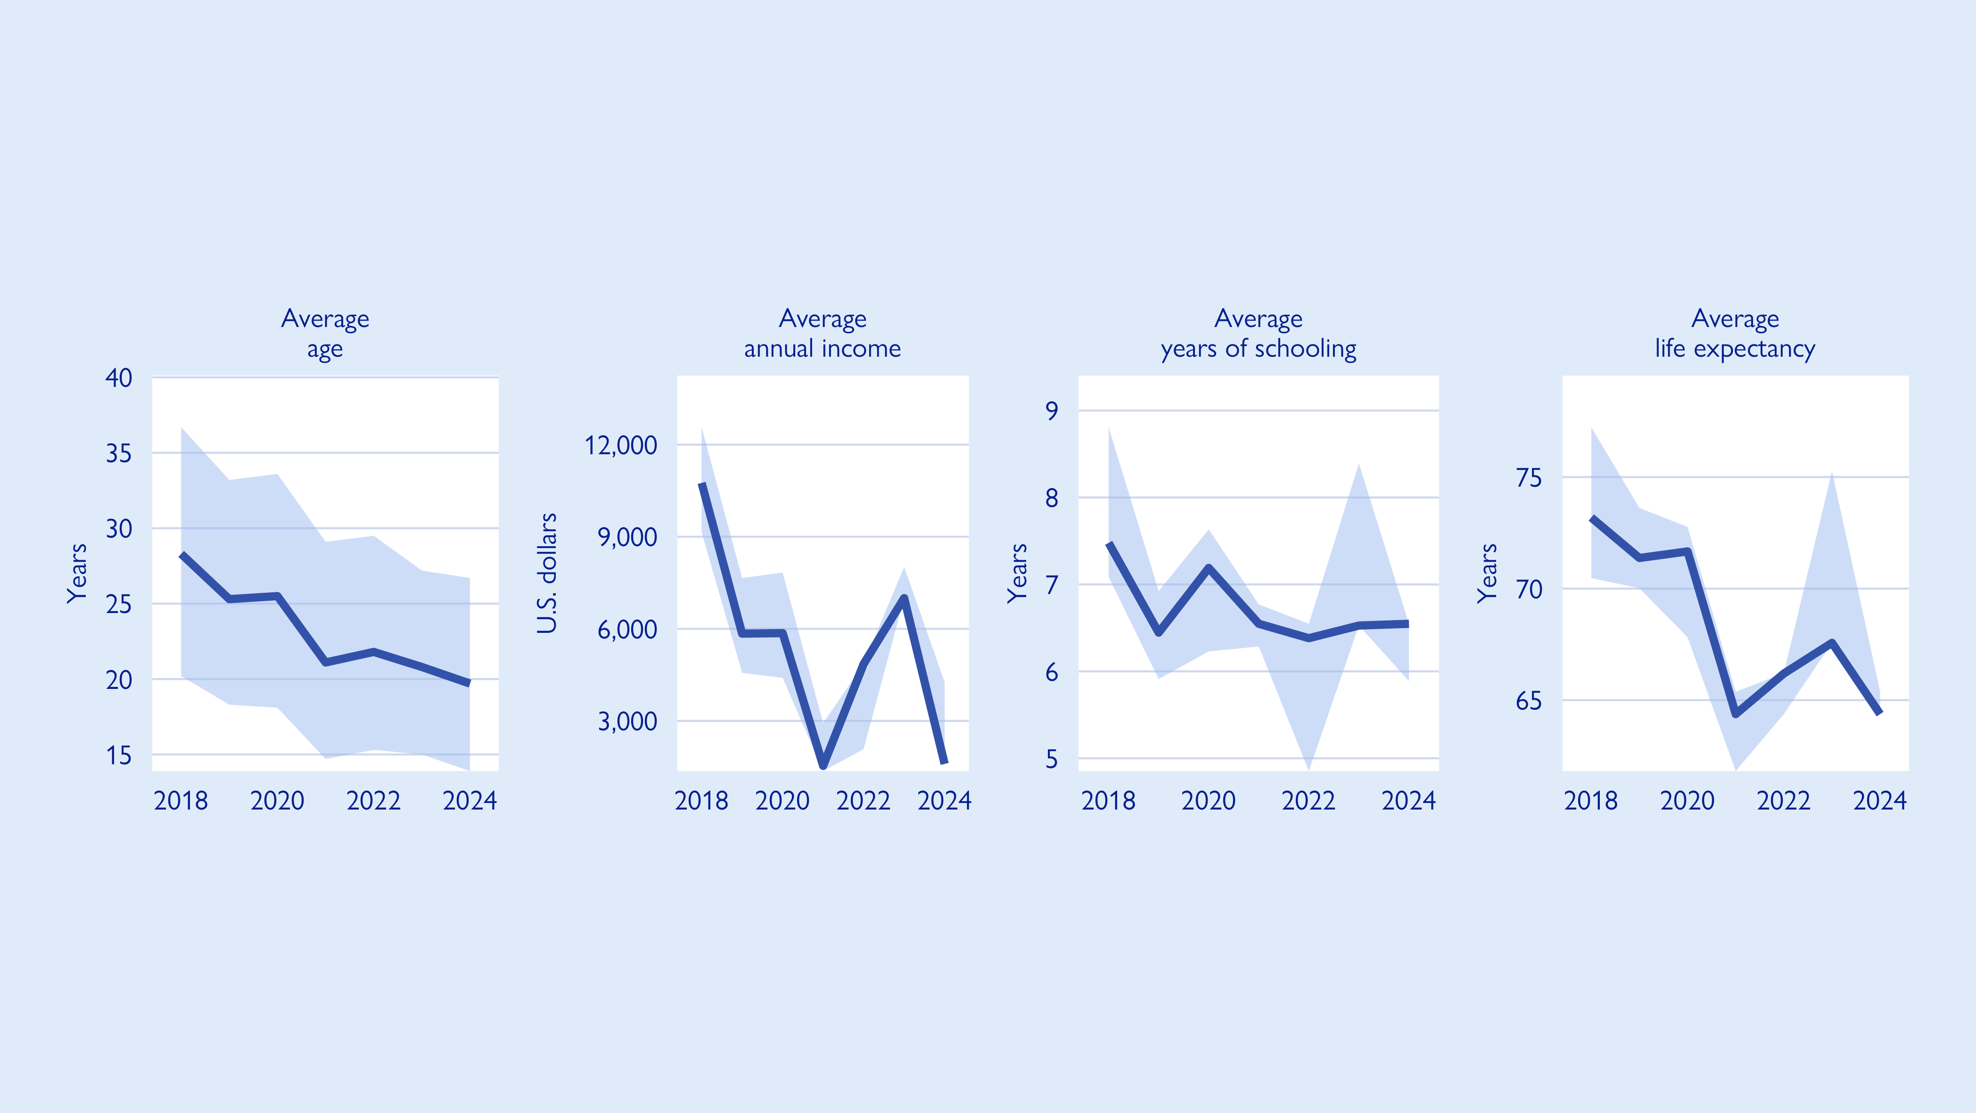
Demographic and socio-economic trends
Internal displacement occurs in overall more vulnerable areas today than it did in the past. Average age (28.3 years ↘ 19.7 years), income ($11,000 ↘ $1,600), years of schooling (7.4 years ↘ 6.3 years), and life expectancy (73 years ↘ 66 years) across displacement areas were all lower in 2024 than in 2018. These downward trends are statistically significant.

Slide 7
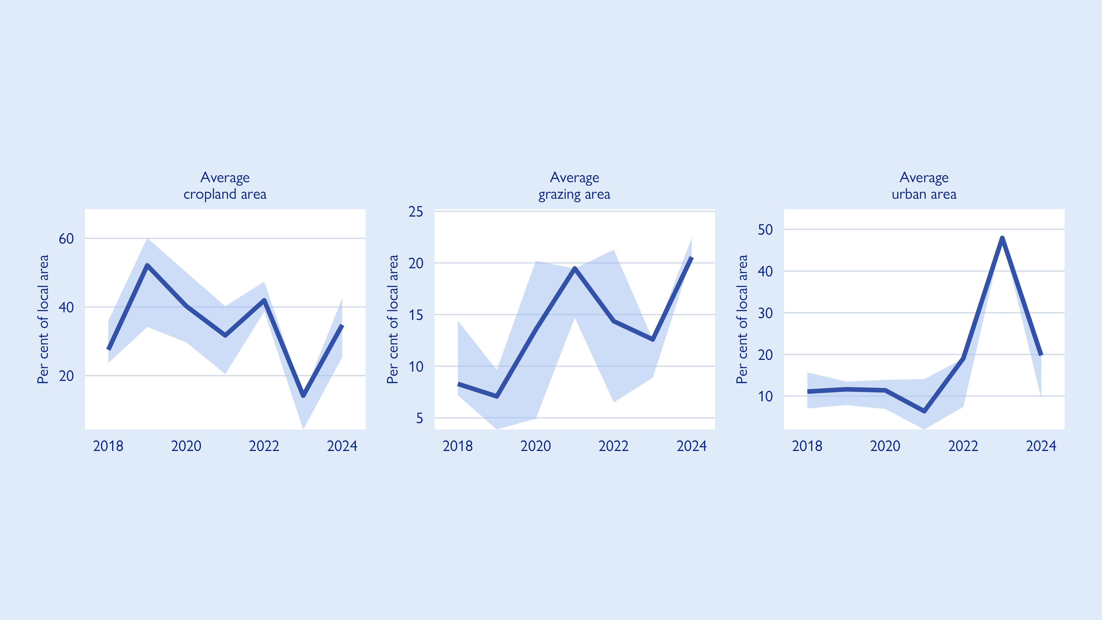
Land use trends
Compared to demographic and socio-economic indicators (see previous slide), land use characteristics of areas impacted by internal displacement overall do not display as clear a directional trend over time.

