Slide 1

Sciter
Present and future.
Details of implementation.
Best practices.
Presented at Symantec HQ, Culver City, LA on January 23rd, 2012

Slide 2
UI, state of affairs
Applications with dynamic UI - whole UI or its parts are getting composed in real time.
Applications have dynamic lifecycle - frequent functionality and UI design updates.
Connected or occasionally connected applications.
UI theming and styling, branding.
Non-trivial user input methods.
Touch interfaces.
Animations.

Slide 3
Really, why Sciter?
Conventional browser engines – security model is not suitable for desktop UI. “Embedability” is quite low.
Existing CSS model – endless “tape” that has width but no height. CSS still does not support vertical-align except of table cells.
JavaScript is good but not good enough for “serious” applications. No modularity, no classes out of the box. Syntax is not that expressive. “Semicolon injection”…

Slide 4
Ok, Sciter, but why new Sciter?
Better monitors are coming:
Transition of screen resolution from 96 dpi to 300 dpi leads to
9 times increase of memory needed for holding bitmaps and window buffers.
Drawing by CPU and copying of such bitmaps from/to display memory is not an option anymore.
That is why Direct2D in new Sciter.
Animations!

Slide 5
Sciter Architecture
Sciter modules:
HTML DOM
CSS
TIScript
Layout managers.
Animation drivers.

Slide 6
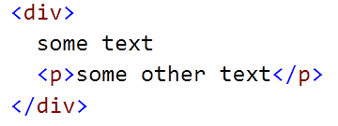

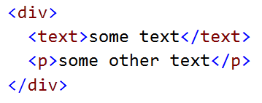
Sciter 1 and Sciter 2 differences, DOM
Sciter 1 – uses rendering tree that maps 1:1 to DOM tree.
the <text> (artificial text container) problem:
Sciter 2 – uses source DOM tree and maintains parallel rendering tree. DOM tree is a parsing (source) tree.

Slide 7
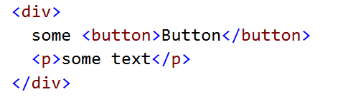
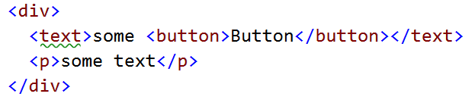

Sciter 1 and Sciter 2 differences, CSS selectors
The only difference - child A > B selectors:
To select the button using child selector:
Sciter 1 - div > text > button
Sciter 2 - div > button (or the above)

Slide 8
HTML DOM
List of classes
Node
Text: Node
Comment: Node
Element: Node
Document: Element
View
DOM tree:
View contains single Document element/node.
Document contains tree of its children.

Slide 9
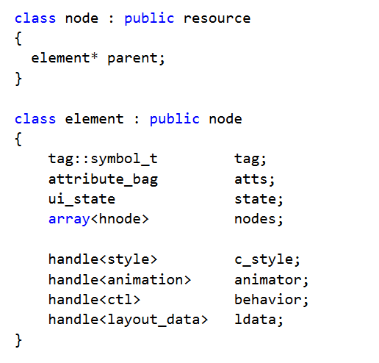
HTML DOM. Node and Element

Slide 10
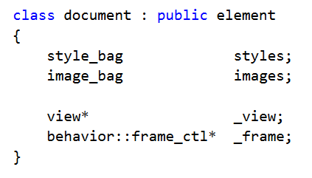
HTML DOM. Document
Document is an element – root of the DOM tree.
Contains resource and style collections:

Slide 11
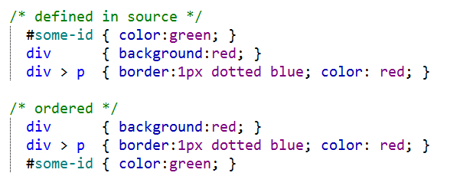
CSS
Architecture:
Flat table of
selector/property-list items
ordered by the selector specificity

Slide 12
CSS. Style resolution. Selectors complexity
To find styles of DOM elements:
Each DOM element is tested against each style selector.
If selector matches style then properties of style rule are applied.
The complexity of style resolution is: O(N*S*D) where:
N – number of DOM elements;
S – number of style rules;
D – depth of the DOM tree;

Slide 13
CSS. Style resolution. Optimization
Engine does sibling style optimization:
Previous sibling with resolved style is tested against “similarity”:
Has same set of attributes and state flags
Has same number of children, etc.
If previous sibling matches then its resolved style is used for the element.
Note: use of :nth-child() selector breaks this optimization.

Slide 14
CSS. Style resolution. Design time optimizations.
Minimize number of CSS rules.
Avoid use of universal selector * (match any).
Define rightmost selector as specific as possible:
ul li.item {…} is better than:
ul .item {…}
Use child selectors:
ul > .item {…} is better than:
ul .item {…}
Use style-set’s where applicable.

Slide 15
Style sets
Style set is an
isolated set of style rules
that is applied to some DOM element and its sub-tree (descendants).
Feature goals:
To bring at least some modularity to CSS
To overcome the style complexity resolution problem - O(N*S*D).

Slide 16
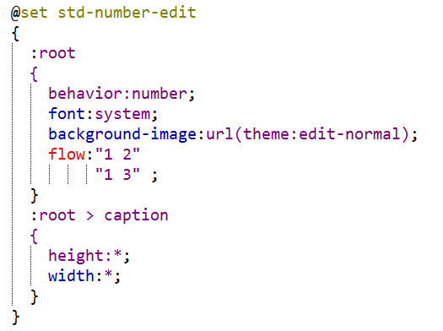
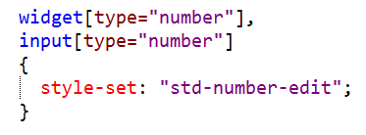
Style sets, declaration
Declaration of the style set:
Applying style set to the element and its sub-tree:

Slide 17
Flow and flex units
HTMLayout/Sciter specific CSS extension.
Introduced to support horizontal and vertical flexible layouts adjustable to different window sizes and screen resolutions.
Standard CSS property display: block | inline-block | table-cell | etc. defines “topology” of elements.
flow: vertical | horizontal | horizontal-flow | “template” | etc. defines exact layout of elements inside a container.

Slide 18
CSS property flow
Defines layout manager used by a container to replace its children, accepts following values:
vertical
horizontal
horizontal-flow and vertical-flow
“template”
stack
row(tag1,tag2,…)
column(tag1,tag2, …)

Slide 19

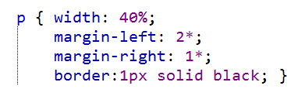
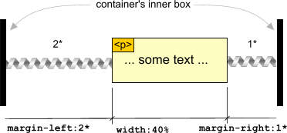
Flex units
Markup:
Style:

Slide 20
Layout computation.
CSS mandates following steps:
Phase I: min/max intrinsic widths. Result: computed width.
Phase II: horizontal layout (text, floats) inside given width. Horizontal flexes computation. Horizontal alignment. Result: computed height.
Phase III: vertical flexes and vertical alignment.

Slide 21
Complexity of layout computation
Most of the time – O(N), N is a number of DOM elements involved.
If overflow: auto is used then complexity is O(t * N) (where t is 1..4) when dimensions are close to intrinsic widths.
CSSS!, use of .width = self.box-border-width() may lead to additional measure/drop-layout/re-measure steps.
Dynamic updates and property animations: small change of the DOM may lead to deep tree layout computation.

Slide 22
Layout complexity, solutions.
Internal optimizations:
Delayed layout computation.
Design time optimizations:
Local layout roots: overflow: hidden | visible + fixed dimensions.
virtual lists and tables. Fixed tables where applicable.
overflow: scroll | scroll-indicator.
avoid use of .width = self.box-border-width() & friends in CSSS!, use static declarations and flexes instead.
Runtime optimizations:
Use of immediate mode drawing, last resort but effective.
Use of transform: scale(…) where applicable.

Slide 23
TIScript
Mostly JavaScript, has:
Compiler, produces bytecodes.
Virtual machine executing those bytecodes
Heap manager that uses copying GC.
Extended by:
Classes, namespaces, decorators, persistent storage, streams.
Integrated with DOM, GC.

Slide 24
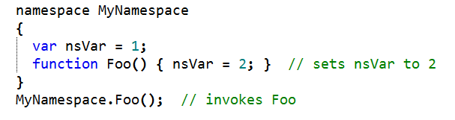
TIScript: namespaces
Namespaces are declared by using the namespace keyword. They can contain classes, functions, variables, and constants:

Slide 25
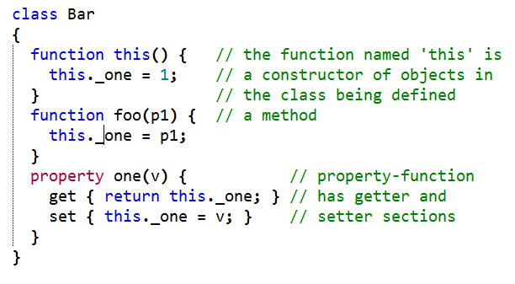

TIScript: Classes, constructors, and properties

Slide 26

TIScript: Lambdas and anonymous functions
Single statement lambda function: ':' [param-list] ':' <statement>;
Lambda function block: ':' [param-list] '{' <statement-list> '}‘
Classic anonymous function: 'function(' [param-list] ')' '{' <statement-list> '}‘

Slide 27

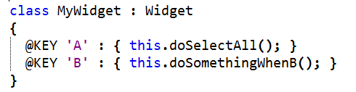
TIScript: Decorators
“metaprogramming” feature

Slide 28
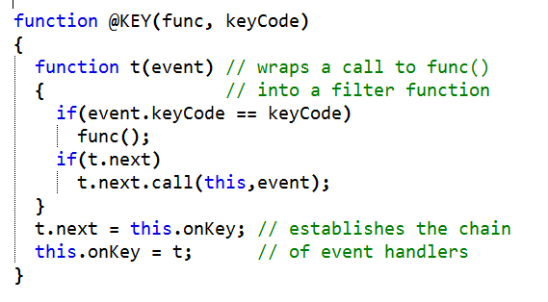
TIScript: Decorator sample
Decorator is a plain function with the name starting from ‘@’:

Slide 29
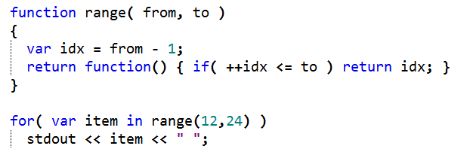
TIScript: iterators
the statement for( var item in func) will call the func and execute the body of the loop with its value on each iteration.

Slide 30
TIScript: types
Numeric: integer, float
Collections: array, map (object)
String and Symbol
Boolean: true and false
Stream (file, socket, in-memory)
Bytes – vector of bytes.
Persistent data: Storage and Index

Slide 31
New Script Painting Model and Graphics
Objects:
Graphics
Graphics.Path
Graphics.Text
Image
Paint events:
element.paintBackground <- func(gfx)
element.paintForeground <- func(gfx)
element.paintContent <- func(gfx)
Request painting:
element.refresh();

