Slide 1
Zomato data set analysis
201 ADITYA LONKAR
202 YOGESH SUKATE
226 OMKAR AWARI

Slide 2
LIBRARIES USED IN DATASET ANALYSIS
1.Pandas 2.Numpy 3.Seaborn 4.matplotlib.pyplot
Pandas is mainly used for data analysis and associated manipulation of tabular data in Dataframes
NumPy is a Python library used for working with arrays.
.

Slide 3
LIBRARIES USED IN DATASET ANALYSIS
Seaborn is an open-source Python library built on top of matplotlib. It is used for data visualization and exploratory data analysis
Matplotlib is a cross-platform, data visualization and graphical plotting library for Python and its numerical extension NumPy. As such, it offers a viable open source alternative to MATLAB

Slide 4
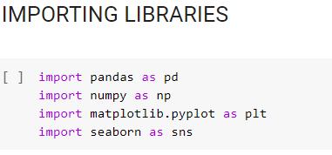
Importing the libraries
import pandas as pd
import numpy as np
import matplotlib.pyplot as plt
import seaborn as sns

Slide 5
Reading the csv files
df=pd.read_csv('/content/drive/MyDrive/data/zomato.csv')
df.head()
df.head() reads the first five rows of data .
df.tail() reads the last five rows of data .
df.shape() shows number of rows and columns
df.columns shows name of the columns
df.info() shows non null , data type objects .

Slide 6
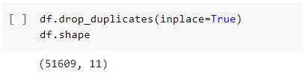
Droping the duplicates
Duplicates present in the table can be dropped as :
df.drop_duplicates(inplace=True)
df.shape

Slide 7
Removing "NEW","-",AND"/5" from Rate Column
In rate column we find that some data is having , which is in string type . Thus to convert entire data into int type we used :
def handlerate(value):
if(value=='NEW' or value=='-'):
return np.nan
else:
value=str(value).split('/')
value=value[0]
return float(value)
df['rate']=df['rate'].apply(handlerate)
df['rate'].head()

Slide 8
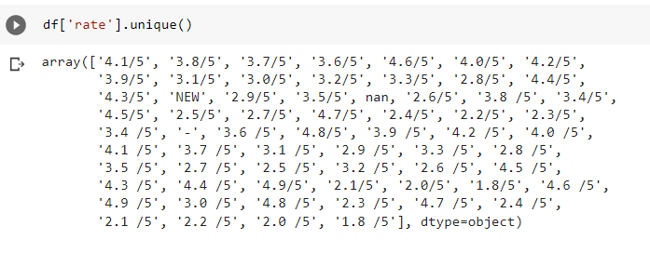
DATA CLEANING
WE CLEANED THE DATA SO THAT IT CAN BE EASY TO ANALYSE .

Slide 9
DATA CLEANING
Filling null values in rate column with mean
Droping Null Values
Listed in(city) and location , both are there , lets keep only one
Removing , from Cost2plates Column
cleaning rest type column
Making rest type less than 1000 in frequency as others
cleaning location column
Cleaning Cusines columns

Slide 10
Data visualiZATION
WE ANALYSED THE DATA AND THEN USING VARIOUS LIBRARIES LIKE SEABORN , NUMPY AND PANDA WE ANALYSE THE DATA USING GRAPHS AGAINST VAROIUS PARAMETERS .
THE ANALYSED DATA CAN BE PLORT INTO THE GRAPH BY AS GIVEN BELOW .

Slide 11
DATA VISUALIZATION
Count plot of various location
visualizing online order
visualising book table
visualizing online order vs rate
visualising book table vs rate
visualizing book table facility, locationwise
visualising types of restaurant vs rate
grouping types of restaurants locationwise
no. of votes locationwise
visualizing top cuisines

Slide 12
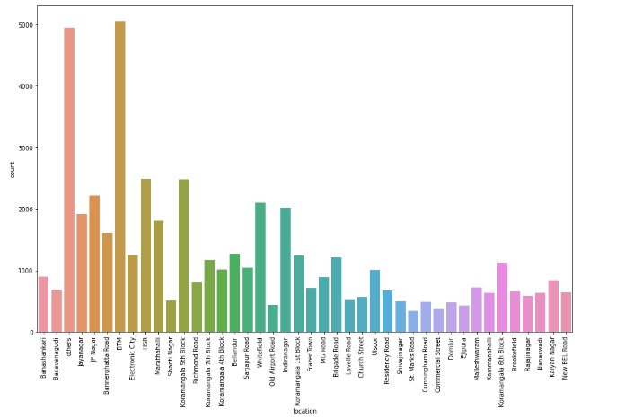
Count plot of various location

Slide 13
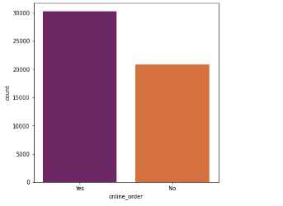
visualizing online order

Slide 14
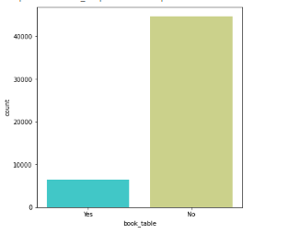
visualising book table

Slide 15
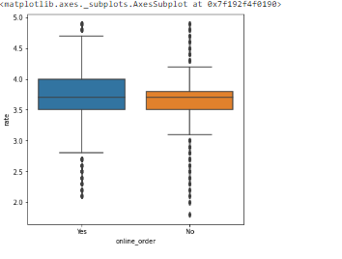
visualizing online order vs rate

Slide 16
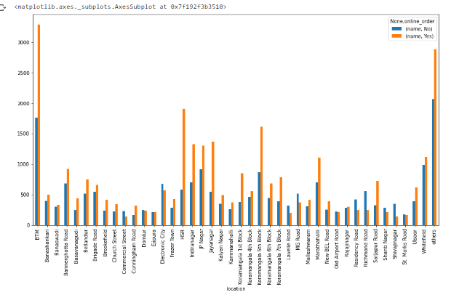
visualising book table vs rate

Slide 17
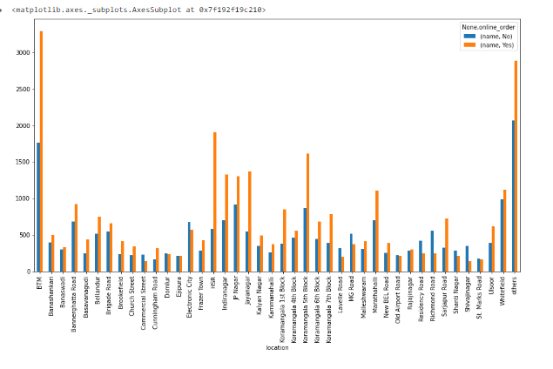
visualizing book table facility, locationwise

Slide 18
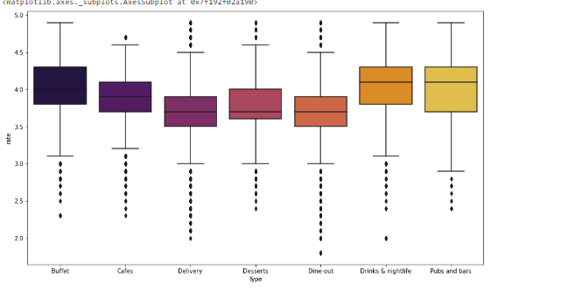
visualising types of restaurant vs rate

Slide 19
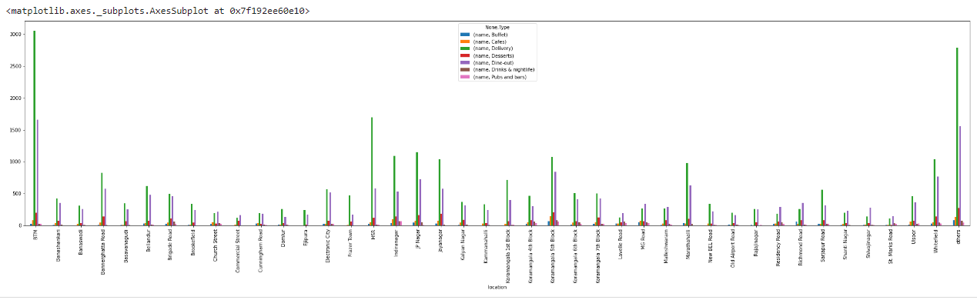
grouping types of restaurants locationwise

Slide 20
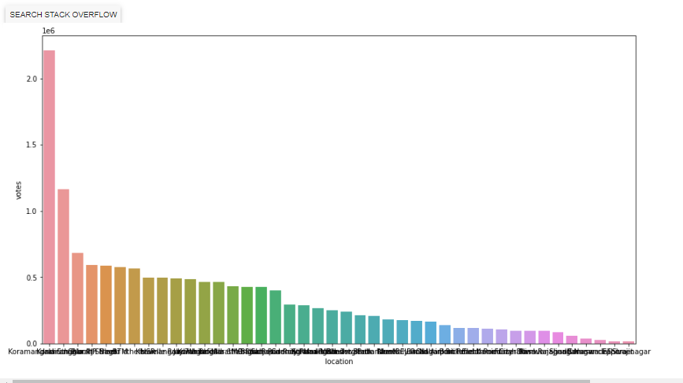
no. of votes locationwise

Slide 21
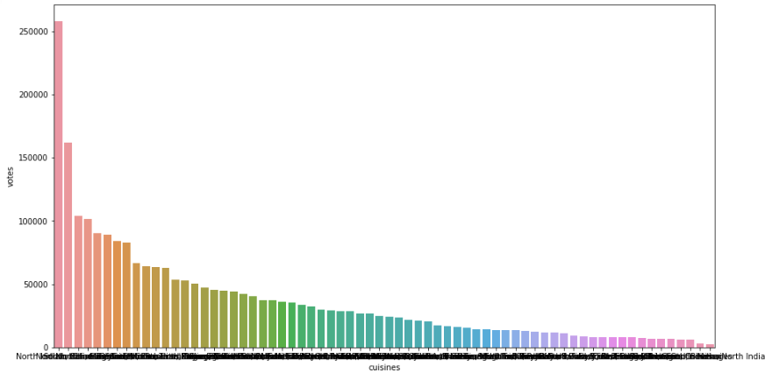
visualizing top cuisines

