Slide 1

Inside a NLP multitasking neural network. BERT, one model to rule them all
Bachelor Thesis in Telecommunication Technologies Engineering
Ion Bueno Ulacia
Notes:
Good morning. First of all, I would like to thank you for your time and your attention during the session.
My name is Ion and I am finishing my degree in Telecommunications Technologies. I am really interested in artificial intelligence. That is the reason why I wanted to investigate and orientate my thesis into this area. I decided to learn more about natural language processing, known as NLP, which is the topic of the thesis.
I have discovered a model which is applied in almost all NLP tasks. It has defined the current trend into NLP and has been used as reference for subsequent models.
It corresponds with BERT, released by Google three years ago. The goal is developing two applications with this algorithm, sentiment analysis and question answering.

Slide 2
Contents
Background
Natural Language Processing (NLP)
Recurrent Neural Networks (RNNs)
The Transformer
BERT implementations
Sentiment Analysis
Question Answering
Conclusion
Notes:
Nevertheless, before going into detail about the algorithm
I am going to present the background which is critical in BERT
Then I am going to explain the keys of both implementation and show the obtained results.
To conclude, I would like to remark on its huge impact in the community as well as some hints about a promising future.

Slide 3
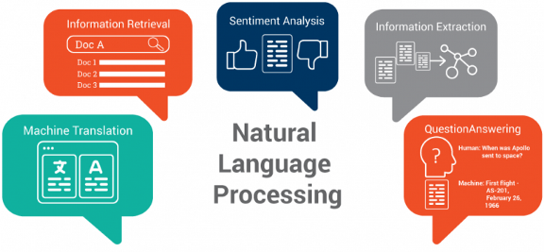
Natural Language Processing (NLP)
An area of Artificial Intelligence
Processing or generation of text
Multiple applications
Used to analyze covid-19 mental health impact
Notes:
Natural Language Processing is an area of artificial intelligence.
It encloses any processing or generation of text. Some common applications are text classification, text summarization, translation.
It is employed in several areas, for example fraud detection or selection processes.
For example, I chose this area because I read about how BERT was being employed to analyse covid-19 impact into mental health using tweets, forums entries, etc.

Slide 4
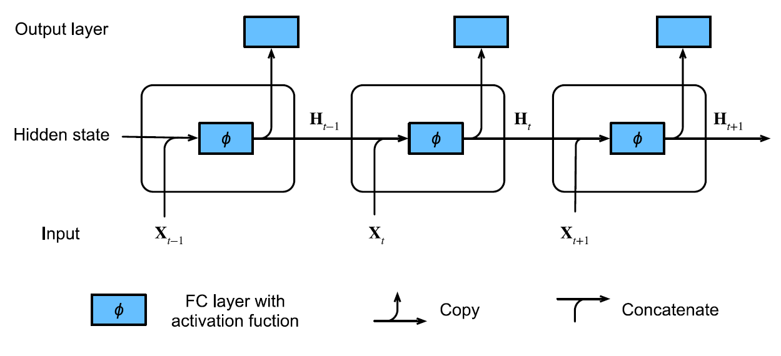
Recurrent Neural Networks (RNNs)
Text is sequential data
Words are dependent between them
RNNs: recurrence computation
Notes:
Text is a special type of data. It is sequential due to the dependency between the words.
The usual approach to deal with it was recurrent neural networks. In this case the network is a sequence of cells. In each cell a word is passed as input to compute a hidden state which generates the next predicted word each time step.

Slide 5
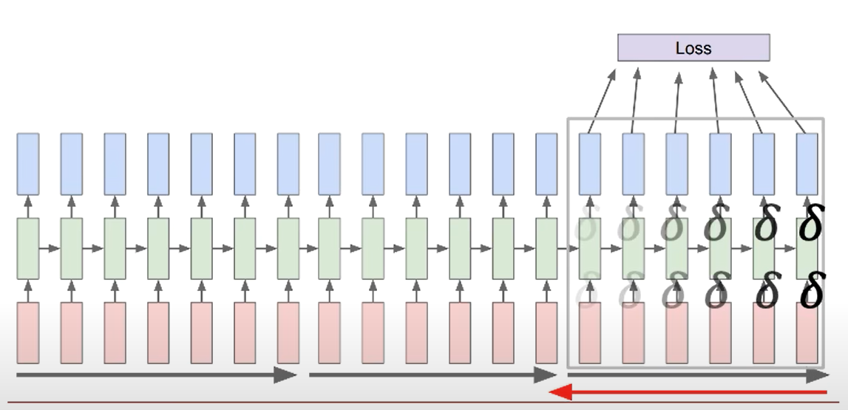
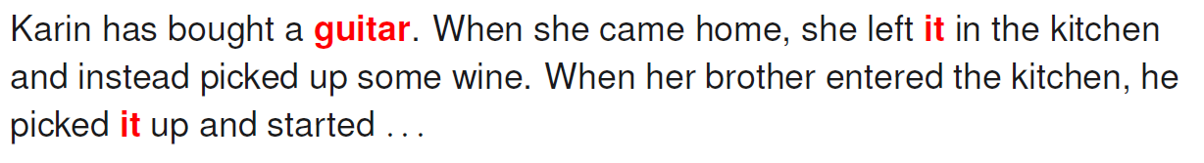
RNNs Drawbacks
Slow to train: sequential computation
Difficult to capture long-term dependencies as the sentence increases: vanishing or exploding gradients
Notes:
In spite of being the usual approach in NLP, RNNs have two main drawbacks which motivates the research of new techniques.
First, they are really slow to train due to use sequential data, which does not fit with the parallelization techniques used in modern hardware.
Second, RNNs have difficulties capturing long-term dependencies. As I mentioned, neural networks are based on optimizing the gradient of a cost function to minimize the error. The problem with this type of architecture is the error signals are propagated through all the network, causing problems with the gradient as the input sequence increases.

Slide 6
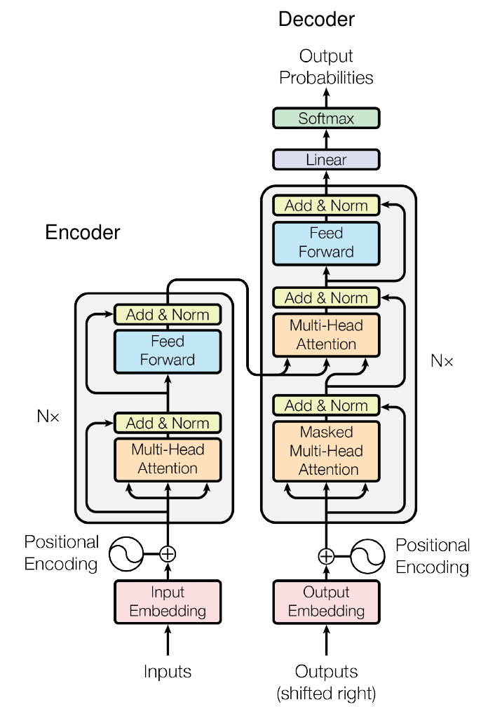
The Transformer
Released in 2017
Parallelization of sequential data
Avoid vanishing or exploding gradients
Pure self-attention mechanisms
Notes:
In 2017, the Transformer was released, as a solution for long sequential computation. It has an encoder-decoder architecture but we are only interested in the encoder, which is the architecture used by BERT.
This model is able to parallelize sequential data, which is the main problem for long training times.
Also, it provides a solution for vanishing or exploding gradients.
The technique to achieve these goals is self-attention.

Slide 7
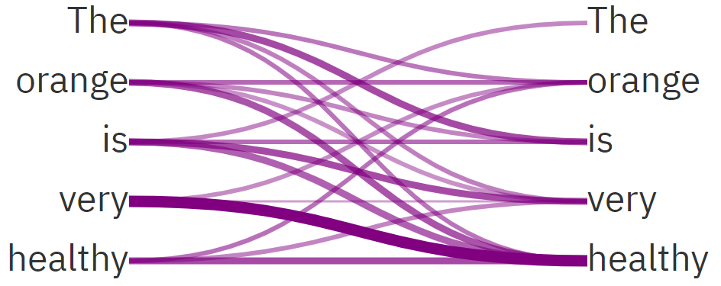
Self-Attention
Representation of a sentence
Maps set to set
Word relations: grammar, semantic…
Critical in BERT
Notes:
This technique is based on relating different positions of a single sequence in order to compute a representation of this one.
The goal is mapping sets to sets, regardless of the order in the sequence.
At the end, we are looking for a rectangular matrix which relates every word in the sentence according to the attention weights. Attention could reflect different relations: grammar, semantic, vocabulary. In the end, we can see it as a mechanism to understand the language, independently of the context.
Self-Attention is critical in the transformer and consequently in BERT. For this reason, I am going to briefly explain the main steps to have some intuition about the process.

Slide 8
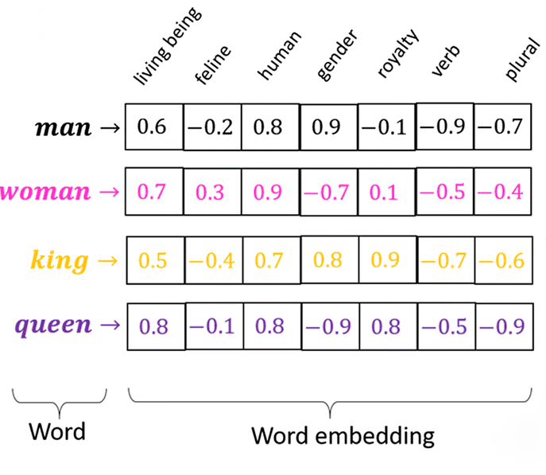
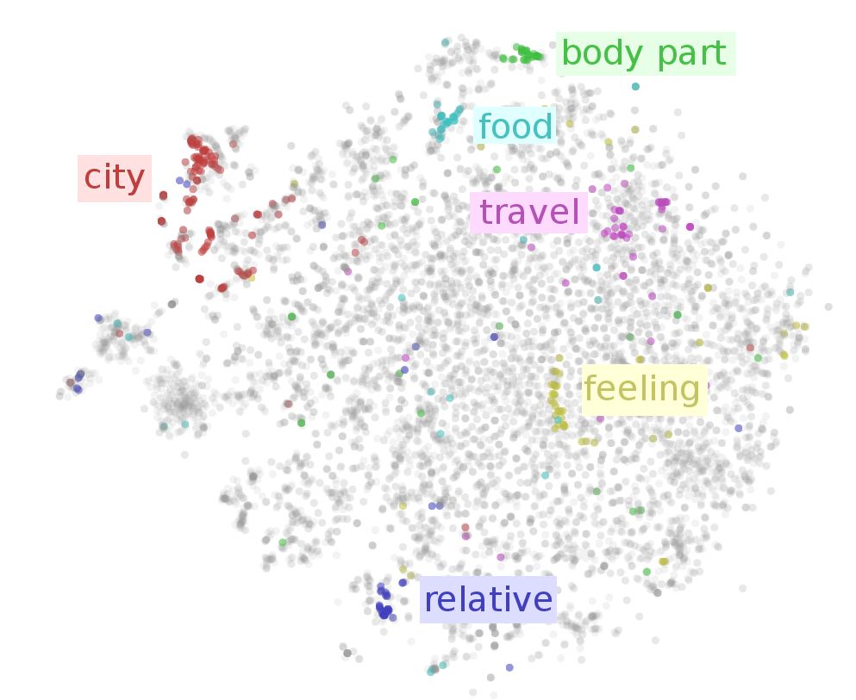

Self-Attention Intuition (I)
Word $→$ Token $→$ Embedding vector
Notes:
First, each word in the sentence is converted to an embedding vector, whose dimension depends on the size of embedding space used. This space tries to cluster similar words, classifying them according to a number of features. The space is composed by a limited number of words, so first it is necessary to index the required word. This number is known as token.
These vectors do not provide any context information, the relation with the rest of the words. For example, the word orange could be a colour or the fruit, depending on the context. So that is why we are looking for an attention vector which takes into account the sentence context. It usually has same dimension as the word embedding.

Slide 9
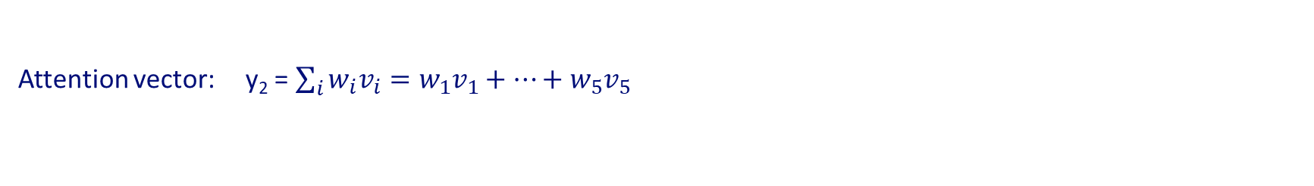
Self-Attention Intuition (II)
Sentence: The orange is very healthy
Word vectors: $x_{1}$ $x_{2}$ $x_{3}$ $x_{4}$ $x_{5}$
Query: $q_{1}=W_{Q}x_{1},…, q_{6}=W_{Q}x_{5}$
Keys: $k_{1}=W_{K}x_{1}, …, k_{6}=W_{K}x_{5}$
Values: $v_{1}=W_{V}x_{1}, …, v_{6}=W_{V}x_{5}$
Selected word: orange $→q_{2}$
Weights: $z_{1}=k_{1}^{T}q_{2}$ , … , $z_{5}=k_{5}^{T}q_{2}$
$\left[w_{1}, …, w_{5}\right]=$ softmax($z_{1}, …, z_{5}$), where softmax($z_{i}$) = $\frac{e^{z_{i}}}{\sum_{j}{e^{z_{j}}}}$
Attention vector: y₂ = $\sum_{i}{w_{i}v_{i}=w_{1}v_{1}+…+w_{5}v_{5}}$
Notes:
Now let us imagine we have the sentence: The orange is very healthy.
Each word is transformed to an embedding vector.
We introduce three new vectors, queries, keys, and values. These ones are obtained by multiplying the embedding vectors with trainable matrices.
If we want to get the attention vector for orange word for example, we select the corresponding query and multiply by all keys, getting five scores, represented here by zeta.
After applying a softmax function, we get the corresponding weights, to compute the final attention vector as a weighted sum.
The idea behind this is provide more weight to similar vectors according to the dot product, with the option of adjust it with trainable matrices.

Slide 10
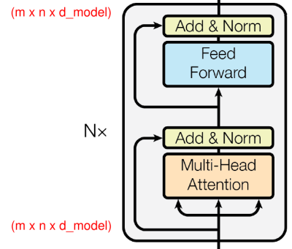
Transformer Encoder
Architecture used by BERT
Multi-Head attention block
Input and output with same dimensionality
m: number of sentences
n: number of words
d_model: embedding dimension
Notes:
Returning to the transformer, we are interested in the encoder, which is used by BERT.
The important part is the attention block, where attention is applied in parallel in blocks called heads, in order to get different representations and get enough flexibility to model. Then, they are combined with another trainable matrix.
In the end, the input is a batch of sentences, with the same number of words in embedding vector format. The output has the same dimensionality. As I have mentioned with self-attention, the goal is mapping sets to sets, which has been critical for the architecture and functionality of BERT.

Slide 11

BERT
Bidirectional Encoder Representations from Transformers, released in 2018 by Google
Composed by a stack of Transformer encoders
Uses self-attention to get left and right context
Notes:
Following the transformer, BERT was published in 2018.
Its name is Bidirectional Encoder Representation from Transformers. This name is due to the architecture being just a stack of transformer’s encoders.
Bidirectional means it gets the left and right context of the sentence using self-attention.

Slide 12
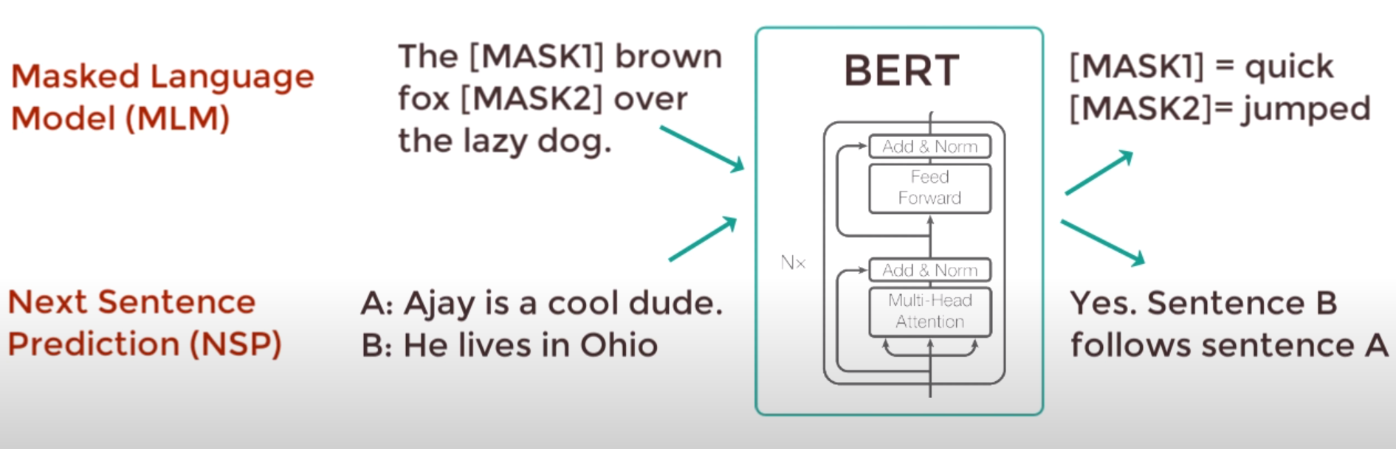
Pre-Training BERT
16 TPUs for 4 days, data from Wikipedia and BookCorpus
Masked language modelling
Next Sentence Prediction
Notes:
BERT has been pre-trained on a large amount of data of Wikipedia and BookCorpus in 16 TPUs, for 4 days. They employed two simple strategies.
First, masked language modelling where they mask a small percentage of random words, and the goal of the model is to predict the corresponding word. It makes the model understand the language and its context.
Second, next sentence prediction, where two sentences are used as input and the objective is to decide if one is the continuation of the other, understanding relationships between sentences. Both tasks are implemented at the same time.

Slide 13
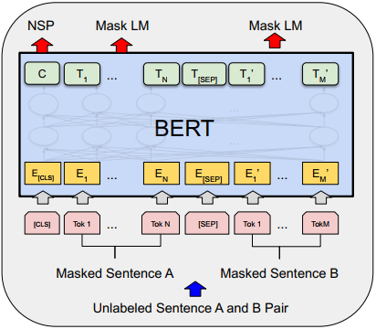
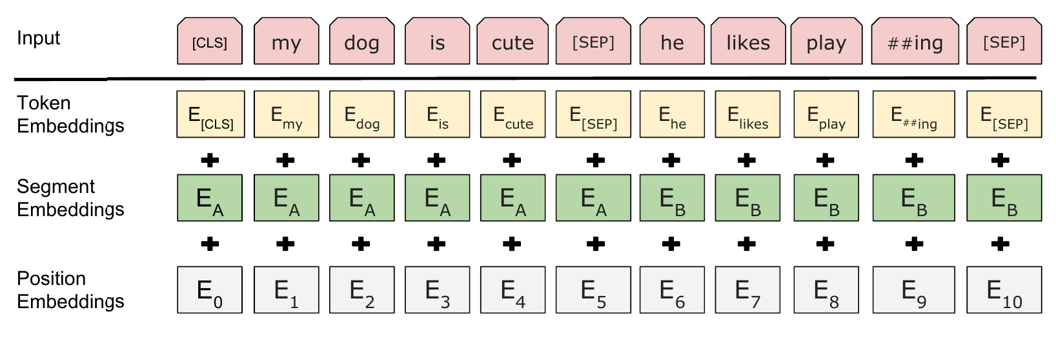
Input-Output BERT
Input: addition of 3 embeddings
Output: classification token and attention vectors
Same dimensionality
Notes:
The input of BERT can be composed by one or two sentences. You only need to pass the tokens and BERT generates an embedding vector result of the addition of other three. Word embedding which is the embedding generated by the used vocabulary. Segment embedding which indicates at which sentence the token belongs to. And position embedding, to reflect the position of the token.
The output is the token C or NSP, which is used for classification tasks. It indicates if sentence B follows sentence A. And the attention vectors for both sentences, including the representation for masked words.
In the end, BERT is an encoder, so the inner embedding size is maintained during the whole process.
Until this point, we have a pre-trained model which has been trained to understand the language.

Slide 14
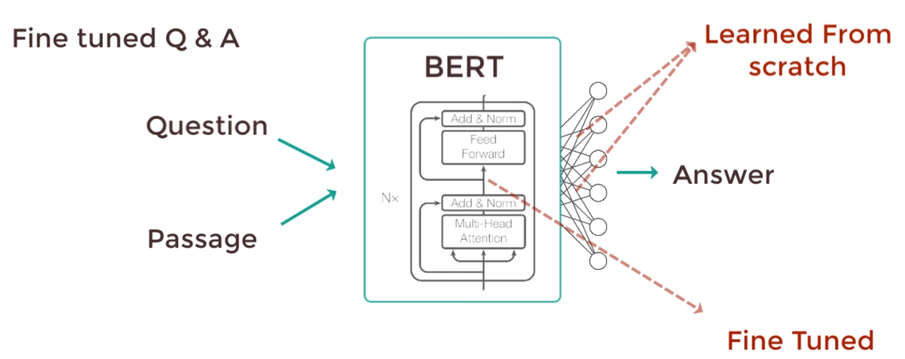
Fine-Tune BERT
Specialization in a task
BERT + output layer and specific dataset
Computationally inexpensive compared with pre-training
Notes:
However, BERT was designed to be used for a wide range of tasks.
That is what corresponds with fine-tune, where simply we add one output layer and perform a new training in a specific dataset.
Only new parameters are learned from scratch, while the rest are slightly fine-tuned. That is the reason fine-tune is relatively inexpensive in computation cost compared with pre-training.
In conclusion, we have a powerful model which is already trained to understand the language, and with an inexpensive training we can get a state-of-the-art model in most of NLP tasks. And that is what I did.

Slide 15
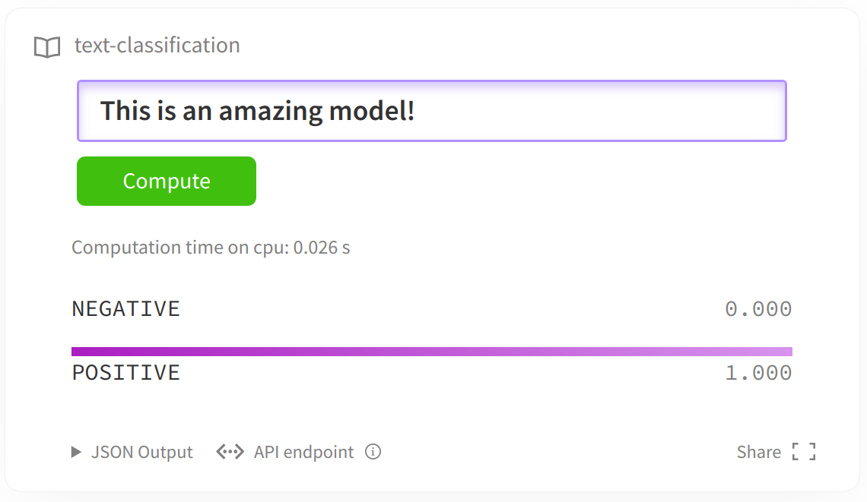
Sentiment Analysis
Predict positive or negative sentiment of a sentence
Two labels: 0 – negative, 1 – positive
Notes:
The first application I developed is sentiment analysis. It is simple, but very powerful and demanded nowadays. The goal is to predict the positive or negative sentiment of a sentence, so there are only two labels.
The 0 is used for negative sentence while the 1 for positive ones.

Slide 16
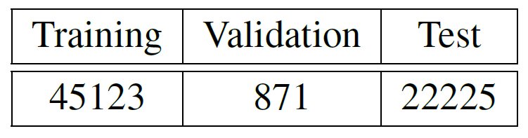
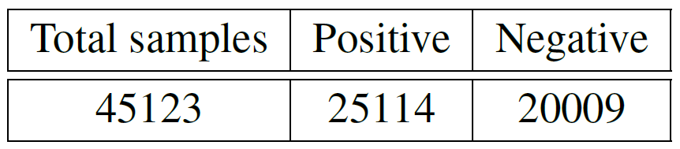
SST-2 Dataset
Stanford Sentiment Treebank (STT-2) dataset
Dataset distribution:
Positive and negative samples in training dataset
Notes:
For training and evaluating the model, I have used SST-2 dataset, which is prepared for this task.
Test samples are taken from training ones, since in the original source they do not have a label, since STT-2 is used in competitions.
That is why I checked if both classes were balanced, as we can see.

Slide 17
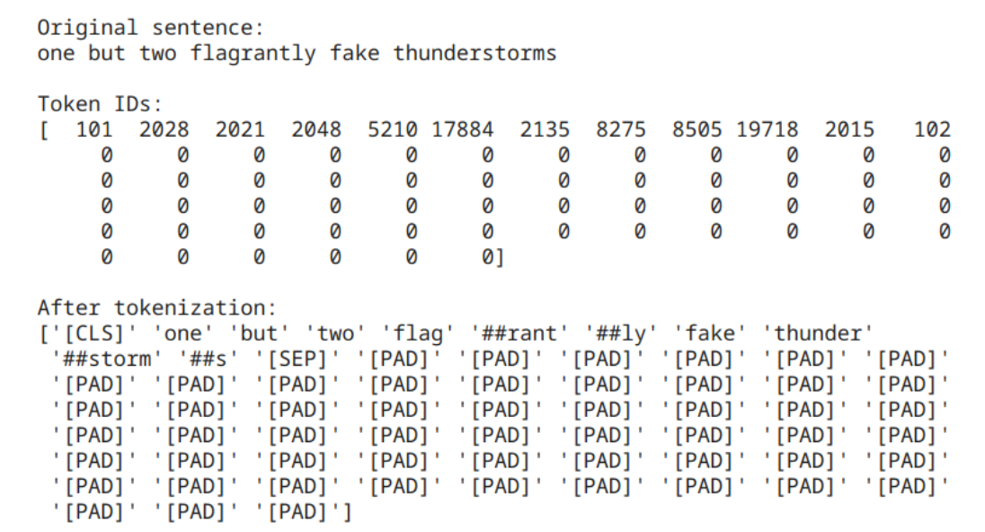
SST-2 Preprocessing
Tokenization: WordPiece
Pad to maximum length
Truncate to 512 if necessary
Add special tokens
Notes:
I think this part is critical in almost any machine or deep learning problem, cleaning and preparing the data before training the model.
In this case, there were many steps to follow. First, tokenize the sentences, converting text into integers according to the embedding space. Mention BERT uses WordPiece, which is a subtokenization algorithm. This means some words are separated into roots and prefix and suffix, in order to be more efficient.
Padding each sentence to the maximum length found in the set, since BERT works with a fixed size.
It has also a maximum size of 512 tokens, so if there were any larger sentence it is necessary to truncate it. Although it was not necessary.
It is also necessary to add some special tokens, as the end of the sequence and the separation between sentences.
Following these steps, we get this result. We can see how every word from the original sentence is converted to a token and it is added 0s for padding. Also, how we added special tokens as the CLS in the beginning of the sentence, padding ones or the one which separates the sentences. Mention how flagrantly is divided in two pieces.

Slide 18
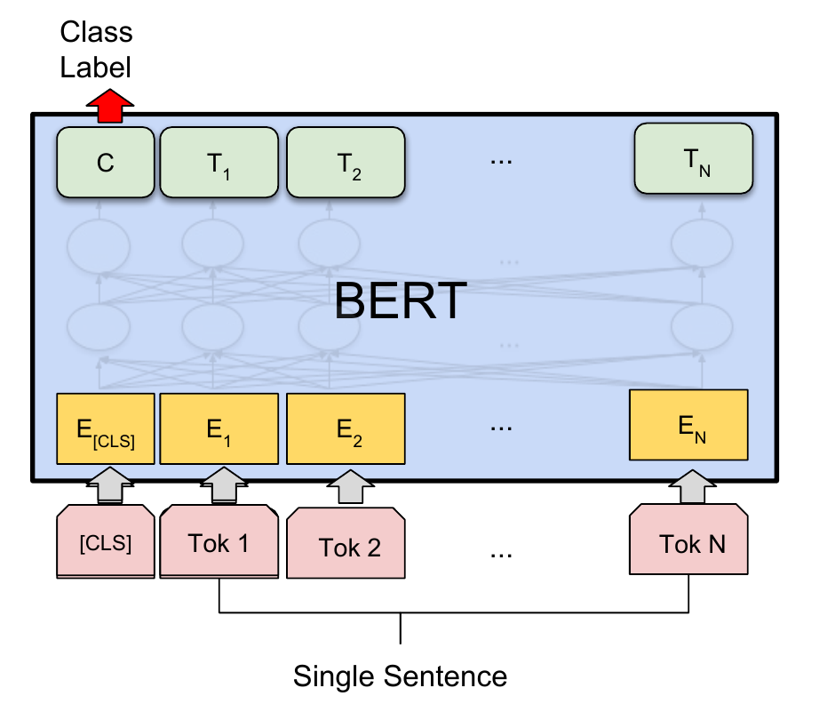
Generation of the Model (I)
Input: single sentence
Output: classification token C
Notes:
The input is simple, a single sentence which is already tokenized.
The used output is only the classification token C since the attention representations are not needed during this task.

Slide 19
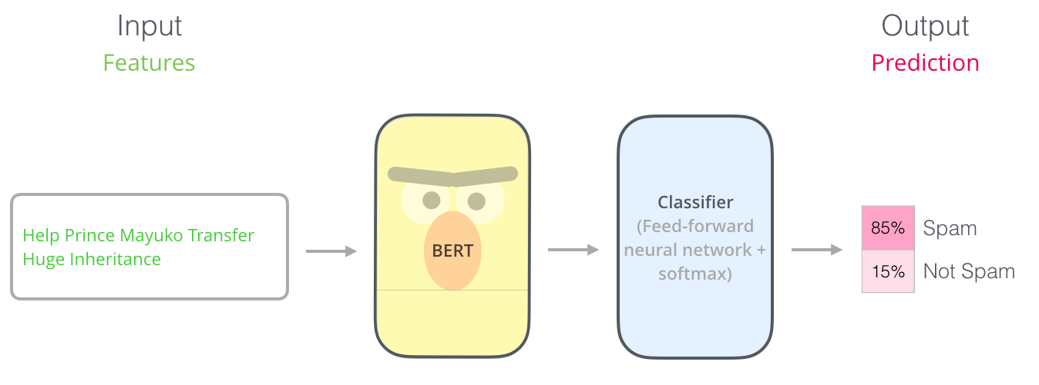

Generation of the Model (II)
BERT + classifier (feed forward network with one single hidden layer)
New parameters to train: classification layer weights $W$
Softmax to calculate probabilities
Notes:
The final model is a combination of BERT and a classifier. This one is just one simple feed forward neural network with one single hidden layer.
It is only introduced the classification layer weights as new parameters to train from scratch.
We passed C as input for the classifier. With new learn weights and softmax is calculated the required probabilities.

Slide 20
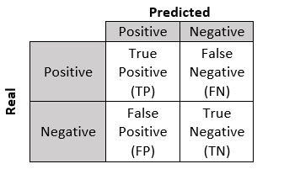

Metrics
Accuracy = $\frac{TP+TN}{TP+TN+FP+FN}$
True Positive Rate = $\frac{TP}{TP+FN}$
False Positive Rate = $\frac{FP}{FP+TN}$
Cross-Entropy Loss: difference between prediction and real value
Notes:
This task is a binary classification problem, so it is necessary to introduce the confusion matrix. There are four possibilities, depending on which is the predicted and the real value.
That is why I used the accuracy to quantify the model performance. It provides the percentage of hits respect the total number of predictions. Mention the true positive rate which evaluates how often we guess positive samples and in contrast the false positive rate, which indicates when we fail.
I also used the cross-entropy loss, which quantifies how far the prediction is from the real value, which provides a more real feedback.

Slide 21
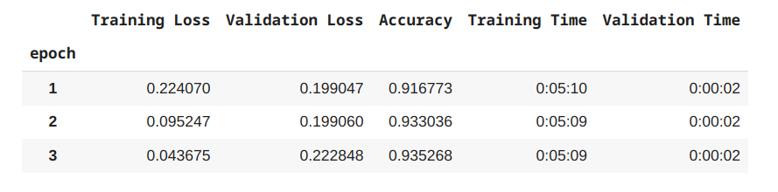
Fine-Tune Results on Sentiment Analysis
1 epoch = 1 iteration whole dataset
Accuracy: 93%
Training time: 27 min 9 sec
Notes:
And these are the obtained results for training. As we can see, we are obtaining a high accuracy of 93 %.
But the most interesting point is that the model is trained in 27 minutes. With conventional models it could take many hours.

Slide 22
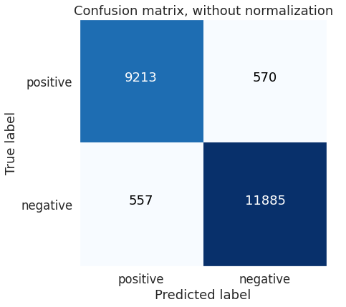
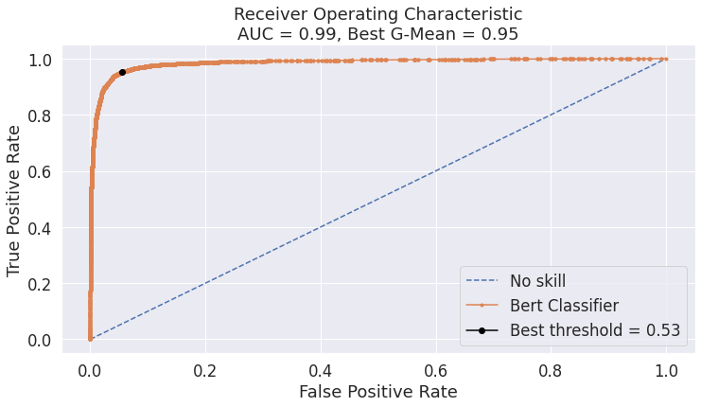
Test Results on Sentiment Analysis
Accuracy: 95%
Notes:
But what happens with test data.
In the upper left corner of the confusion matrix, there are the number of positive samples classified as positive and in the lower right the negative ones. The hits overcome completely the number of fails, obtaining an accuracy of 95%.
At the right, we have the ROC curve, which compares the true positive rate with the false positive rate in a range of probability thresholds. The threshold indicates at which probability is predicted a sample as positive. In the end, this gives us an intuition about how good we classify the positive samples. The best value will be an area under the curve (AUC) of 1, and in our case, we have 0.99, which is almost a perfect result.

Slide 23
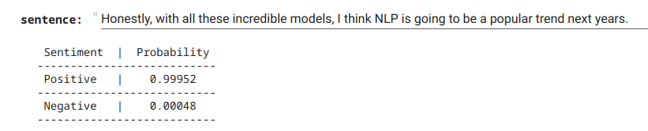
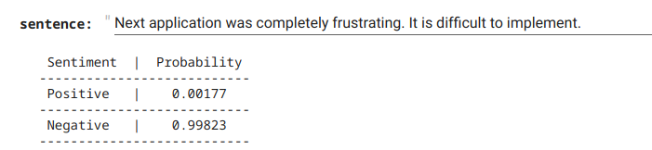
Final Application for Sentiment Analysis
Example of a positive prediction
Example of a negative prediction
Notes:
To conclude with sentiment analysis, I developed a pipeline where you only need to introduce the sentence you want and the model provides you the probability of being positive or negative.
This code and the implemented models are published in my GitHub for free access.

Slide 24
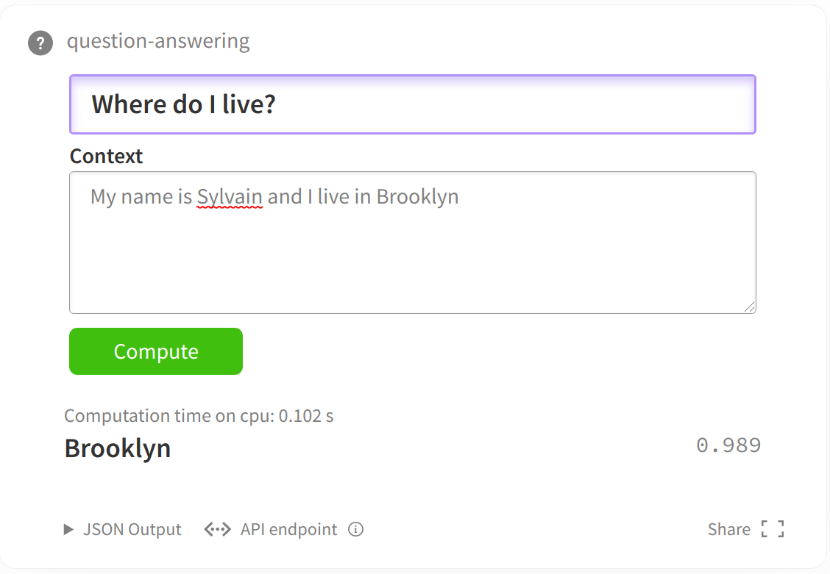
Question Answering
Answer a question about the context
The answer is taken from the context
Notes:
Question answering is a more challenged task and completely different from sentiment analysis. However, BERT can also be used and the process is not so much different. Providing a context, the goal is to answer a question about this text.
This answer is taken directly from the context. BERT does not generate new text.

Slide 25
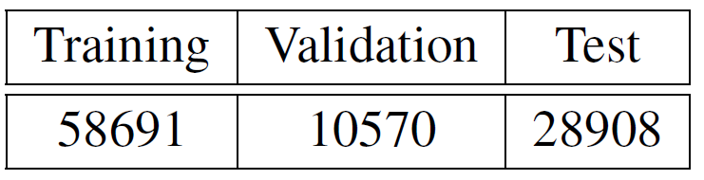
SQuAD Dataset
Stanford Question Answering Dataset (SQuAD)
Dataset distribution:
Notes:
In this case I employed SQuAD dataset, which is a compilation of Wikipedia passages with a question/answer pair associated.
As before, there are enough samples, having more than 58K to train the model.

Slide 26
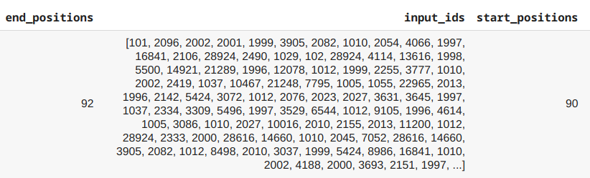
SQuAD Preprocessing
As sentiment analysis: tokenize and pad
Truncate: divide long contexts into features
Map answers
Notes:
The procedure to preprocess the data in question answering is almost identical than sentiment analysis. We have to tokenize the answer and the context as well as padding.
However, in this case there were many cases where the context plus the question is larger than the maximum size. Here the truncation is a critical process, since if we divide a context, we could lose the answer for the original question. The strategy is the following. It is truncated the context into features, text shorter than maximum length of BERT, and allowed some overlap between them in case the answer lies at the point it has been split a long context.
Then it is necessary to find in which feature the answer is and map for every sequence the answer in a span, indicating the start and end positions.

Slide 27
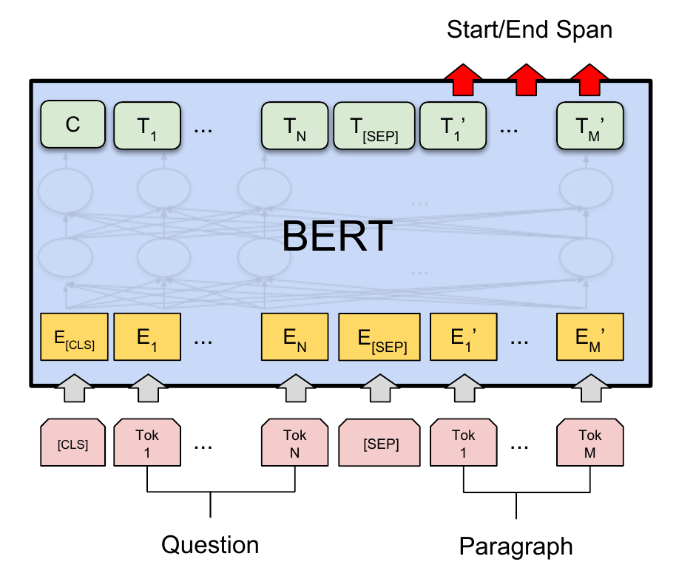
Generation of the Model (I)
Input: pair of sentences, question and context
Output: start/end span answer
Notes:
In this case, the input is the pair of sentences composed by the question and the context.
Now, as output it is needed the attention representation of each token to calculate the probabilities of being the start or end tokens.

Slide 28
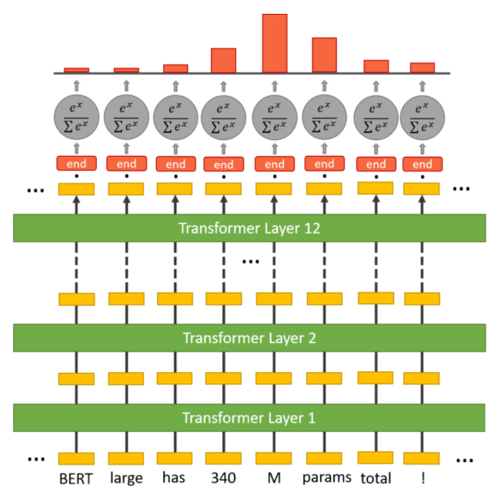

Generation of the Model (II)
New parameters: start (S) and end (E) vector
Probability = $\frac{e^{S⋅T_{i}}}{\sum_{j}{e^{S⋅T_{j}}}}$ , for S and E
Score = $S⋅T_{i}+E⋅T_{j}$, i start and j end
Notes:
Now we introduce a start and end vector of inner embedding dimension.
To compute the probability of a word being the start or the end of the answer, it is computed the dot product between the start vector or end vector and the attention representation of the token followed by a softmax over all the words in the sequence.
The score for a candidate is defined as $S⋅T_{i}+E⋅T_{j}$, where i is the start position and j the final position. The maximum scoring span is used as prediction.

Slide 29
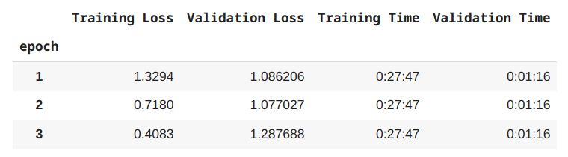
Fine-Tune Results on Question Answering
Loss evaluation. Difficult to quantify
Training time: 1 h 23 min 21 sec
Notes:
In this case we can only evaluate the model respect the loss. Mention that in the end it is difficult to measure the performance for question answering. That is due to a correct answer could differ from the original one.
Training time is very short for training a model in a complicated task as this one. For example, with RNNs it could take many hours.

Slide 30
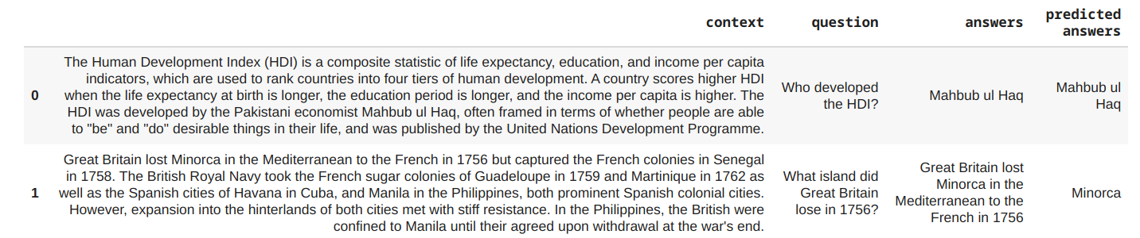
Test Results on Question Answering
Notes:
As I mentioned, quantify the performance of a model in question answering is difficult. One way is with the percentage of exact match, but it does not show a real feedback, since sometimes the answer is correct but it is not the selected one.
For example, here we have two predictions from my model. As you can see the first one is an exact result. However, the second one not, and at least for me it would be a correct answer, but shorter.

Slide 31
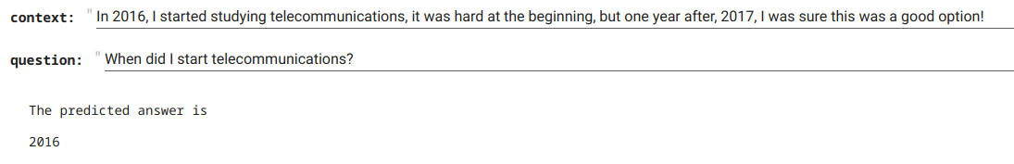
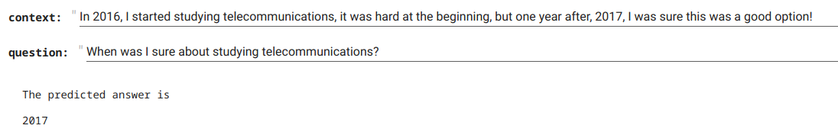
Final Application for Question Answering
Same context but different questions
Notes:
As before, I developed a final pipeline where you only have to introduce a context and a question. And as you can see, the model provides you the answer.
It is also published in my GitHub as well as the implemented model.

Slide 32
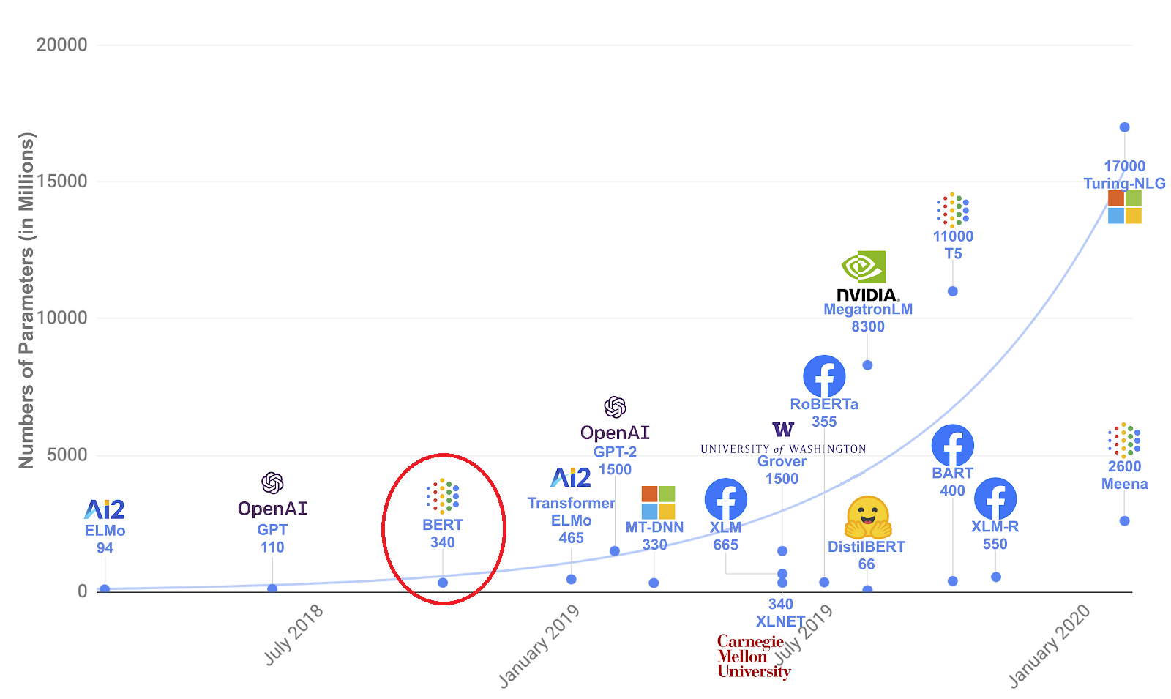
Conclusion
Transformer and self attention defined current state-of-the-art architectures
BERT boost pre-trained language models
State of the art models in multiple NLP tasks
Fine-tune in short times
Notes:
To conclude I would like to remark in some points.
First, the transformer and its pure self-attention mechanism defined current state-of-the-art architectures.
Second, BERT boost pre-trained language models and defined the current trend into NLP. As I have shown, it can be used to develop state-of-the-art models in multiple NLP tasks.
In spite of being a novel model, the industry is evolving so fast and the research is in continuous operation. Powerful companies are leading the field, as Google, Facebook, or Microsoft. Subsequent models followed the trend of increasing the number of parameters to get better results, which has been criticized, since they do not provide nothing new in most of the cases, it is only a matter of computational resources. Others tend to look for alternatives more optimized and with less parameters, as DistilBERT from Hugging Face.

Slide 33
Thank you for your attention
Notes:
Thank you so much for your attention. I will be happy to answer any question you have. Thank you.

