Slide 1
Milestone 4: Presenting your findings
John Leon
17/06/2023

Slide 2


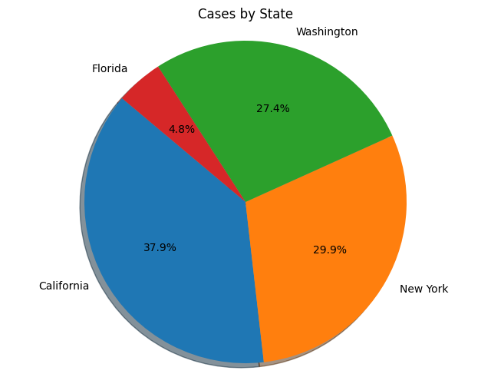
Exploring the Dynamics of COVID-19 Spread in 2020
This research project aims to analyze COVID-19 data, including information on date, county, state, FIPS codes, cases, and deaths. The objective is to investigate specific aspects related to the spread of the virus and its impact on sectors near the most affected counties
I have chosen the NYT Covid19(20) dataset, I think it will be a good topic to analyze. The data are obtained from the following repository https://github.com/nytimes/covid-19-data

Slide 3
Questions
When did coronavirus cases start growing at an accelerated rate?
Were the sectors near the counties with the highest covid cases affected by these?
Did the most affected counties manage to stabilize infections?

Slide 4
Initial Hypothesis
COVID-19 cases began growing at an accelerated rate in a specific time period, indicating a significant increase in transmission.
Sectors near counties with the highest COVID-19 cases experienced notable disruptions and adverse effects due to the pandemic.
The most affected counties implemented measures that successfully stabilized the number of COVID-19 infections over time.

Slide 5
Data Analysis Approach
For Question 1, conduct a time series analysis on the COVID-19 cases to identify the specific period when the growth rate increased significantly. This analysis will involve examining the rate of change in cases over time and identifying any inflection points or sudden spikes in the data.
For Question 2, analyze the proximity of sectors (such as healthcare, education, tourism, etc.) to the counties with the highest COVID-19 cases. Investigate any observable impacts on these sectors by considering indicators such as business closures, employment rates, and economic downturns.
For Question 3, analyze the trends in COVID-19 cases for the most affected counties over time. Examine the implementation of various interventions, such as social distancing measures, testing and tracing strategies, and vaccination campaigns, to evaluate their impact on stabilizing the number of infections.

Slide 6
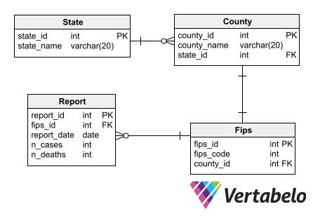
ERD

Slide 7
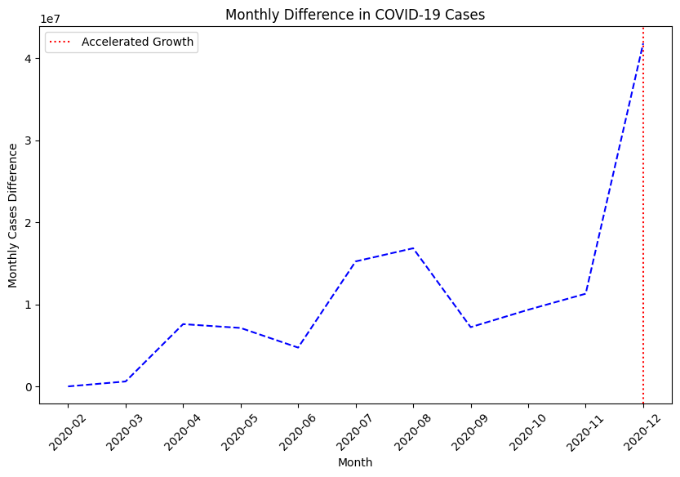
Research Computing for question 1
Based on the analysis of the monthly difference in COVID-19 cases, it is evident that the growth of cases is not following a steady pattern. Instead, we observe fluctuations and periods of partial COVID-19 management or even a gradual decline in cases.
Prior to February, there was a continuous increase in COVID-19 cases, indicating a rapid spread of the virus during that period. However, starting from February, the growth rate of cases started to fluctuate, with periods of acceleration followed by periods of depreciation.
Notably, the peaks in COVID-19 cases occurred in March, June, and November. Interestingly, after each peak, there was a subsequent decline in the number of cases within a period of one to two months. This suggests that measures taken to control the spread of the virus, such as lockdowns, social distancing, and increased testing, were effective in reducing the number of new infections.
These findings highlight the importance of implementing timely interventions to mitigate the spread of COVID-19. The observed fluctuations in case growth emphasize the need for continued vigilance and adherence to preventive measures even during periods of relatively lower case numbers. By closely monitoring the trends in COVID-19 cases and implementing appropriate measures, we can work towards managing and controlling the impact of the pandemic more effectively.

Slide 8
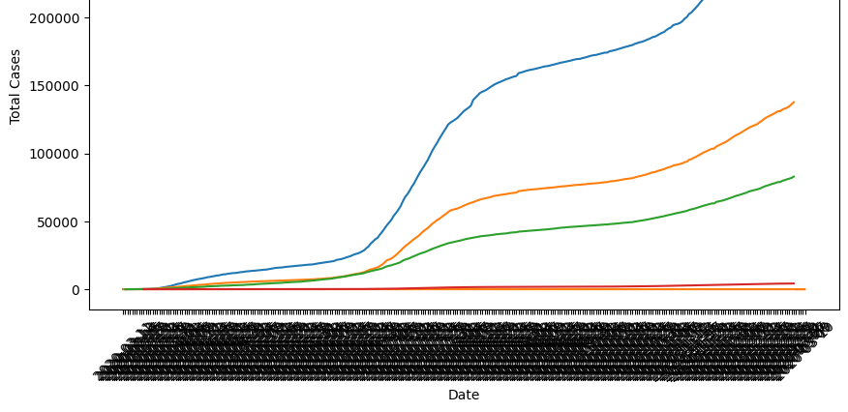
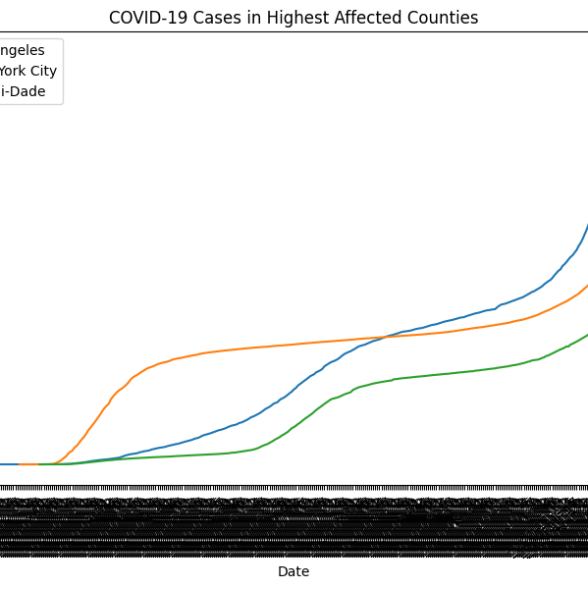
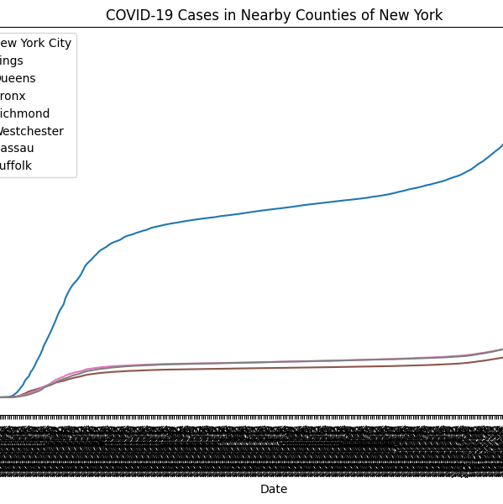
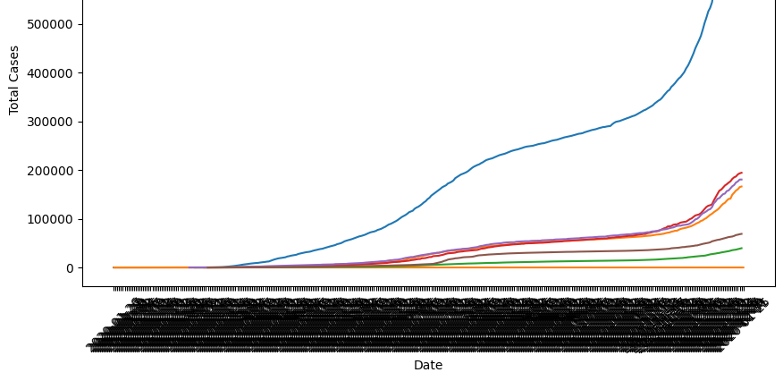
Research Computing for question 2
The analysis focused on assessing the impact of COVID-19 cases in nearby counties of Los Angeles, New York City, and Florida. The findings reveal interesting patterns and variations among these regions.
In the case of Los Angeles, none of the counties near Los Angeles demonstrated COVID-19 case numbers as high as Los Angeles itself. Although there were temporal similarities in terms of peaks or spikes in cases, it can be concluded that the neighboring counties were not significantly affected by the high COVID-19 case count observed in Los Angeles. This suggests that there might have been distinct factors influencing the spread of the virus in Los Angeles compared to its neighboring counties.
Similarly, the analysis of New York City and its nearby counties indicated that the counties in close proximity did not experience the same level of impact from COVID-19 cases as New York City. The curves representing the nearby counties demonstrated a clear divergence from the trajectory of New York City's cases. This suggests that the containment measures and dynamics of the virus transmission may have differed between New York City and its neighboring regions.
In contrast, the analysis of Florida, specifically focusing on Miami-Dade and its nearby counties, revealed a notable influence of Miami-Dade's COVID-19 cases on the surrounding areas. The peaks or spikes in cases were observed to be shared among the counties in close proximity to Miami-Dade. This suggests a closer interconnectedness and potential transmission dynamics between Miami-Dade and its neighboring counties, resulting in similar patterns of COVID-19 cases.
Overall, these findings highlight the importance of considering the specific dynamics and geographical factors when examining the impact of COVID-19 cases in nearby counties. The varying patterns observed in different regions emphasize the need for tailored strategies and localized interventions to effectively mitigate the spread of the virus and protect public health.

Slide 9
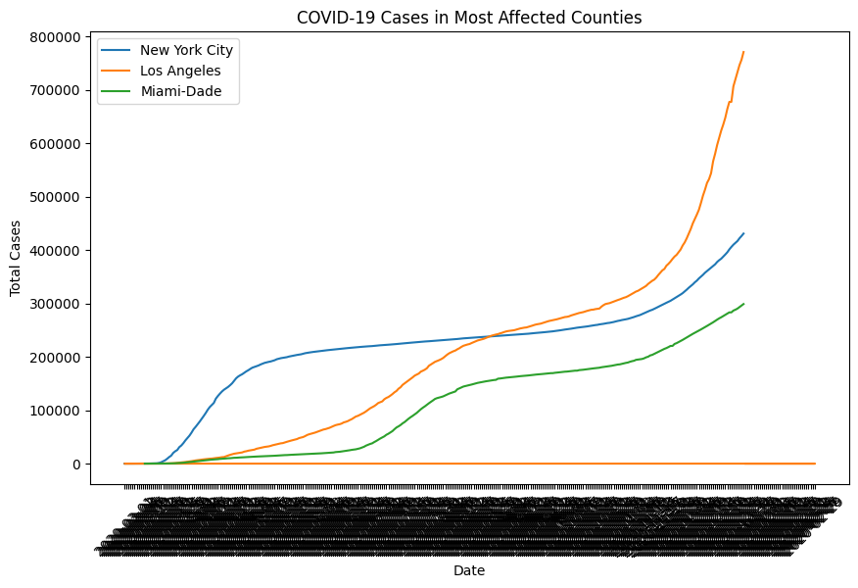
Research Computing for question 3
Based on the analysis of the COVID-19 data, we observed distinct patterns in the number of cases in New York City, Los Angeles, and Miami-Dade counties. In the case of New York City, it experienced a high number of cases in the initial stages of the pandemic. However, the city was able to effectively contain the spread of the virus for a considerable period, roughly from April to October. This suggests that the stringent measures and interventions implemented in New York City during that time were successful in curbing the transmission of COVID-19.
In contrast, Los Angeles and Miami-Dade counties exhibited a different trend. These counties continued to experience increasing numbers of COVID-19 cases, with evident peaks or rises in cases. Unlike New York City, there was no apparent control or indication of a pause or decline in reported cases on a daily basis in these counties. This suggests that the measures implemented in these regions were not as effective in managing the spread of the virus, leading to sustained transmission and a lack of control over the case numbers.
The observed trends highlight the importance of implementing and maintaining robust public health measures to control the spread of COVID-19. The success seen in New York City demonstrates the effectiveness of proactive measures in containing the virus, while the ongoing challenges in Los Angeles and Miami-Dade counties underscore the need for continued efforts to control the transmission and protect public health.
It is crucial for policymakers and health authorities to closely monitor the situation and adjust strategies accordingly, especially in regions experiencing sustained increases in cases. By learning from the successes and challenges observed in different areas, we can improve our response to the pandemic and work towards mitigating its impact on communities and healthcare systems.

