Slide 1
Introduction to Wastewater Management
Notes:
Stretch your face. Levity and structure. A toolkit for you to personalize to your area.

Slide 2
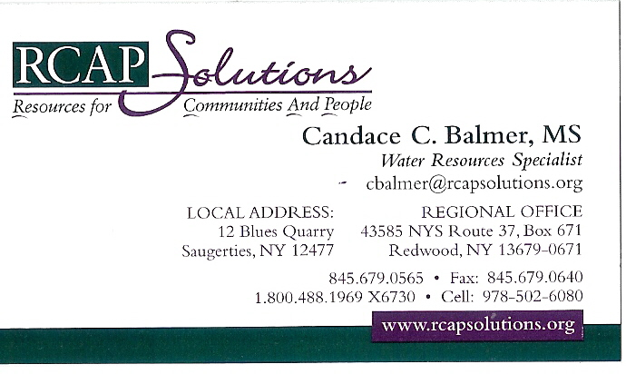
Notes:
Introduction. Tell something about yourself: my well and septic system.

Slide 3
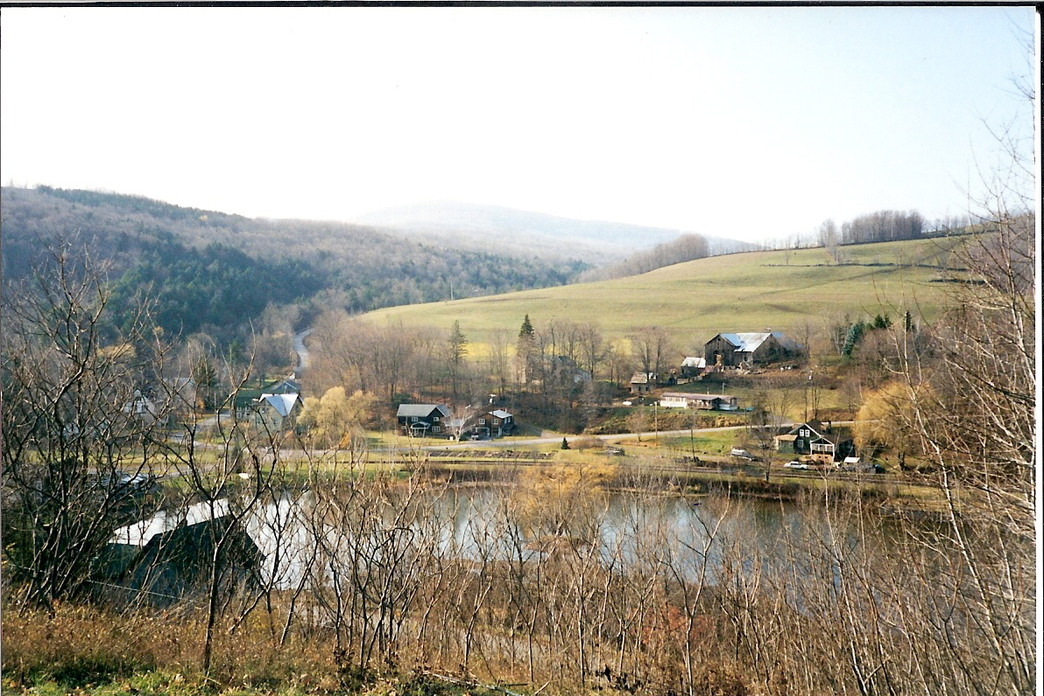
Notes:
Local pictures or photos of similar areas with similar needs and projects.
Most people think NY looks like NY City. This community was one of my first projects. It is located in the heart of the Catskill Mountains less than 150 miles from NYC.

Slide 4
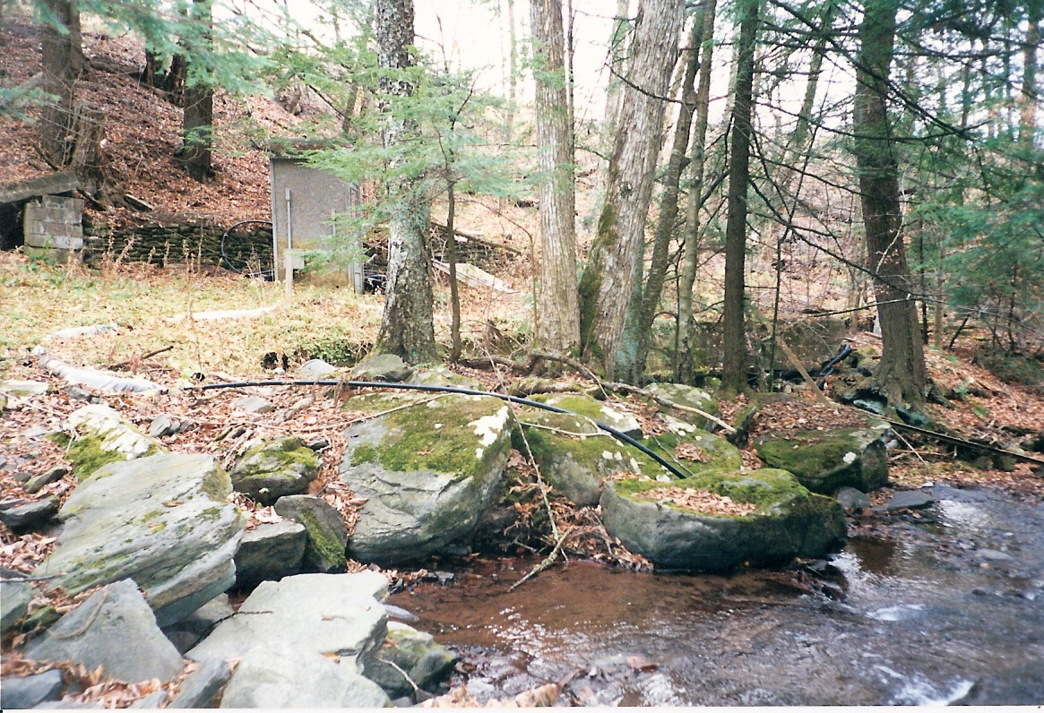
Notes:
The surface water supply which served about 40 or so homes, was vulnerable to contamination, as well as damage. The water supply was drawn from this stream, located in a deep ravine.

Slide 5
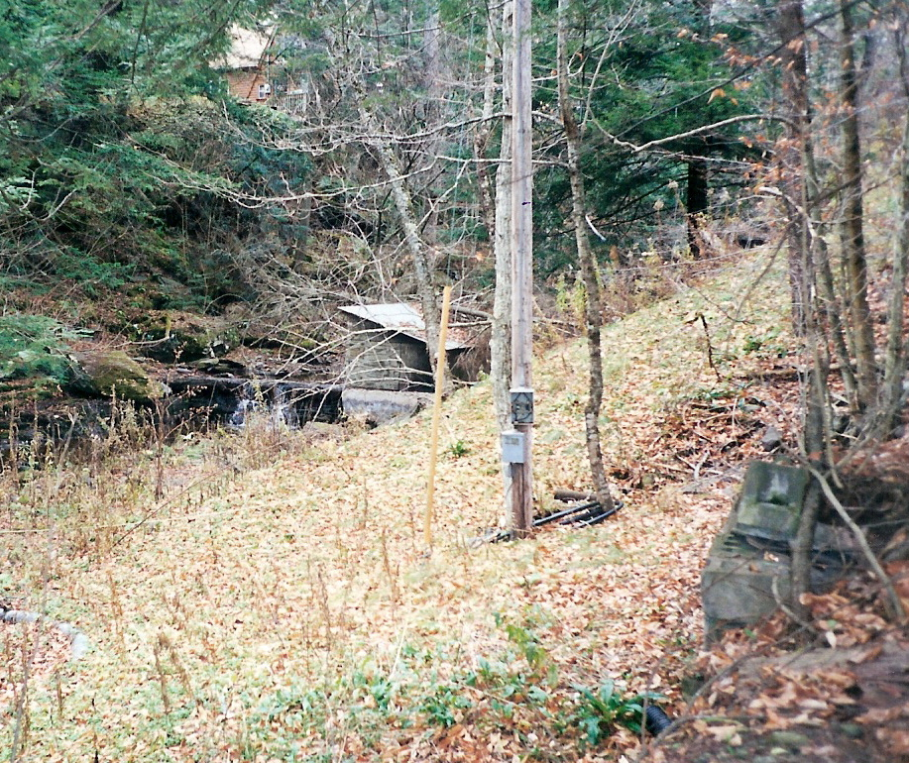
Notes:
The water intake and supply pipes were located in a deep ravine: one big flood could have taken out the intake pipes and the main distribution pipe.

Slide 6
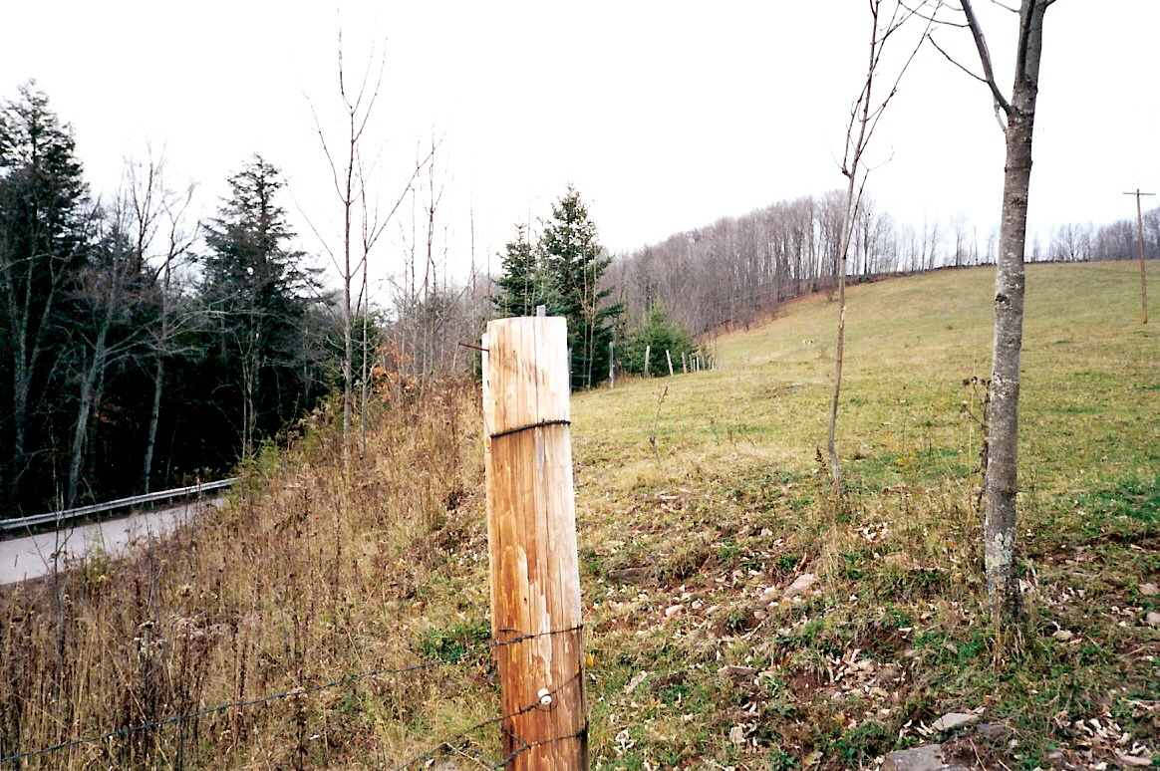
Notes:
Ultimately, new wells were installed on this hill. The biggest issue now is keeping the cows out of the wellhead protection area. On the left, on the other side of the road, and down, is the stream from which the original water supply was drawn. Interestingly, a dowser was used to locate the drilling site: in fact he has been called in on over 100 wells drilled by the same outfit.

Slide 7
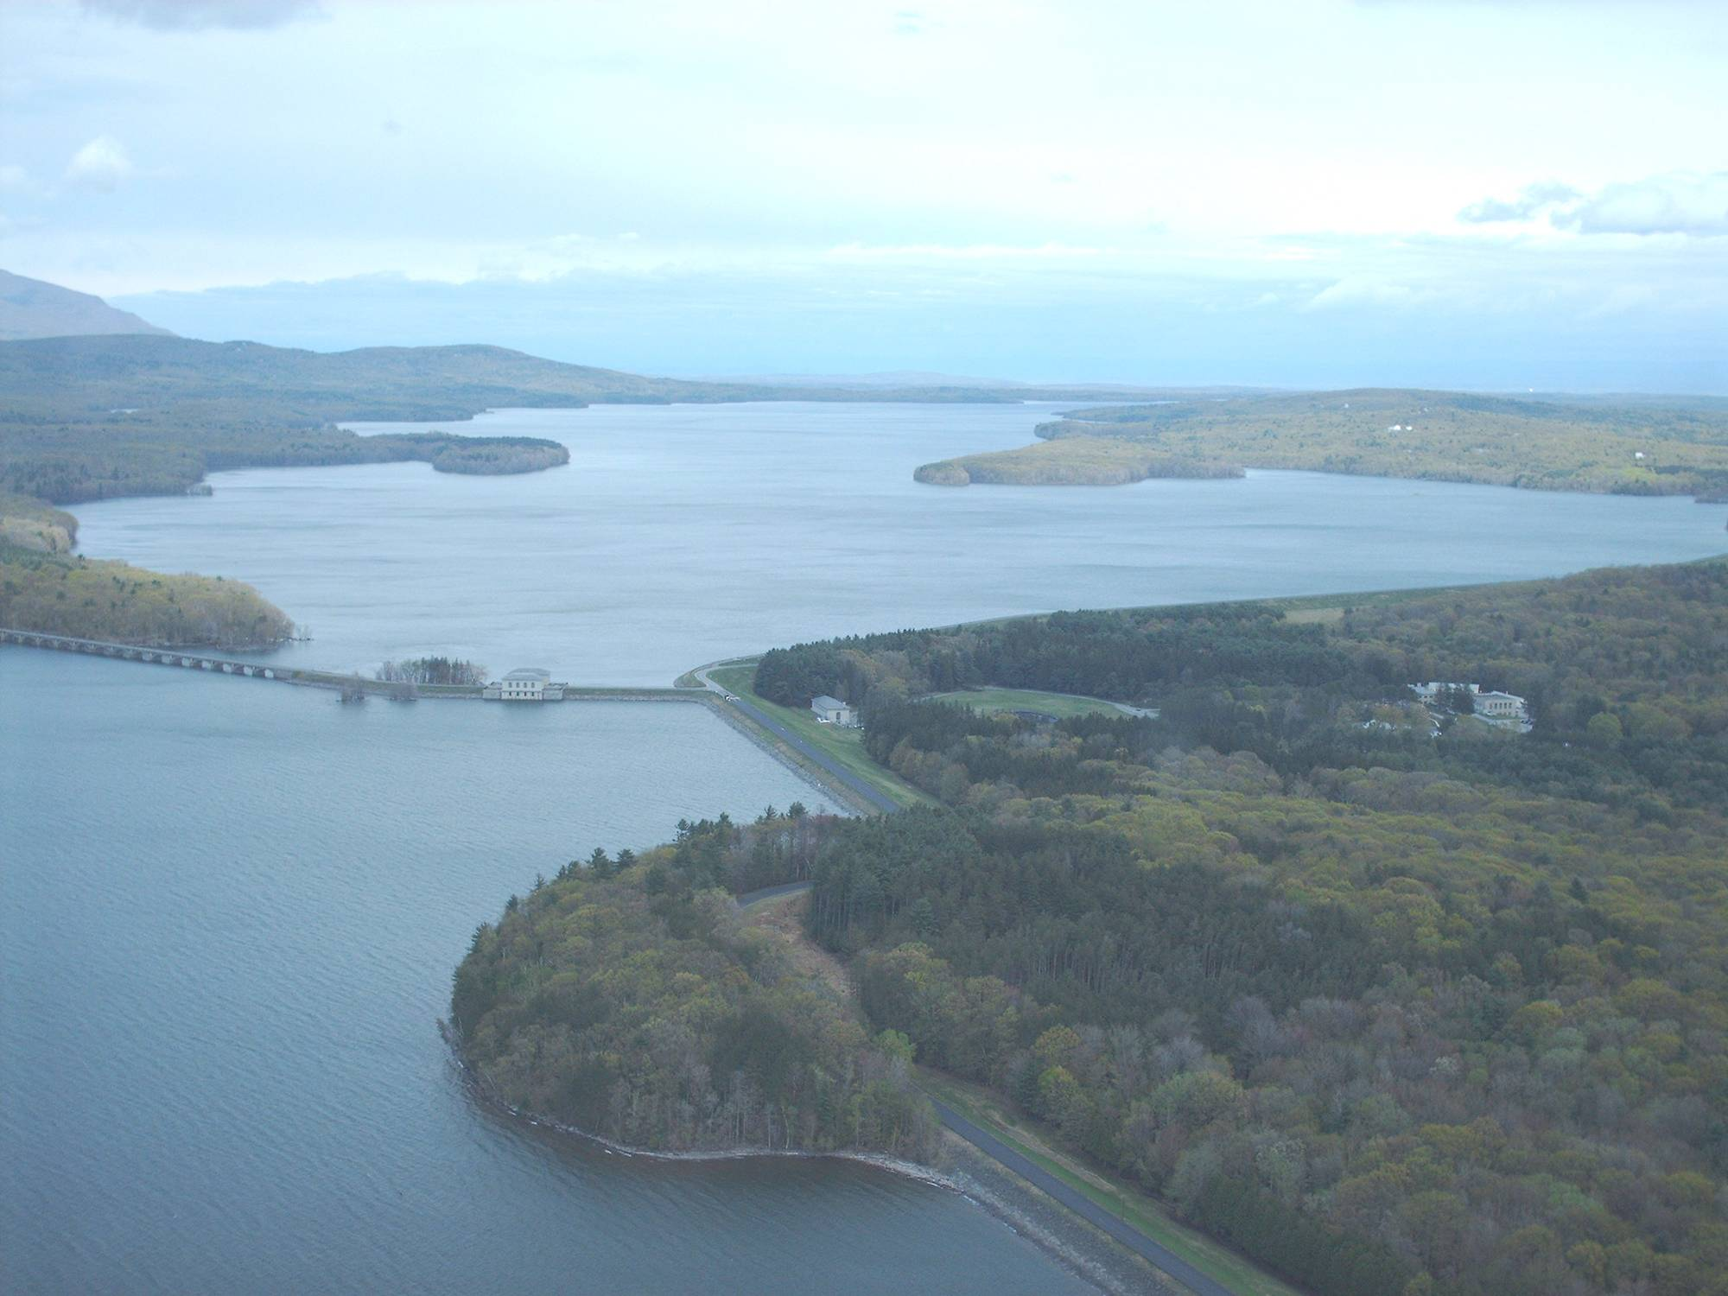
Notes:
The issues we are talking about today, the protection of drinking water supplies, also applies to large surface water supplies, like this, one of NYC’s reservoirs. Regardless of your water source, or its size, many of the same principles apply whether you are in Washington State, Louisiana or Maine.

Slide 8


Protecting Drinking Water through Strategic Wastewater Planning
Section I
Introduction
Notes:
Today, we are talking about…
In creating the modules, the hardest part was keeping it simple, yet as informative as possible. As this training moves through the RCAPs and out into the field, I imagine it will become more streamlined, essential, and tailored to fit the circumstances. Wide variety of experience will be represented in the room.

Slide 9
Wastewater Segment Objectives
Understand why and how to identify potential threats to source water from wastewater, especially onsite septic systems
Understand the mechanics of wastewater treatment and how septic systems can threaten ground and surface water supplies
Gain familiarity with a range of technical and management options for addressing threats from wastewater contamination
Gain familiarity with local and technical resources, including RCAP
Notes:
As a result of the training, participants will be able to:

Slide 10
Wastewater Segment Objectives
Understand the major categories of project planning activities
Appreciate the importance of viewing water supply protection and water resource management from a watershed, regional or multijurisdictional perspective
Understand the importance of recording data in a retrievable, useable and shareable format
Gain familiarity with techniques for identifying and attracting stakeholders to the planning process, re: application of social marketing
Notes:
As a result of the training, participants will be able to:

Slide 11
Wastewater Segment Overview
Introduction
Protecting Drinking Water from Wastewater Contamination
Introduction to Wastewater Treatment
Onsite Wastewater Treatment Overview
Advanced Treatment
Problem Characterization / Moving to Action
Maintenance and Management
Exercises
Notes:
Expect to cover 1 through 5 and perhaps begin 6 in the first half, then the rest of 6-8 in the second half.

Slide 12
Additional Tools
Sample Residential Wastewater Surveys
Sample Wastewater Survey Report Spreadsheet
EPA FRD-10 Onsite Systems PP
Onsite Regulations Matrix
Primacy Agency Spreadsheet
CCE Homeowner Recordkeeping Guide
RCAP Solutions Articles

Slide 13
Training Tips
Know your audience
Ice breakers
Use a scribe
Use pictures and diagrams
Don’t get too busy with slides
Verbally present material slightly differently than is shown on slide
Ask questions of the audience often
Use multiple examples and interactive exercises to make it “real”
Don’t use big words or acronyms without defining

Slide 14
Training Tips
More about the audience
Presentations are guidance
Pick and choose
Make it locally relevant
Add local and other case studies

Slide 15
More about the audience
Septic Professionals
Licensed Operators
Elected Officials
Homeowners Associations
Homeowners and Landowners
Special Interest and Civic Groups
Watershed Groups
Non-Community Water Systems
Notes:
These are the eight target audiences, not necessarily in order of priority, that were identified by the focus group held in April 08.

Slide 16
Acknowledgements
Anish Jantrania, VA Dept. of Health
Consortium of Institutes for Decentralized Wastewater Treatment (CIDWT)
NESC
NY Onsite Wastewater Treatment Training Network (OTN)
RCAP Solutions
Skaneateles Lake Onsite Demonstration Project
US EPA
Notes:
Many of these slides were created by others and the source is so noted on the slides themselves.

