Slide 1
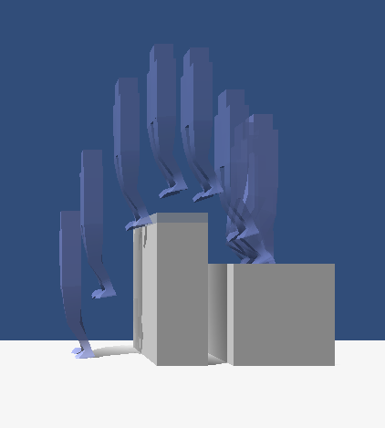
Controller for Jumping Animations to Achieve Target Positions
Ian Ooi

Slide 2
Agenda
Introduction
Skeleton and Muscle Setup
Torque-based Simulation
Energy-based Simulation
Limitations
Visualization
Future Work

Slide 3
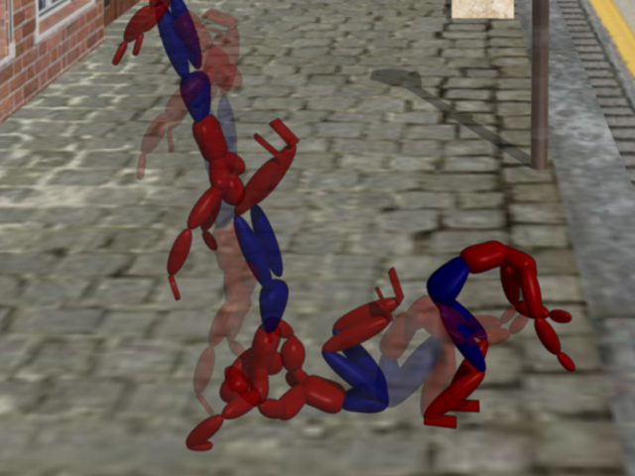
Overview
Animation is hard
Work and time intensive process
Use physics simulation to reduce work in part of the process

Slide 4
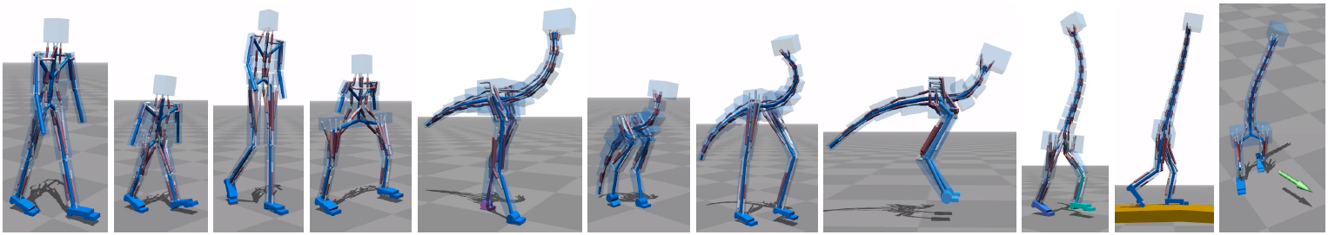
Simulating for Animation
Simulate muscles to produce a motion/pose for a character's body
Muscle → Force → ? → Position/Velocity
First need a representation of the character and of a jump

Slide 5
Related Work
Falling and Landing Motion Control for Character Animation, Sehoon Ha, Yuting Ye, and C. Karen Liu. 2012
Flexible Muscle-Based Locomotion for Bipedal creature, Thomas Geijtenbeek, Michiel van de Panne, and Frank van der Stappen. 2013
Unity3D Mecanim
Autodesk 3ds Max Footprints

Slide 6

Jumping
Acceleration of center of mass (CoM) against gravity
Controller handles the jump until the character lands

Slide 7

Jump Stages
Path Estimation (before jump)
Windup (a)
Thrust (b)
In-Air (c)
Landing (not pictured)

Slide 8
Agenda
Introduction
Skeleton and Muscle Setup
Torque-based Simulation
Energy-based Simulation
Limitations
Visualization
Future Work

Slide 9
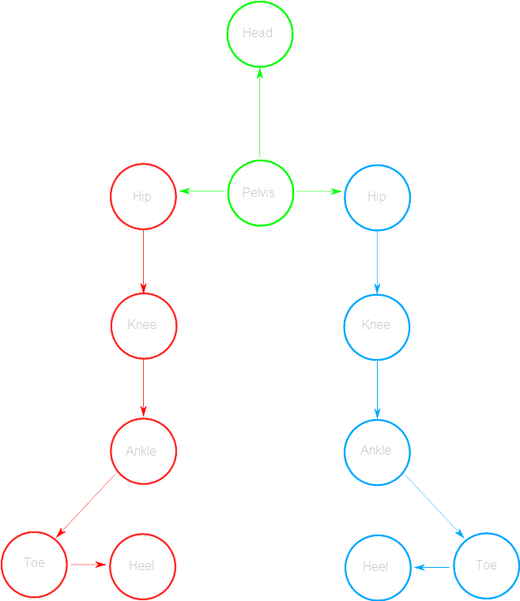
Skeleton Setup
Use rig (skeleton) with mesh created by artist
Joint has position, rotation, scale
  Specific to this simulation, also stores the mass of the limb
  Constraints on motion
Tree of joints

Slide 10
Muscle Force
Muscle == Spring (approximately)
Linear springs (Hooke's Law):
Force (F)
Spring Constant (k)
Spring Displacement (s)

Slide 11
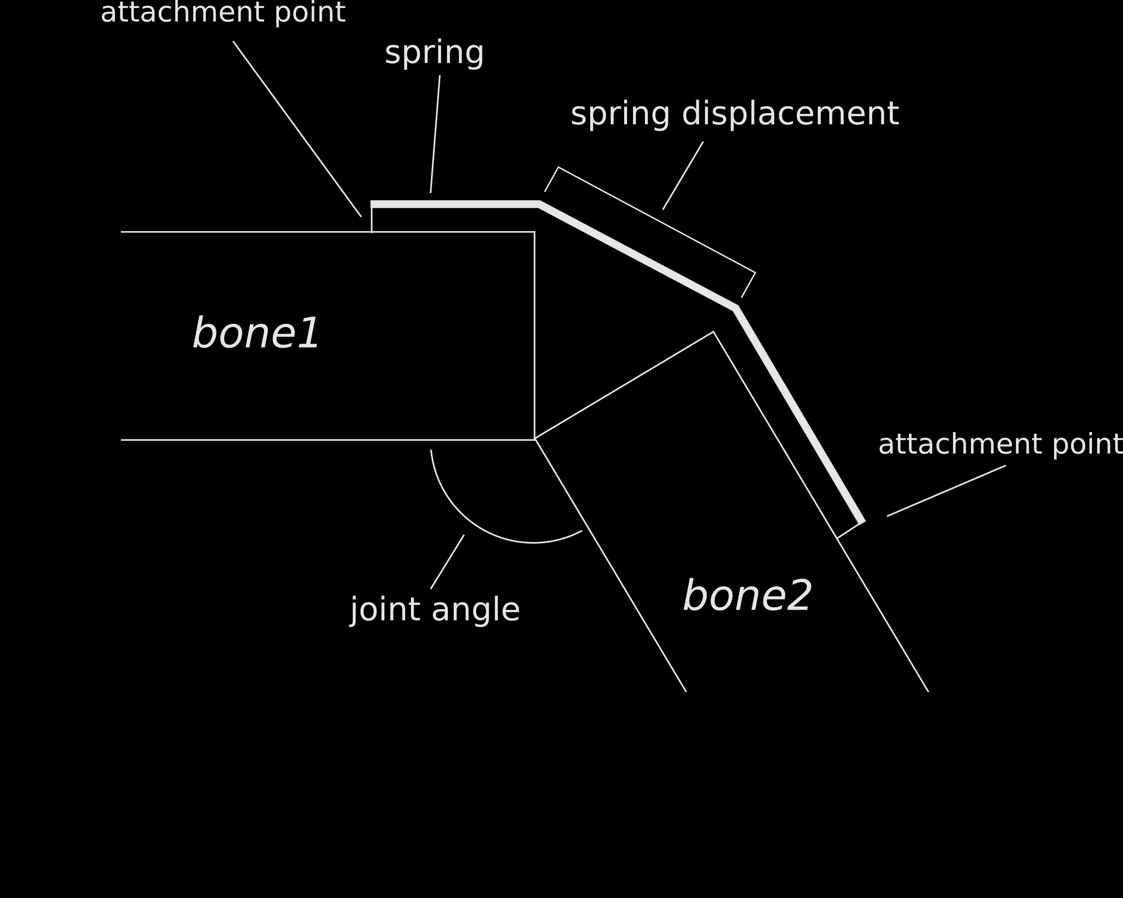
Muscle Setup

Slide 12
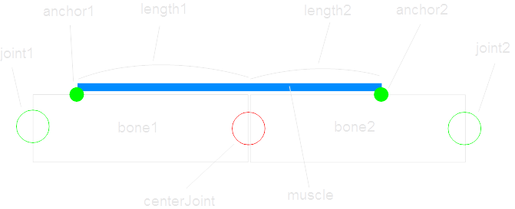
Muscle Setup
3 Joints: crosses center joint, anchored near other two

Slide 13
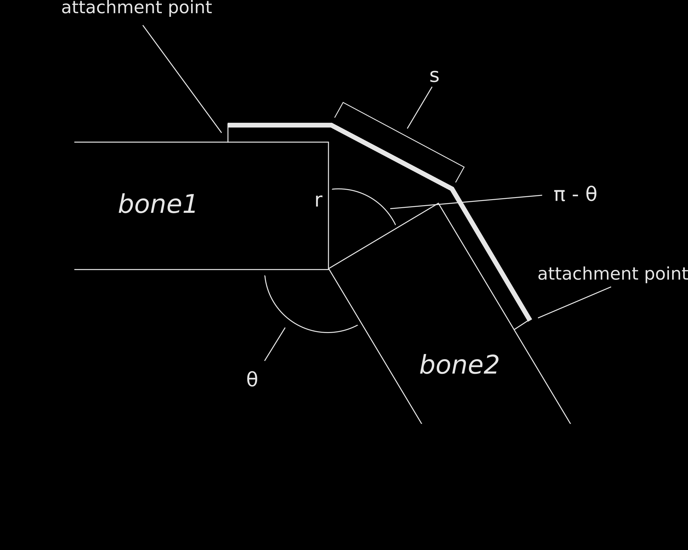
Calculating Spring Displacement

Slide 14
Selecting k
Use displacement (s) calculated previously, calculate force
Need k value for F = -ks
Found empirically to reach 1-1.5m long jump and 0.5-0.75m vertical jump

Slide 15
Agenda
Introduction
Skeleton and Muscle Setup
Torque-based Simulation
Energy-based Simulation
Limitations
Visualization
Future Work

Slide 16
Muscle Force and the Skeleton
Can't just sum the forces of each muscle
Muscles produce a torque on the joint

Slide 17
Torque and Motion
Torque is related to angular momentum
Angular momentum → linear momentum (direction is tangent to circle)

Slide 18
Torque and Motion
Linear momentum relates to acceleration
Find the direction for p by finding the tangent to the circle traced by the limb at timestep, constantly changing
Perform for all muscles to find acceleration for body

Slide 19
Torque and Body Pose
Have an estimate of what the skeleton can do at a particular body pose
How to pick a pose?

Slide 20
Path Estimation
Estimate desired initial velocity and acceleration
Classical mechanics
Forward kinematic “path” through the air

Slide 21
Path Estimation – Calculating Velocity
Estimate initial velocity to travel over distance given constant acceleration due to gravity

Slide 22
Path Estimation – Calculating Acceleration
Assuming we start at rest, acceleration is:
To accommodate initial velocity:

Slide 23
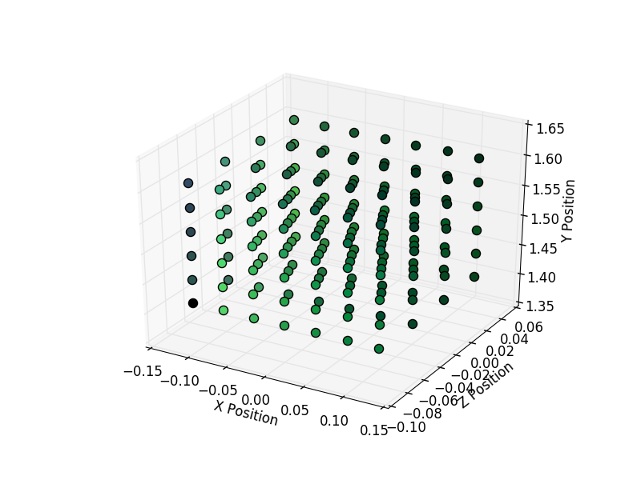
Windup - Finding the Pose
Sample poses of the skeleton
Given varying pelvis position, solve IK problem to find pose of legs and calculate output acceleration
How to solve IK?

Slide 24
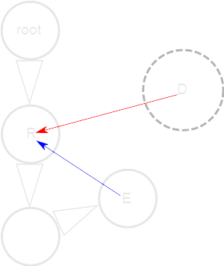
Windup – IK Solving
“Kine” by Jeff Landers
Cyclic Coordinate Descent
Simple, greedy method
Use dot product to find angle between vectors, rotate by that angle

Slide 25
Windup – Restricting the Samples
Many different positions for the skeleton, most of which are “invalid” due to balance issues
Should restrict the sample region to the area where the character is balanced

Slide 26

Windup – Balance and CoM
Character balanced when CoM is over the supporting polygon (rectangle around contacts with ground)
Error calculated by projecting CoM onto plane of supporting polygon
2D distance from polygon centroid

Slide 27
Windup – Sampling and Finding Poses
Sample uniformly within prism in which the character is balanced (supporting polygon up to pelvis height when extended)
Position pelvis and collect torques and acceleration
Order by acceleration error, collect lowest, choose among those by balance.

Slide 28
Windup – PD Control
Proportional Derivative control used for positional adjustments and for upper body balance adjustments
Feedback control based on proportion of error and change in error
Output u at time t based on the error function e
Constants kp and kd adjust rate of change

Slide 29
Thrust – Angular Acceleration
Torque gives angular acceleration through moment of inertia I.
Where r is the length of the limb:

Slide 30
In-Air
Rigid body physics simulation
Move the character as a whole based on the velocity and acceleration from gravity

Slide 31
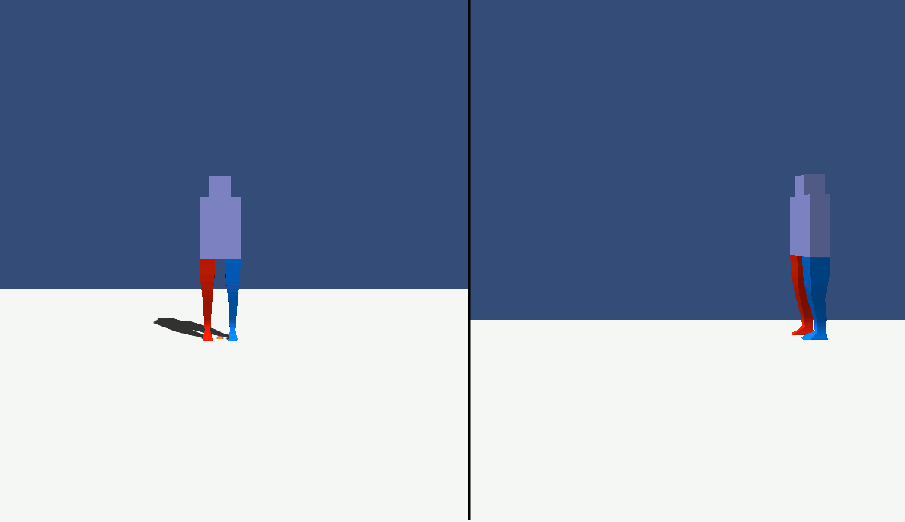
Torque-based Simulation Result

Slide 32
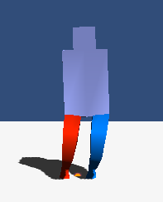
Torque-based Simulation Result
Issues, some unknown bug
Inconsistent convergence
Favors one side for a straight long jump
After fixing some bugs, more consistent but still unstable

Slide 33
Agenda
Introduction
Skeleton and Muscle Setup
Torque-based Simulation
Energy-based Simulation
Limitations
Visualization
Future Work

Slide 34
Energy-based Simulation
Alternative method to torque
  Attempts to avoid repeated work
Consider the total elastic energy of the muscles of the character
Modify windup and thrust stages

Slide 35
Energy-based Muscle Calculation
Elastic potential energy for a muscle
Energy sums simply, no need to calculate resultant as with torque

Slide 36
Energy-based Path Estimate
Instead of comparing to acceleration, compare to required kinetic energy
Calculate velocity as before:
Kinetic energy:

Slide 37
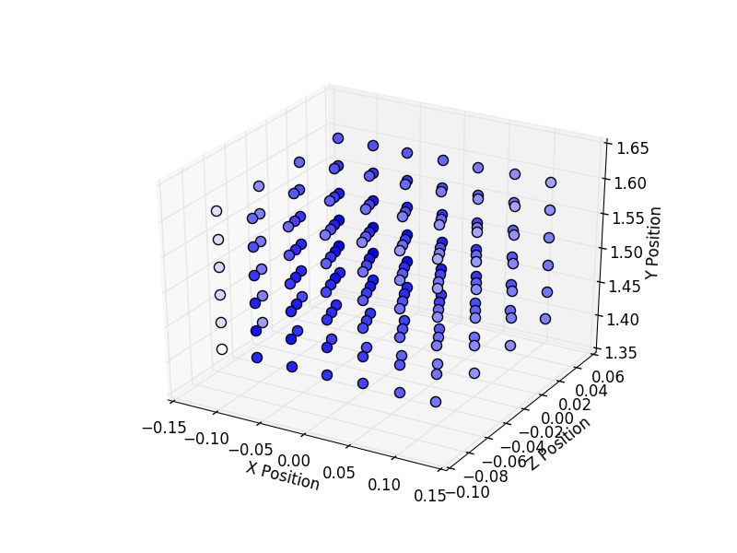
Energy-based windup
Sampling used again with PD control
Looking for an assignment of bends of the joints that produce the desired total energy (or greater)

Slide 38
Energy-based Thrust and In-Air
Direction of motion assigned to the desired direction
Continually extend, moving pelvis in desired direction accelerating to reach target velocity at full extension
Extension performed within given windup time
In-Air proceeds as before

Slide 39
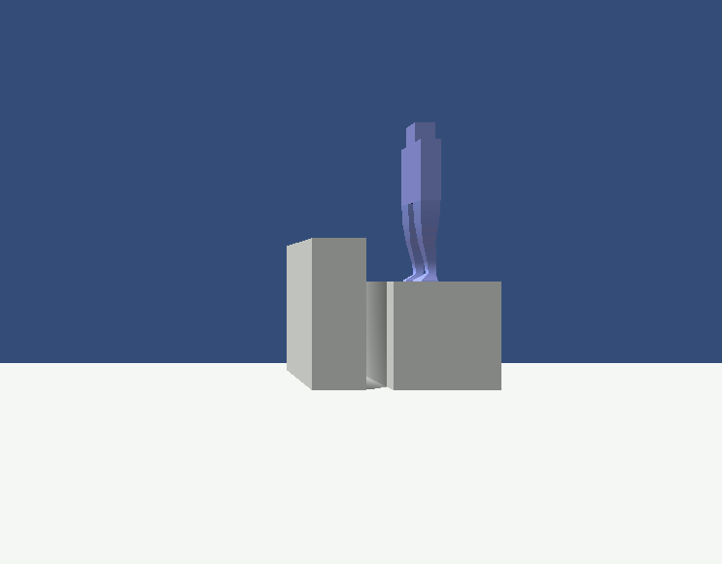
Energy-based Results

Slide 40
Agenda
Introduction
Skeleton and Muscle Setup
Torque-based Simulation
Energy-based Simulation
Limitations
Visualization
Future Work

Slide 41
Limitations
Issue in torque-based simulation
Less flexible than specifying per frame
Requires specification of muscle and world constants
Lack of upper body definition in current simulation

Slide 42
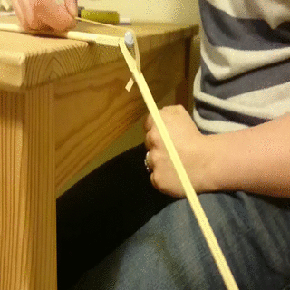
Limitations - Lack of Patella
Image retrieved from: http://imgur.com/KSMB2tI [Accessed March 15, 2016]

Slide 43
Agenda
Introduction
Skeleton and Muscle Setup
Torque-based Simulation
Energy-based Simulation
Limitations
Visualization
Future Work

Slide 44
Visualization of Motion
Used for debugging, viewing, and presentation
Types used:
  Trails following parts of the character
  Ghost images of the character
  Composites of frames
  Animated sequences/Sequences of frames
  Gizmos/Handles (Unity3D features)

Slide 45
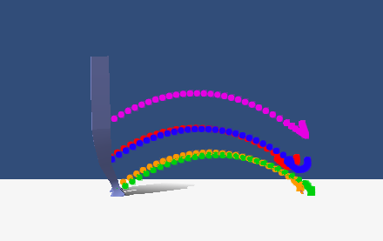
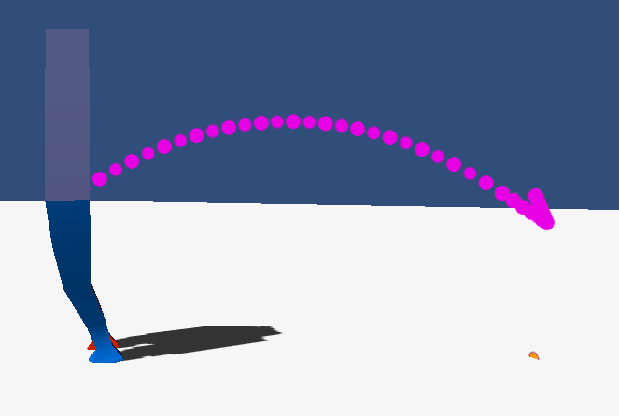
Trail Visualization
Marker particles placed at position of joint at certain rate
Questionably useful for windup/thrust phases
Good for tracing in-air path
Shows some IK twisting issues

Slide 46
Trail Visualization

Slide 47
Trail Visualization

Slide 48
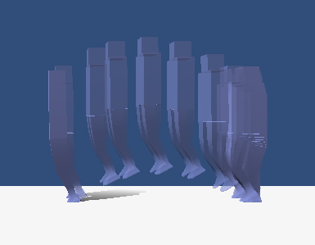
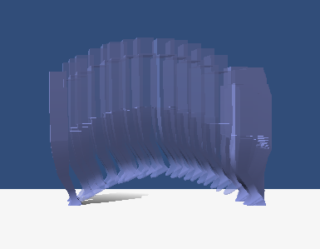
Ghost Image Visualization
Instead of leaving a dot behind, leave a copy of the character mesh
Messy and busy visual, but can show issues in timing and positioning

Slide 49
Ghost Image Visualization

Slide 50
Ghost Image Visualization

Slide 51
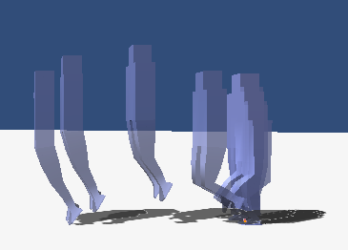
Frame Composite Visualization
Select few frames
Matte image
Composite mattes
Similar issues to the ghost image visualization

Slide 52
Animated Sequences
GIFs as seen in results slides
  Only usable in digital formats
Sequences of frames (for print formats)
  Long sequences of frames
  space consuming
  not very clear (user must glance between many frames across several images or over a long image)

Slide 53
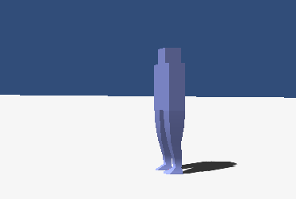
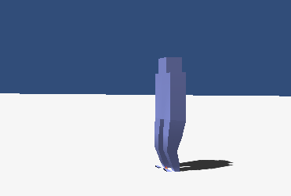
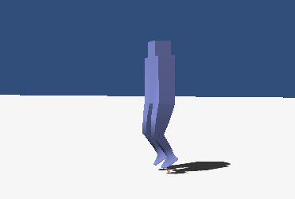
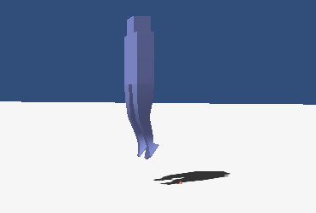
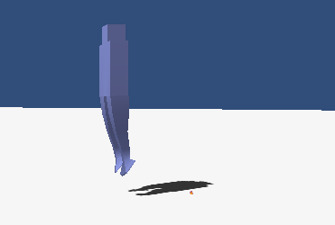
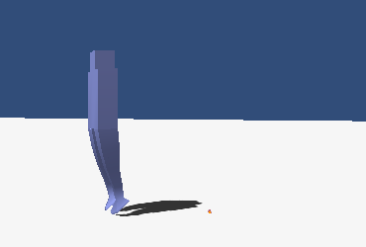
Frame Sequence

Slide 54
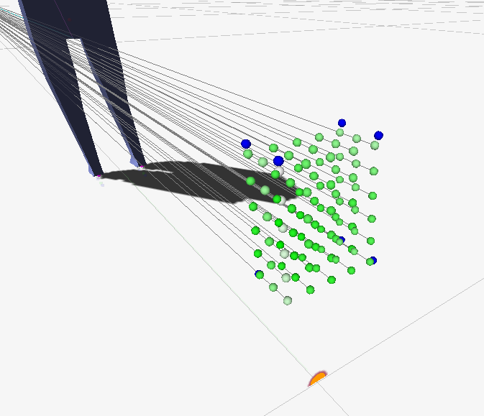
Gizmos
Debugging visuals provided by Unity3D
Used for visualizing vectors and samples

Slide 55
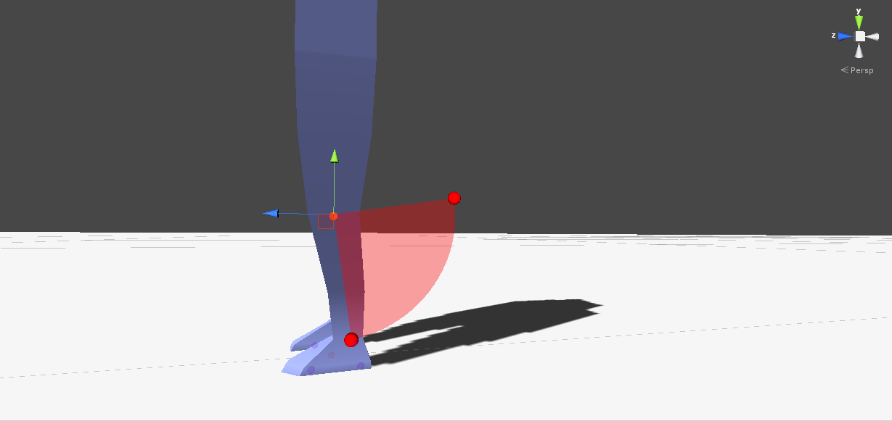
Handles
Used for visualizing joint constraints
Allows visual editing of joint constraints

Slide 56
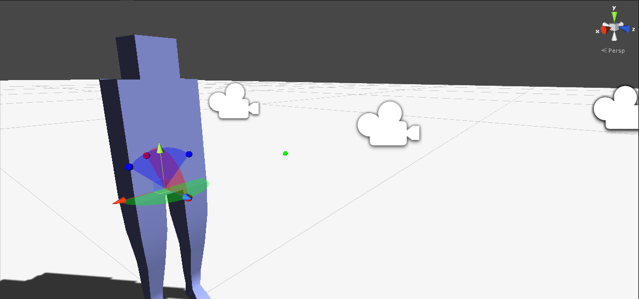
Handles

Slide 57
Agenda
Introduction
Skeleton and Muscle Setup
Torque-based Simulation
Energy-based Simulation
Limitations
Visualization
Future Work

Slide 58
Future Work
Allow specification by desired height
  Jump over achieved by changing times, can instead detect required height and modify time accordingly
Attempt a learning approach
Complex in-air control
  Flips/Acrobatics
  Vaults

Slide 59
Thank you for your time

