Slide 1

Coca Cola How did Ronaldo’s comments affect the customers perception of the brand?
Sentiment Analysis
Ioana ispir
Tiberiu Stoica
Adriana Nicoleta Stroe

Slide 2
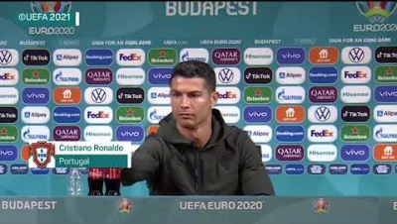
The Event
What?
Ronaldo promptly removes the Coca Cola bottles (one of the main sponsors of the tournament) from the shot and encourages his viewers to drink water.
Where?
Euro 2020 first pre-match press conference.
When?
14 June 2021

Slide 3
The Analysis - Methods
Sentiment Analysis:
Reviewing the sentiment of Twitter users regarding Coca Cola before and after the event
Visualization Tools:
Visualizing the most common words used in Tweets regarding Coca Cola before and after the event in the form of Wordclouds and bar charts
T Test:
Comparing the means of the Twitter users sentiment regarding Coca Cola before and after the event
Stock Market:
Reviewing Coca Cola’s share prices before and after the event

Slide 4


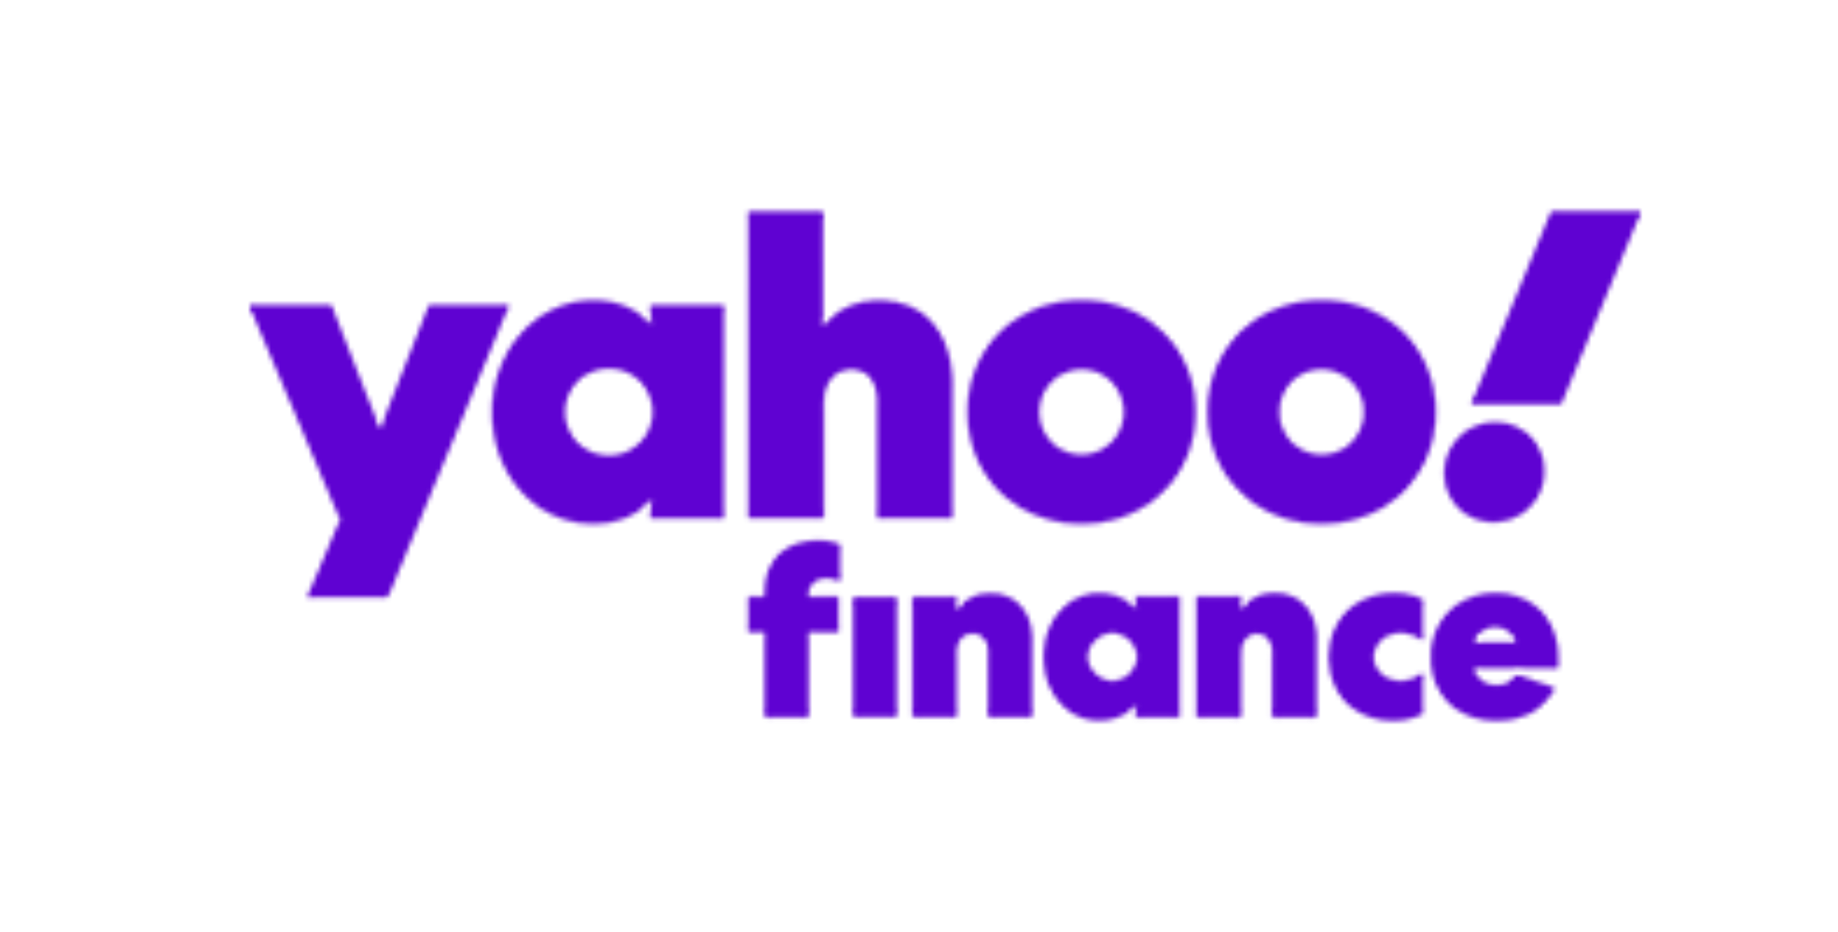
The Analysis - Means
Twitter Developer
Anaconda – Spyder – Python
Yahoo Finance

Slide 5
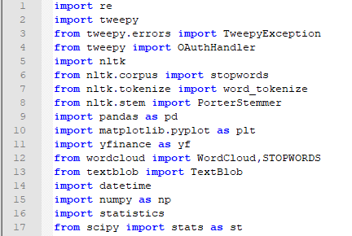
The Code – Importing libraries

Slide 6
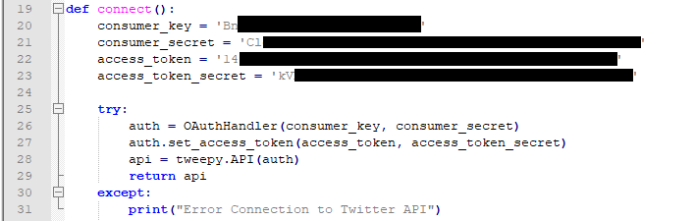
The Code – Connecting to Twitter’s API

Slide 7
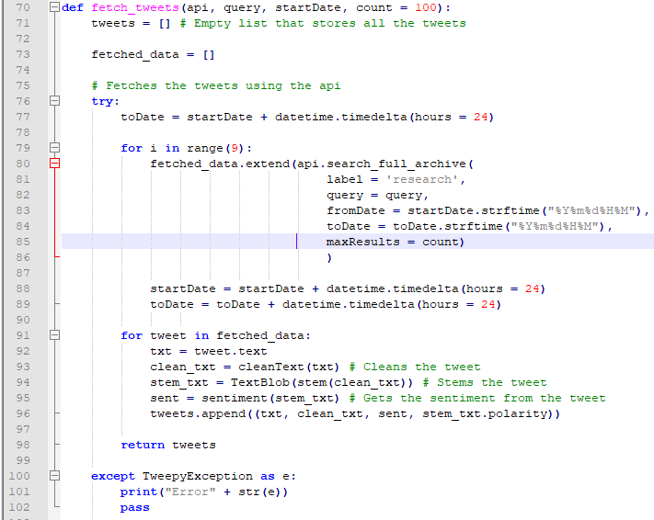
The Code – Fetching the tweets 1

Slide 8
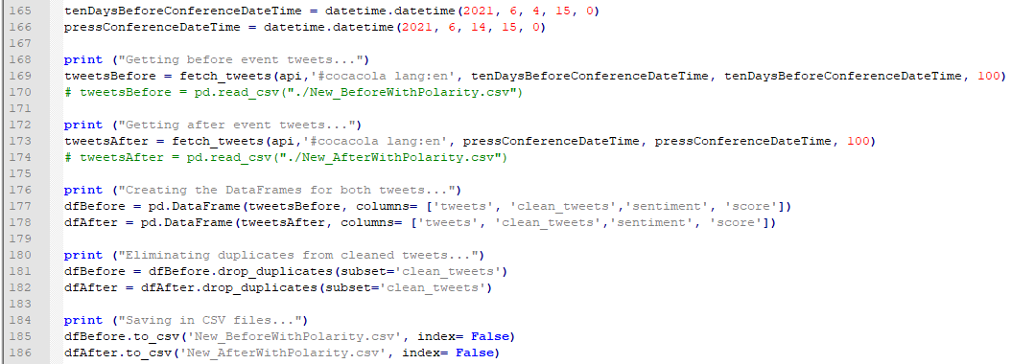
The Code – Fetching the tweets 2
We called the Twitter API twice and obtained 2 sets of data, before and after the event. Before saving the data, we dropped the duplicate tweets.
We created then 2 datasets that were saved as CSV files for later use, as the Elevated Acces on the Twitter Developer Platform only allowed us to extract a maximum of 5000 tweets/ month, so we could not retrieve the tweets every time we wanted to test the later parts of the code.

Slide 9
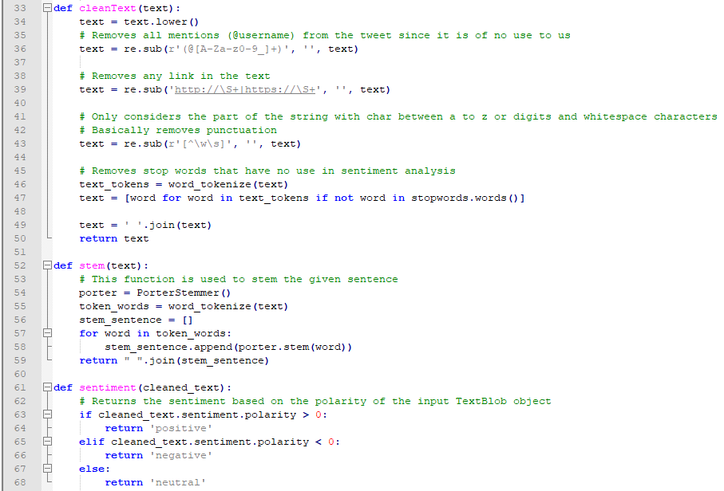
The Code – Preparing the tweets
We defined functions for:
Cleaning the data: removing usernames, links, punctuation marks, stop words
Stemming each word in every sentence, to categorize or count words more easily
Returning a sentiment (positive, negative, neutral) depending on the sentiment score of each sentence (which had received a score ranging from -1 to +1 by using the TextBlob library).

Slide 10
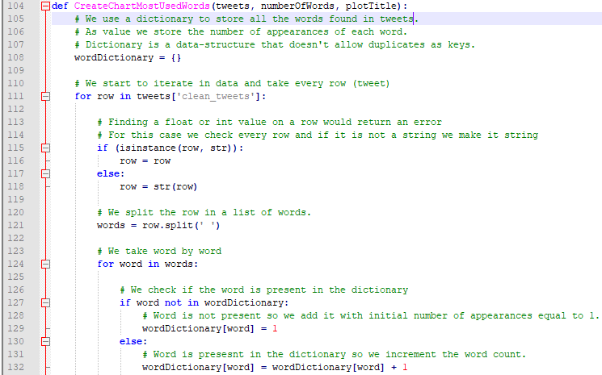
The Code – Visualisation Tools 1. Charts
To create a chart with the most commonly used words in tweets related to Coca-Cola before and after the event, we started by defining a function that would count the number of appearances of each word.

Slide 11
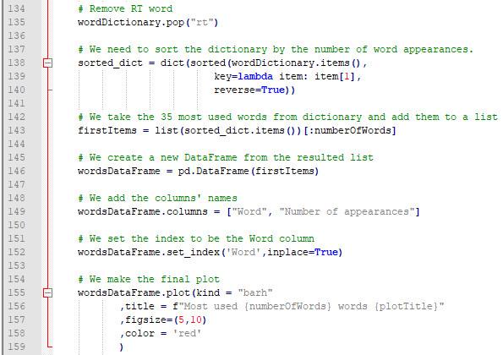

The Code – Visualisation Tools 1. Charts
We removed the rt (retweets) word from our results, since we considered it irrelevant for the chart. We performed this operation at this time, because we could no longer adjust the part of the code in relation to the extraction of the tweets and run a new query on Twitter’s API, as we had already reached the maximum number of fetched tweets.
We then obtained the top 35 words and plotted the results.

Slide 12
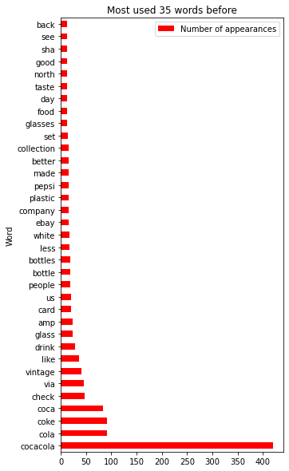
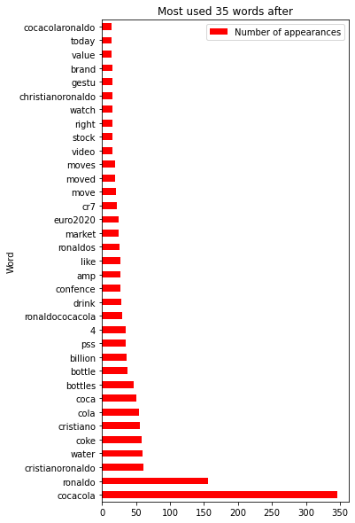
Results – Visualisation Tools 1. Charts
The results show us that while Coca-Cola remained the most used word (which was of course expected), the conversation relating to the company after Ronaldo’s comment and gesture during the press conference changed the content of tweets dramatically. We can observe the association of the company’s name with words such as: Ronaldo, CristianoRonaldo, water, Cristiano, conference, Euro2020.

Slide 13
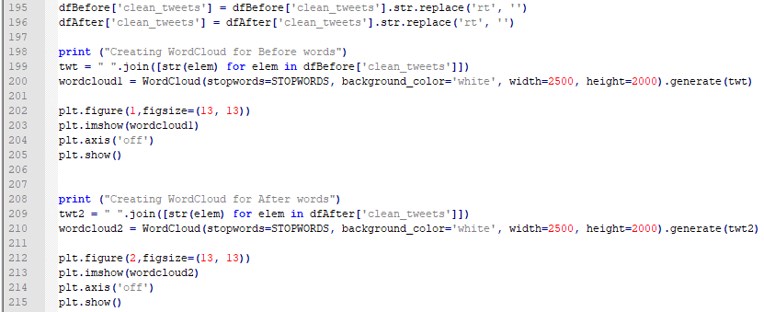
The code – Visualisation Tools 2. Word Cloud
We also removed the rt word from the dataset, before creating the wordclouds representing Coca-Cola related tweets before and after the event.

Slide 14
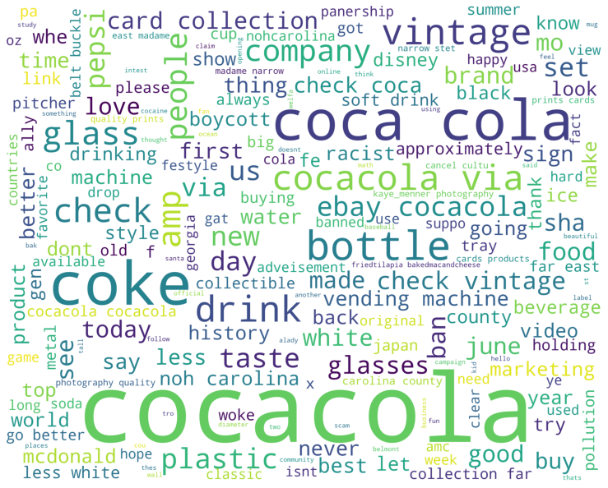
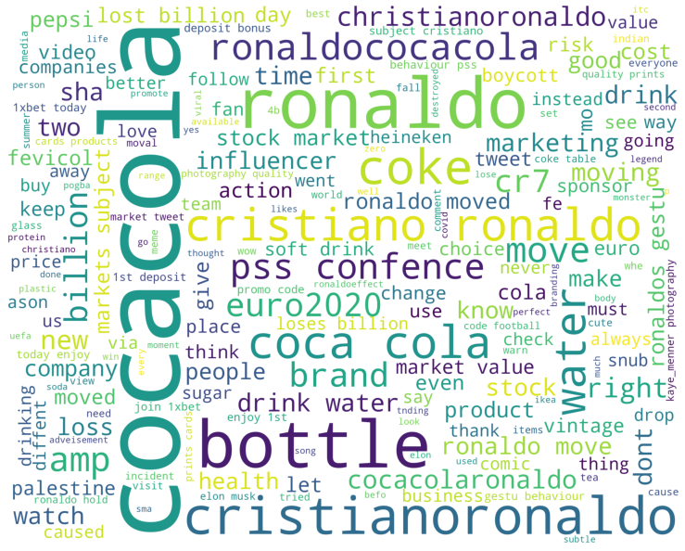
The results – Visualisation Tools 2. Word Cloud
Before event
After event

Slide 15
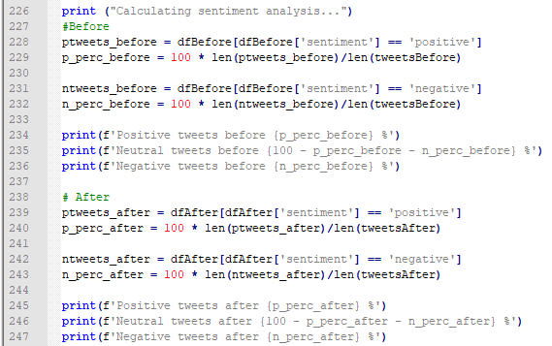
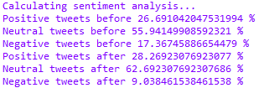
The Code - Sentiment Analysis
We calculated the percentage of each category of sentiment (positive, negative, neutral) that had been calculated earlier with TextBlob.
And received the following results in the console.

Slide 16
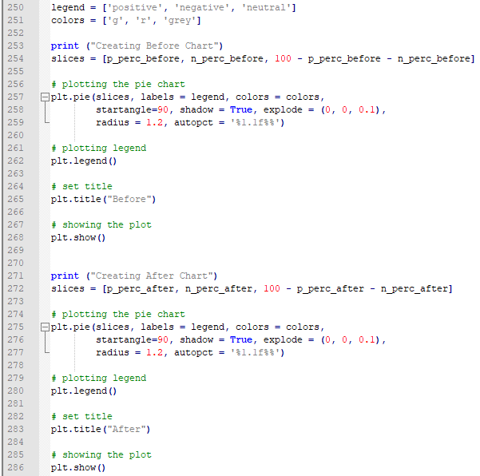
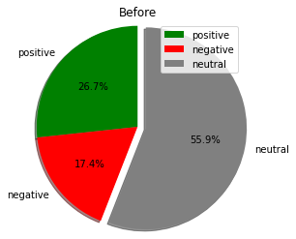
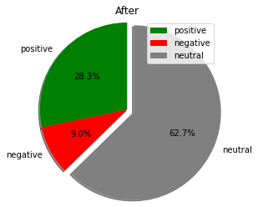
The Code & Results – Pie Charts with Sentiment Analysis Percentages
We then wanted to represent that information visually, by using 2 pie charts.
As it can be seen in the figures on the right, after the event, the number of positive tweets in relation to Coca-Cola increased slightly, and the negative comments also decreased, rather signiticantly.
The event produced „virality” and a strong association between Coca-Cola and Ronaldo on Twitter, but that did not necessarily make users think of Coca-Cola in worse terms than they did before. Instead, they might have simply be amused by the incident.

Slide 17
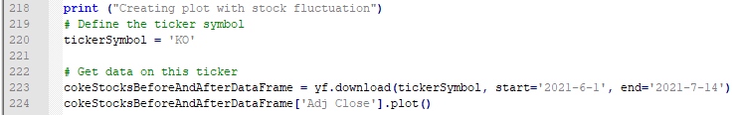
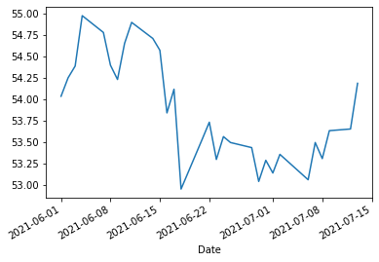
The Code and Result– Yahoo! Finance
We also wanted to connect the information from Twitter with data obtained from Yahoo! Finance in relation to the fluctuation of Coca-Cola (KO) share prices on the stock market. We noticed that around the 14th of June (date of press conference) the stock started to decrease; the impact was not significant and it could have been related to a number of other reasons apart from Ronaldo’s comments.

Slide 18

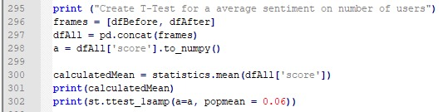
The Code – T tests
As a final step, we performed 3 T-tests.
1. The first one was an unpaired T-test in relation to the mean of the sentiment scores before and after the event.
The p value is not significant (p>0.05). Therefore, we can conclude that the sentiment of the two variables is not significantly different.
2. The second one was a T-test for the average sentiment on the number of users, to determine if a number of tweets randomly chosen would score an average sentiment comparable with that of the whole group of reference.
The p value is not significant (p>0.05). Therefore, we can conclude that the sentiment of the sample is not significantly different than 0.06.

Slide 19
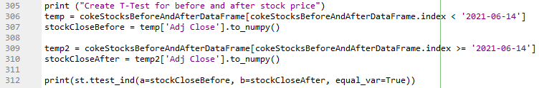
The Code – T tests
3. Lastly, we performed a T-test for the mean of the stock price before and after the event.
As the p-value was not significant (p = 1.259 > 0.05), we can conclude that the mean share prices between the two periods mentioned before are not significantly different.

Slide 20
Thank you!

