Slide 1
Cloud Platform Development
Coursework: Object & PPE Detection with AWS Artificial Intelligence (AI)
S1108900 - Iona Wright
Notes:
Iona Wright
In this video I am going to talk through the infrastructure setup and python code written for the cloud platform development coursework.

Slide 2
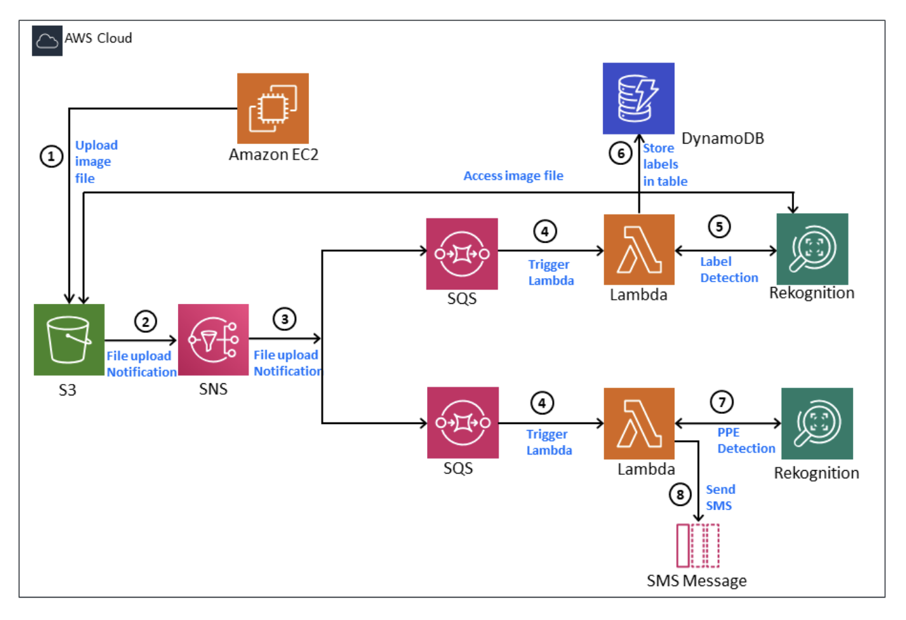
Notes:
Firstly, I want to share the application architecture that was provided in the coursework specification. The aim of this project is to scan images uploaded for personal protection equipment and receive a text message if there is no PPE worn & to store in a DB the confidence levels of what has been detected in an image.
The diagram demonstrates how there is a virtual server that will run the application (The EC2 instance (Elastic Computing service)
The image will be uploaded from the instance into an S3 bucket (which is a storage resource is AWS) and send a notification to the SNS service (which is a simple notification service that delivers messages particularly to mobile phone users).
This SNS service then is subscribed to the SQS service (Simple Queue Service) and it will trigger the lambda function (which is an anonymous function that will will run each time a message is sent).
As you can see there is two SQS services that will trigger a different lambda function, one is to store the labels detected in an image (with their confidence) and the other is to send a text message when an image has been scanned but no PPE is worn.

