Slide 1
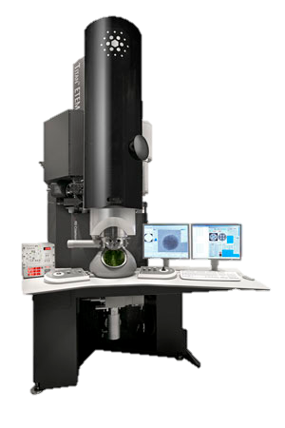
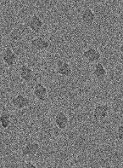
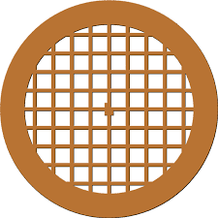
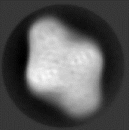
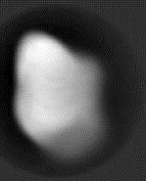

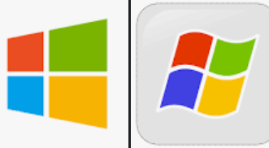












a) Native MS
c) Ion-beam deposition
e) Cryo-EM
TEM Grid
m/z
Carbon film
b) Protein selection
d) Cryogenic cooling
f) Single particle analysis
m/z
LN₂

Slide 2
O
N
M
I
M
N
I
O
OM
O
M
NI
N
I

Slide 3



Slide 4



Slide 5
ES-IBD
Explorer
Starting…

Slide 6
ES-IBD
Explorer
ES-IBD
Explorer
Loading…
Loading…
ES-IBD
Explorer
ES-IBD
Explorer
Loading…
Loading…

Slide 7




ESIBD
Explorer
ESIBD
Explorer
ESIBD
Explorer
ESIBD
Explorer
Loading…
Loading…
Loading…
Loading…
Notes:
export using save as picture

Slide 8
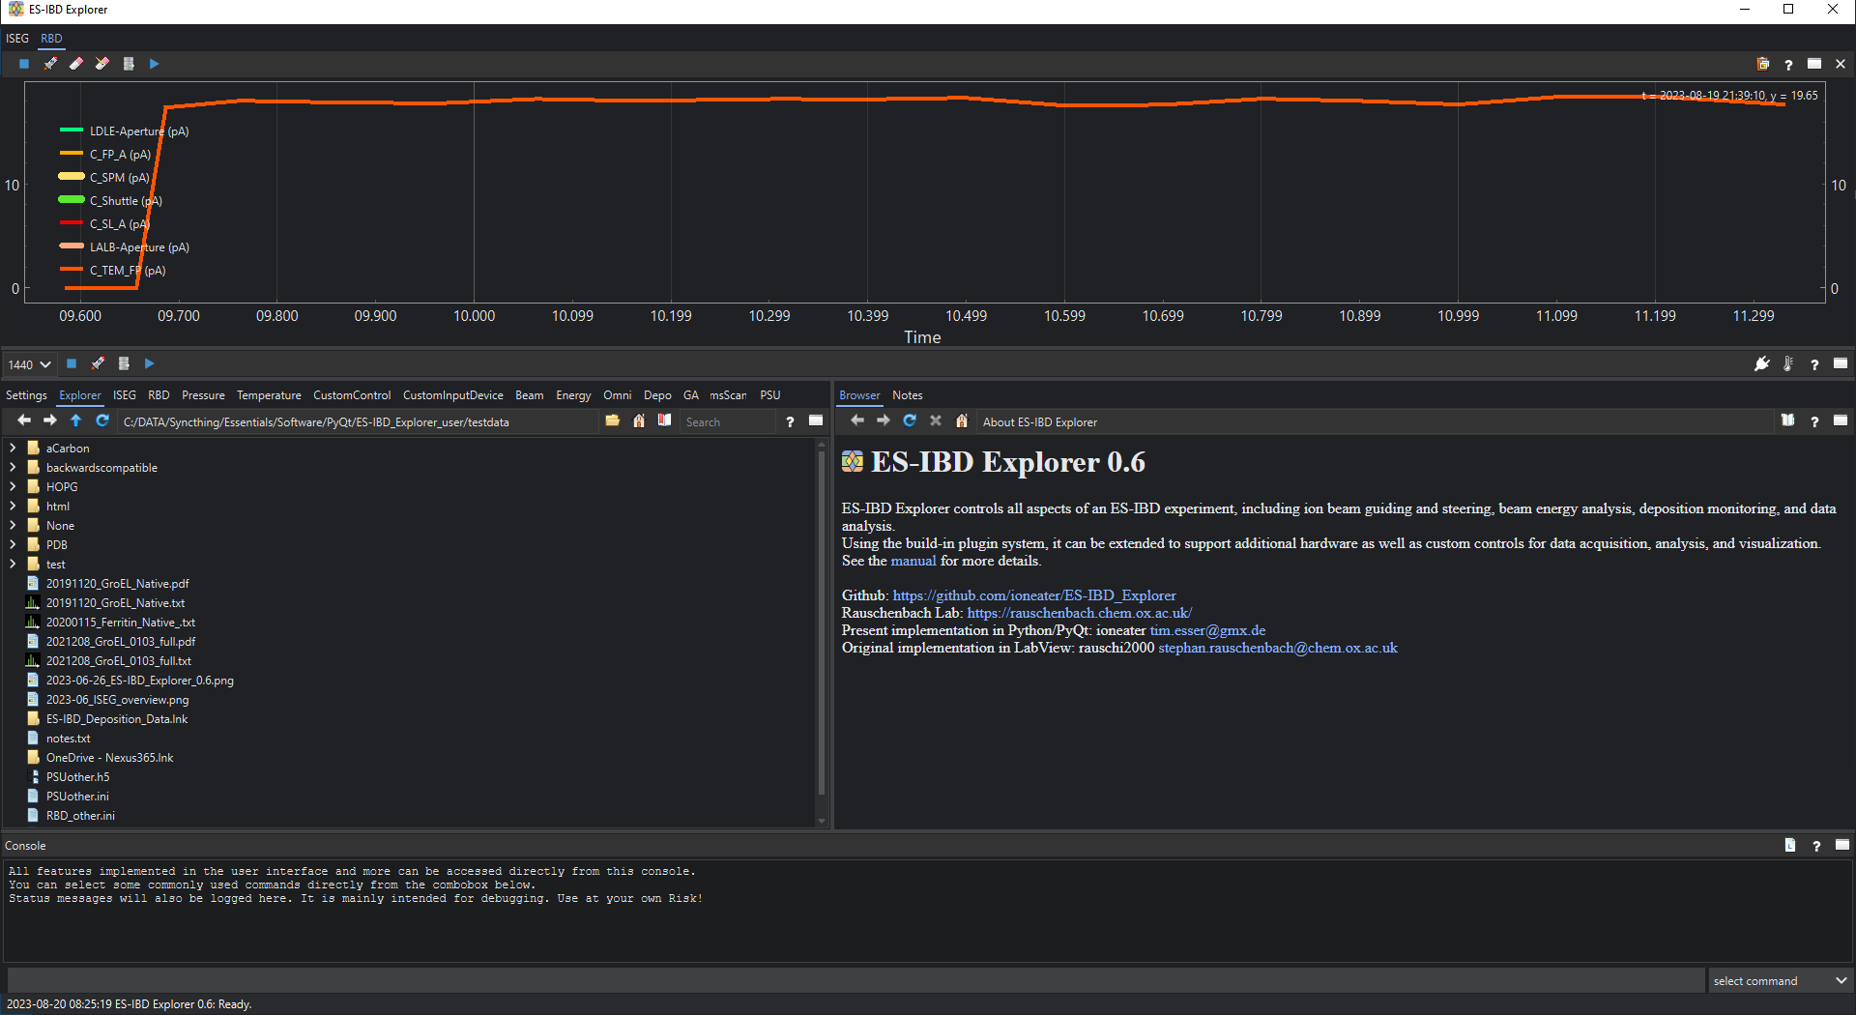
Notes:
qdarktheme dark

Slide 9
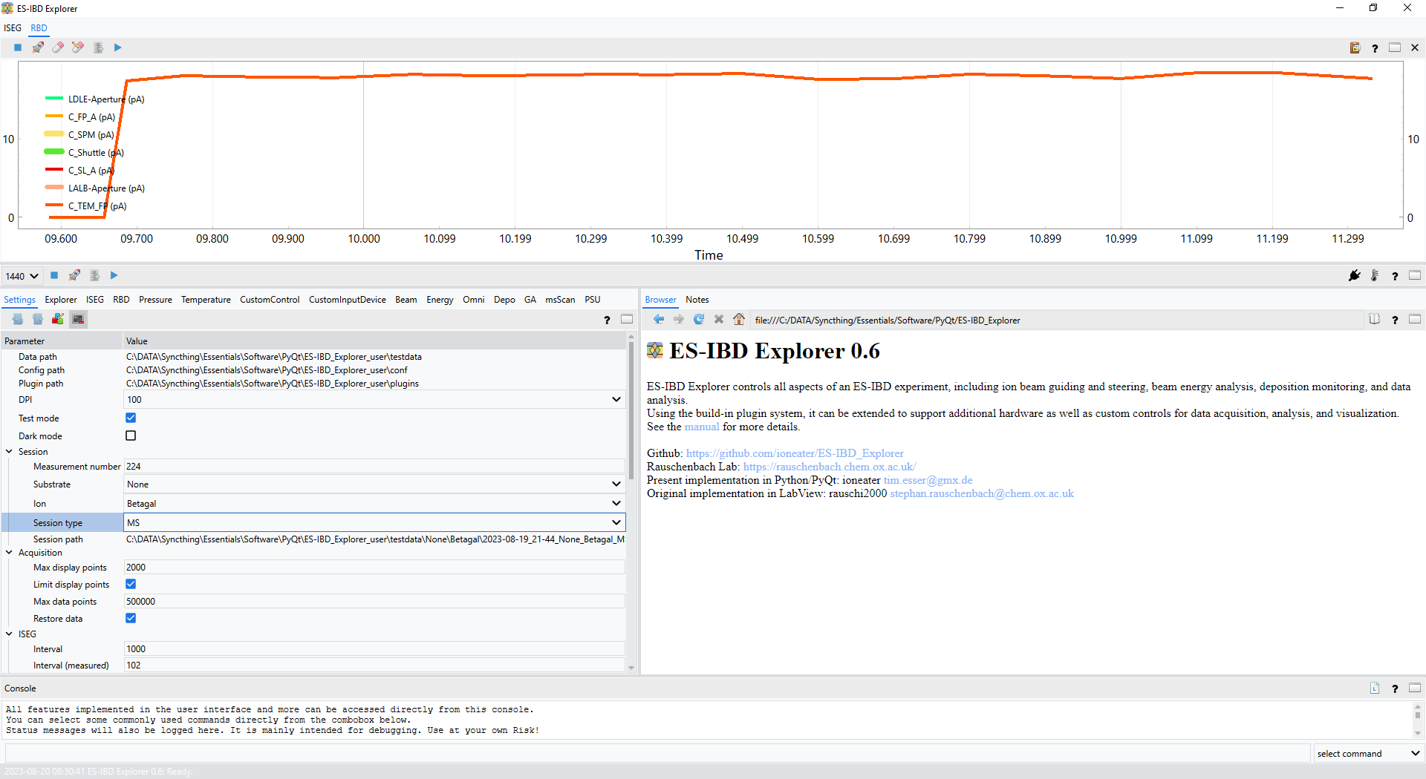
Notes:
qdarktheme light

Slide 10






Notes:
custom dark theme

Slide 11
Notes:
custom light theme

