Slide 1


Dr. Stylianos Karagiannis
[PDM/Portugal]
AI/ML Intrusion Detection System
Email: stylianos.karagiannis@pdmfc.com

Slide 2


Slide 3
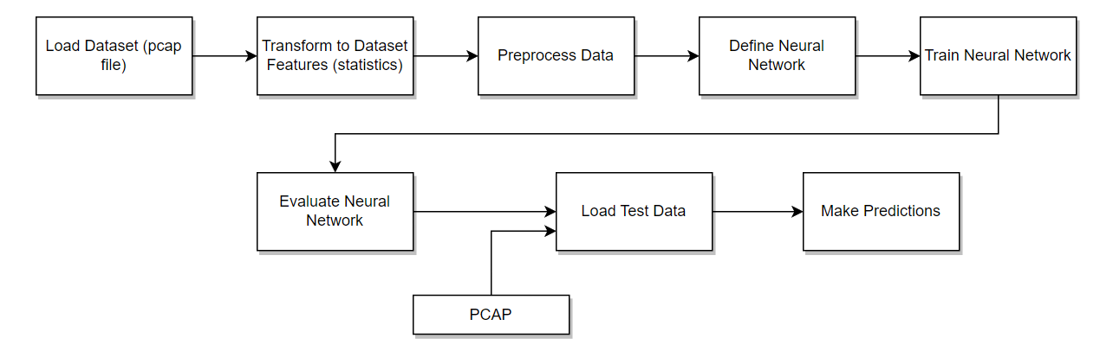

Slide 4
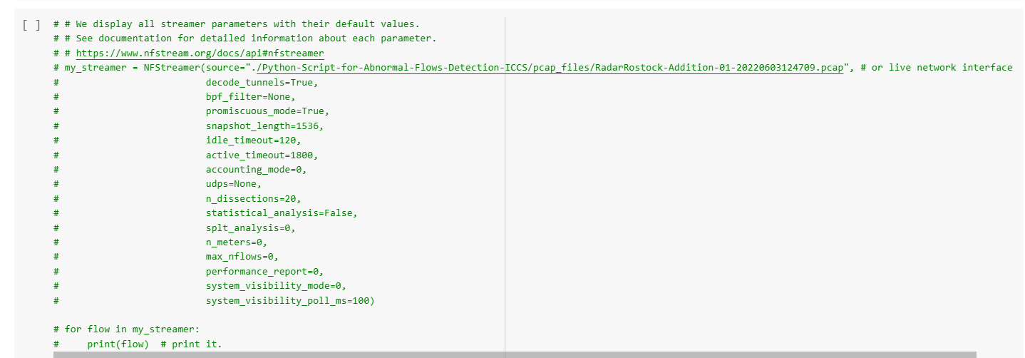

Slide 5
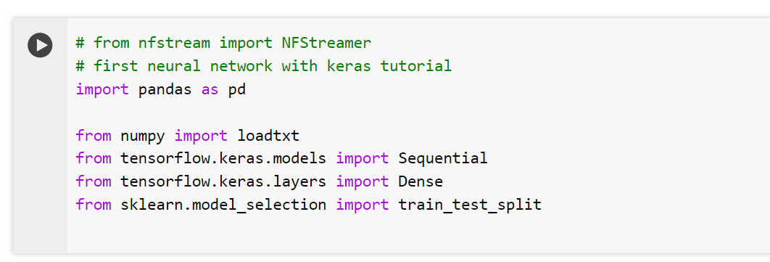
Indicators of Abnormalities
High PIAT Values: Could indicate network latency or delay issues.
Large Standard Deviations: High variability might suggest unstable network conditions.
Asymmetry: Significant differences between dst2src and src2dst metrics might indicate asymmetric routing issues or imbalanced traffic loads.
Extreme Packet Sizes: Unusually large or small packets might indicate specific attack vectors or misconfigurations.
Unusual Traffic Patterns: Sudden spikes in packets or bytes can be a sign of network attacks, such as DoS, or legitimate changes in network usage patterns.

Slide 6
dst2src_max_piat_ms: The maximum Packet Inter-Arrival Time (PIAT) in milliseconds from destination to source. This indicates the longest time interval between consecutive packets traveling from the destination to the source.
dst2src_mean_piat_ms: The average PIAT in milliseconds from destination to source. This gives the average time interval between packets in this direction.
dst2src_min_piat_ms: The minimum PIAT in milliseconds from destination to source. This shows the shortest time interval between consecutive packets traveling from destination to source.
dst2src_stddev_piat_ms: The standard deviation of PIAT in milliseconds from destination to source. This measures the variability or dispersion of the PIAT values in this direction.
dst2src_max_ps: The maximum packet size in bytes for packets traveling from destination to source. This indicates the largest packet size observed in this direction.
dst2src_mean_ps: The average packet size in bytes for packets traveling from destination to source. This gives the average size of packets in this direction.
dst2src_min_ps: The minimum packet size in bytes for packets traveling from destination to source. This shows the smallest packet size observed in this direction.

Slide 7
dst2src_stddev_ps: The standard deviation of packet sizes in bytes for packets traveling from destination to source. This measures the variability in packet sizes in this direction.
src2dst_stddev_ps: The standard deviation of packet sizes in bytes for packets traveling from source to destination. This measures the variability in packet sizes in this direction.
bidirectional_max_ps: The maximum packet size observed in either direction (source to destination or destination to source).
bidirectional_min_ps: The minimum packet size observed in either direction.
bidirectional_mean_ps: The average packet size observed in either direction.
bidirectional_stddev_ps: The standard deviation of packet sizes observed in either direction. This measures the variability in packet sizes bidirectionally.
dst2src_packets: The total number of packets traveling from destination to source.
src2dst_packets: The total number of packets traveling from source to destination.
dst2src_bytes: The total number of bytes traveling from destination to source. This is the sum of the sizes of all packets in this direction.
src2dst_bytes: The total number of bytes traveling from source to destination. This is the sum of the sizes of all packets in this direction.

Slide 8
dst2src_max_piat_ms / dst2src_mean_piat_ms / dst2src_min_piat_ms / dst2src_stddev_piat_ms
Abnormal: Significantly higher than usual values could indicate network congestion, packet loss, or inefficient routing.
Sudden changes: Sharp increases or high variability might suggest network instability or attacks like Denial of Service (DoS).
dst2src_max_ps / dst2src_mean_ps / dst2src_min_ps / dst2src_stddev_ps
Abnormal: Unusually large packet sizes might indicate jumbo frames or potential data exfiltration.
Small packets: High frequency of minimal-sized packets could suggest scanning or probing activities.
src2dst_stddev_ps:
Abnormal: High variability in packet sizes might indicate inconsistent application behavior or varying types of traffic.
bidirectional_max_ps / bidirectional_min_ps / bidirectional_mean_ps / bidirectional_stddev_ps
Abnormal: Extreme values or high standard deviation can signify issues such as bandwidth misconfiguration or diverse traffic types affecting consistency.
dst2src_packets / src2dst_packets:
Abnormal: Unusually high packet counts could suggest a flood attack or very chatty protocols.
Low counts: Could indicate dropped connections or underutilized links.
dst2src_bytes / src2dst_bytes:
Abnormal: Very high byte counts might indicate heavy data transfer, possibly legitimate (like large file transfers) or malicious (like data exfiltration).
Low counts: Could signify connectivity issues or low activity periods.

Slide 9
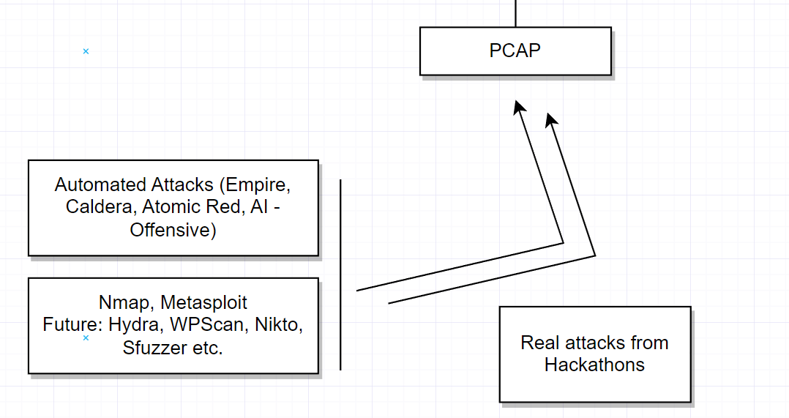

Slide 10
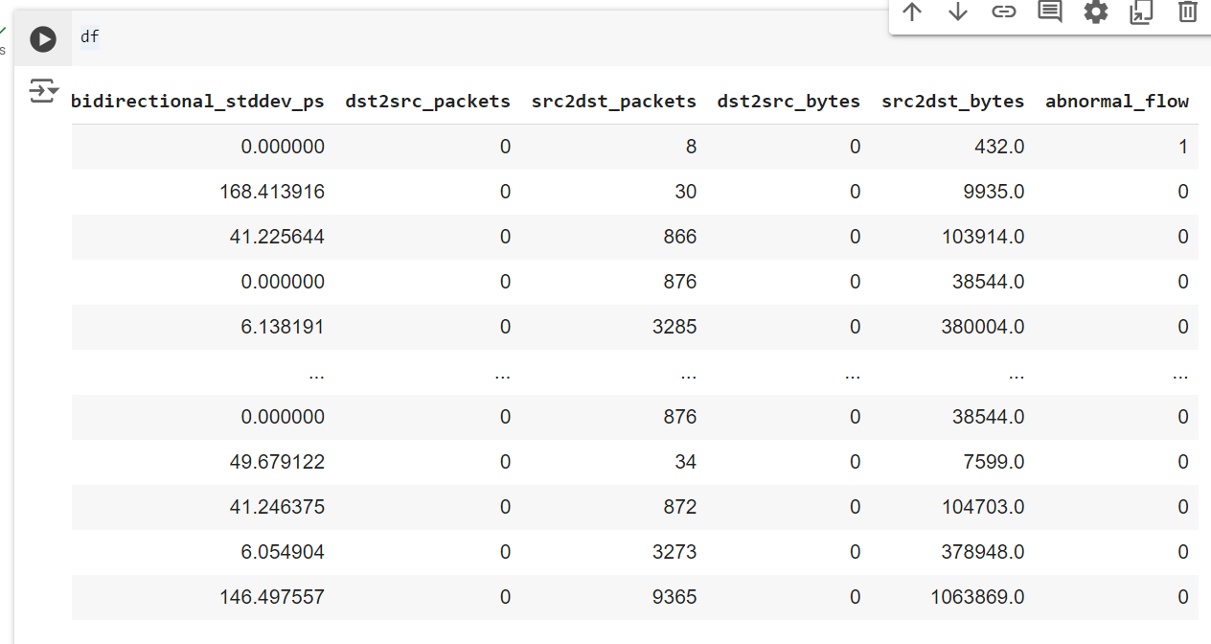

Slide 11
