Slide 1

NITRO: An Interconnected 5G-IoT Cyber Range
ARES2024, Vienna
Aristeidis Farao | Stylianos Karagiannis skaragiannis@ionio.gr
Christoforos Ntantogian | Emmanouil Magkos | Alexandra Dritsa | Christos Xenakis
University of Piraeus, Ionian University

Slide 2
NITRO Objectives
Deliver a Novel Cybersecurity Platform
Focus: Virtualized 5G-IoT Cyber Range Services
Goal: Improve security for standalone & interconnected 5G and IoT environments
Approach: Integrate existing IoT & 5G testbeds
Create the First Common Data Repository
Scope: 5G-IoT Cyber Ranges
Content: Attacks, Threat Analysis, Scenarios
Standards: XML & JSON for Metadata
Benefit: Open-data access for knowledge transfer & big data analytics
Offer a Powerful Training Environment
Target: Security Operation Centres Staff & Pen Testers
Features: Virtual Cyberwarfare Training, Real-world Stress Conditions
Tools: Virtualized IDS/IPS, Penetration Testing Tools
Emulate Innovative AI Adversarial Attacks
Focus: 5G & IoT Networks Management Structures
Purpose: Test Detection Capabilities & Impactful Attack Scenarios

Slide 3
NITRO Objectives
Action 1: Deliver a Novel Cyber Range Platform
Purpose: Simulated environment for testing and refining 5G and IoT security.
Benefits:
Comprehensive platform for real-world scenario simulation.
In-depth analysis of potential threats and attack vectors.
Enhances cybersecurity for critical infrastructures (Industry 4.0, smart cities).
Privacy: Utilizes a privacy toolbox to address potential GDPR issues.
Action 2: Examine and Identify Novel Cascading Attacks
Focus: Vulnerabilities in 5G and IoT networks.
Prime Targets: Supply chains, network infrastructure, device compromise, and protocol exploitation.
Outcome:
Understanding of threats from critical system integration.
Design of more secure 5G-IoT systems.

Slide 4
NITRO Objectives
Action 3: Deliver Cyber Range for Adversarial AI Attack and Defence
Scope: Interdisciplinary field of AI and cybersecurity.
Features:
Controlled platform to study adversarial techniques.
Development of robust and secure AI models.
Datasets: Utilizes DeepSlice, Secure5G, WSN-DS, and CICIDS18 datasets.
Action 4: Create NITRO Data Repository
Design: Capture, organize, and manage threat information.
Usage:
Resource for security practitioners and researchers.
Tracking, analysis, and response to threats and incidents.
Capabilities: Incident response, forensics analysis, and dissemination of best practices.
Automation: Tool for generating related traffic for security validation and testing.

Slide 5
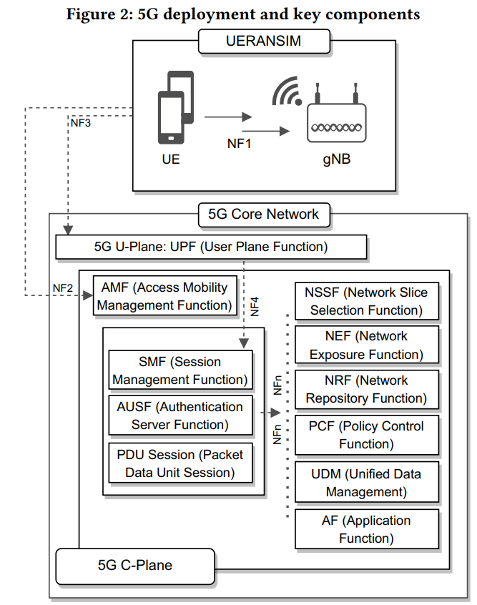
Key Components of the 5G System
According to 3GPP, the 5G System has three main components:
User Equipment (UE)
Devices enabled with 5G.
5G Radio Access Network (5G-RAN or gNB)
Radio base stations that connect UEs to the core network wirelessly.
5G Core Network (5GC)
Facilitates Network Functions (NFs) such as:
Session Management
Authentication
Policy Control
Data Storage

Slide 6
Key Technologies in NITRO's 5G System Implementation
Next Generation Node B (gNB): 5G base station for radio access.
Network Slice Selection Function (NSSF): Selects network slices for service requirements and resource utilization.
Network Exposure Function (NEF): Exposes network services to external applications via APIs.
Network Repository Function (NRF): Maintains a repository of network functions, supporting registration, discovery, and status management.
Policy Control Function (PCF): Manages QoS, access control, and charging rules.
Unified Data Management and Repository (UDM and UDR): Centralized management of subscriber data, user profiles, authentication details, and policies.
Application Function (AF): Interacts with external applications, providing service-specific functionalities.

Slide 7
Key Technologies in NITRO's 5G System Implementation
Authentication Server Function (AUSF): Manages the authentication of user devices for secure access.
Access and Mobility Management Function (AMF): Handles user access and mobility management, including connection setup and handover.
Session Management Function (SMF): Manages session tasks like establishing, modifying, and terminating user sessions.
User Plane Function (UPF): Manages user data traffic routing, forwarding, and processing.
Packet Data Unit Session (PDU Session): Establishes data communication sessions for internet access and application connectivity.

Slide 8
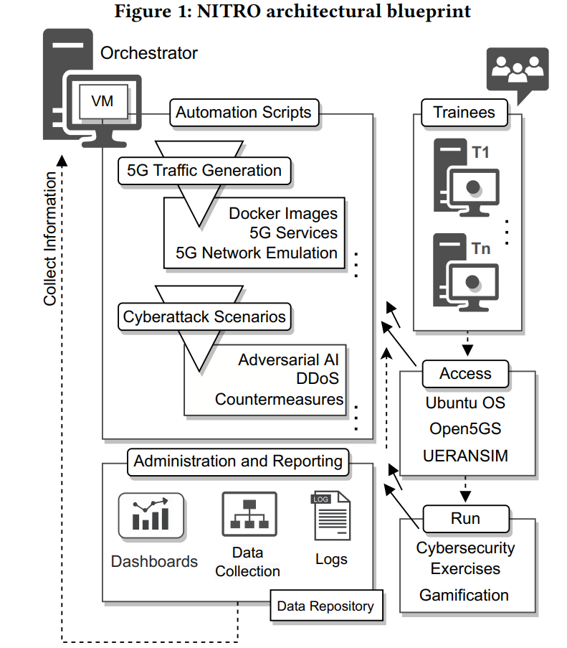
Key Components of the 5G System
According to 3GPP, the 5G System has three main components:
User Equipment (UE)
Devices enabled with 5G.
5G Radio Access Network (5G-RAN or gNB)
Radio base stations that connect UEs to the core network wirelessly.
5G Core Network (5GC)
Facilitates Network Functions (NFs) such as:
Session Management
Authentication
Policy Control
Data Storage

Slide 9
NITRO Cyber Range: 5G Core Network
Free5GC
Language: Go
3GPP Specification: Release 15
License: Apache 2.0
Unique Feature: Non-3GPP Inter-Working Function (N3IWF)
Connects untrusted non-3GPP devices (Wi-Fi APs, LoRaWAN Gateways) to 5GC.
Usage:
Container image releases
Docker Compose file for automated deployment
Resources: Articles, studies, tutorials
Latest Version: 3.4.1
Open5GS
Language: C
3GPP Specification: Release 17
Features:
IPv6 support
Multiple PDU sessions
Handover functions
Integration of VoLTE and Vo5GNR
Advantages:
Larger contributor base
Weekly commits, frequent releases
Management: Web application for managing UE subscription information

Slide 10
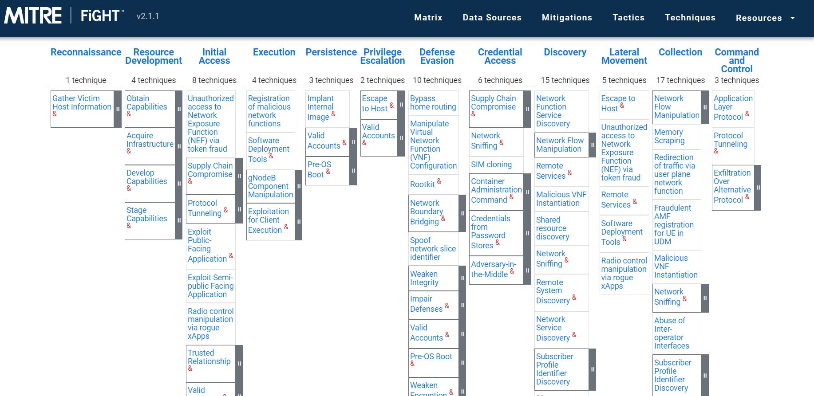

Slide 11
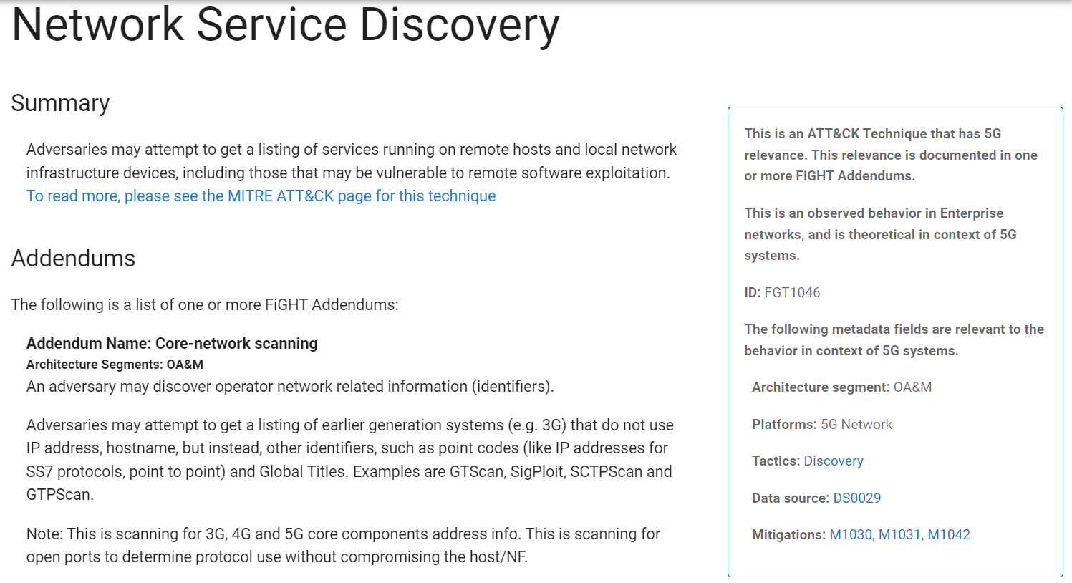

Slide 12
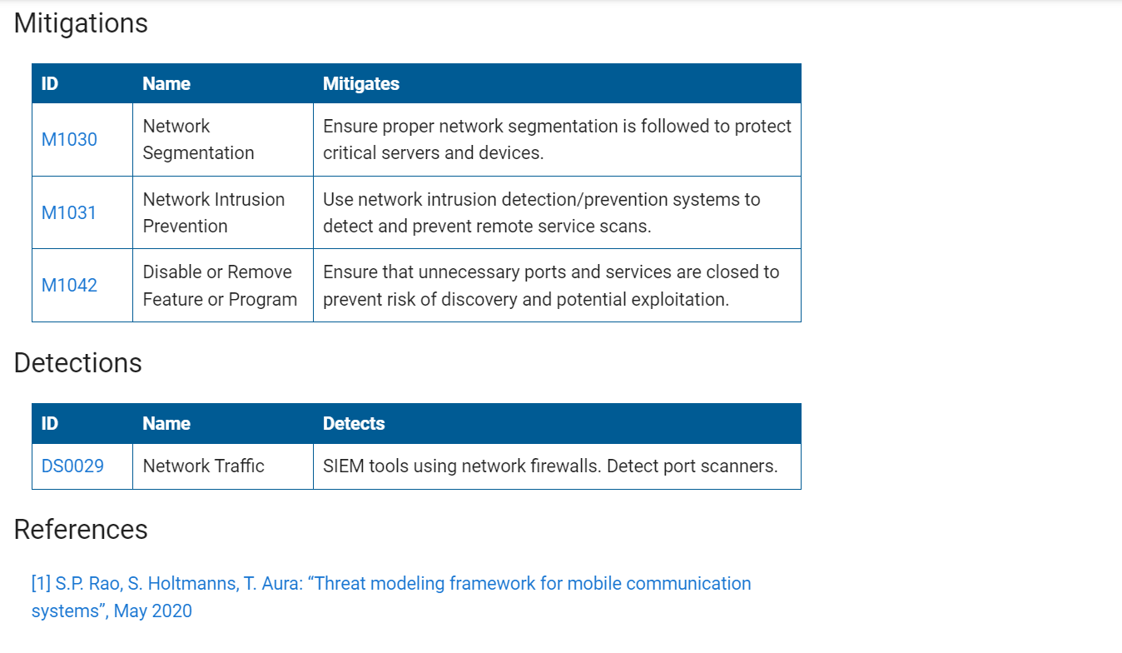

Slide 13
Future Work
Deploy the topology
Investigate the attacks on 5G
Experiment with educational scenarios
Embed the educational platform
Define the Scoreboard and Blue Teaming scoring

Slide 14
Thank you
Do you have any questions?
Email: skaragiannis@ionio.gr
nmslab.di.ionio.gr

Slide 15

AI-Powered Penetration Testing using Shennina: From Simulation to Validation
ARES2024, Vienna
Stylianos Karagiannis (skaragiannis@ionio.gr) | Camilla Fusco | Leonidas Agathos | Wissam Mallouli | Valentina Casola | Christoforos Ntantogian | Emmanouil Magkos
Ionian University, PDMFC, University of Naples Federico II, Montimage

Slide 16
Research Contributions
AI4SIM Development
Enables advanced AI-powered cyberattacks in a realistic environment.
Extracts benefits for enhancing cybersecurity research.
Validation and Effectiveness of AI4SIM Framework
Conducts simulations and analyzes collected datasets.
Adapts AI models to create accurate detection rules for AI-powered attacks.
Provides methodology for validating AI-powered cyberattacks and simulations.
Dataset Extraction and Utilization
Further exploitation of datasets from executed cyberattacks.
Advancement of Cybersecurity Research
Practical solution for simulating and analyzing AI-powered cyberattacks.
Offers valuable insights for rule creation in detecting and mitigating threats.
Enhances resilience of critical systems against evolving cyber threats.

Slide 17
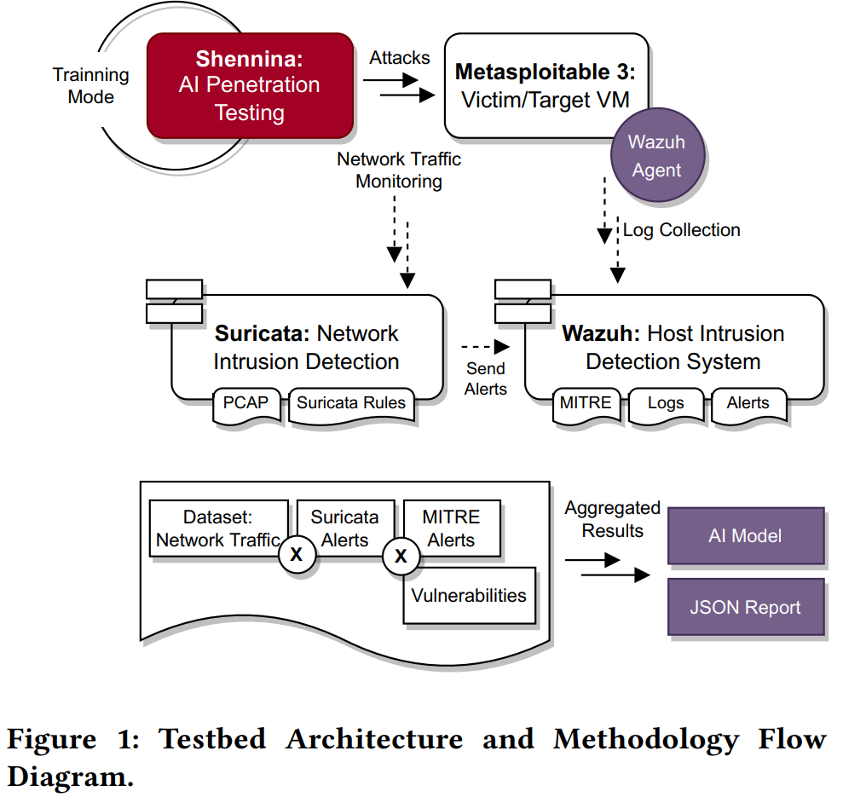
Architecture
Phase 1: Setup and Training of Shennina
Installation and Configuration:
Debugging for proper functionality.
Target Machine: Metasploitable.
Training Shennina with Metasploitable as the target.

Slide 18
Methodology
Phase 2: Testbed Deployment
Architecture Implementation:
Intrusion Detection Systems (IDS):
Suricata
Wazuh
Monitoring and Verification:
Network traffic monitoring.
Capturing detailed traffic logs of attempted exploits.
Phase 3: Observations and Considerations
Effectiveness Evaluation:
Assessing the tool's ability to simulate attacks.
Detailed Examination:
Analyzing tactics and techniques employed.
Identifying the most prevalent attack strategies.

Slide 19
Testbed Architecture and Methodology
Key Components:
Shennina: AI-Powered Cyberattack Tool
Configured to autonomously execute various cyberattacks.
Utilizes tactics like buffer overflow, SQL injection, and remote code execution.
AI algorithms adapt attack strategies based on target system responses.
Metasploitable 3: Vulnerable Virtual Environment
Deliberately designed with multiple security vulnerabilities.
Serves as a target for exploit testing with the Metasploit Framework.

Slide 20
Testbed Architecture and Methodology
Logging Mechanisms:
Capture detailed information about attack payloads, commands, system responses, and network traffic.
Network Traffic Monitoring:
Tools capture and analyze data packets between Shennina and Metasploitable.
Provides insights into communication patterns and potential indicators of compromise.
Data Analysis:
MITRE ATT&CK Framework:
Collected data is compared against MITRE Tactics, Techniques, and Procedures (TTPs).
Helps understand the operation and behavior of AI-powered cyberattacks.
Validation:
Analyzes attack behaviors using Suricata signatures and MITRE TTPs.
Provides insights into the effectiveness and evasiveness of AI-powered cyberattacks.

Slide 21
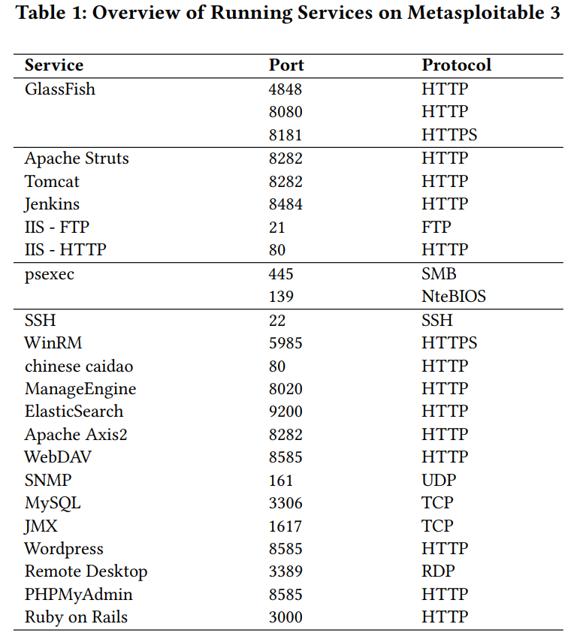
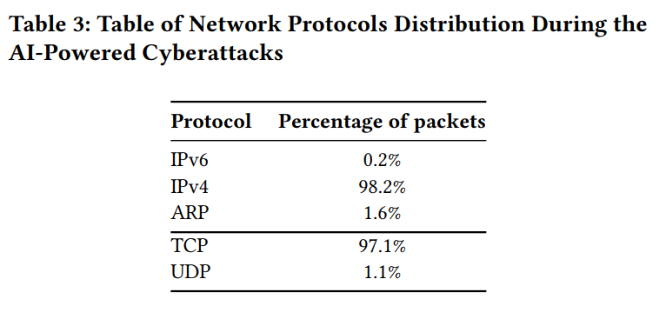
Services and Protocols

Slide 22
Results and Explanation (1)
Initial Access and Privilege Escalation
Attackers exploited public-facing applications to gain initial access.
Various vulnerabilities were leveraged for privilege escalation on compromised systems.
Execution and Persistence
Attackers executed commands via APIs and exploited client-side vulnerabilities.
Persistent access was maintained through data staging, application layer protocols, and network boundary bridging.
Discovery and Defense Evasion
Network discovery activities aimed at mapping the network and identifying potential targets.
Attackers used techniques to evade detection, such as data obfuscation and hiding sensitive data transmission.
Credential Access and Discovery
Network sniffing and default credentials were used to gain access to sensitive information.
Extensive network scanning and service identification were performed to find exploitable systems.

Slide 23
Results and Explanation (2)
Lateral Movement and Collection
Remote file copying and external remote service connections facilitated lateral movement within the network.
Information was gathered from system repositories and staged for exfiltration.
Command and Control
Attackers established command and control channels to exfiltrate data and maintain communication with compromised systems.
Web shells were deployed for remote command execution.
Exfiltration and Impact
Data exfiltration over covert channels was performed to avoid detection.
Obfuscation techniques were used to hide the data being transmitted out of the network.

Slide 24
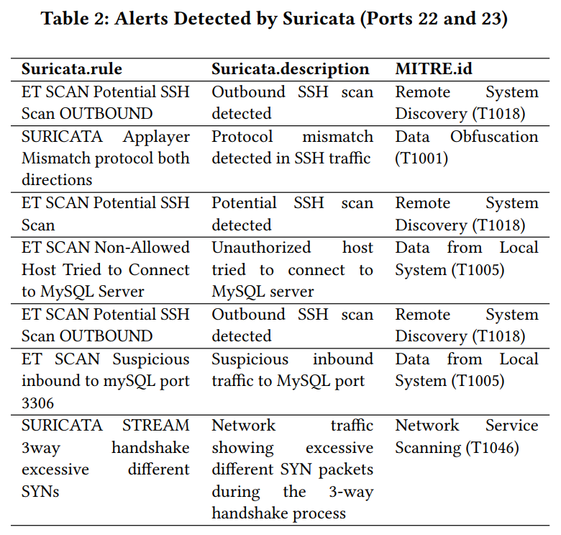
Network Alerts

Slide 25
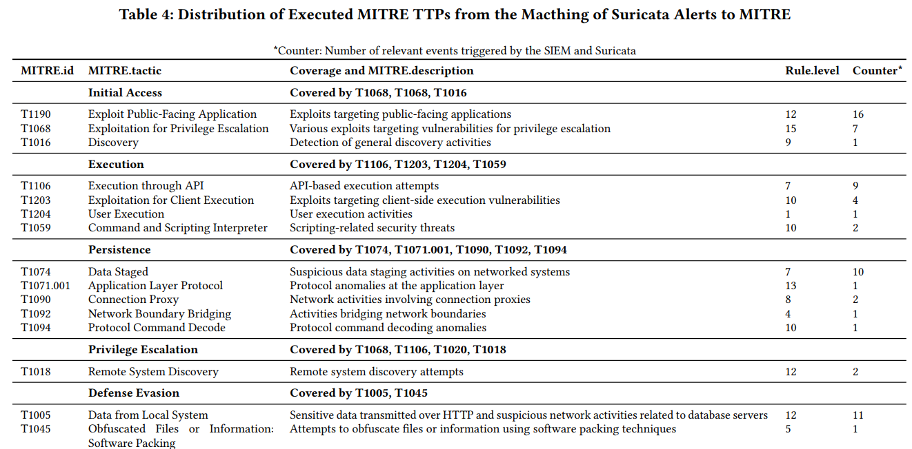
MITRE ATT&CK Matching (1)

Slide 26
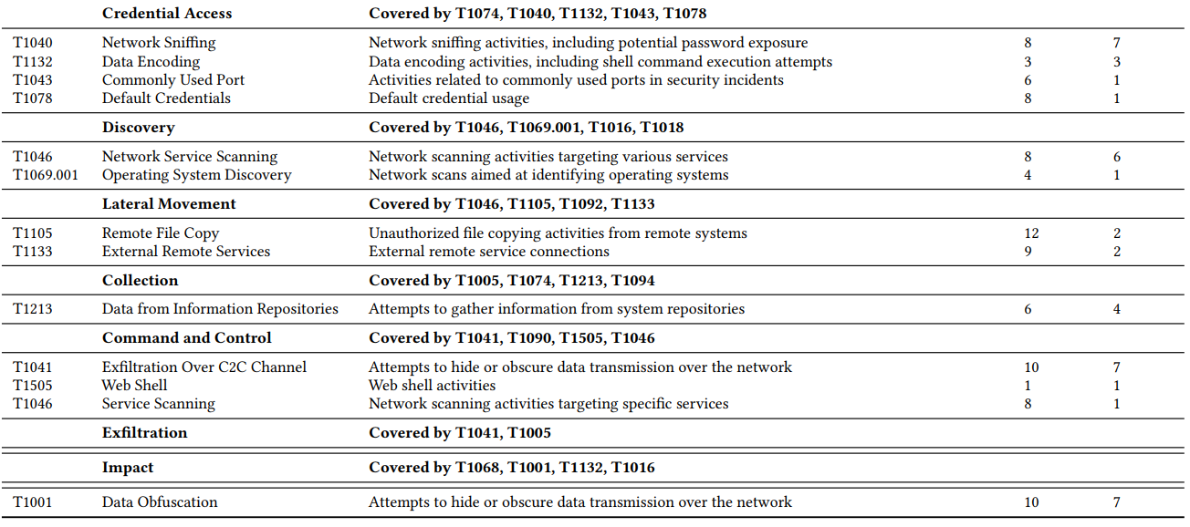
MITRE ATT&CK Matching (2)

Slide 27
Future Work
Execute in Healthcare Cyber Range
Collect data for ML-IDS
Enhance AI capabilities using more tools than Metasploit
Investigate the impact overall of AI on Offensive Security

Slide 28
Thank you
Do you have any questions?
Email: skaragiannis@ionio.gr
nmslab.di.ionio.gr

