Slide 1

Finding, Understanding and Learning: Making Information Discovery Tasks Useful for Children and Teachers
Ion Madrazo, Nevena Dragovic and Sole PEra

Slide 2


Motivation
Difficult interaction
Hinder search as learning
Notes:
Children Use Search engines daily
SE are for traditional users
Children have trouble creating queries
Even if they get relevant content, they have trouble understanding it
In response to those issues

Slide 3
What is YouUnderstood.me (YUM)?
Easier querying
YUM
Search as learning
Easier understanding

Slide 4

What Does YUM Offer Children?
Search
Intent
YUM
Kristoff
lollipop
Lollipop song
Lollipop movie
Tracking
Query
Recommendation
Doc1
Readability:8
Easy
OK
Dif.
YUM?
Doc2
Readability:8
Easy
OK
Dif.
YUM?
Readability
Filtering
Doc3
Readability:8
Easy
OK
Dif.
YUM?

Slide 5
Search Intent
Initial Query
Sven the amaaazing raindeer of Frozen
Stop-word removal
Sven amaaazing raindeer Frozen
Spelling for children
Sven amazing reindeer Frozen
Children’s relevant term detection
Sven reindeer Frozen
Final Query
Sven reindeer Frozen
QuIK
“Is Sven Seven?” A Search Intent Module for Children, Nevena Dragovic, Ion Madrazo Azpiazu, Maria Soledad Pera, SIGIR 2016

Slide 6
Query Recommendation
Which are the main characters of Frozen movie?
Did you mean?
“ Frozen main characters ”
“ Frozen character costumes “
“ Disney characters “
“Frozen”
Search Intent
Analysis
Candidate
Generation
Multi-criteria Recommendation
Readability Analysis
Topical Filtering
ReQuIK
Search Intent module
UbberSuggest
Children Resources
WordNet
SVD++
Flesh-Kincaid
Notes:
Ambiguity diversity better comprehension of the child needs
The search intent only considers one options
Child may be interested in another thing
This is to offer more options to the child

Slide 7



Tracking
Doc1
Readability:10
Readability < 10
Easy
OK
Dif.
YUM?
Doc2
Readability:5
Readability > 5
Easy
OK
Dif.
YUM?
Doc3
Kristoff
Readability > 7
Readability:7
Easy
OK
Dif.
YUM?
Readability: 8
Doc4
No constraint
Readability:8
Easy
OK
Dif.
YUM?
Doc5
Readability < 9
Readability:9
Easy
OK
Dif.
YUM?

Slide 8

Filtering by Readability
Doc1
Readability:8
Easy
OK
Dif.
YUM?
Doc2
Readability:10
Kristoff
Readability: 8
Easy
OK
Dif.
YUM?
Doc3
Doc1
Readability:8
Easy
OK
Dif.
YUM?
Readability:8
Easy
OK
Dif.
YUM?
Doc4
Readability:5
Filtering
Doc3
Easy
OK
Dif.
YUM?
Readability:8
Easy
OK
Dif.
YUM?
Doc5
Readability:7
Easy
OK
Dif.
YUM?

Slide 9



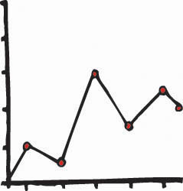


What Does YUM Offer Teachers?
8th Grade class Mr. Smith
Kristoff
Readability: 8
Anna
Readability: 9
Readability
Sole
Readability: 7
Nev
Readability: 8
Time
Nick
Readability: 7

Slide 10
What Does YUM Offer Teachers?
No Search
Intent
YUM
Kristoff
lollipop
Select readability
Manually Selectable Readability
No Query
Recommendation
Readability:8
Readability:8
Readability
Filtering
No Tracking
Readability:8

Slide 11




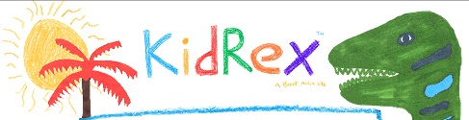

Initial Study: Description
lollipop
How long are… ?
cheetas
frozen
batman
Star wars
K-9 Idaho Teachers
50 Children
300 open queries
5 Search Engines

Slide 12
Initial Study: Results
 | YUM | Google | Kiddle | KidRex | Safe Search Kids | Gogooligans
Difficulty to retrieve adequate resources | 12% | 17% | 21% | 21% | 21% | 42% (cannot handle questions)
Average readability | Chosen for user | 12.4 | 12.8 | 10.6 | 15.6 | 11.6
Non adequate content | None | Non-filtered ads | Ads related to query | None | Non-filtered ads | Ads filtered for children
Mobile friendly | Yes | Yes | Yes | No | Poor adaptation | No
Query suggestions | Yes | Yes, but for general audience | No | No | No | Yes, Based on dictionary

Slide 13




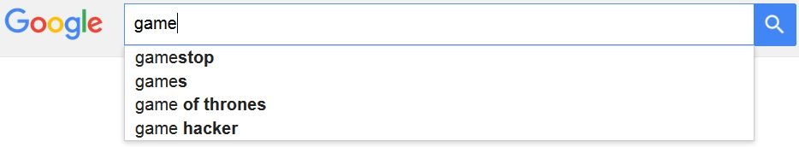
Initial Study: Results
5% less
Non-appropriate ads
Avg. Readability: >11
Poor adaptability
Poor aid for creating queries

Slide 14
Conclusion and Future Work
Future work
Implicit feedback
Ad-hoc readability formula
Further interaction between teacher and student
YUM
Kristoff
lollipop
Lollipop song
Lollipop movie
Doc1
Readability:8
Easy
OK
Dif.
YUM?
Doc2
Readability:8
Easy
OK
Dif.
YUM?
Doc3
Readability:8
Easy
OK
Dif.
YUM?

Slide 15

Thank You!
Special thanks to SIGIR Student travel grant.

