Slide 1
Group Meeting
2017.10.23

Slide 2
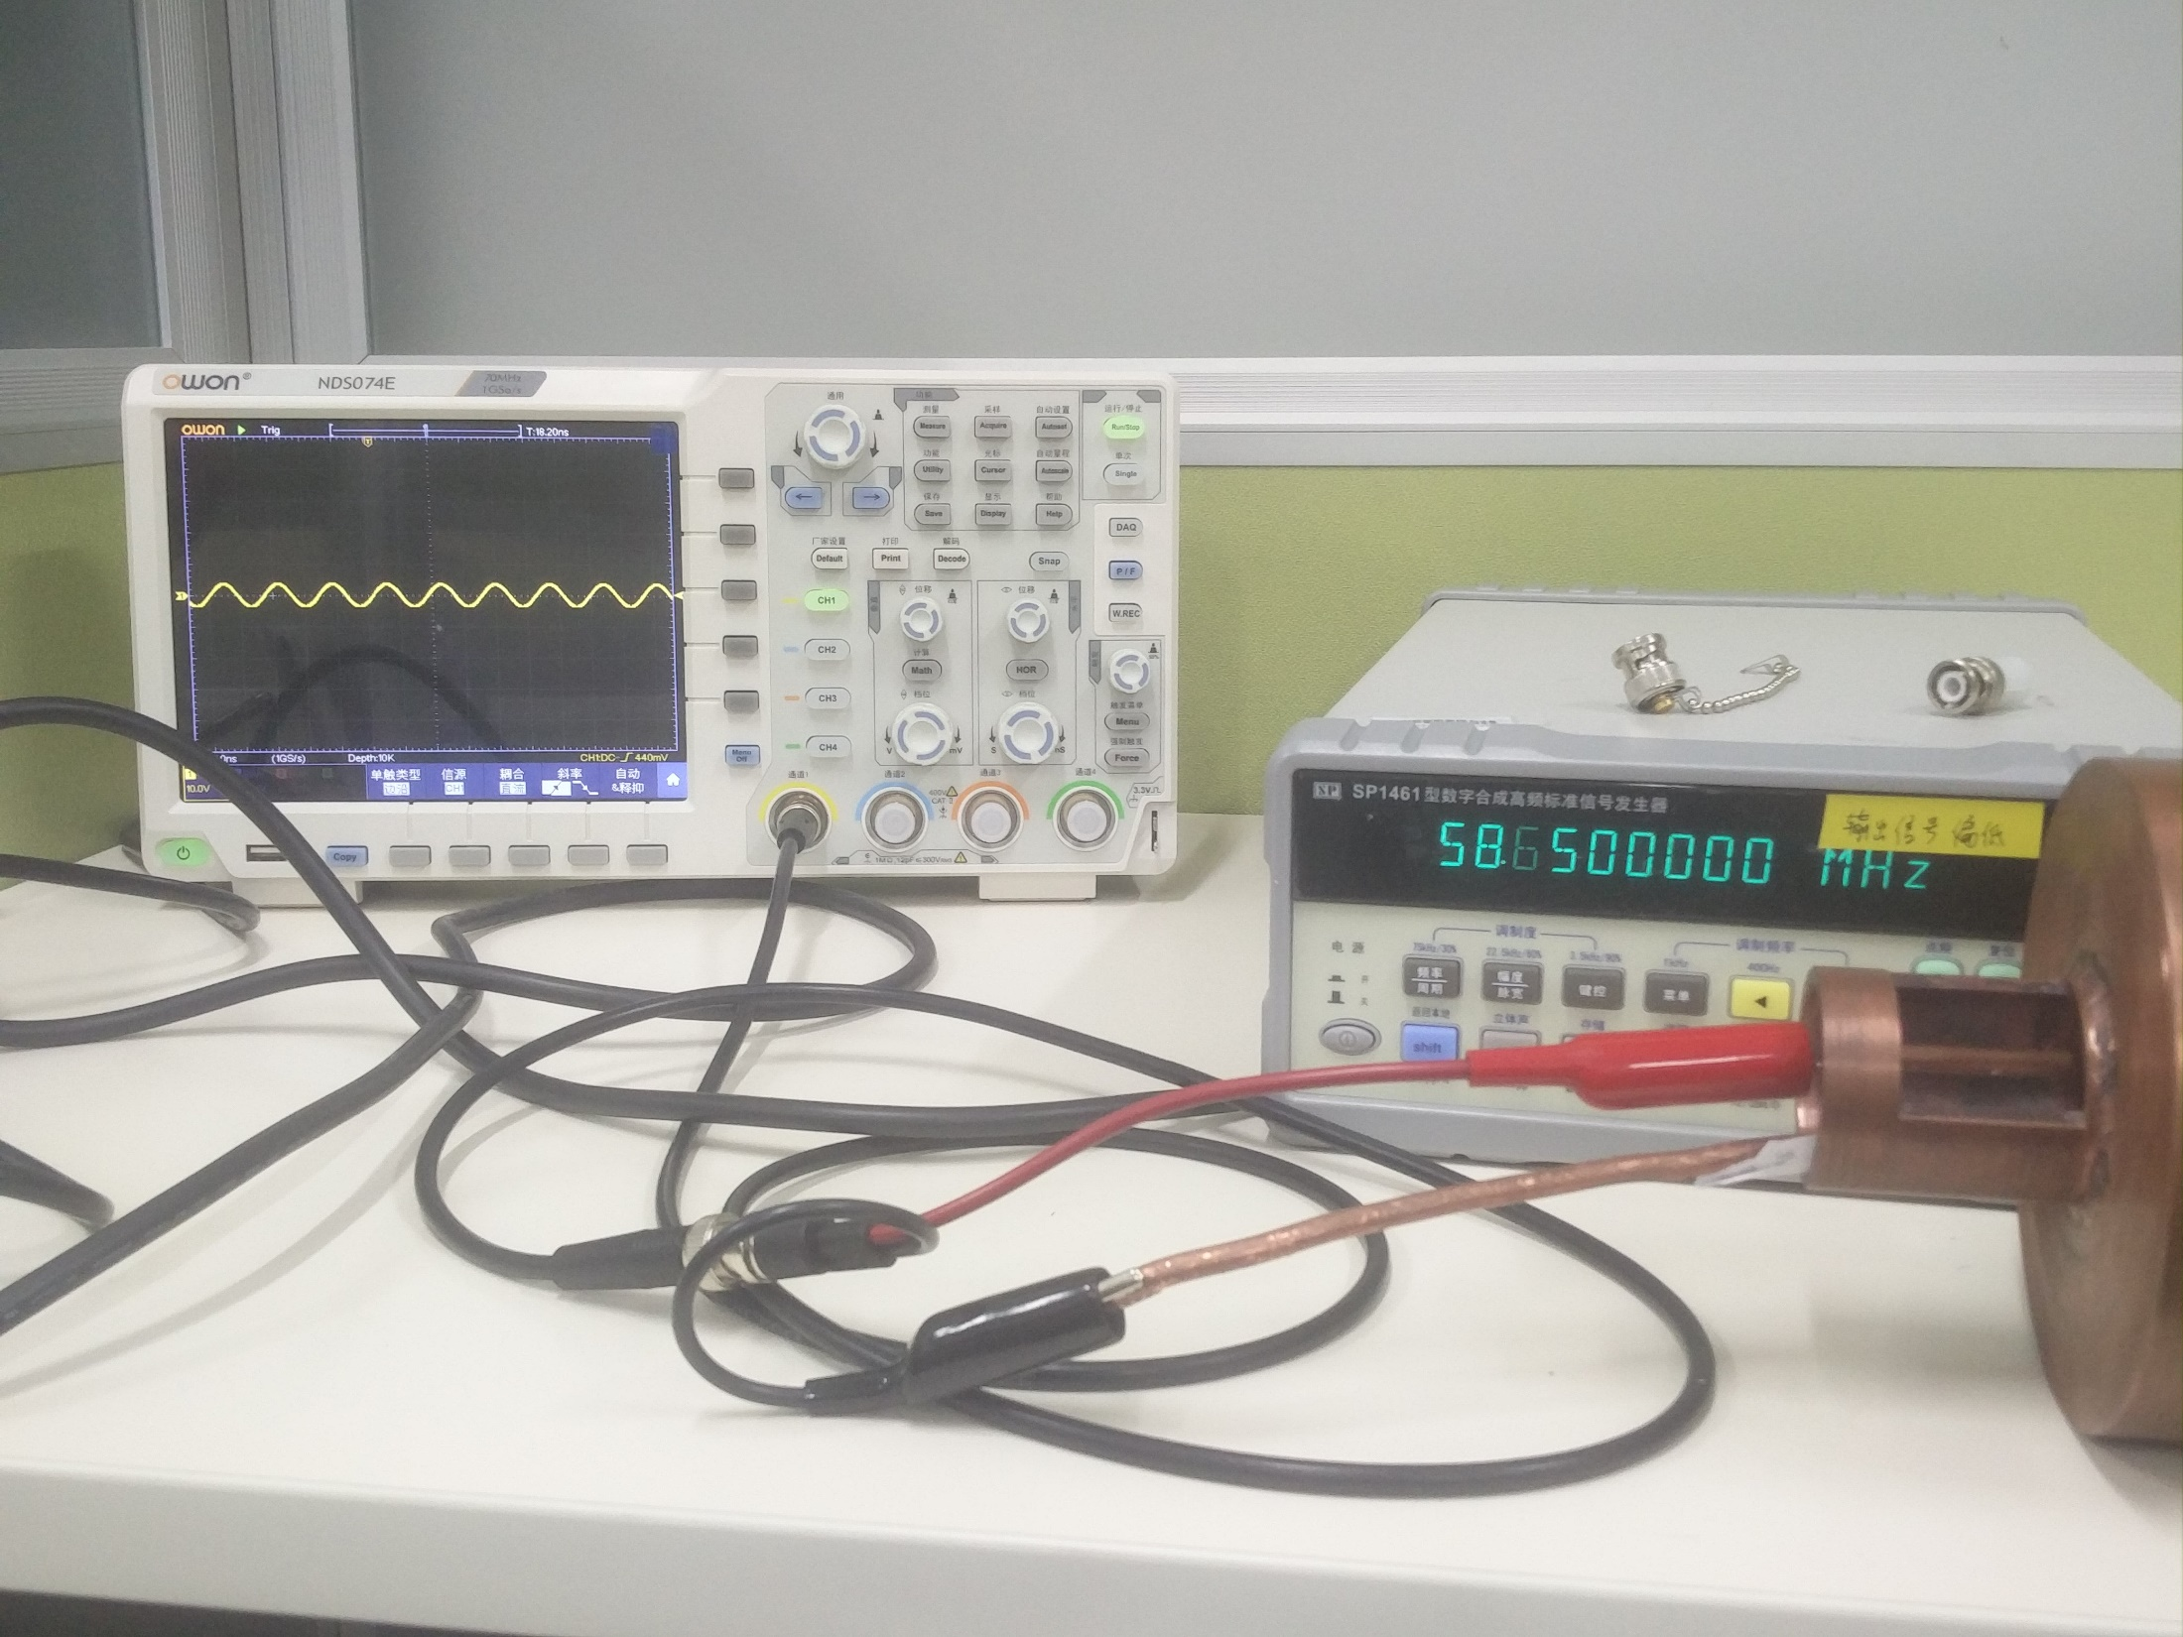
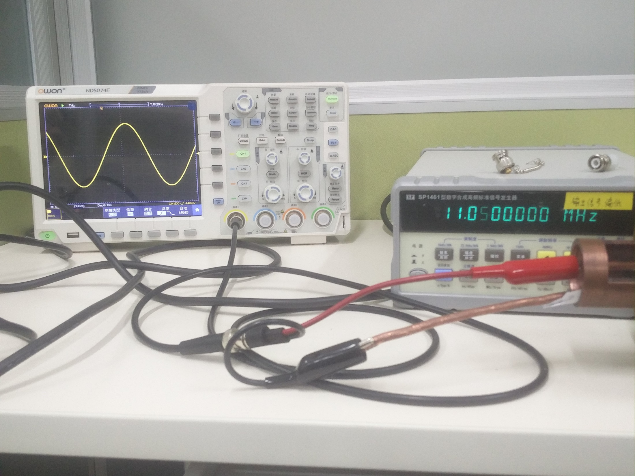
Helical Resonator Test
Two resonant frequency: 11.04MHz, 58.6MHz.
Input Power: 1dBm
~10V(vpp)
65V(vpp)

Slide 3
Helical Resonator Test
11.04MHz: resonance vanished after inserting a resistance.
58.6MHz: FWHM=56.7—60.9MHz, Q=30…
Output will be better without grounding.
Using direct coupler to test the reflection signal again

Slide 4
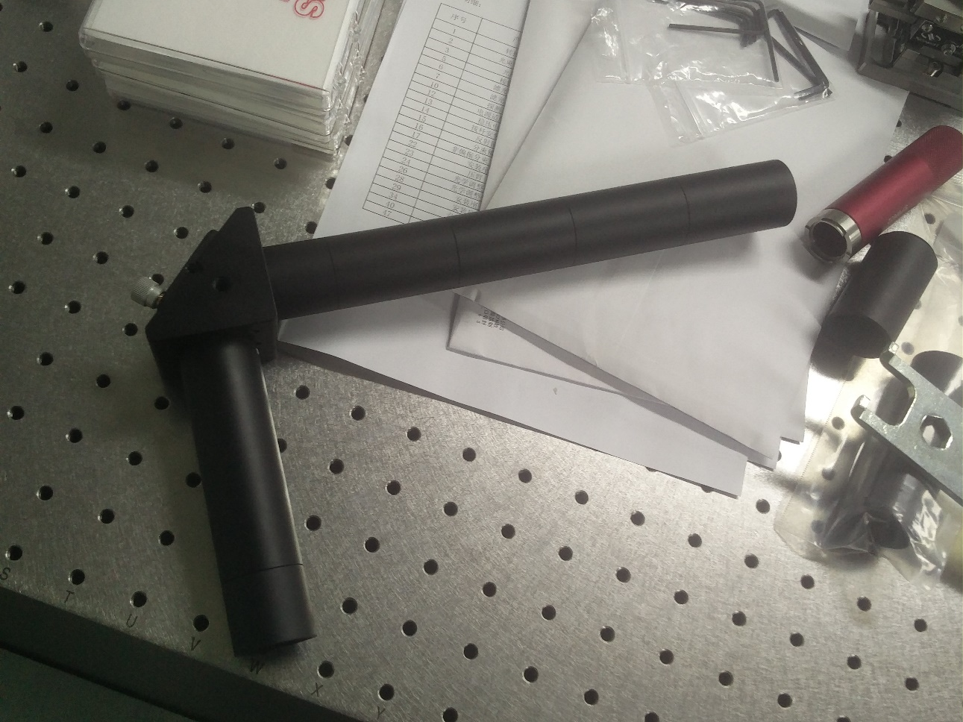
Addressing
Lacking some components
Design details

Slide 5
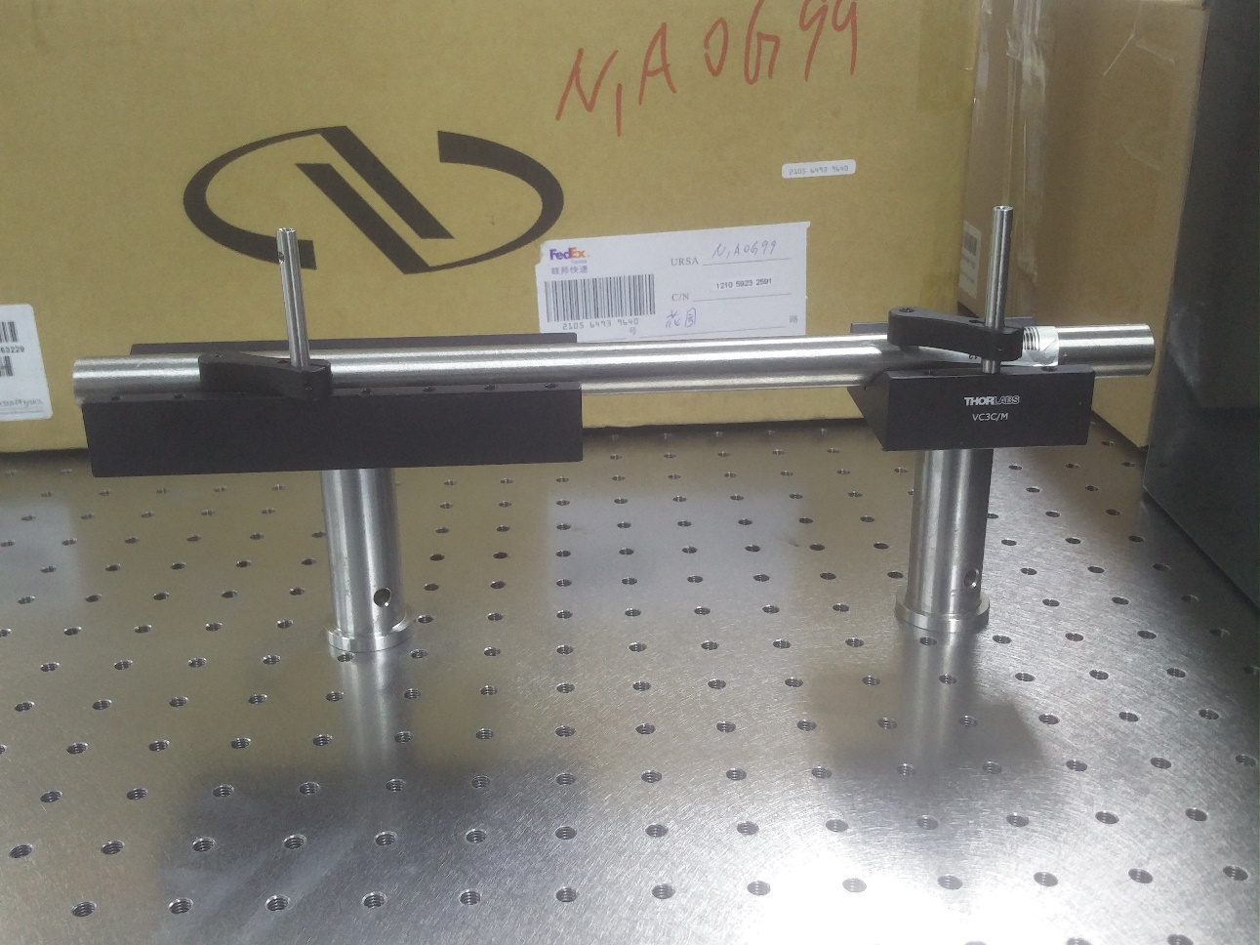
Laser stabilization
30cm-long confocal optical cavity
No output signal detected
Revise the cavity design
Inconvenient to adjust the mirror
Input a off-resonant laser firstly

