Slide 1
The test of AWG0
zwd

Slide 2
Why we have to test
AWG is very important for electric controlling
Our goal:
AWG can generate a arbitrary waveform produce by mathematics
And every channel can realize phase synchronization
Our requirement
The output should be the same with input
Work well under extreme condition
Phase synchronization within several channels with the external triggle signal

Slide 3
How do we test
1. program to control AWG output
2. collect and observe the data from oscilloscope
3. input the data
4. distinguish noise and the effective data
5. pick one period
6. plot
7 compare

Slide 4
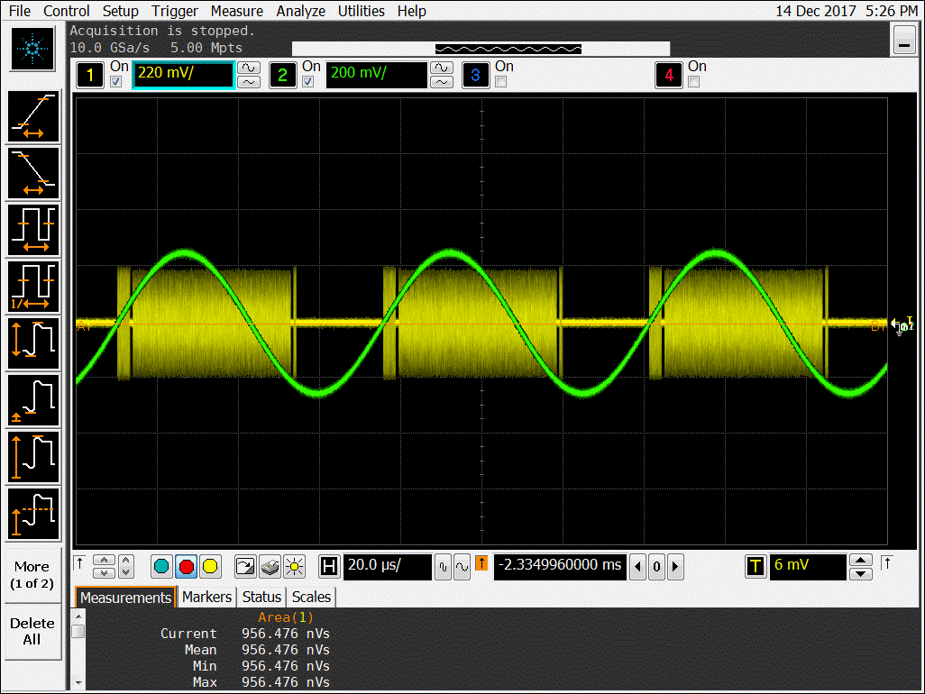
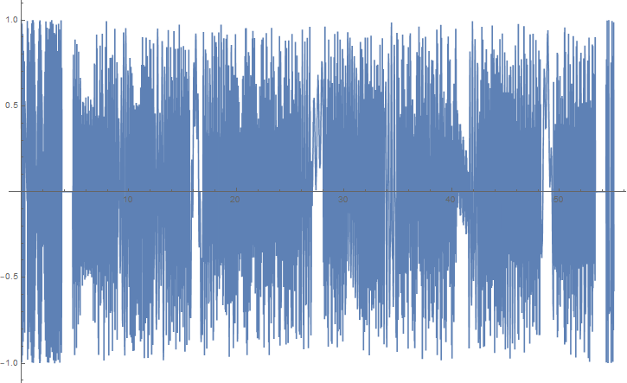
The input
What we get from oscilloscope
at the first step

Slide 5
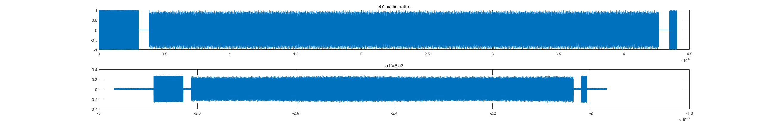
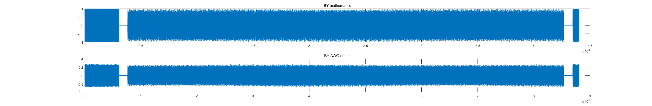
20Mhz sampling
(a)Obtain the origin data and plot (b) make some adjustment, delete unnecessary part in waveforms
About the noise, judge what is the noise when no input and not demand
What is the extra and unnecessary part
Exclude the noise and

Slide 6
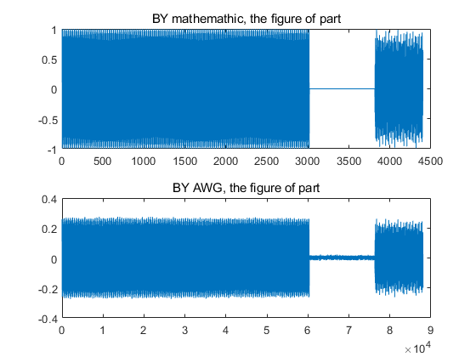
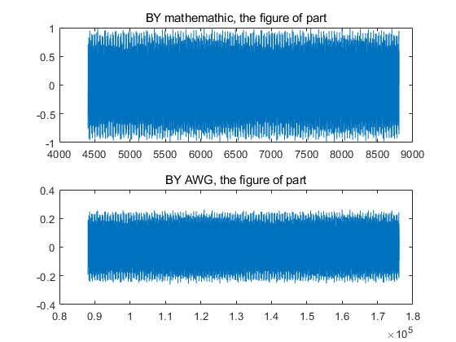
The detail of output comparsion
I divide the output into 10 parts and plot each one respectively and compare to the input produced by mathematics

Slide 7
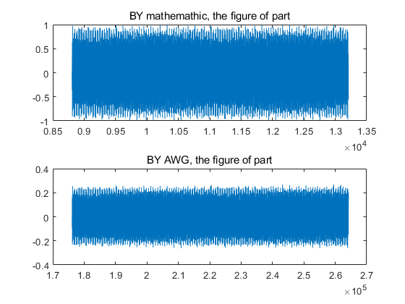
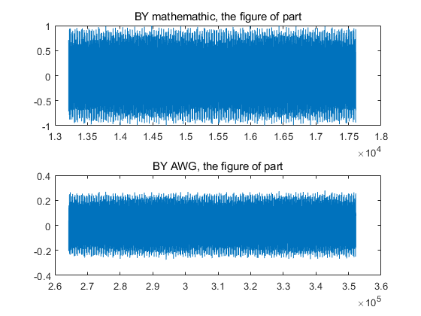

Slide 8
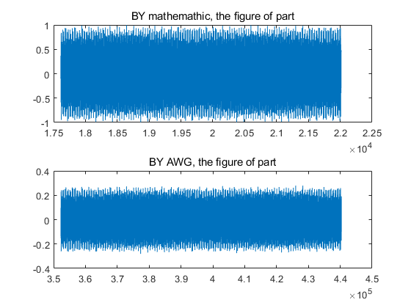
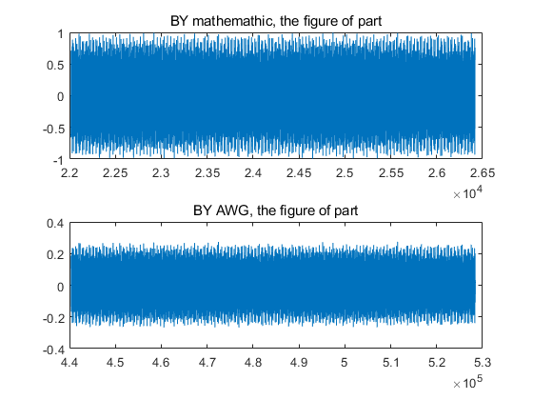

Slide 9
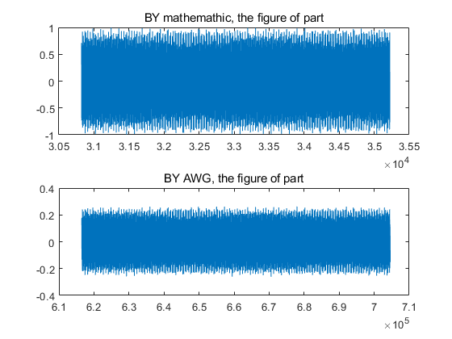
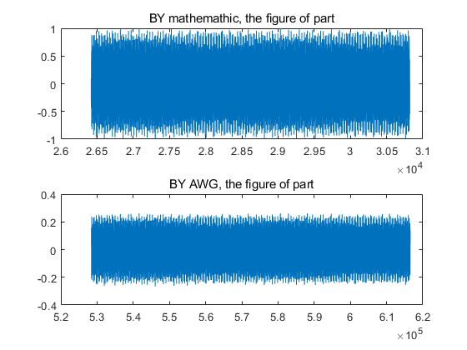

Slide 10
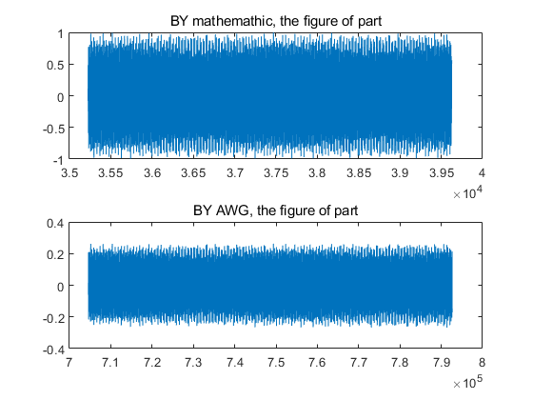
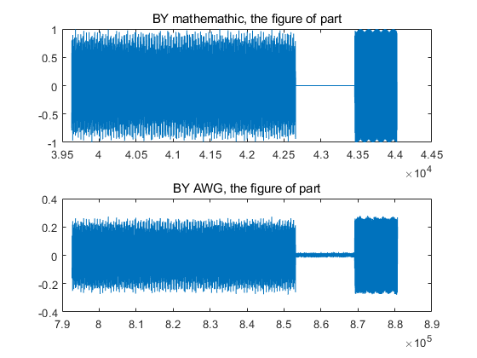

Slide 11
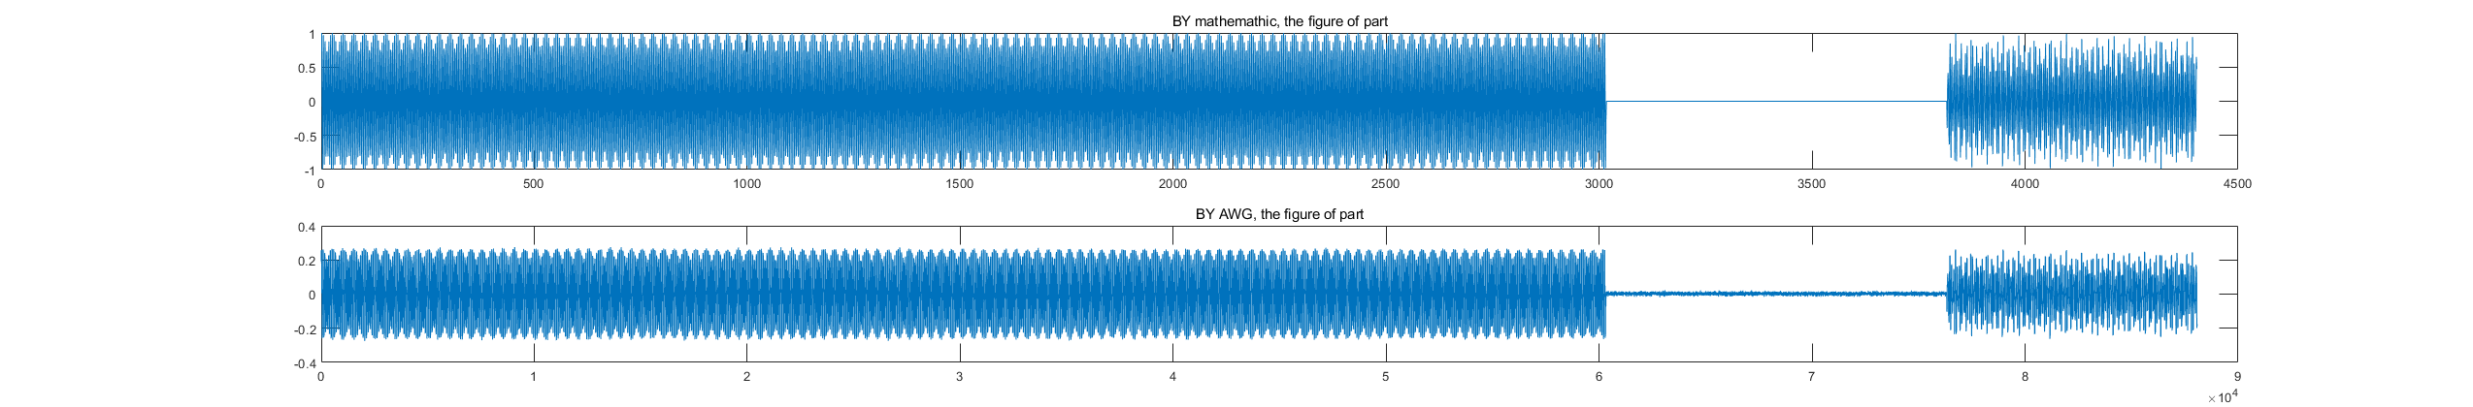
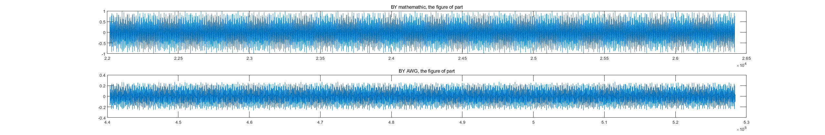
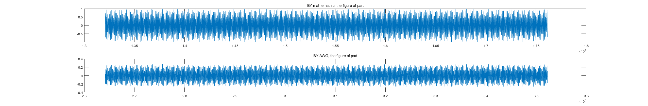
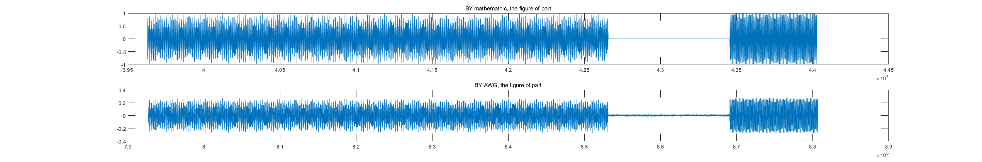

Slide 12
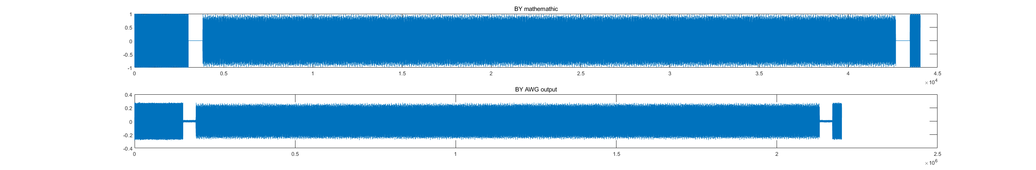
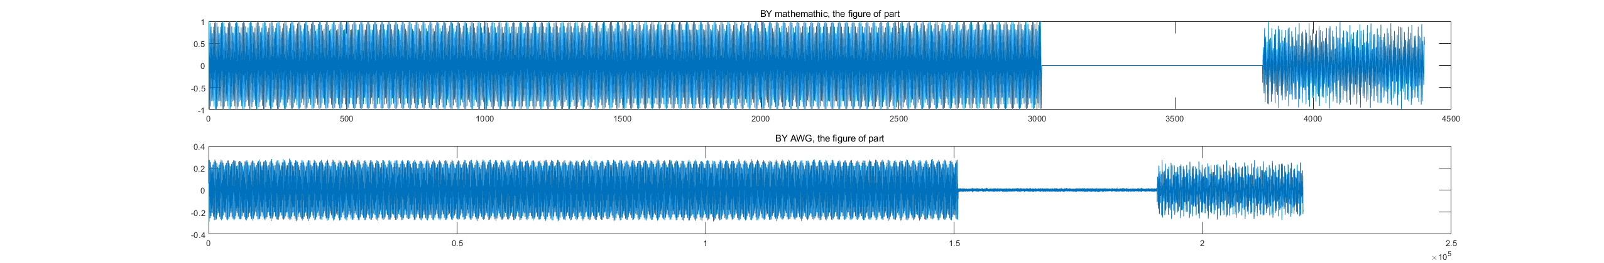
100mhz

Slide 13
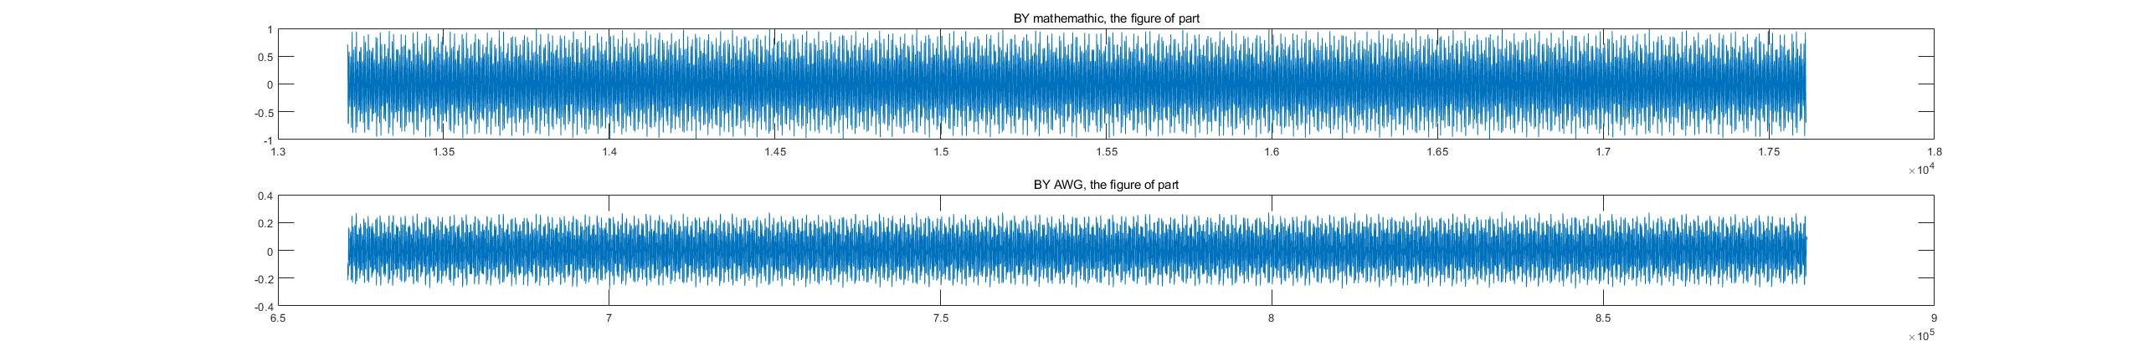
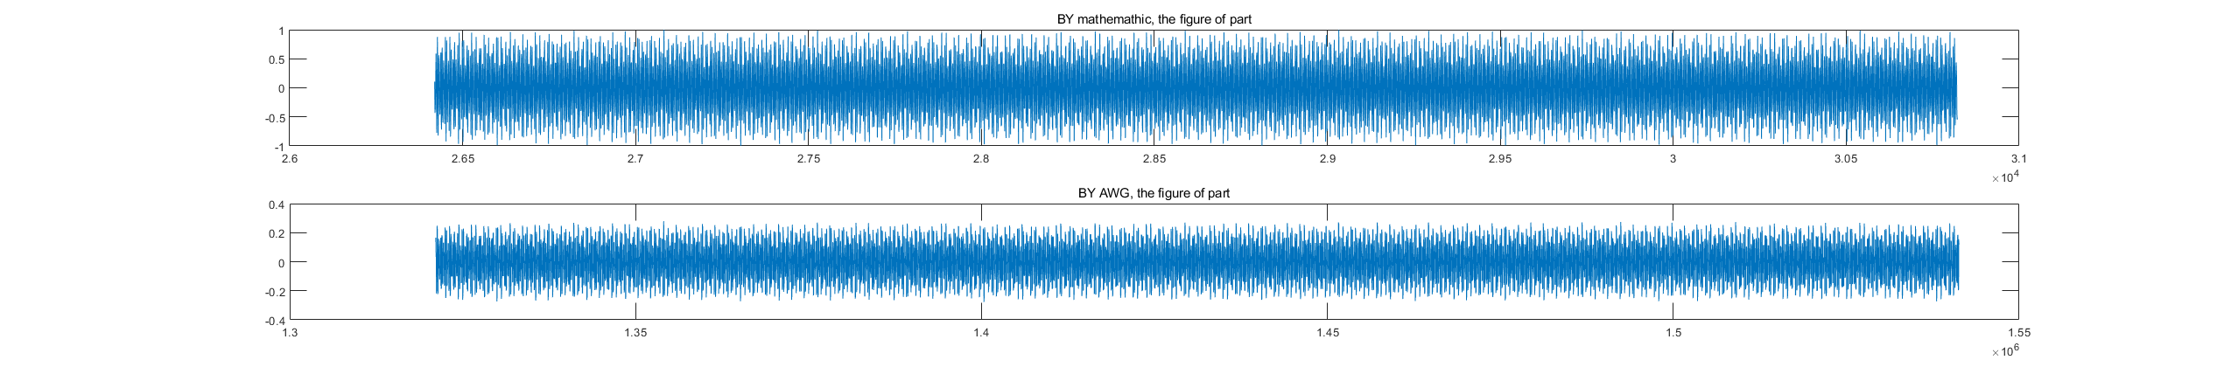
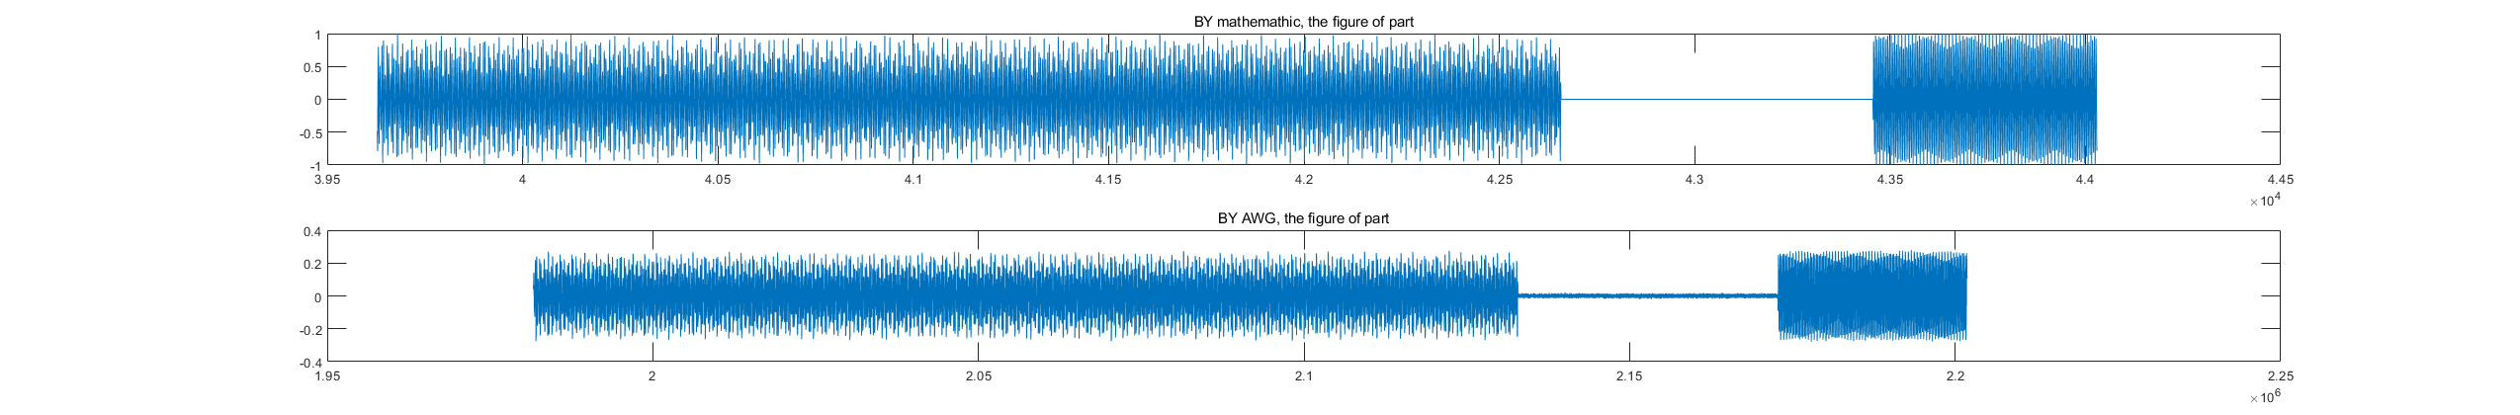

Slide 14
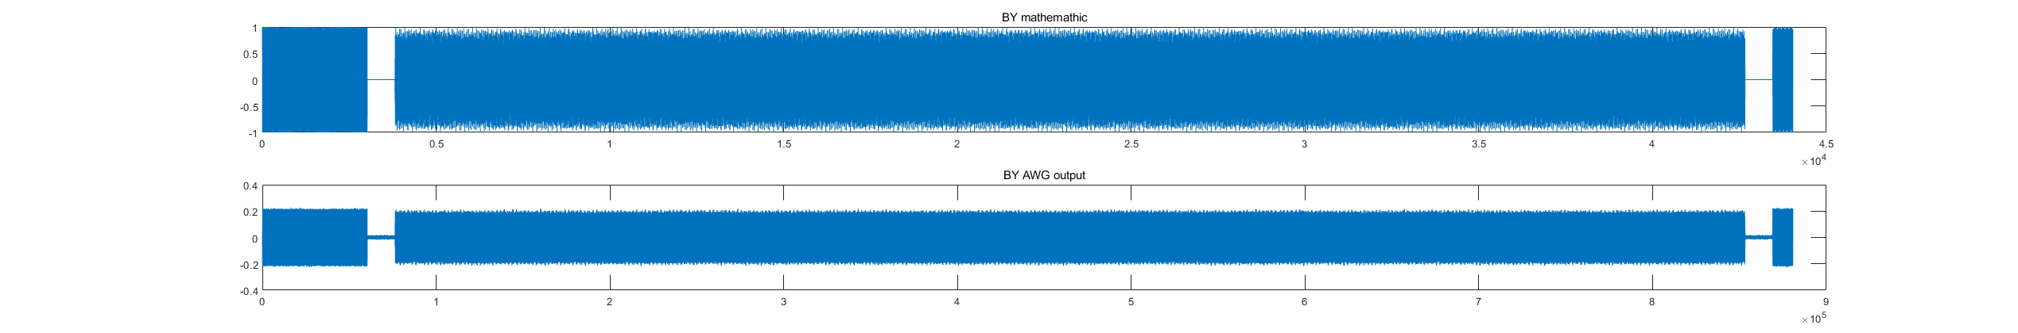
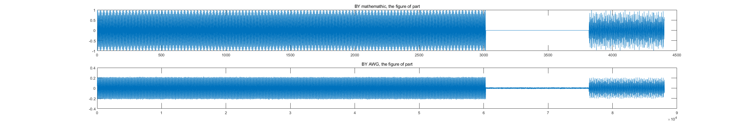
1000mhz

Slide 15
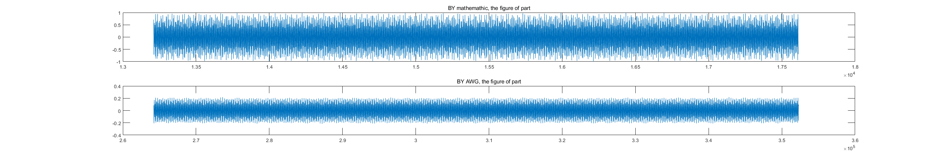
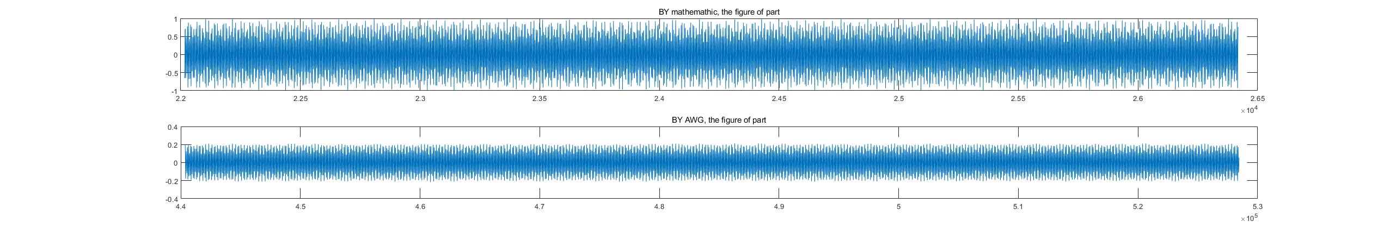
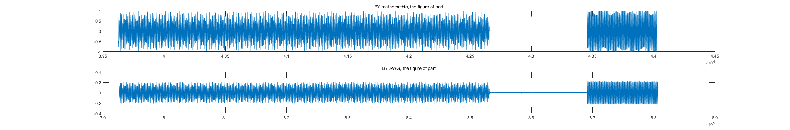

Slide 16
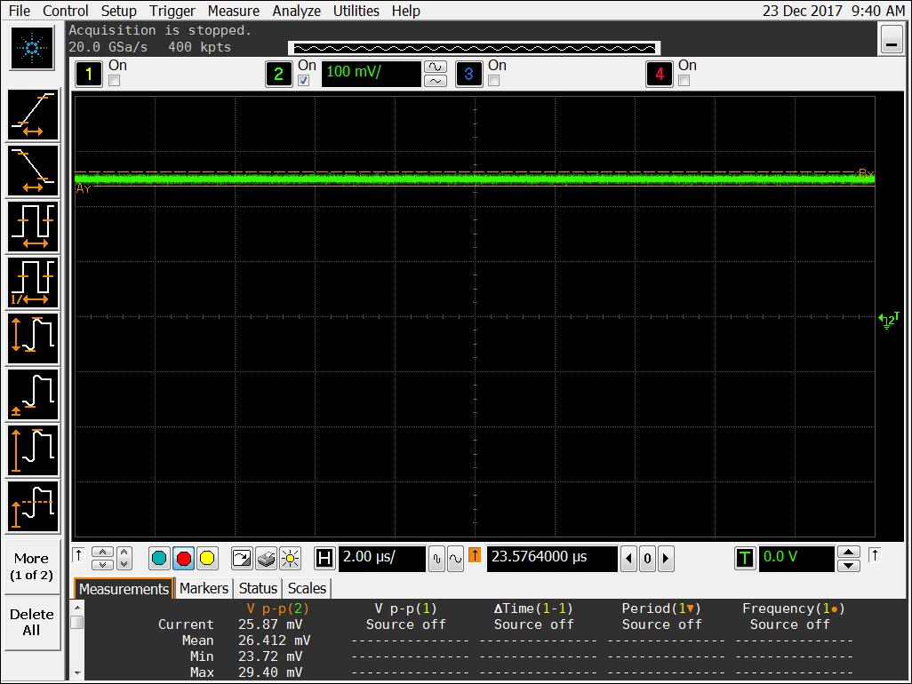
全1全0
测试30min+一直保持稳定 误差率小于0.2%

Slide 17
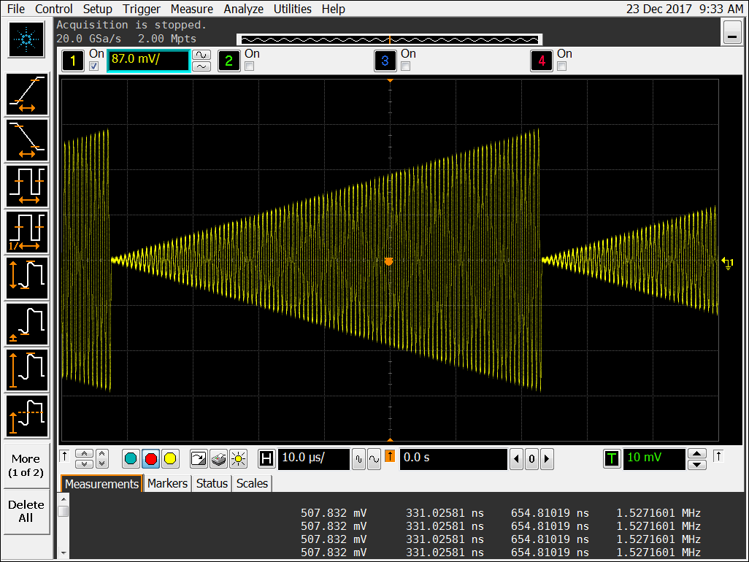
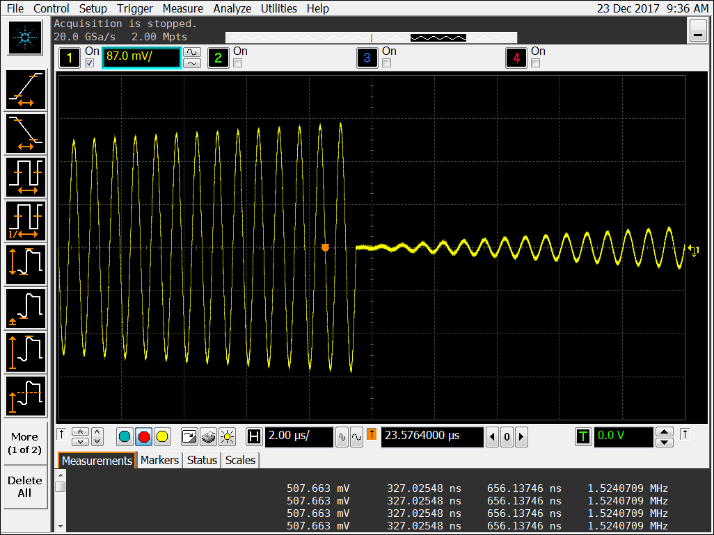
变大波形，无失真，连接处

