Slide 1
Group Meeting
2017.10.23

Slide 2
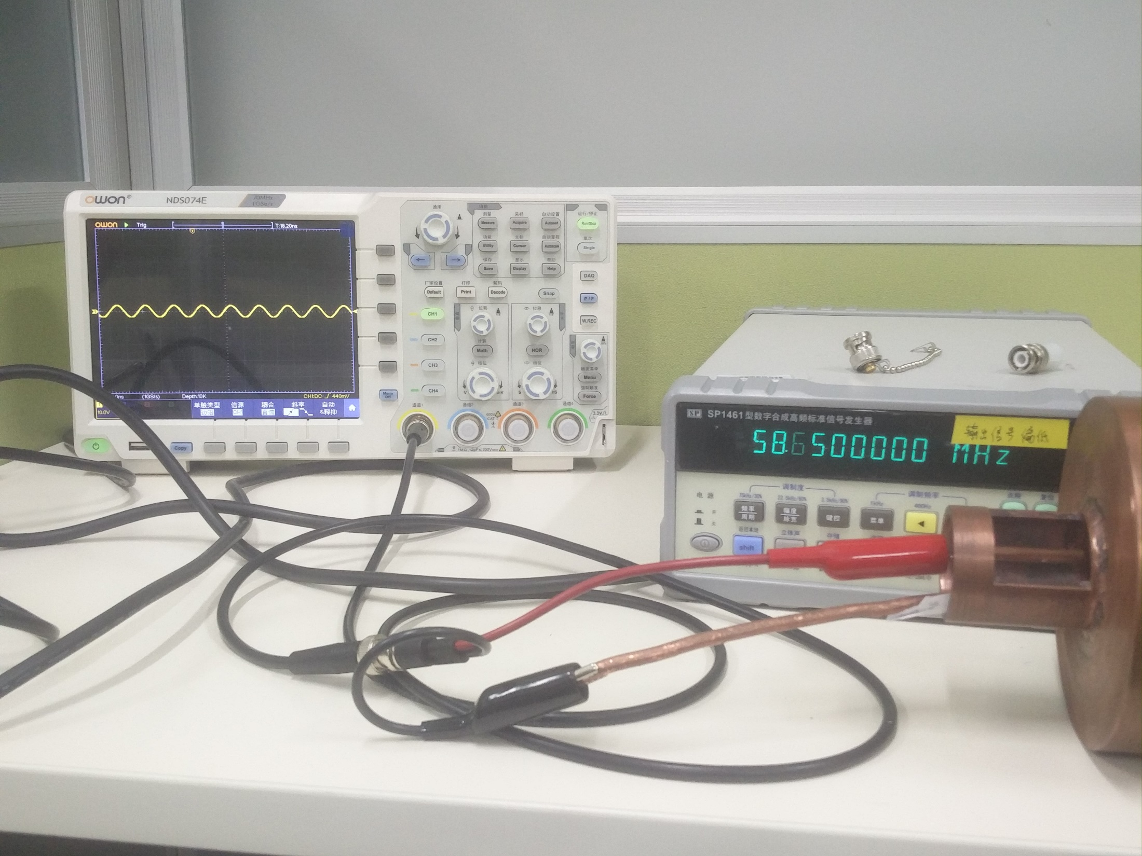
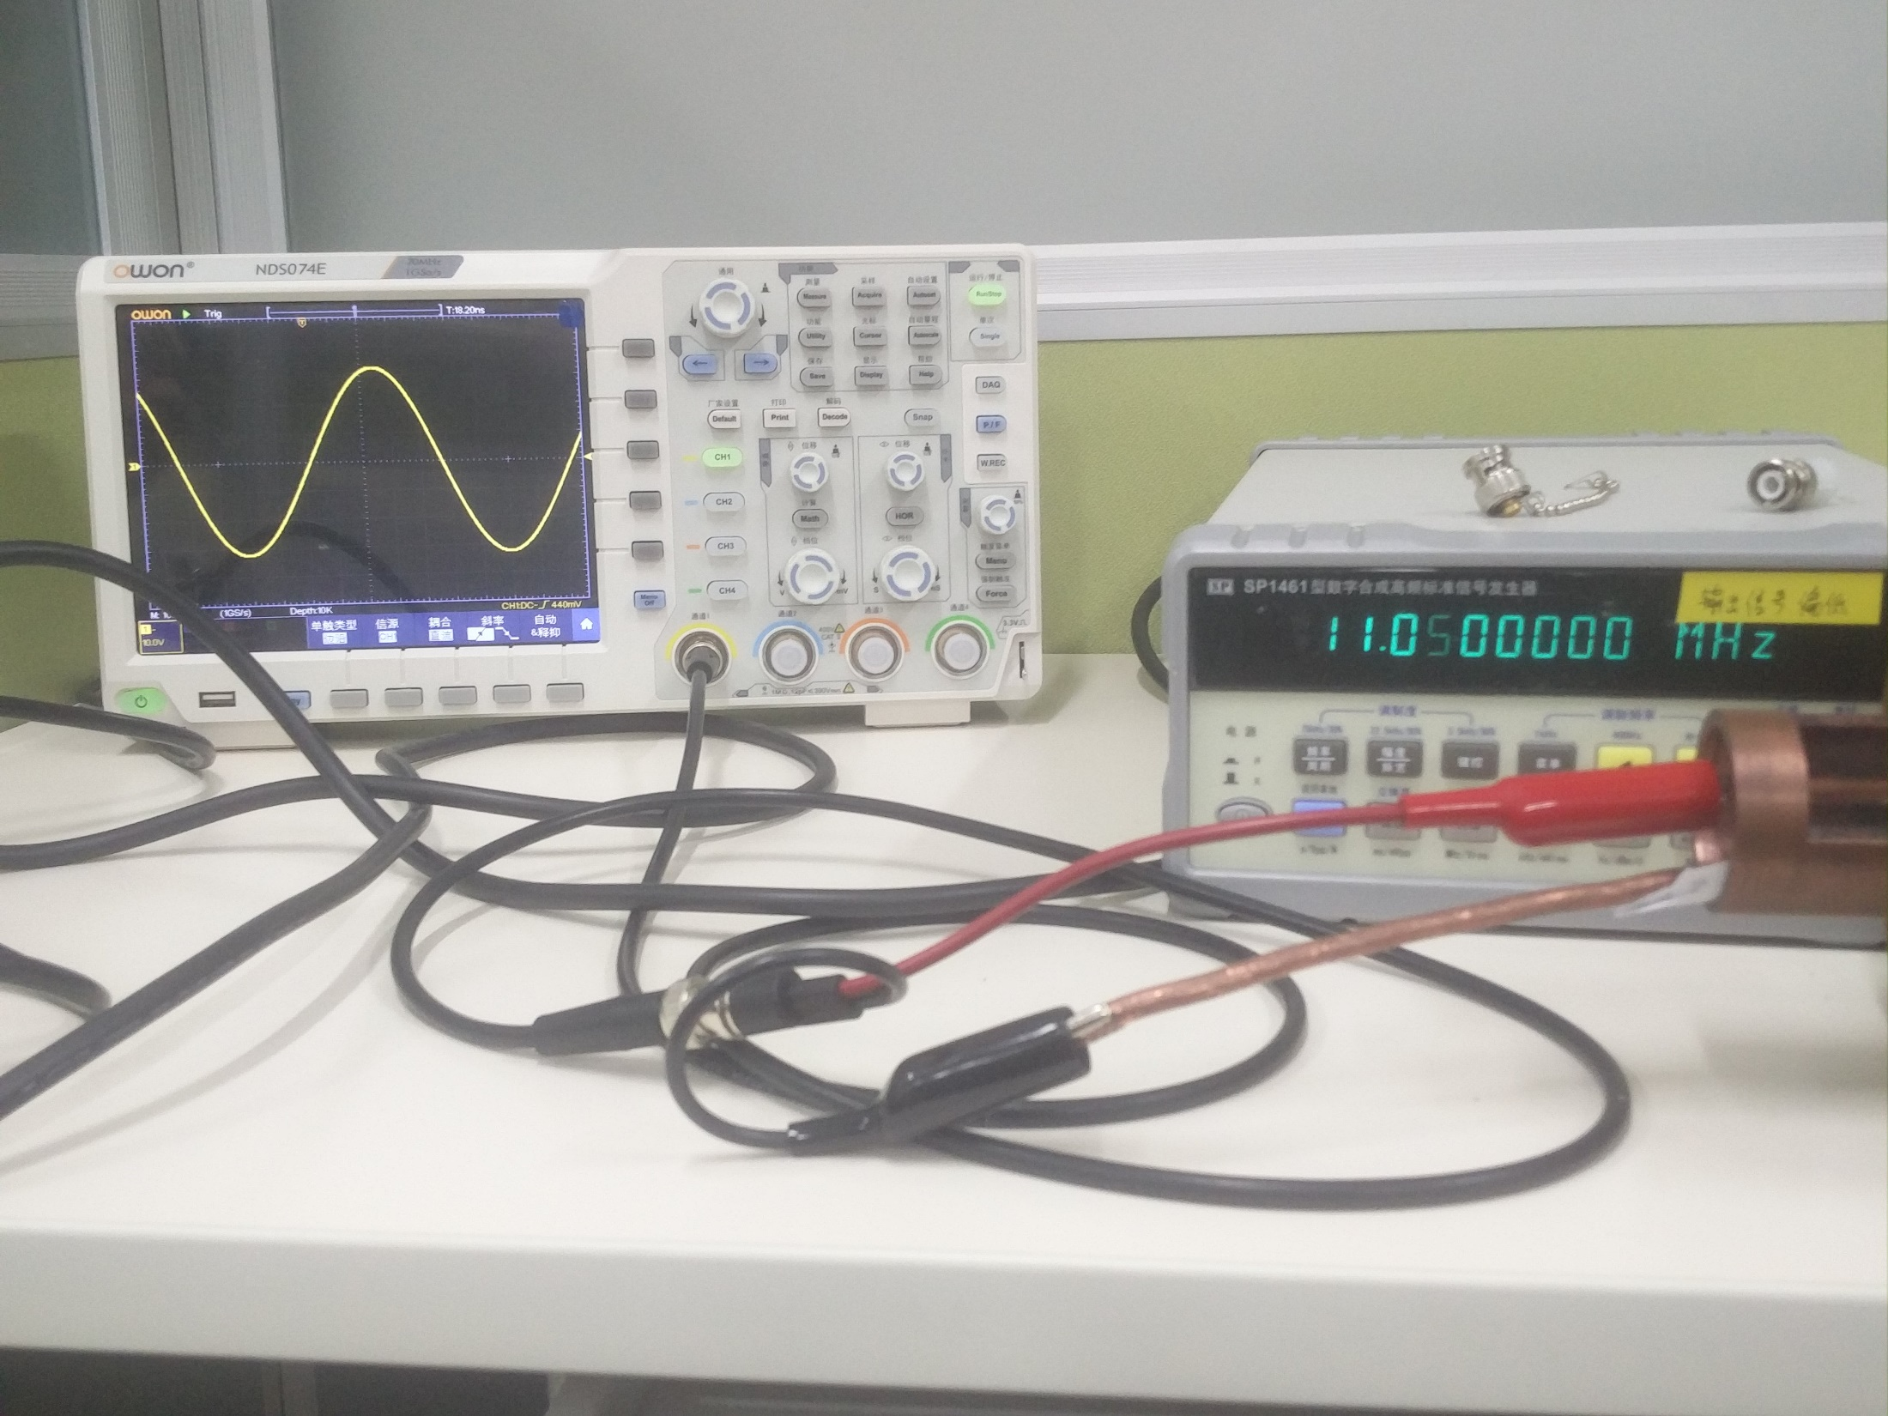
Helical Resonator Test
Two resonant frequency: 11.04MHz, 58.6MHz.
Input Power: 1dBm
~10V(vpp)
65V(vpp)

Slide 3
Helical Resonator Test
11.04MHz: resonance vanished after inserting a resistance.
58.6MHz: FWHM=56.7—60.9MHz, Q=30…
Output will be better without grounding.
Using direct coupler to test the reflection signal again

Slide 4
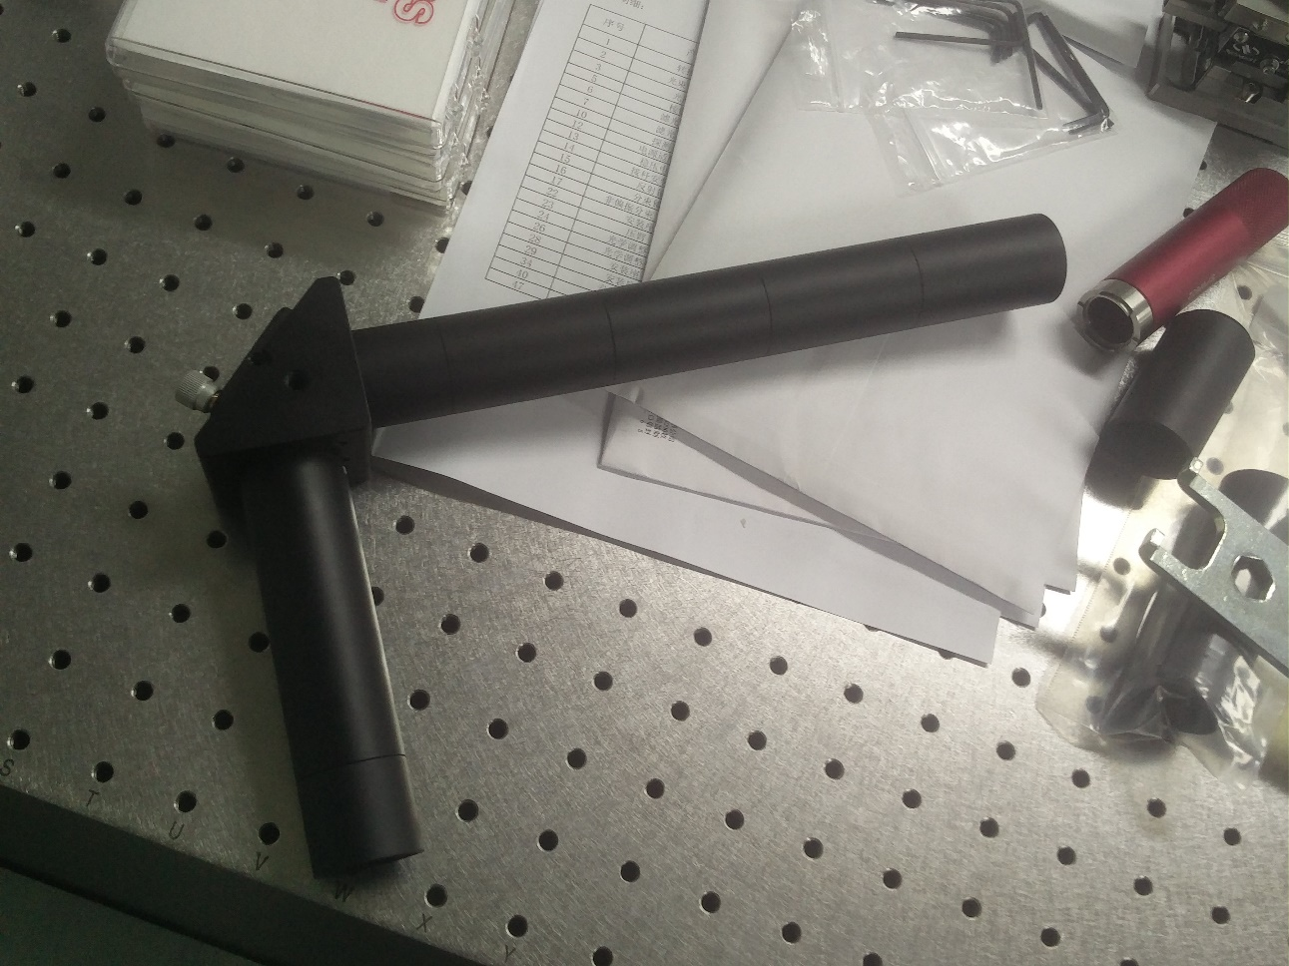
Addressing
Lacking some components
Design details

Slide 5
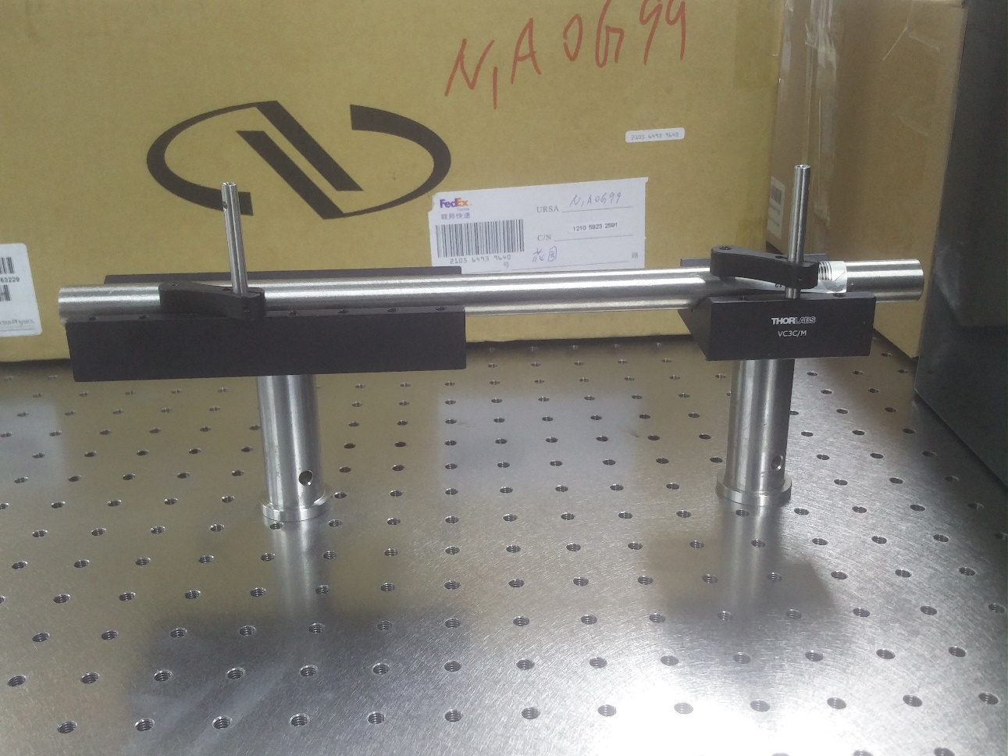
Laser stabilization
30cm-long confocal optical cavity
No output signal detected
Revise the cavity design
Inconvenient to adjust the mirror
Input a off-resonant laser firstly

Slide 6
Long working distance objective
The long working distance objective we did build for Maryland this year had a tested wavefront error of about 0.15 waves rms at 355 nm. The maximum possible error predicted by the tolerancing analysis is 0.2 waves rms at 355 nm. The least expensive option is to have us build more of the catalog, 25 mm working distance objectives, but the wavefront error will be larger than the custom objective.
Lastly, I have one more possible option, we are working on a new design that has infinite conjugate input and has a working distance of about 20 mm and the NA=0.55. This is a custom objective that is designed to operate at 397 and 422 nm, although we could tweak the design to operate at 370 nm. Again, since this is custom it will be expensive, although if we can get more than one party to purchase the assemblies then the unit costs will be reduced for everyone.

