Slide 1

FMINATORUL

Slide 2
Project Overview
FMInatorul is a web-based educational platform designed to help students learn more effectively by automatically generating quizzes from uploaded study materials (PDFs) and enabling real-time collaboration in virtual rooms.
Frontend: ASP.NET MVC (Razor Views)
Backend: ASP.NET Core WebAPI
Database: Entity Framework Core, SQL Server LocalDB
Authentication: ASP.NET Identity
AI Service: Flask API deployed on Google Cloud using Nginx

Slide 3
Testing Strategy
Unit Testing: Isolated method verification
Integration Testing: Multi-component workflow validation
System Testing: End-to-end functional validation
Security Testing: Authentication and authorization enforcement
Mutation Testing: Quality assurance via Stryker.NET
Boundary Testing: Edge case handling
Equivalence Partitioning: Valid and invalid data sets
Main Categories:
StudentsAndProfessorsFlowTests (Integration Tests),
HomeControllerSecurityTests (Security Tests),
ProfessorsControllerSecurityTests (Security Tests),
RoomsControllerSecurityTests (Security Tests),
StudentsControllerSecurityTests (Security Tests),
CriticalFunctionsUnitTests (Unit Tests).

Slide 4
Test categories
Integration Tests
StudentsAndProfessorsFlowTests.cs: focused on real user workflows between students and professors and validates that controllers, roles, and database interactions work end-to-end.
Ex: EditCollegeProf_UserIsStudent_ReturnsForbidResult (checks that a student user cannot modify a professor's data.)
Security Tests HomeController: Role-based view access, error handling, file upload validation.​
ProfessorsController: Only authorized professors can edit or validate subjects/questions.​
RoomsController: Validates access for joining/leaving rooms and handling invalid room codes.​
StudentsController: Secures actions like quiz playing, PDF uploading, and data editing.
Unit Tests​
CriticalFunctionsUnitTests.cs: targeted at the StudentsController's critical function: PDF upload and quiz creation and the logic is tested in isolation with mocked dependencies.​
Ex: UploadPdf_QuizNotNullAsync (PDF uploads result in a valid quiz)

Slide 5
Testing Implementation
1. Mocking with Moq All tests use the Moq library to create fake (mocked) versions of services like UserManager, RoleManager, HttpContext, ILogger, IFormFile, and IHubContext, ensuring isolation from external dependencies and making tests fast and deterministic.
2. Testing Frameworks xUnit defines tests with the [Fact] attribute, encouraging independent, self-contained test cases, while NUnit uses [TestFixture] and [Test] for more structured and flexible test organization.
3. Asynchronous Testing Tests follow the async Task pattern to realistically simulate operations such as file uploads, API calls, and database queries.
4. Code Coverage Tools The project uses Coverlet Collector, an open-source tool that measures test coverage and works around the limitations of Visual Studio Community Edition. To visualize coverage results, Report Generator is used to convert Coverlet output into readable HTML reports, enabling visual inspection of untested code paths.
5. Mutation Testing with Stryker.NET Mutation testing is performed using Stryker.NET, which introduces intentional bugs into the code to verify the quality of the test suite. This ensures that tests are capable of catching failures and are not just passing trivially.

Slide 6
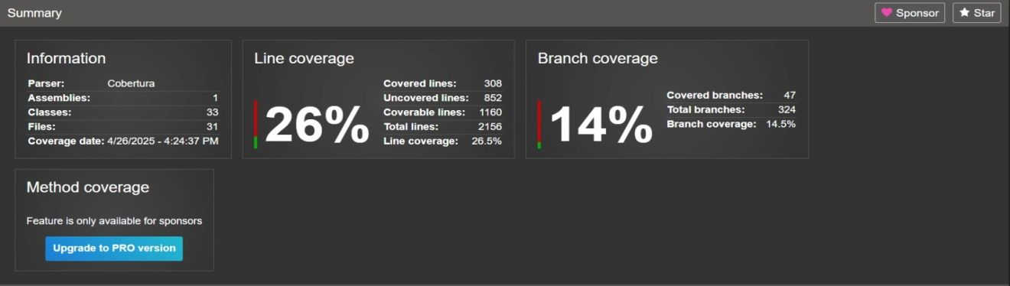
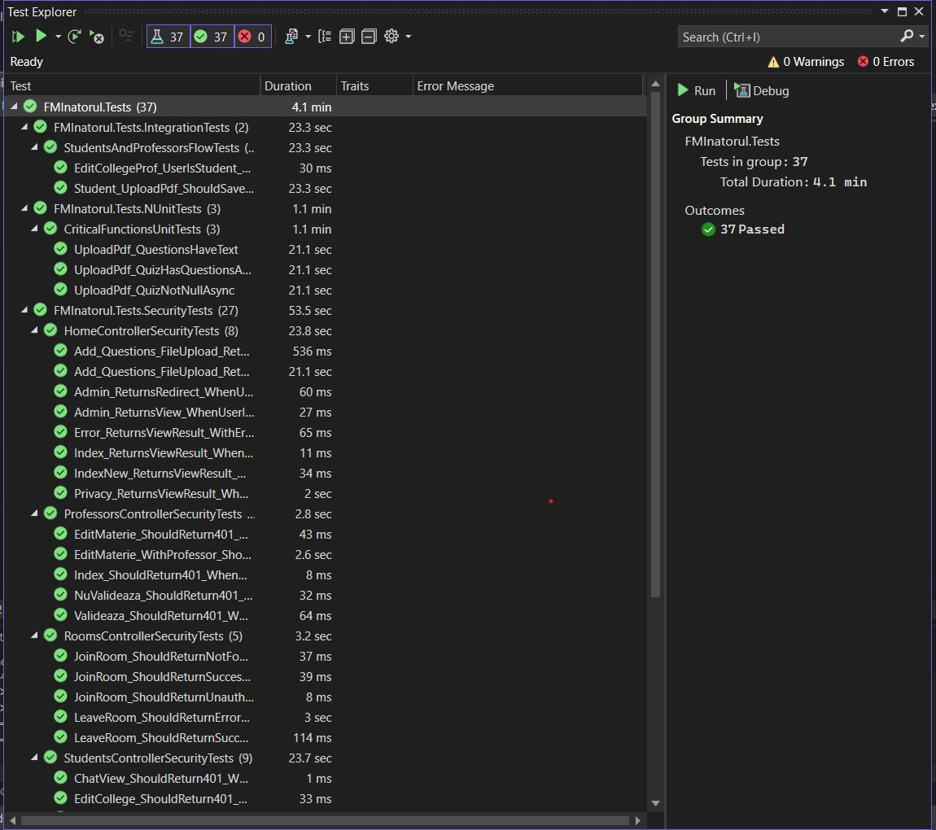
Execution Results
Test Metrics | Status
Unit Tests | 100% Pass
Integration Tests | 100% Pass
System Tests | 100% Pass
Security Tests | 100% Pass
Test Coverage | 25% coverage
Mutation Tests | 66% killed

Slide 7
Ai tool usage in Testing
We used ChatGPT4o to assist in:
Template generation for unit tests
Identifying test packages and commands in .NET
Prompt Example: Generate a xUnit test for PDF upload and quiz creation.
Aspect | Manual Suite | AI-Generated
Coverage | Higher | Moderated
Code Quality | Optimized | Good, needs tweaks
Security Testing | Fully covered | Minimal

Slide 8
Security analysis
Ci/CD pipeline
API (https://api.fminatorul.xyz)
Hosted behind Nginx with HTTPS
JWT authentication for API requests
1-minute token expiry for minimized risk
Website:
Role-based access control (Admin, Student, Professor)
Restriction based on email domains (e.g., s.unibuc.ro)
Comprehensive security testing implemented
Hosting: Google Cloud VPS
Web Service: Flask, Nginx, Gunicorn
Auto Deployment: GitHub Actions triggered by branch push
Deployment Latency: ~20 seconds
Main App: Pull requests with mandatory review on main branch

Slide 9
Research Resources
Unit Testing with NUnit and .NET Core
Unit Testing C# with NUnit and .NET Core
Getting Started With .NET Unit Testing Using NUnit
Comparison between NUnit and xUnit
https://stackoverflow.com/questions/9769047/nunit-vs-xunit
Mutation Testing with Stryker.NET​
​
Mutation Testing with C# and .NET Core​
Mutation Testing with Stryker in .NET Projects​
Mutation Testing in C# with Stryker​
Write Perfect Unit Tests with .NET Stryker Mutation Testing

Slide 10
References
[1] M. Roper, Software Testing, McGraw-Hill, 1994.
[2] Glenford J. Myers, Corey Sandler, Tom Badgett, The Art of Software Testing, Wiley, 2004.
[3] Bertolino, A., Software Testing Research: Achievements, Challenges, Dreams, IEEE, 2007.
[4] OpenAI, ChatGPT, https://chatgpt.com/, Data generării: 1 martie 2025.
[5] xUnit Documentation, https://xunit.net/docs/getting-started/netfx/visual-studio
[6] draw.io, https://app.diagrams.net/, Accessed: 24 April 2025.
[7] Stryker.NET, https://stryker-mutator.io/.

