Slide 1
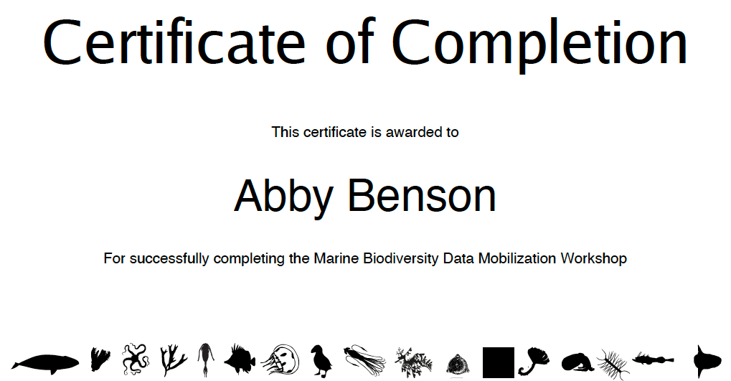
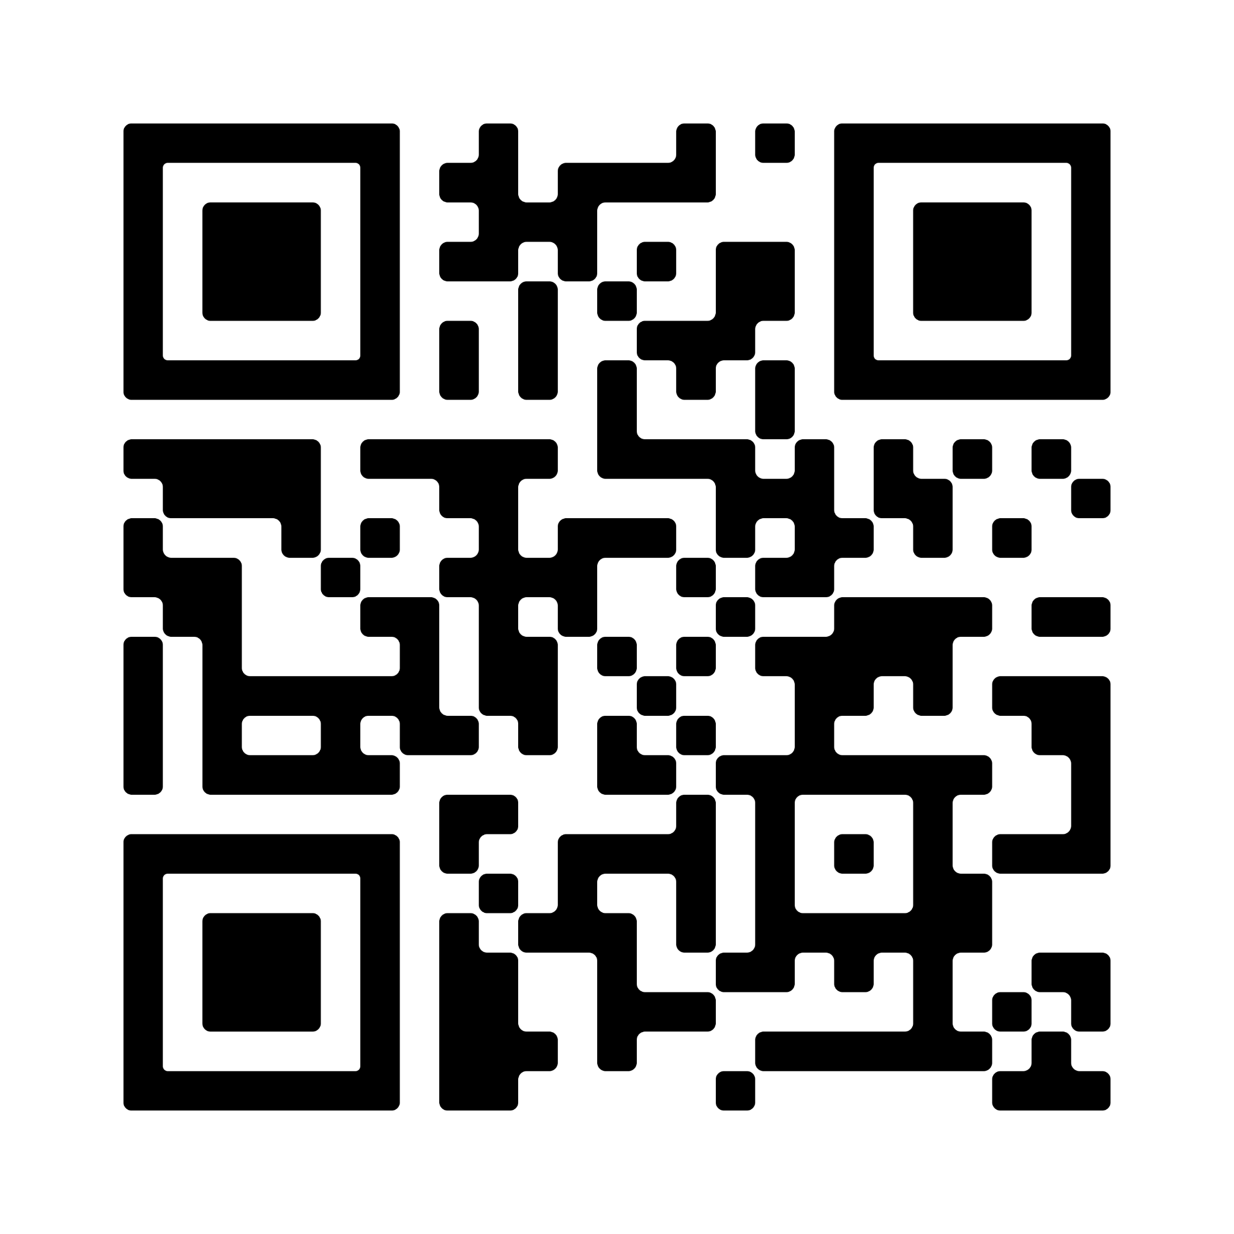
Certificate of Completion
This certificate is awarded to
Abigail Mary Moore
for successfully completing the Marine Biodiversity Data Mobilization
Workshop on April 22-23, 2024.
workshop DOI

