Slide 1




IOOS Biological Data Services
Three Steps to Enrollment
Tune in
Turn On
Drop Out
May 28, 2014
(don’t drop out)
Philip Goldstein (University of Colorado, OBIS-USA)
Hassan Moustahfid (NOAA US IOOS)

Slide 2
OBIS and IOOS Biological Data
Once Upon a Time in OBIS:
The message from Federal leadership about OBIS:
Not enough information
Errors and ambiguities
Quality and completeness problems
Can’t do enough with the data
Can’t maintain support this way
Still around! What happened ? …
Requirements-based and partner-based enhancements
OBIS-USA and IOOS joint development
Outcomes
Presence-Absence-Abundance
Integrate with Env Data & CF
IOOS Biology in 3 RAs
OBIS-USA from 3M to 28M
IODE/OBIS enhancing too

Slide 3
Even Better: In 2015,
encountering very rich data
Today we see many bio datasets like this:
Taxonomic range, span trophic/functional groups
Presence – Absence – Abundance (with effort)
Intentional study locations relevant to research design
Consistent sampling methods; time series
Consistent env data and methods accompany bio data
What enables managing data this rich?
Data content standards and data flow …
… and the enrollment process, a consistent, repeatable process.

Slide 4
Enrollment in Three Steps
Crosswalk data and metadata with DMAC standard
(logical)
Put in common format for serving
(technical)
Configure web services and IOOS Catalog
(technical)
1
2
3
Tune in
Tune in
Turn on
Enrollment is the process of developing data
From original source …
… to IOOS web service
(and on to downstream services: OBIS, NCEI)

Slide 5
Enrollment Skills in Three Steps
Crosswalk data and metadata with DMAC standard
Put in common format for serving
Configure web services and IOOS Catalog
1
2
3
Skills:
Love data
Attention to detail
Know the science agenda
Communication
Balance and adapt enrollment for local requirements
Skills:
Data structures (table, RDBMS)
Scripting, programming, for example, SQL, R, others)
Skills:
System admin and configuration (e.g., datasets.xml config file)
Operations and testing

Slide 6
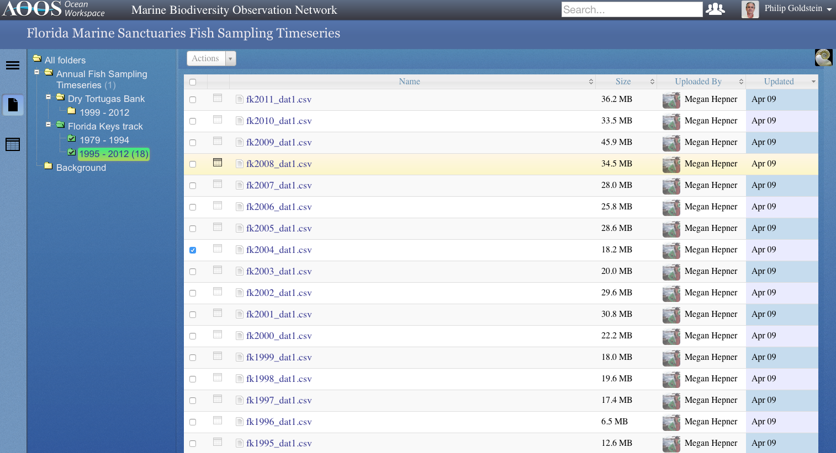
Enrollment Crosswalk Example
Florida NMS Fish Sampling Timeseries
18 years of data; via Sanctuaries MBON organization
File ‘fk2004_dat1.csv’: 182,519 records (start with a single year)

Slide 7
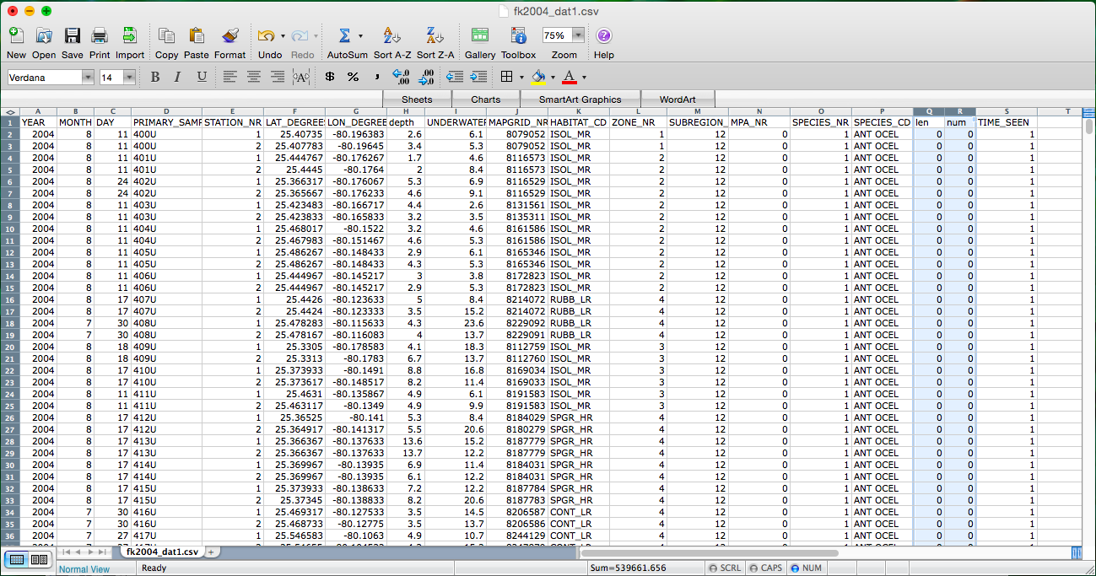
Enrollment Crosswalk Example
Florida NMS Fish Sampling Timeseries
Below, a look inside the contents of the fish data (legacy data)

Slide 8
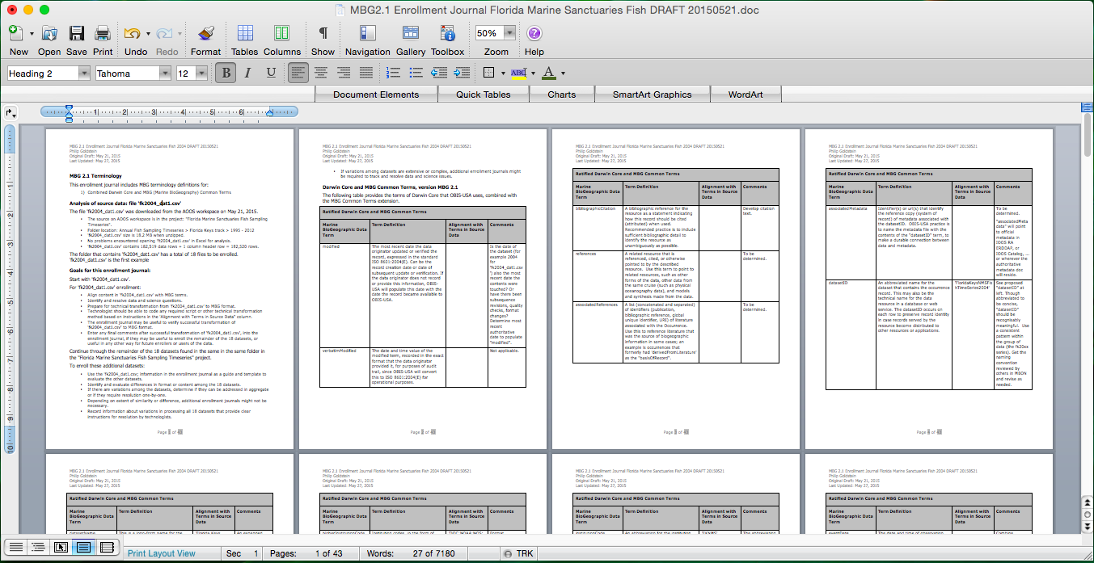
Enrollment Crosswalk Example
Florida NMS Fish Sampling Timeseries
Below, a glimpse of the fk2015_dat1.csv Enrollment Journal
Analyze alignment, circulate, resolve questions, specify coding step

Slide 9
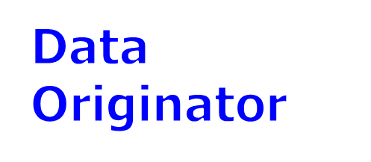

Enrollment Skills Alignment
by Organization (proposed)
Crosswalk data and metadata with DMAC standard
Put in common format for serving
Configure web services and IOOS Catalog
1
2
3

Slide 10
Assisted Enrollment – Outside Help
Data Originator
IOOS Bio Data Projects
When enrollment requires outside help:
In the IOOS projects,
everyone helped,
ad hoc.
OBIS-USA does assisted enrollment regularly; lots of one-off data sources.
Working Group: IOOS HQ, RAs, OBIS, other agencies, EDUs, Data Originators
Original data
Assisted Enrollment
USGS OBIS-USA
Original data
Assisted Enrollment
Hidden benefit of assisted enrollment:
IOOS and OBIS globally learn new features

Slide 11
Self-Enrollment: Done in the Network
Data Originator
Data Originator / IOOS RA
Joint Activity
Self-Enrollment: Skills reside in the network to get the job done.
Repeat-Enrollment is the key: beat the learning curve
Self-Enrollment enables optimal adaptation of enrollment process for original programs’ science needs.
Self-Enrollment
Original data
Get enrollment skill into the network
Enable originators and RAs to self-enroll.
Enable local decision-making on priorities.
This is the goal of enrollment training.

Slide 12
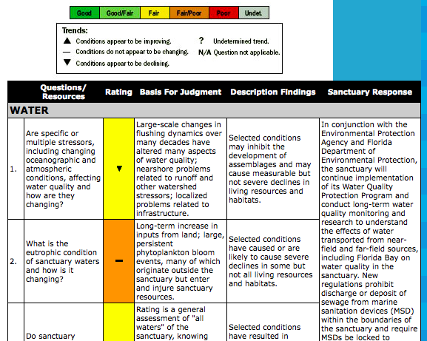
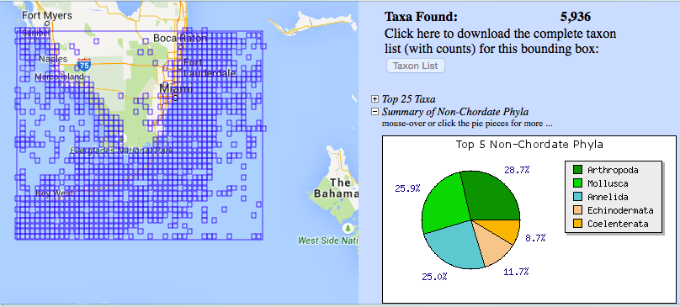
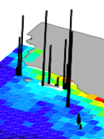
Science Applications in the Network
Data Originator
Data Originator / IOOS RA
Joint Activity
Joint Originator / Regional Association
science applications
Original data
Facilitate joint science applications by originator and RA, within enrollment skill set.
Incorporate application automation into enrollment cycle.
Enrollment

Slide 13
Enrollment Flavors:
Legacy Data and New Data
Data Originator
Data Originator / IOOS RA
Joint Activity
Keys to legacy data enrollment may be archived information or personal contact.
Key to new data is coordination with research design.
Legacy Data
Enrollment
New Data
Important roles for the enroller:
Align and balance science and data activities.
Represent management decision-making.
Feedback to US, GOOS, IODE global practices.
Can new data originate pre-enrolled??

Slide 14
Biological Data Enrollment
Training Plan (proposed)
Training model:
The goal is to create independent enrollers
Train-the-trainer
Train by example – while enrolling actual data
Format:
  Hour sessions over time, telecon or webinar
  - or -
  Site visit, e.g., two-day workshop

Slide 15
Biological Data Enrollment
Training Plan (proposed)
Training resources:
Experienced enrollers as instructors
Documents and tools
Prior examples
Reference implementation (proposed)

Slide 16
Biological Data Enrollment
Training Plan (proposed)
Training preparation:
Obtain dataset(s) to enroll
Identify enroller(s) to be trained
Verify technical choices / Prepare technical environment (web service installation, tools)

Slide 17
Biological Data Enrollment
Training Plan (proposed)
Training Agenda – Day 1
Activity: Fill in the Enrollment Journal: Start by immersion; Jump into the first example dataset
Topic: intro to minimum data / rich data approaches
Topic: quality checks and how to respond
Topic: CF LLAT (latitude, longitude, altitude, and time)
Topic: Taxon validation
Topic: advanced information: absence, abundance, biological details, sampling details, tracking, env data
Topic: advanced min data / rich data: how to choose

Slide 18
Biological Data Enrollment
Training Plan (proposed)
Training Agenda – Day 2
Activity: Wrap up enrollment journal for first dataset example
Activity: Transform to servable format – e.g., R, SQL, others …
Activity: Populate ACDD metadata
Activity: Configure web service (e.g., ERDDAP)
Topic: Source data extraction: table, matrix, relational DBMS
Topic: metadata formats and methods
Topic: Discuss that might not have been represented in the first training example.
Topic: The global context of the OBIS/IOOS standard, and what it means to scientists, enrollers, and users.

