Slide 1
IOOS National Glider Data Assembly Center
June 18, 2015
John Kerfoot
Coastal Ocean Observation Lab
Rutgers University
kerfoot@marine.rutgers.edu
(848) 932-3344

Slide 2
Tutorial Outline
Data Provider Perspective
System Description/Background
Documentation
NetCDF File Specification
Data Provider Registration
WMO IDs
Deployment Registration
File Submission

Slide 3
IOOS National Glider DAC Goals
  Simple file format & submission process for data providers
  Provide public data access via existing web services, in a variety of well-know formats (NetCDF, json, csv, tsv, html, etc.).
  Facilitate the distribution of data sets to the Global Telecommunication System (GTS)
  Permanent data archive (NODC)
  Provide some level of QA/QC independent of data provider methods.

Slide 4
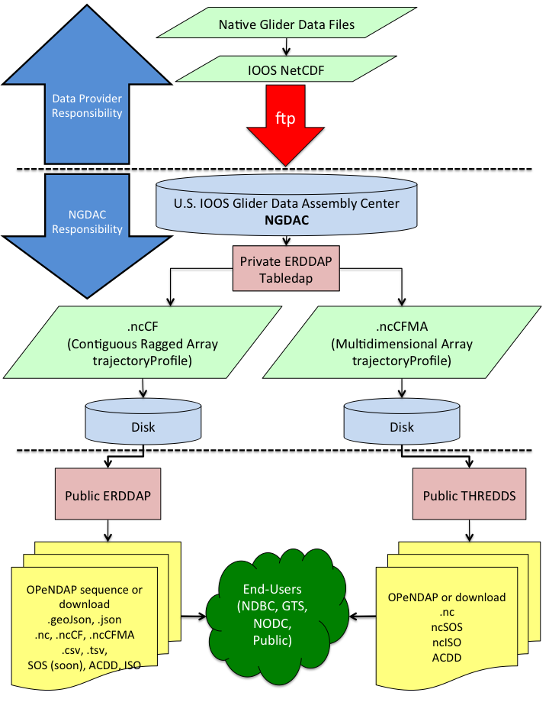
System Description/Background
Break dives into individual profiles (downs & ups)
Add metadata
Apply QA/QC?
Write NetCDF files

Slide 5
Data Provider Documentation
https://github.com/ioos/ioosngdac
  /wiki
  /erddap
  /thredds
  /nc
    /template
      IOOS_Glider_NetCDF_v2.0.cdl
      IOOS_Glider_NetCDF_v2.0.nc
      IOOS_Glider_NetCDF_v2.0.ncml
  /util
    createIoosGliderNcTemplate.py
    ncFtp2ngdac.pl

Slide 6
Terminology
Deployment/Trajectory
Segment 1
Segment 2
Dive 1
Dive 2
Dive 3
Dive 4
Dive 5
Dive 6
Profile 1
Profile 2
Profile 3
Profile 4
Profile 5
Profile 6
Profile 7
Profile 8
Profile 9
Profile 10
Profile 11
Profile 12

Slide 7
NetCDF File Specification
Key Point: gliders record data as a series of one or more dives (a single down/up profile followed by a up/down profile).
These dives must be separated into individual profiles, which are then written to NetCDF.
We must be able to determine the minima & maxima for a depth time-series.

Slide 8
Profile Indexing
No universal solution
Community submitted code:
  Matlab Slocum Power Tools (SPT): https://github.com/kerfoot/spt
  Python USF-COT: https://github.com/USF-COT/glider_utils
  Always looking for more community contributed code!

Slide 9
NetCDF File Specification
https://github.com/ioos/ioosngdac/wiki/NGDAC-NetCDF-File-Format-Version-2
File Naming Conventions
Global Attributes (NODC, ACDD, CF)
Dimensions
  time
  traj_strlen
Variable Types
  Trajectory/Deployment name (traj_strlen dimension)
  Time-Series (time dimension)
  Profile (dimensionless & hold scalar value)
  Container (dimensionless)

Slide 10
File Naming Conventions
https://github.com/ioos/ioosngdac/wiki/NGDAC-NetCDF-File-Format-Version-2#file-naming-conventions
Realtime:
  glider_yyyymmddTHHMMSSZ_rt.nc
Delayed/Recovered:
  glider_yyyymmddTHHMMSSZ_delayed.nc
Timestamp must be in UTC time zone and should denote the start of the deployment.

Slide 11
Global Attributes
Global file attributes provide searchable metadata fields for the deployment data set.
All attributes must be included AND have descriptive values in order to provide relevant metadata for the data set.
See: https://github.com/ioos/ioosngdac/wiki/NGDAC-NetCDF-File-Format-Version-2#description--examples-of-required-global-attributes

Slide 12
Dimensions
2 dimensions:
  time
  traj_strlen
Dimension variables (i.e.: time) may NOT contain _FillValues.
Some variables provide profile context or metadata and are dimensionless
Some dimensionless variables hold scalar data values and some do not.

Slide 13
Variable Types
4 Variable Types
  Trajectory Identifier (traj_strlen dimension)
  Time-Series (time dimension)
  Profile (dimensionless & hold scalar value)
  Container (dimensionless): metadata variables
Most, but not all, of the above variable types have a corresponding VARIABLE_qc flag variable to denote some level of provider QA/QC.

Slide 14
Trajectory Variable
Definition: a single deployment of a glider which may span multiple data files
Must be unique in order to allow aggregation of multiple trajectories/deployments
Typically use the deployment name for the value of this variable, i.e.: glider_yyyymmddTHHMMSS
Dimension: traj_strlen

Slide 15
Time-Series Variables
Contain measured “data” values
Have corresponding *_qc variable
Configured sampling can result in profiles that have incomplete time-depth-VARIABLE. In this case, consider interpolation and set appropriate QC flag values.
Dimension: time
Examples: time, pressure, temperature, conductivity, salinity, density, lat, lon

Slide 16
Profile Variables
Scalar variables identifying the time and position of the profile
Dimensionless
Must contain values (not _FillValue)
All but profile_id have corresponding *_qc variables.
profile_id: incrementing number identifying the profile WRT the trajectory. Must not be duplicated in any other file for that trajectory.
Examples: profile_id, profile_time, profile_lat, profile_lon

Slide 17
Container Variables
“Metadata” variables: store information (serial numbers, glider name, etc.) on the glider and instrumentation used to acquire profile data.
Dimensionless
Empty: don’t store any relevant measured data.
Referenced (via variable attributes) by other variables, i.e.: temperature:platform = “instrument_ctd” ;
Examples: platform_meta, instrument_ctd

Slide 18
Container Variable Examples
Provide as much of the metadata (values for attributes) as possible!
int platform ;
platform:_FillValue = -999 ;
platform:comment = " " ;
platform:id = “ru01" ;
platform:instrument = "instrument_ctd" ;
platform:long_name = “Slocum Glider ru01" ;
platform:type = "platform" ;
platform:wmo_id = ”1234567 " ;
int instrument_ctd ;
instrument_ctd:_FillValue = -999 ;
instrument_ctd:calibration_date = " " ;
instrument_ctd:calibration_report = " " ;
instrument_ctd:comment = "pumped CTD" ;
instrument_ctd:factory_calibrated = " " ;
instrument_ctd:long_name = "Seabird Glider Payload CTD" ;
instrument_ctd:make_model = "Seabird GPCTD" ;
instrument_ctd:platform = "platform" ;
instrument_ctd:serial_number = " " ;
instrument_ctd:type = "platform" ;
Also a global attribute
global:wmo_id = 1234567 ;

Slide 19
Creation of trajectoryProfile NetCDF
“Profile” NetCDF files submitted by data providers are modified:
  Attributes added
  Some global attributes are promoted to variables
“Profile” NetCDF files are aggregated (via ERDDAP) to create CF-compliant trajectoryProfile NetCDF files
trajectoryProfile NetCDF files are served to the public.

Slide 20
DAC Data Flow
Break dives into individual profiles (downs & ups)
Add metadata
Apply QA/QC?
Write NetCDF files

Slide 21
Resources
Question: How can we streamline and simplify production of compliant NetCDF files prior to submission to the DAC?
NetCDF compliance: Use of either of the following STRONGLY recommended prior to submitting to the DAC:
  IOOS NetCDF compliance checker: https://github.com/ioos/compliance-checker
  DAC NetCDF compliance checker: https://github.com/kerfoot/nc-validate
NetCDF files that pass either/both of the above compliance checkers will be accepted by the DAC.

Slide 22
Dataset Submission Process
Data Provider Registration (1 time only) requires POC for account
WMO id assignment for active deployments
  Required for GTS transmission
  GTS transmission for data <= 3 weeks old
  Assigned by NDBC according to deployment in a WMO region.
  receive WMO id within 24 hours of request (often much sooner)
Deployment Registration
  http://data.ioos.us/gliders/providers/
File Uploads
  Drag & drop
  ftp

Slide 23
DAC Data Flow
Break dives into individual profiles (downs & ups)
Add metadata
Apply QA/QC?
Write NetCDF files

Slide 24
Dataset Status
Checking on data set status:
  http://data.ioos.us/gliders/status/
Currently, data sets will be available via ERDDAP and THREDDS ~ 2 hours after the first NetCDF file is uploaded. This time will be decreased once load is determined.

Slide 25
Current Data Access End-Points
ERDDAP
  http://data.ioos.us/gliders/erddap/tabledap/
THREDDS
  http://data.ioos.us/gliders/thredds/catalog/deployments/catalog.html
IOOS Catalog
  http://catalog.ioos.us/map/Glider_DAC
Observing System Monitoring Center (OSMC):
  http://osmc.noaa.gov/erddap/tabledap/

Slide 26
Global Telecommunication System Transmission
NDBC harvesting
  ERDDAP tabledap
  Some (minimal) QA/QC
    Complete profiles
    Salinity spiking
    Density inversions
  BUFR encoding
  Release to GTS
GTS data available at: http://osmc.noaa.gov/erddap/tabledap/

Slide 27
Questions & Support
How can we help?
Google Groups?
Additional, more detailed tutorials?
kerfoot@marine.rutgers.edu
ioos.glider.data@noaa.gov

