Slide 1

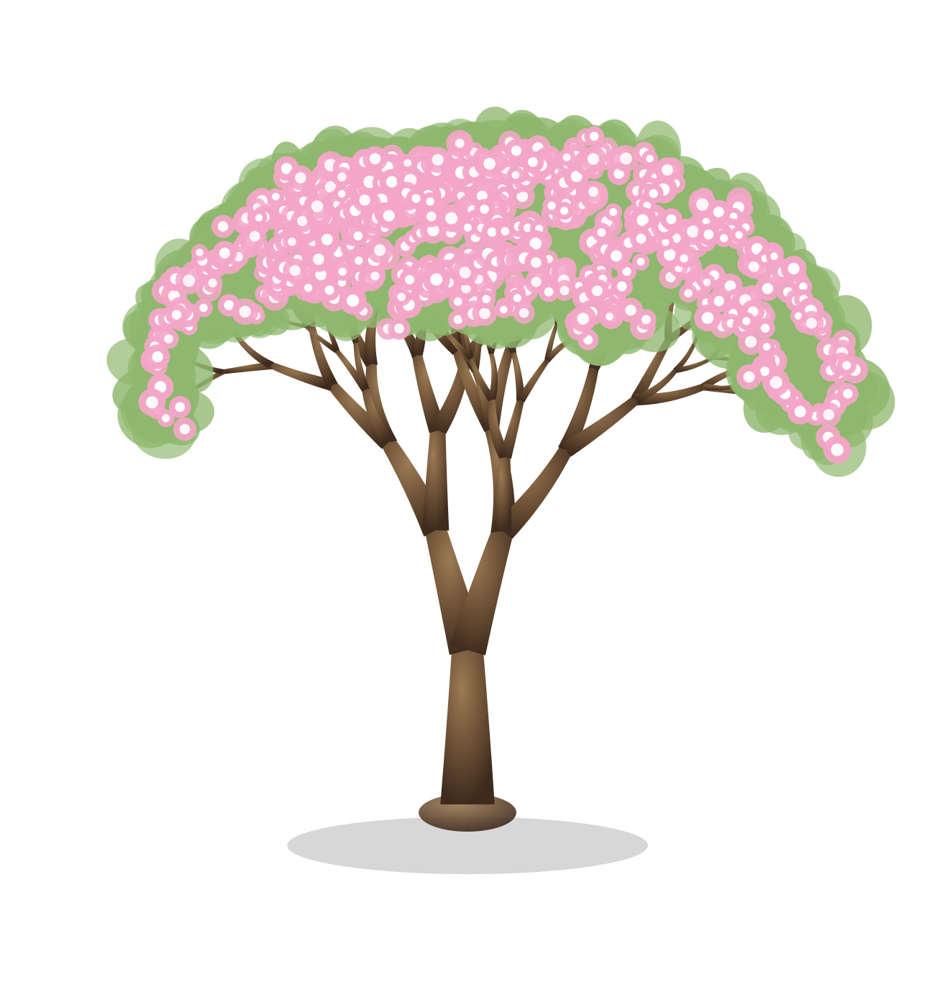
Grove
Grow together, one task at a time.
BTeamBros
CS160 · Final Presentation · August 6, 2026
Notes:
KELVIN · 0:00–0:05 We're BTeamBros. This is Grove — a productivity app where finishing your tasks grows a living tree, and you don't do it alone.

Slide 2


THE PROBLEM
Task lists are easy to start
and easy to abandon.
Finish a task.
Your tree grows.
Working alone, no one keeps you honest — and after two months there's nothing to show you did anything at all.
WHO IT'S FOR
Students and young professionals who focus better when someone is working alongside them.
day one
Notes:
KELVIN · 0:05–0:40 Todo apps are lonely and disposable. You lose momentum, and there's no record of what you already did. Grove is for students who focus better next to someone. The idea: finish a task, and your tree grows.

Slide 3


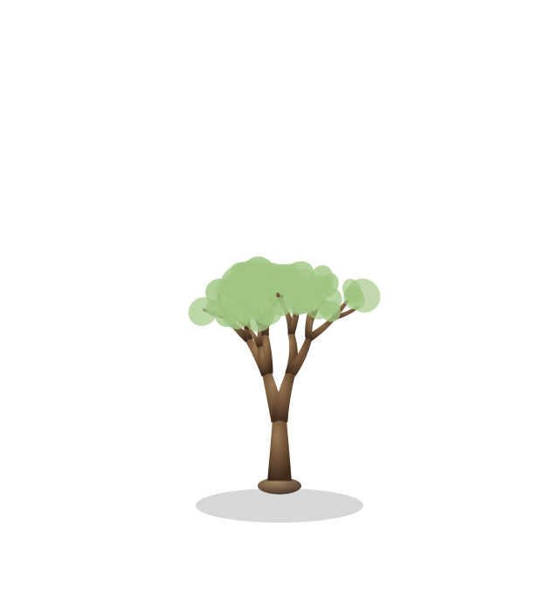
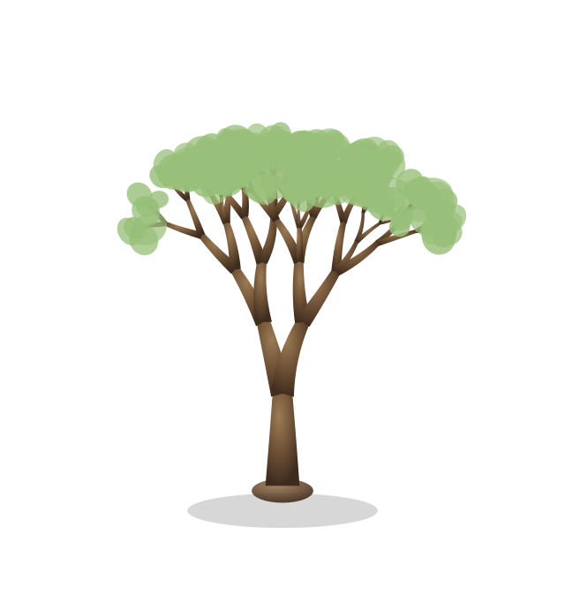
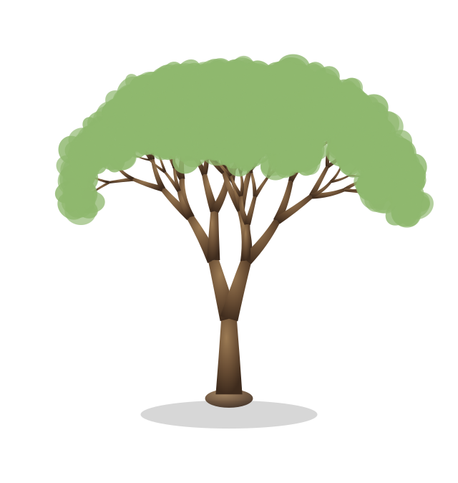
LEVELS 1 – 20
First, the tree grows up.
One level a day
Seeded per user
Locked at level 20
You can't cram — the only way up is coming back.
Your account decides the branching. No two trees match.
The shape never changes again. It's how you started.
LEVEL 1
LEVEL 6
LEVEL 12
LEVEL 20
Notes:
KELVIN · 0:40–1:08 The first twenty levels build the tree itself. One level per day, so you can't rush it. The branching is seeded from your account, so nobody else grows the same tree — you'll see that live in a minute. At twenty the shape locks permanently.

Slide 4
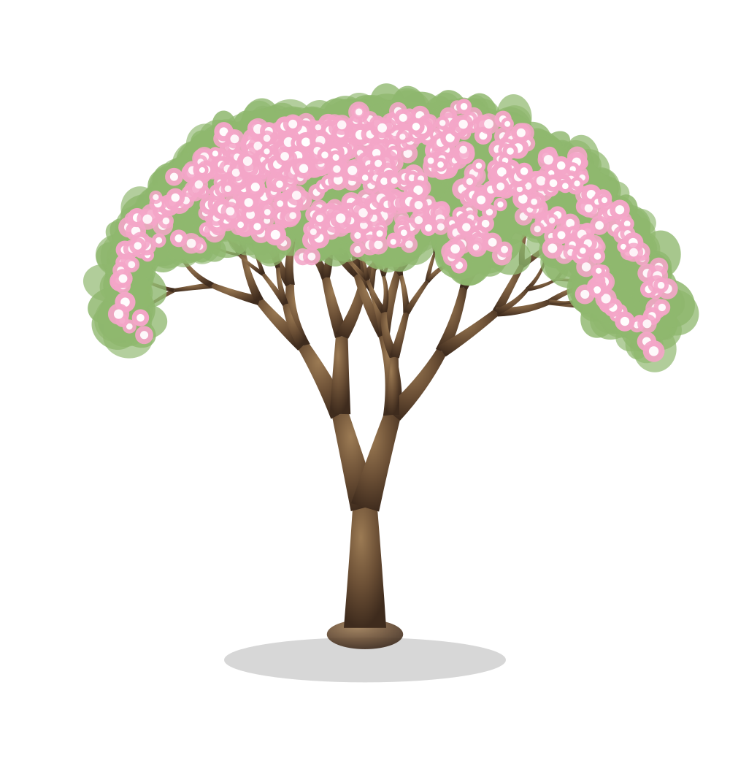
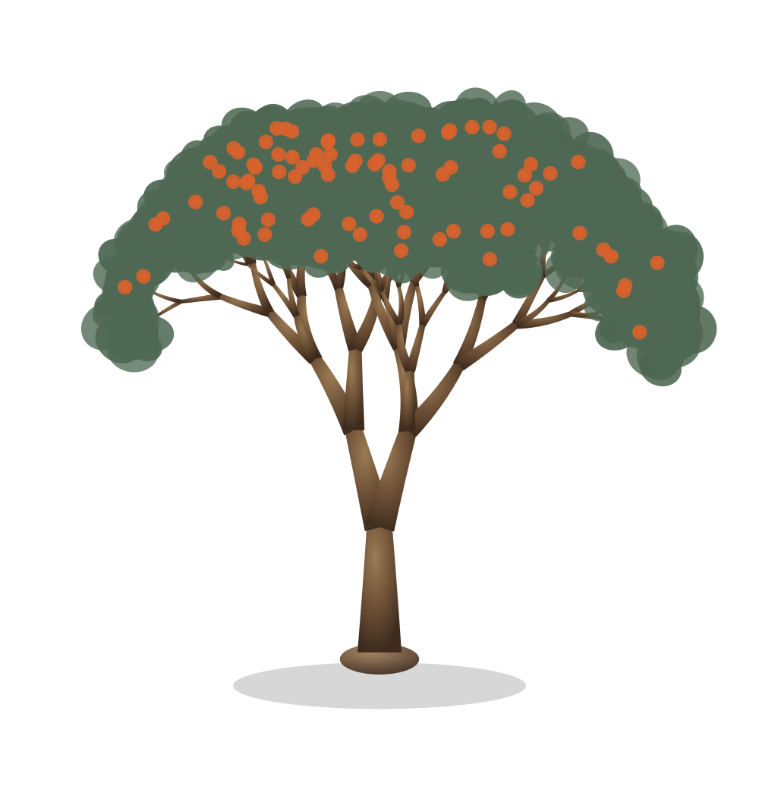

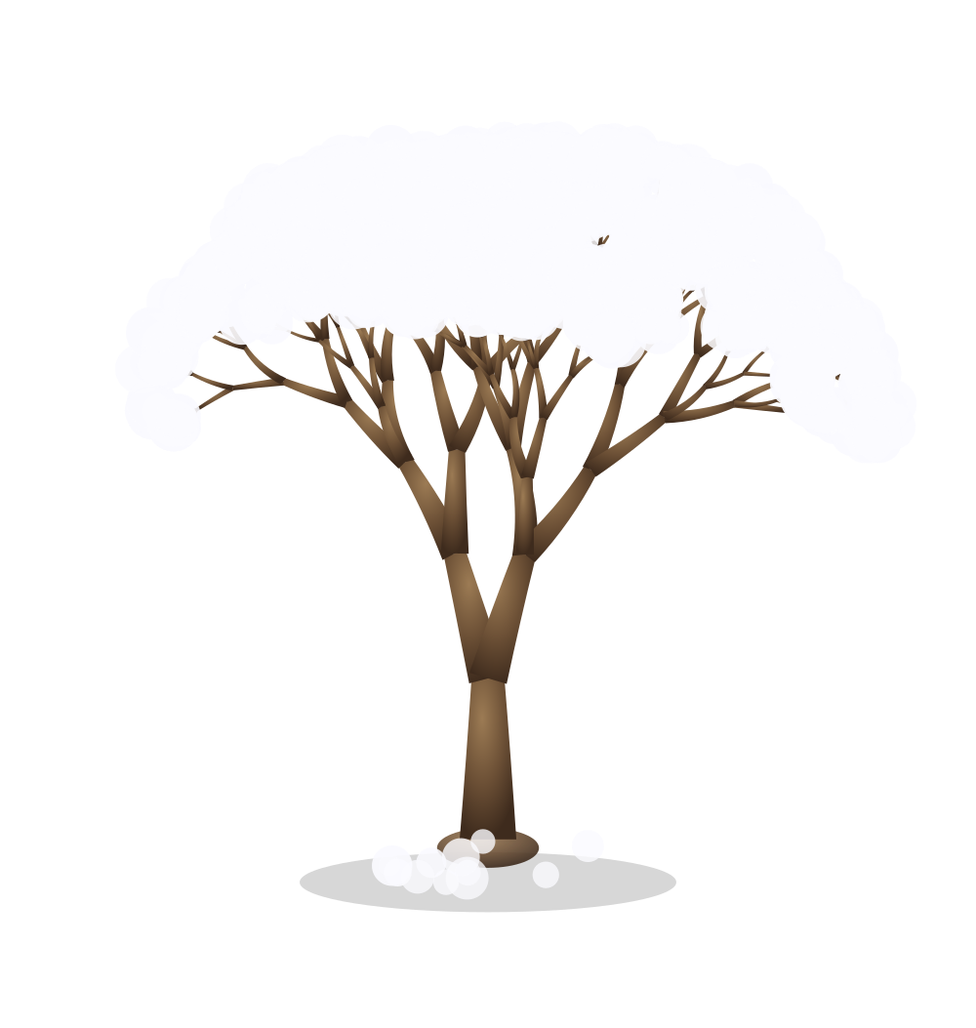
Then it starts living.
From level 21 the tree cycles through the seasons — twenty levels each, changing a little every single day.
Spring
Summer
Fall
Winter
LEVELS 21 – 40
LEVELS 41 – 60
LEVELS 61 – 80
LEVELS 81 – 100
buds open into blossom
deep green, and it fruits
leaves turn, then let go
bare branches under snow
Notes:
KELVIN · 1:08–1:36 After twenty, the shape is frozen and the seasons take over. Twenty levels each — blossom, then fruit, then the leaves turn and drop, then snow. Eighty levels is a full year. This is the part you can't show in a demo, and it's the reason people come back. HAND OFF: "Kyle's going to show you where the work actually comes from."

Slide 5
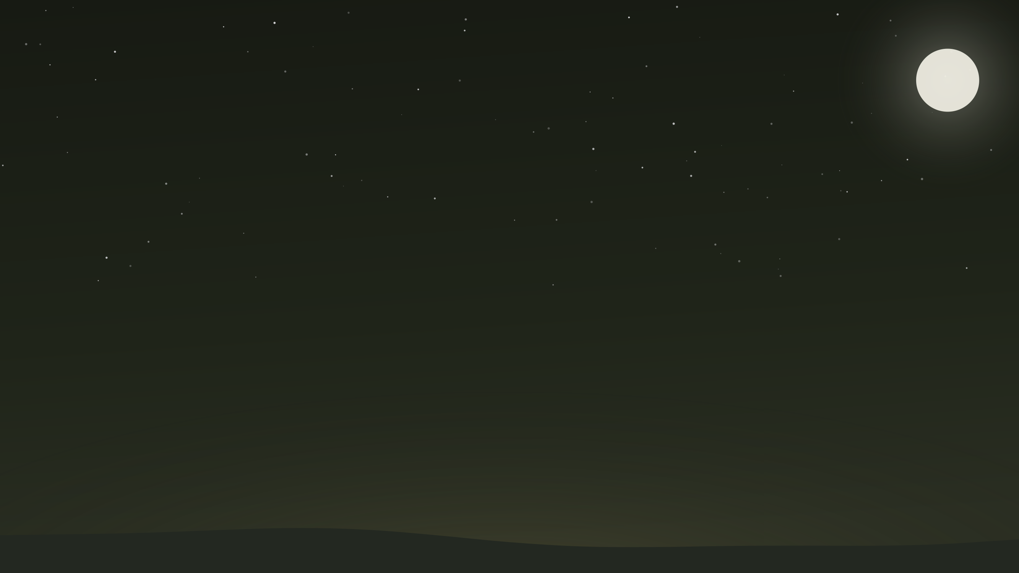
TASKS & CALENDAR
Decide the day before
you start it.
Every task carries a due date, and the calendar lays the week out in front of you — so you choose what matters instead of reacting to whatever's loudest.
Due dates
Every task is anchored to a day
One calendar
The whole week, filled in automatically
Notes:
KYLE · 1:36–1:54 Open with: "The deck just moved into Grove's night theme — that's the part I built." Then: tasks aren't just a list. Everything has a due date, and it lands on the calendar automatically, so you plan the day before you're in it.

Slide 6
THE RULE
Only finished work moves the tree.
Completing a task is the single input. There's no other way to earn a level, and you can only earn one a day.
1
0
100
level per day, maximum
other ways to earn one
levels to a full year
The tree can't be gamed — which is what makes it an honest record.
Notes:
KYLE · 1:54–2:12 The constraint is the feature. Completing a task is the only input, capped at one level a day, so the tree can't be inflated. That's what makes it worth looking at. HAND OFF: "But none of this works if you're doing it alone — Turner."

Slide 7

STUDY ROOMS
People focus better when
someone else is there.
It's why libraries and study halls work. Grove reproduces that feeling without putting a camera in your face — you get company, not surveillance.
A room is a place to sit together and work — not a meeting.
Notes:
TURNER · 2:12–2:30 The reason rooms exist: co-presence. People work better with someone in the room. Video calls are exhausting and performative — a Grove room gives you presence without a camera.

Slide 8
INSIDE A ROOM
The room is shared, not just visible.
Everyone in the room sees the same state at the same time.
The host sets the scene
Chat, live
Invite from inside
Background and ambient sound change for everyone in the room at once.
Messages arrive in real time and stay grouped by day.
Pull a friend straight into the room you're already sitting in.
Notes:
TURNER · 2:30–2:48 A room isn't a chatroom bolted on. The host changes the background and sound for everyone, chat is live and grouped by day, and you invite friends from inside the room. HAND OFF: "Let's show you." → switch to the browser.

Slide 9

Live demo
01
02
03
Make it yours
Plan and finish
Study together
Log in, set your photo and bio, add a friend
Add homework #1, see it on the calendar, check it off
Open the lobby, create a room, invite your friend
Notes:
DEMO · 2:48–4:38 (110s) One browser, one driver (Kelvin). Both accounts pre-logged-in, tabbed. KELVIN 2:48–3:25 — login, main page, profile (photo + bio), friends tab. On friends: "These are real accounts at different streaks — same system, four different trees." Then add the fifth friend live. KYLE 3:25–3:58 — add homework #1 with due date, show the calendar, check it off, tree levels up. TURNER 3:58–4:38 — streak page, lobby, create room, invite the friend, chat + background/sound. Toggle the theme once. PRE-SEED: friends at streak 38 / 57 / 65 / 99, plus a fifth low-level account to add live.

Slide 10
WHAT WE LEARNED
Three things we know now.
01
Real-time is a design problem, not just a technical one
Live chat and shared room state forced us to decide what everyone sees, and when.
02
The constraint was the feature
Capping the tree at one level a day is what made a streak worth caring about.
03
Our workflow mattered as much as our code
Branches, reviews and migrations kept the team moving without overwriting each other.
Notes:
KELVIN · 4:38–4:58 >>> REPLACE THESE WITH THE TEAM'S REAL TAKEAWAYS <<< Drafted from the codebase and git history — rewrite in your own words before Thursday.

Slide 11

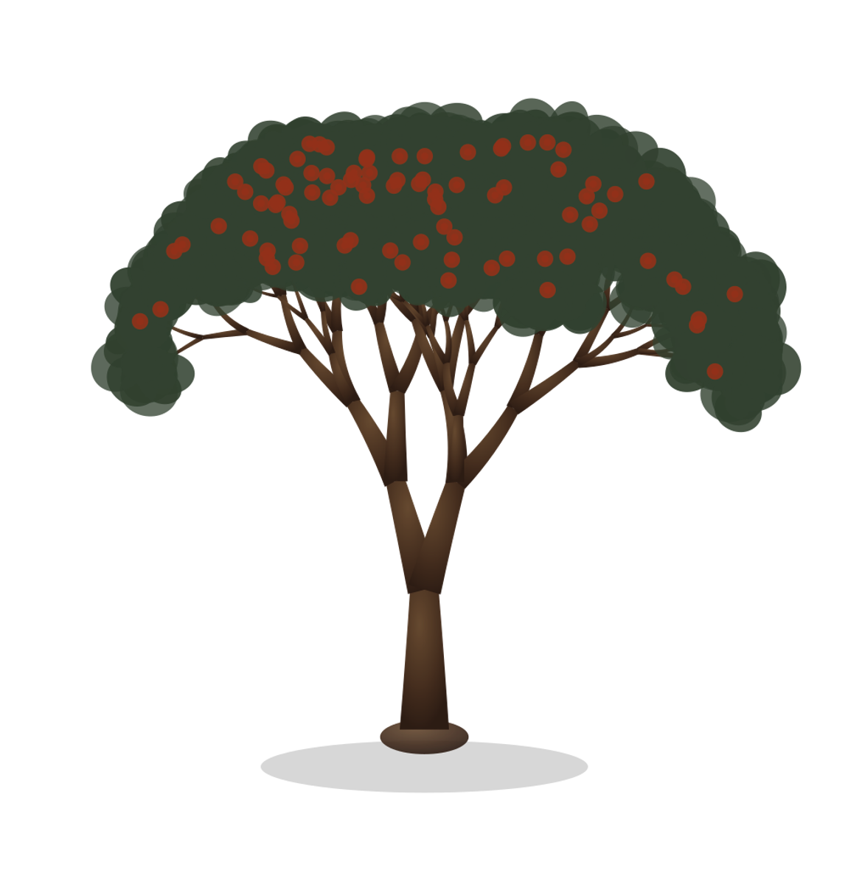
Grow together.
Questions?
BTeamBros · Grove · CS160
Notes:
KELVIN · 4:58–5:00 Thank you — happy to take questions. Likely Q&A: why one level a day? what happens past 100? how is the tree generated? how does room state sync? (Kelvin: tree + growth model. Kyle: tasks, calendar, day/night. Turner: rooms, chat, invites.)

