Slide 1
03 0&1 Study Flood fill
지정된 위치와 연결된 부분을 탐색하자

Slide 2
INDEX
03 Flood fill
2nd Week
PART3
Flood fill
01 DFS
02 BFS
03 Q&A

Slide 3
DFS
Part 03 – 01 DFS
1
2
6
깊이 우선 탐색
3
7
8
4
5

Slide 4
DFS
Part 03 – 01 DFS
1 | 0 | 1 | 1 | 1
1 | 0 | 0 | 0 | 1
1 | 1 | 1 | 0 | 1
1 | 0 | 1 | 0 | 1
1 | 1 | 1 | 1 | 1
1
15
14
13
2
12
깊이 우선 탐색
3
18
17
11
4
16
10
5
6
7
8
9

Slide 5
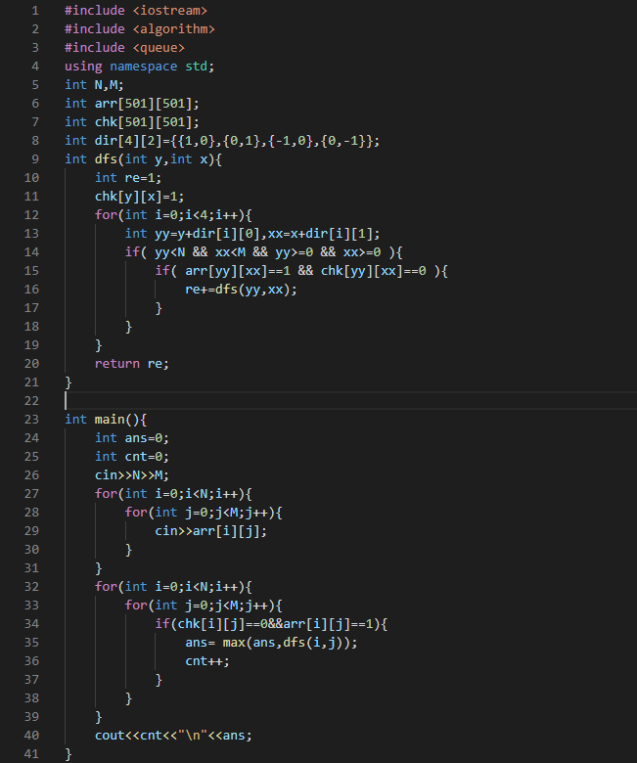
DFS
Part 03 – 01 DFS
1 | 1 | 0 | 0 | 1 | 1
1 | 0 | 1 | 0 | 1 | 0
1 | 0 | 1 | 0 | 1 | 1
1 | 0 | 1 | 0 | 1 | 1

Slide 6
BFS
Part 03 – 02 BFS
1
2
3
너비 우선 탐색
4
5
6
7
8

Slide 7
BFS
Part 03 – 02 BFS
1 | 0 | 1 | 1 | 1
1 | 0 | 0 | 0 | 1
1 | 1 | 1 | 0 | 1
1 | 0 | 1 | 0 | 1
1 | 1 | 1 | 1 | 1
1
15
14
13
2
12
너비 우선 탐색
3
4
5
11
4
6
10
5
6
7
8
9

Slide 8
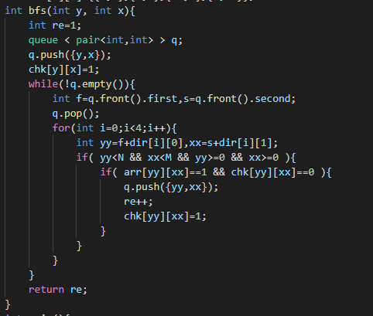
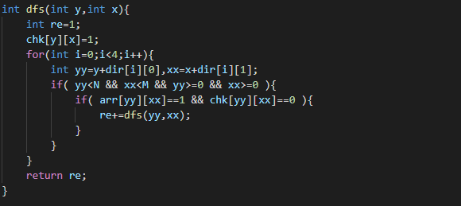
BFS
Part 03 – 02 BFS
1 | 1 | 0 | 0 | 1 | 1
1 | 0 | 1 | 0 | 1 | 0
1 | 0 | 1 | 0 | 1 | 1
1 | 0 | 1 | 0 | 1 | 1

Slide 9
End of Document
03 0&1 Study Flood fill
Flood fill

