Slide 1
05 0&1 Study Tree

Slide 2
INDEX
05 Tree
2nd Week
PART5
Tree
01 Tree
02 순회
03 Q&A

Slide 3
Tree
05 Tree
순환이 없는 방향 그래프

Slide 4
Tree
5 Tree
root
edge
sub
parent
child
leaf

Slide 5
05Tree
depth
height
0
3
1
2
2
1
3
0

Slide 6
05 Tree
Non – binary tree

Slide 7
05 Tree
binary tree
이진 트리

Slide 8
05 Tree
포화 이진 트리
완전 이진 트리

Slide 9
0
0
1
1
1
2
1
2
3
parent
3
4
5
6
2
4
7
parent* 2 + 1
parent* 2 + 2
n
2^n
2^(n+1)-1

Slide 11
순회
05 Tree
Preorder : root
Inorder : left subtree
Postorder : left subtree
left subtree
root
right subtree
right subtree
right subtree
root

Slide 12
05Tree
Preorder : root – left subtree - right subtree
1
1
1
2
4
2
3
2
3
7
8
5
4
5
6
4
6
5
3
9
7
8
9
7
8
6
9

Slide 13
05Tree
Inorder : left subtree - root - right subtree
7
1
1
4
8
2
3
2
3
2
5
5
4
5
6
4
6
1
3
9
7
8
9
7
8
9
6

Slide 14
05Tree
Postorder : left subtree - right subtree - root
7
1
1
8
4
2
2
3
3
5
2
5
4
5
4
6
6
9
6
9
7
9
7
8
8
3
1

Slide 15
End;
05 0&1 Study Tree
Tree

Slide 16
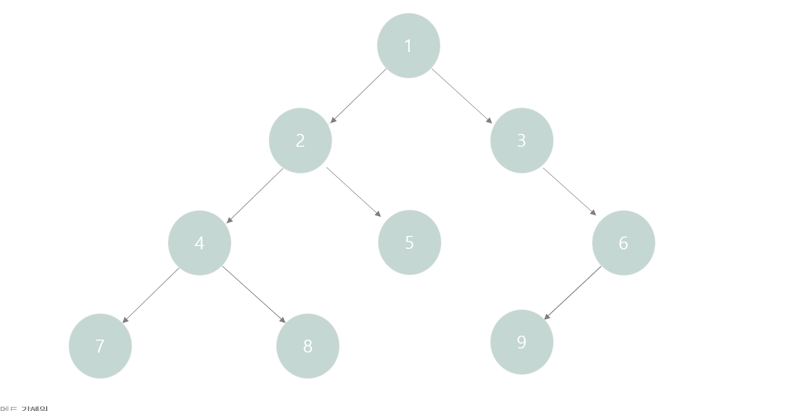

Slide 17
Preorder
1
Inorder
7
Postorder
7
2
4
8
4
8
4
7
2
5
8
5
2
5
1
9
3
3
6
6
9
3
9
6
1

