Slide 1

CAUSAL LEARNING & EXPLAINABLE AI

Slide 2
Table of Contents
Causal Learning and Explainable AI
Causal Inference
DoWhy Library
Steps for Causal Inference
Explainable AI
Interpret ML
Counterfactual Explanations
Data Driven Decision Making
Causality Pipeline
3D Object Detection

Slide 3
Causal Learning
Causal learning focuses on discovering causal relationships between variables. In contrast to traditional machine learning, which focuses on predicting the value of a target variable based on input features, causal learning aims to identify the causal relationships between variables and understand how changes to one or more variables can affect the behaviour of other variables.

Slide 4
Causal Inference
Causal Inference refers to the process of uncovering cause-and-effect relationships from data.
It aims to go beyond simple prediction. It helps us answer questions like "What causes this outcome?" and "How does one variable affect another?" This is crucial for making informed decisions in many fields.
Causal Inference doesn't rely solely on patterns in data (correlation), but it seeks to understand the fundamental drivers of those patterns (causation). It allows us to distinguish between mere associations and true cause-and-effect relationships.

Slide 5
Causality vs Correlation
The key difference is that correlation indicates a statistical relationship or association between two variables but does not imply causation. Causality, on the other hand, signifies a direct cause-and-effect relationship, where changes in one variable are responsible for changes in another. Establishing causality often requires more rigorous research methods and experimental designs to demonstrate a true cause-and-effect link

Slide 6
DoWhy Library for Causal Inference
DoWhy provides a unified interface for causal inference methods and automatically tests many assumptions, thus making inference accessible to non-experts [1].
The library makes three key contributions:
Provides a principled way of modelling a given problem as a causal graph so that all assumptions are explicit, and identifying a desired causal effect
Provides a unified interface for many popular causal inference estimation methods, combining the two major frameworks of graphical models and potential outcomes.
Automatically tests for the validity of causal assumptions if possible and assesses the robustness of the estimate to violations.
[1]. Sharma, Amit, and Emre Kiciman. "DoWhy: An end-to-end library for causal inference." arXiv preprint arXiv:2011.04216 (2020).

Slide 7
DoWhy Steps for Causal Inference
DoWhy builds on two of the most powerful frameworks for causal inference: graphical models and potential outcomes. It uses graph-based criteria and do-calculus for modeling assumptions and identifying a non-parametric causal effect. For estimation, it switches to methods based primarily on potential outcomes [1]. It follows four steps to perform causal inference, which are as follows:
Model the causal question
Identify the causal estimand
Estimate the causal effect
Refute the obtained estimate
[1]. Sharma, Amit, and Emre Kiciman. "DoWhy: An end-to-end library for causal inference." arXiv preprint arXiv:2011.04216 (2020).

Slide 8
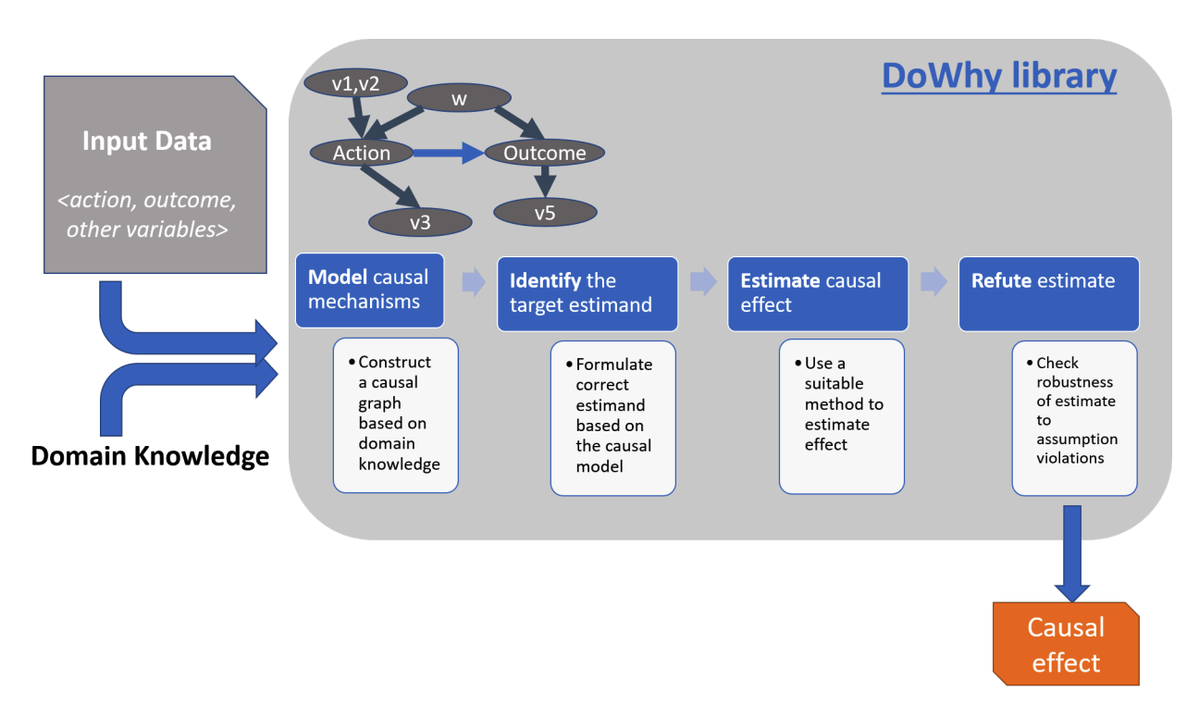
DoWhy Steps for Causal Inference (Cont.)
The four-step analysis pipeline in DoWhy [1]
https://colab.research.google.com/drive/1HcATvn7mybHxZ5ozOf5Xs-RSjCx7RhkD?usp=sharing
[1]. Sharma, Amit, and Emre Kiciman. "DoWhy: An end-to-end library for causal inference." arXiv preprint arXiv:2011.04216 (2020).

Slide 9
Modelling The Causal Question
DoWhy creates an underlying causal graphical model for each problem.
The graphical model makes causal assumptions explicit.
The graph may be partial, representing prior knowledge about some variables.
DoWhy automatically considers the remaining variables as potential confounders.

Slide 10
Identification Of Causal Estimand
DoWhy finds ways to determine causal effects through graph-based criteria and do-calculus in a causal graph.
Supported identification criteria for Causal Inference are:
Back-door criterion
Front-door criterion
Instrumental Variables
Mediation Analysis

Slide 11

Identification Of Causal Estimand (Cont.)
Backdoor Criterion:
Backdoor criterion is a sufficient condition for identifying causal effects in causal graphs.
It requires confounding variables between treatment and outcome
When these conditions are met, the causal effect can be identified using observational data.
Instrumental Variable (IV):
An instrumental variable affects the treatment but not the outcome directly.
The key idea is that the instrumental variable only influences the treatment, not the outcome, except through its impact on the treatment.
Intermediate confounding variables should be present
Mediation analysis
Mediation analysis is a statistical method.
Its purpose is to identify and estimate indirect effects.
It assesses how a treatment variable influences an outcome variable through a mediator variable.
Mediator variables essentially absorb the effect of treatment and transmit it to outcome.
Frontdoor Criterion:
It necessitates a direct path from treatment to outcome.
Intermediate confounding variables should not exist.
It requires a clear and direct causal link between treatment and outcome.
Contrasts with the backdoor criterion, which allows for indirect effects with proper adjustment for third variables

Slide 12
Estimate the causal effect
DoWhy supports methods based on both the back-door criterion and instrumental variables for causal analysis.
It offers non-parametric confidence intervals to assess the uncertainty of estimates.
DoWhy provides a permutation test for evaluating the statistical significance of obtained causal effect estimates.

Slide 13
Estimate the causal effect (Cont.)
Supported estimation methods include:
Methods based on estimating the outcome model
Linear Regression
Generalized Linear Models
Methods based on the instrumental variables identification
Binary Instrument/Wald Estimator
Two-stage least squares
Regression discontinuity
Methods for front-door criterion and general mediation
Two-stage linear regression
Methods based on estimating the treatment assignment
Propensity-based Stratification
Propensity Score Matching
Inverse Propensity Weighting
Notes:
Hjdbkajdkjasbndkjasbdkajsbndkajdbaksjbdkajsbdkasbd
Laksdnaslkdnlaskndlksndlaksdnalksdn
Lkasdnlkasndlkasndlaksndlkasdnaldnlak

Slide 14
Refutation Testing
Refutation testing is a set of methods used to validate the assumptions of a causal model.
Its primary objective is to uncover potential biases in the model and evaluate the resilience of causal estimates.
It also helps to identify that the cause we have identified is the right cause or not by applying different methods based on the causal estimate

Slide 15
Refutation Methods
Refutation Method | Description
Add Random Common Cause | Adds a random variable to the dataset and reruns the analysis to see if the causal estimate changes. If the estimate changes, then it is sensitive to unobserved common causes.
Placebo Treatment | Replaces the treatment variable with a random variable and reruns the analysis to see if the causal estimate goes to zero. If the estimate does not go to zero, then there may be bias in the analysis.
Dummy Outcome | Replaces the outcome variable with a random variable and reruns the analysis to see if the causal estimate goes to zero. If the estimate does not go to zero, then there may be bias in the analysis.
Simulated Outcome | Replaces the outcome variable with a simulated outcome based on a known data-generating process and reruns the analysis to see if the causal estimate matches the effect parameter from the data-generating process. If the estimate does not match, then there may be bias in the analysis.
Add Unobserved Common Causes | Adds an additional common cause (confounder) to the dataset and reruns the analysis to see how sensitive the causal estimate is to the added confounder. If the estimate is sensitive to the added confounder, then it is important to control for the confounder in the analysis.
Data Subsets Validation | Replaces the given dataset with a randomly selected subset and reruns the analysis to see if the causal estimate changes significantly. If the estimate changes significantly, then the analysis may be sensitive to sampling variability.
Bootstrap Validation | Replaces the given dataset with bootstrapped samples from the same dataset and reruns the analysis to see if the causal estimate changes significantly. If the estimate changes significantly, then the analysis may be sensitive to sampling variability.
Refutation is done to check the robustness of estimate to assumption voilations.

Slide 16
Explainable AI
Explainable Artificial Intelligence (XAI) is a set of techniques and methods that aim to provide clear and human-understandable explanations for the decisions generated by AI and machine learning models. There are many different types of XAI, each with its own strengths and weaknesses. Some of the most common types of XAI include:
Model Explainability: This involves developing models that are inherently interpretable, such as linear models or decision trees.
Post-hoc Explainability: This involves using techniques to explain the decisions of existing models, even if they are not inherently interpretable.
Human-in-the-loop: This involves involving humans in the AI decision-making process, such as by asking humans to review and approve AI-generated recommendations.

Slide 17
Interpret ML
Interpretability in machine learning (ML) is a component of eXplainable Artificial Intelligence (XAI).
Focuses on making ML model predictions and decisions understandable.
Aims to provide transparency into how ML models work.
Includes techniques like feature importance, model transparency, and local/global explanations.
Can be applied post hoc to existing ML models.

Slide 18
Counterfactual Explanations
Explanations that describe how the AI’s decision would have been different if it had received different input information for some key features are known as counterfactual explanations.
Counterfactual explanations fall in post-hoc which depend on identifying relations between events especially causal, intentional or deontic relations
For Example:
CE: I would have got high marks in exam if I had extra time
CI: I did not get high marks because I did not have extra time
Library: DiCE

Slide 19
Data Driven Decision Making
ML Models usually fail when the data they’re being deployed upon changes
This failing can lead to bad decision making and can cause problems later
Importantly it can lead to biasis in critical situations
So the question arisis why do we care about decision making?
For better decision making we need to find the features that both cause the outcome and we need to estimate how that outcome would change if the features are changed

Slide 20
Causality Pipeline
Interpret Ml will provide which feature is more important and which feature is less important
Causal Inference will find why this specific feature is important, what’s the cause behind it.
Counterfactual Explanations will explain that if we change this specific feature, is the output also going to change or not

Slide 21
3D OBJECT DETECTION

Slide 22
3D Object Detection
2D object detection only predicts 2D bounding boxes
With 3D object detetcion we can know various details of that detected object e.g. Size of that object, we can know know the position of that object, orientation of that object etc
It can be used in various applications like self driving cars, robotics, augmented reality
There are various 3D datasets available which are related to street scenes, traffic monitoring
These datasets are created by 3D capture sensors like LiDAR

Slide 23
Dataset
Data Format Requirement:
We require the data in Point Cloud format from LiDAR and Depth senors.
Dataset Protocol Requirement:
The dataset must adhere to all Kitti dataset protocols. This is necessary to ensure compatibility for loading and training the model.
Additional Information:
You can find detailed information about the Kitti dataset, including its protocols and analysis tools, at the following link: Kitti Dataset Information

Slide 24
LiDAR based 3D Object Detection
Lidar sensors can detect and locate objects in 3D space, including vehicles.
Deep learning algorithms can be used to process lidar data and identify vehicles within the point cloud. One popular method for vehicle detection using lidar is the use of 3D object detection algorithms such as
Complex Yolov4
mmdetection3D
PointRCNN
PV-RCNN

Slide 25
Object Tracking (Norfair)
Norfair is a customizable lightweight Python library for real-time multi-object tracking.
Using Norfair, we can add tracking capabilities to any detector with just a few lines of code.
It can track objects with a moving camera
It can also track 3D Objects

Slide 26
Thank You

