Slide 1
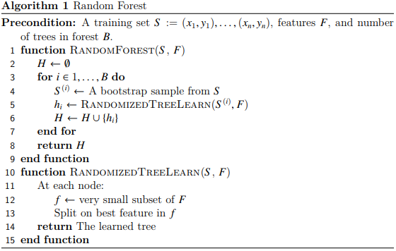
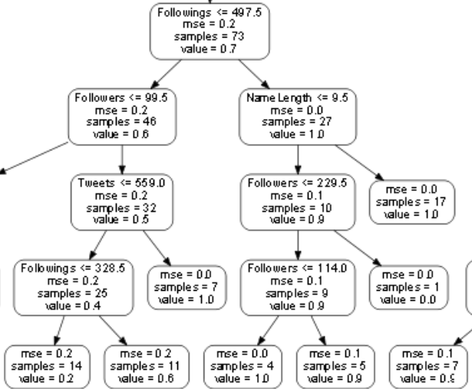
Detecting Twitter Bots Using Machine Learning
Marcell Batta
Abstract
This project aims to classify Twitter accounts as either bots or human-made using machine learning along with a variety of parameters. This is achieved using core functionality of Python as well as popular libraries such as Numpy, Pandas and SKLearn. Some portion of Deep Learning was also explored briefly.
Introduction & Background
The main aim of this project is to create a program that can attempt to classify Twitter accounts based on a number of features to an accurate degree as either human-made or run by a script or bot. Issues related to bots have been on the rise with the 2016 US elections being one of the main focal points even in public news. These problems have carried on and are most likely taking place in almost every area today.
Design
The main algorithm I used for classification was random forest. During my research I found a few systems doing a similar thing and they mostly seemed to be using the same algorithm, hence why I went with it as well. They all seem to be doing a similar job at classifying, however it just comes down to the features selected and such to try and improve the accuracy of the classification.
The system could be used in areas where we see or believe there is an influx of scripted Twitter accounts such as elections across the world or even just the comments surrounding popular Twitter accounts.
The objective of my project was to attempt to recreate these accuracies achieved by these other systems if not better.
Figure 1
Implementation
Implementation took part in 2 ways. Firstly there was the ground up implementation of random forest. This was done without using any major libraries and with the help of pseudocode such as the one seen in figure 1.
Secondly there was the implementation using the Sklearn library. This is also where I decided to save an image of one of the trees in each run to see how it looks. You can see a small section of an otherwise large decision tree in figure 2.
Figure 2
Testing & Evaluation
There were two sets of results, one for each implementation, as well as for different parameters used. For the sake of keeping it simple these are results from one set of parameters used on both versions. The results are as follows:
Type | 1 tree | 5 trees | 10 trees | 100 trees | 1000 trees
Random Forest | 89.9% | 93.6% | 93.8% | N/A | N/A
SKLearn | 87.7% | 88.5% | 88.5% | 89.3% | 89.2%
The results did get better overall with more trees, however there was a greater increase in accuracy with the ground up implementation compared to the Sklearn version. The reason there are no later results for the first row is because it took too long to run on that high amount of trees
Conclusions & Future Work
Overall, I’d say the project was relatively successful from a results view. The fact that the Sklearn implementation gave lower overall accuracies was quite surprising, however it does seem to run much more efficiently allowing more trees to be used.
To further this project, it is possible to use this system to try and find networks of these Twitter bots and maybe try and detect them during crucial times such as elections.

