Slide 1

AWS VPC with Terraform
Yordanka Dimanova Jekova
iordanka911/TerraformVpc (github.com)

Slide 2
Prerequisites
Terraform CLI installed
AWS CLI(command line interface) installed
AWS account and IAM with credentials

Slide 3
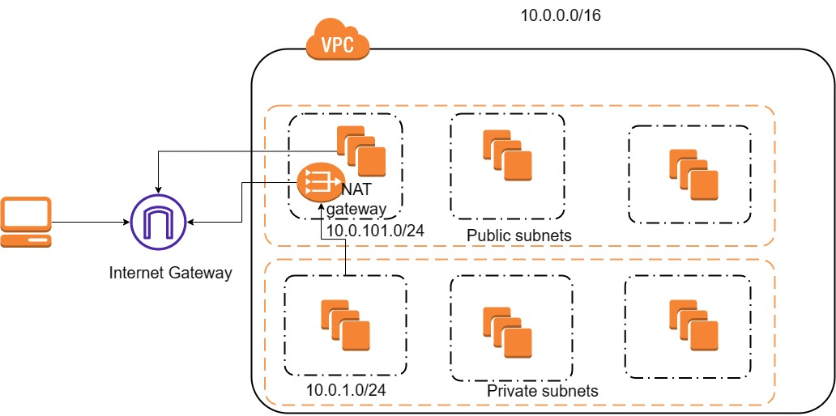

Slide 4

VPC Configuration
Aws is used for provider
Specific region is needed (eu-central-1)
We create EC2 instance awc_instance with instance type t2.micro
A tag gives the instance name
Three availability zones with 3 private and 3 public subnets

