Slide 1
The team

Slide 2


Slide 3
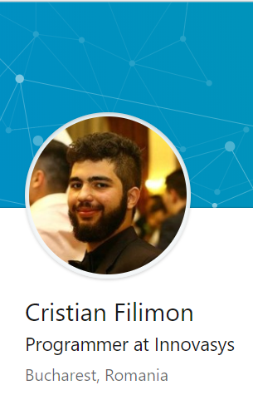
“Can get refactored? Let’s do it”
GitHub : https://github.com/iorege
LinkedIn : https://www.linkedin.com/in/cristian-filimon/
Mail : ctfilimon@gmail.com

Slide 4
Scenario

Slide 5


Slide 6
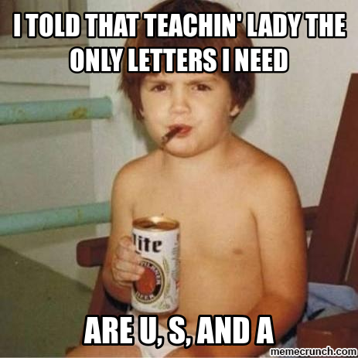
Character Name : Kiddo
Class : Rogue
Race : Gnome (more like Troll)
Alignment : Chaotic Evil
Background : Charlatan
Strength : 10
Dexterity : 14
Constitution : 8
Intelligence : 16
Wisdom : 8
Charisma : 16
Skills : shadow scholar, hyper energy
Proficiency : Persuasion, Deception, Stealth, Athletics

Slide 7
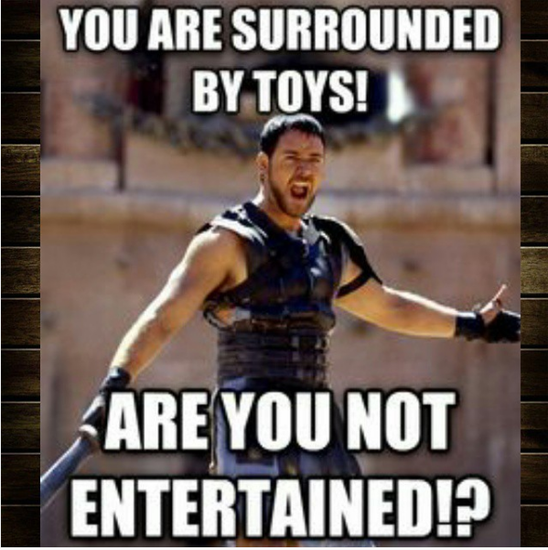
Character Name : Parent
Class : Fighter
Race : Human
Alignment : Chaotic Good
Background : Worker
Strength : 13
Dexterity : 10
Constitution : 12
Intelligence : 13
Wisdom : 13
Charisma : 10
Skills : workaholic, work-work-drink-fight
Proficiency : Survival, Medicine, Intimidation

Slide 8
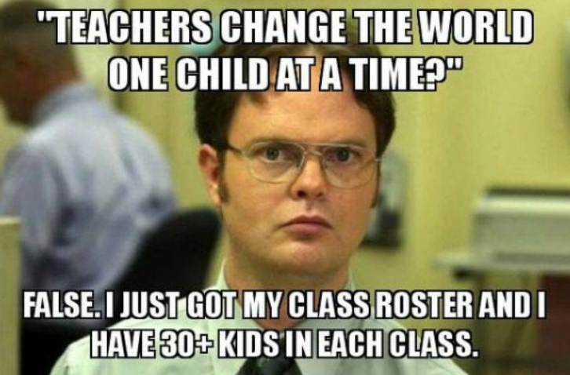
Character Name : Teacher
Class : Wizard
Race : Elf
Alignment : Lawful good
Background : Cloistered scholar
Strength : 10
Dexterity : 12
Constitution : 10
Intelligence : 17
Wisdom : 17
Charisma : 12
Skills : degrees911, rosterWhisperer
Proficiency : Insight, Animal Handling, Performance

Slide 9
11% of Americans don’t use the internet. Who are they?
A third of non-internet users (34%) did not go online because they had no interest in doing so or did not think the internet was relevant to their lives. Another 32% of non-users said the internet was too difficult to use, including 8% of this group who said they were “too old to learn.” Cost was also a barrier for some adults who were offline – 19% cited the expense of internet service or owning a computer.
4 billion people still don’t have internet access.
Reasons :
- Infrastructure
- Affordability
- Skills, awareness and cultural acceptance
15% of adults globally are considered illiterate.
Local adoption and use
© 2018 World Economic Forum

Slide 10
Solution

Slide 11
NEW APP AVAILABLE IN YOUR SCHOOL THIS YEAR

Slide 12


Slide 13
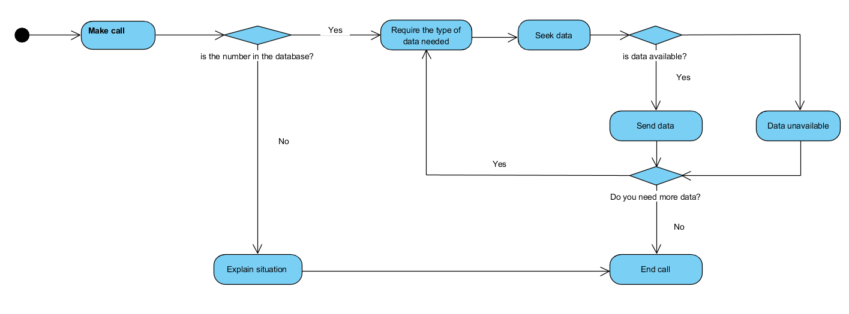

Slide 14
The code

Slide 15
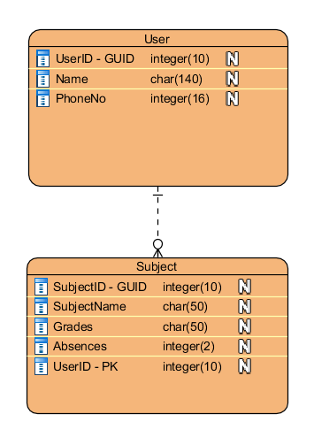

Slide 16
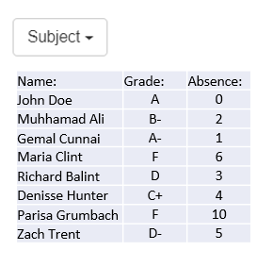

Slide 17
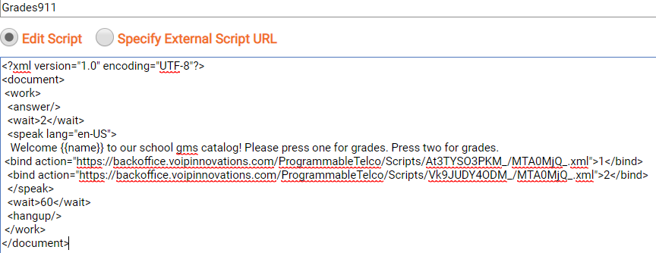
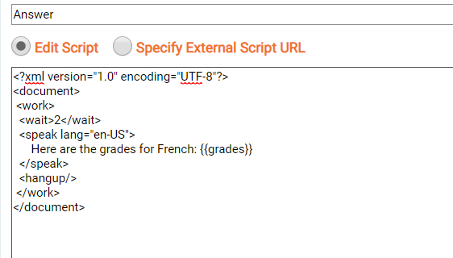

Slide 18
Vision

Slide 19
Business wise
Client : Public schools (Government), Private schools (Parents)
Beneficiary : Teachers and parents
Service format : year subscription
Languages : English

Slide 20
Infrastructure+
Each yearly subscription comes with x number of DIDs (international / local) depending on the number of teachers in that institution.
Parents just need an working phone/mobile.
The school / teachers need an internet connection and a device to use for the connection and storage.

Slide 21
Possible features
Automatic call when a pupil get +5 absences
Automatic message at the end of each week with the new grades
Call assistant for teacher
Other languages added

Slide 22
Enjoy coding

