Slide 1

Intro to Firmware development in
Use PyBadge as example development board w/ Rodeostat Featherwing
Many other devevelopment boards you can use
- over 517 on CircuitPython.org
- feather M4 Express, QtPy, Raspberry Pi Pico, Teensy 4.1, etc.

Slide 2

What are we going to cover?
PyBadge hardware overview
Setting up your board: installing bootloader & circuitpython
Basic development tools: editor/IDE, serial terminal, how to upload firmware
First programs: hello world, multiple source files, …
Talking to hardware. DigitalIO, AnalogIO, etc.
More development tools: libraries,the CircuitPython bundle and circup
Using buttons and display
Startup configuration: boot.py
Serial communications and writing files
Rodeostat Featherwing hardware and the Potentiostat class
Potentiostat examples

Slide 3
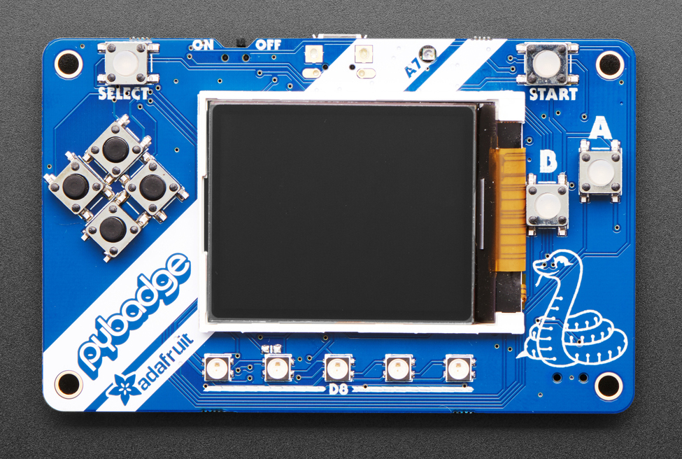
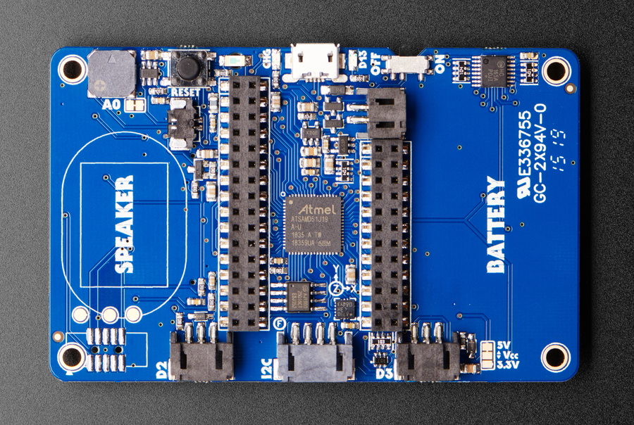
PyBadge hardware overview
MCU (ATSAMD51)
TFT display (160 x 128)
on/off
Reset
Battery connector
Buttons for user input
Featherwing headers
DigialIO, AnalogIO,
I2C connector
https://learn.adafruit.com/adafruit-pybadge/overview

Slide 4
PyBadge hardware overview
MCU ATSAMD51
- 3.3V, 120MHz
- 192KB of RAM
- 512KB of flash
2 MB of QSPI flash for file storage
13 GPIO (Digital input/outpus) D0, …, D13
8 Analog Inputs (ADC) A0, … A7
2 Analog Outputs (DAC) A0, A1
Serial buses: I2C, SPI, UART
8 user buttons
TFT Display 1.8”, 160x128, color
Other stuff: lipo charger, temp sensor, light sensor, accelerometer, neopixels
https://www.adafruit.com/product/4200
https://learn.adafruit.com/adafruit-pybadge/overview

Slide 5
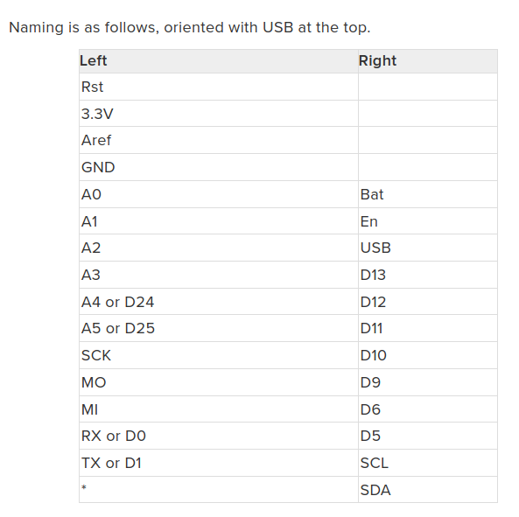
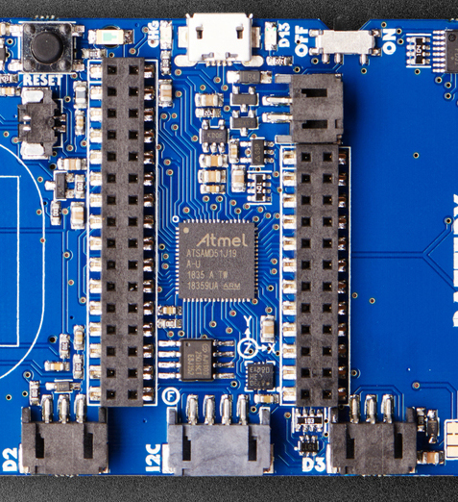
Feather header pinout

Slide 6
Installing/updating CircuitPython & bootloader
When connected via USB PyBadge will show up as drive called CIRCUITPYTHON
- CircuitPython is running
We want the uf2 boot drive to appear, called PYBADGEBOOT
- unmount/safely-remove drive
- double-click the RESET button
- a new drive will appear named PYBADGEBOOT
Get new bootloader and version of CircuitPython from circuitpython.org
- copy bootloader PYBADGEBOOT
- copy new circuitpython to PYBADGEBOOT
- CIRCUITPYTHON drive should reappear
https://learn.adafruit.com/adafruit-pybadge/installing-circuitpython

Slide 7
Basic development tools
Text editor/IDE for editing source code
- vscode, mu editor, vim, emacs, …
Serial monitor for debugging/exploration
- vscode plugin or mu editor
- tio, screen (linux)
- putty (windows)
Upload mechanism for moving source files from PC to PyBadge
- upload script: bash (linux), powershell (windows)-
- mu editor

Slide 8
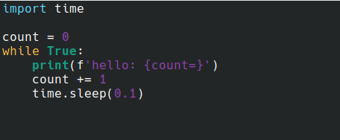
First Program: hello world
entry point is code.py
- on startup (or reset) looks for code.py and if found executes code in file

Slide 9
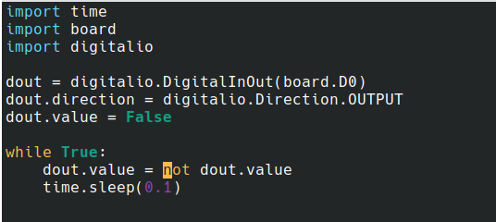
Talking to hardware: digitalio
using built-in modules: board, digitalio
set direction and value
digital input is similar
- set Direction to INPUT
- read .value

Slide 10
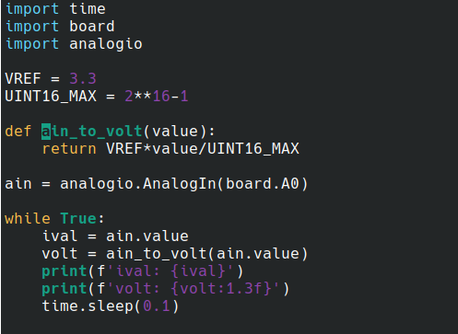
Talking to hardware: analogio
using built-in modules: board, analogio
set direction and value
Analog out is similar - use AnalogOut, set value instead of reading

Slide 11
More development tools
the CircuitPython bundle
- https://circuitpython.org/libraries
- https://github.com/adafruit/Adafruit_CircuitPython_Bundle
circup: a tool for managing circuitpython libraries
- download, update, create requirements.txt, etc.
- https://github.com/adafruit/circup

Slide 12
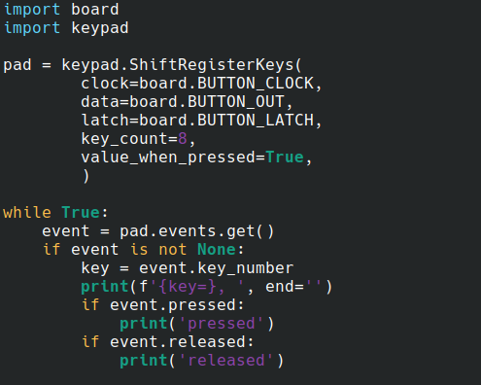
Using buttons
use keypad shift and look at events as they occur
https://learn.adafruit.com/key-pad-matrix-scanning-in-circuitpython/shiftregisterkeys

Slide 13
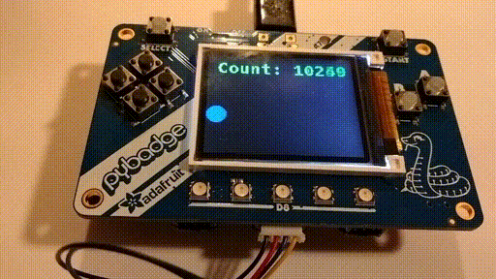
Using the display
Resources
https://learn.adafruit.com/circuitpython-display-support-using-displayio/introduction
https://docs.circuitpython.org/en/latest/shared-bindings/displayio/

Slide 14
Startup configuration
boot.py file is special
- executed when CircuitPython starts up via hard reset or powering up the board
- not run on soft reset e.g. reload from serial console/REPL
- can be used for configuration
Example CIRCUITPY drive
- by default read-write by host PC and read-only for CircuitPython
- can change so read-write for CircuitPython and read-only for host unless
users presses a button on startup

Slide 15
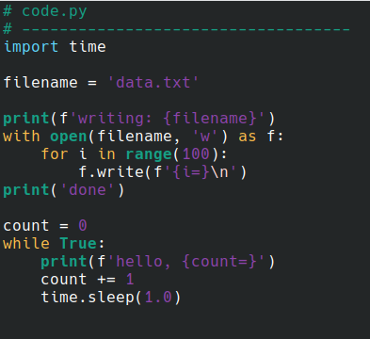
Writing files
CIRCUITPYTON drive needs to be mounted read-write (use boot.py )

Slide 16
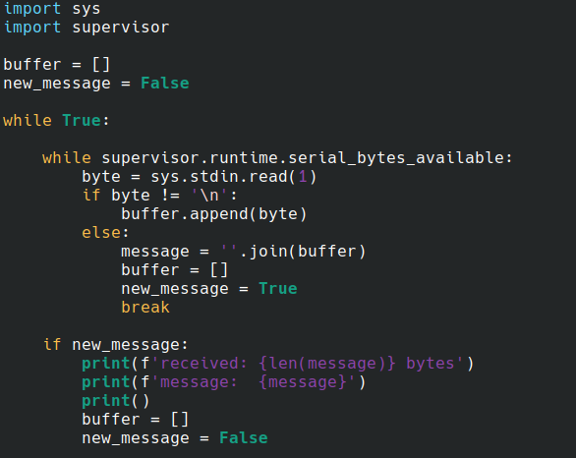
USB/Serial communications with host

Slide 17
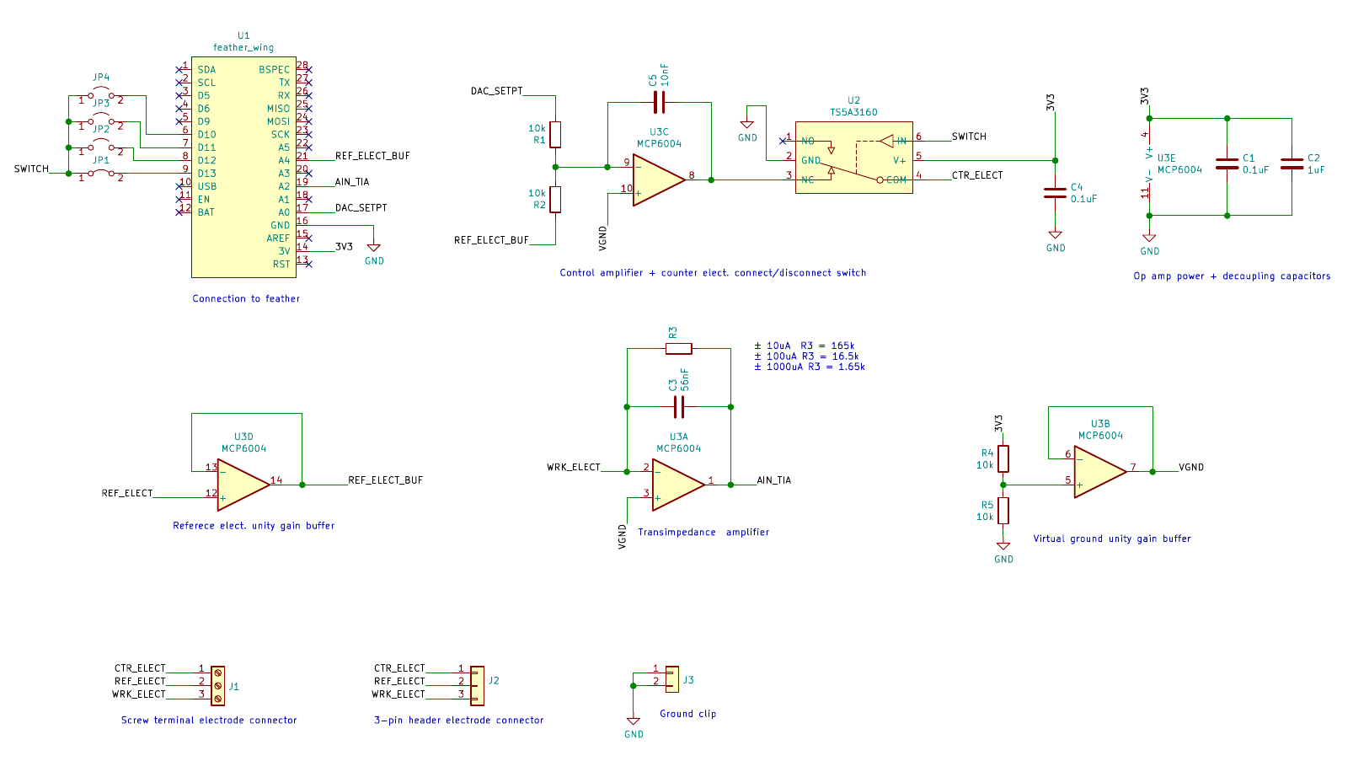
Rodeostat Featherwing hardware

Slide 18
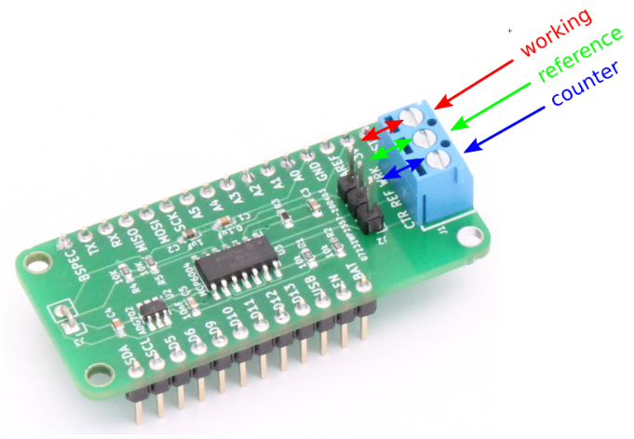
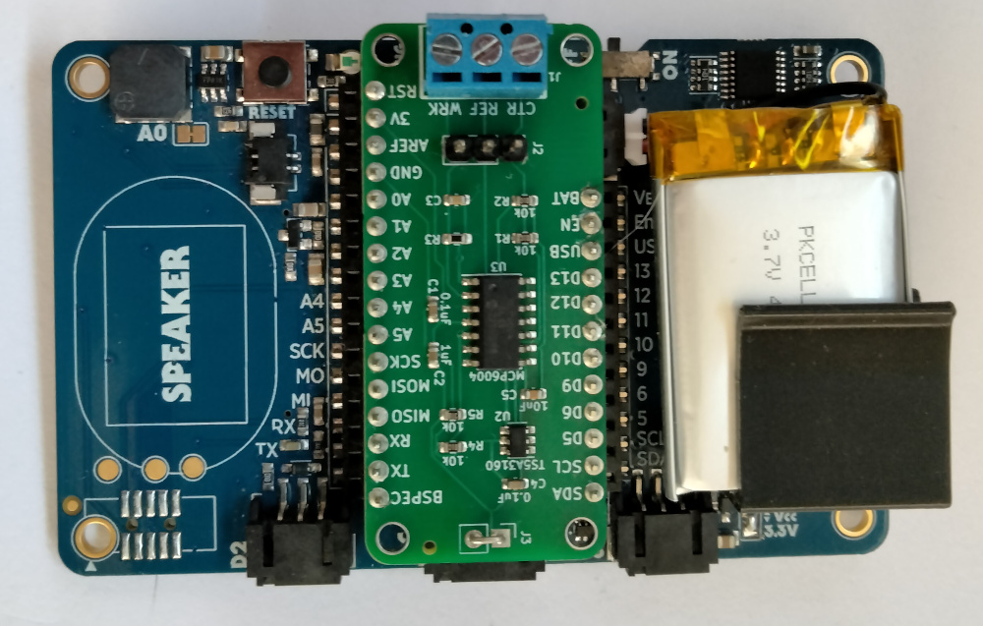
PyBadge and Rodeostat Featherwing
GND clip, 0V with respect to PyBadge not VGND
- for oscilloscope probes etc.

Slide 19
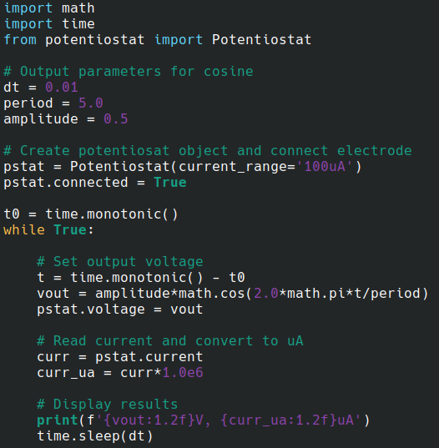
The Potentiostat class

Slide 20
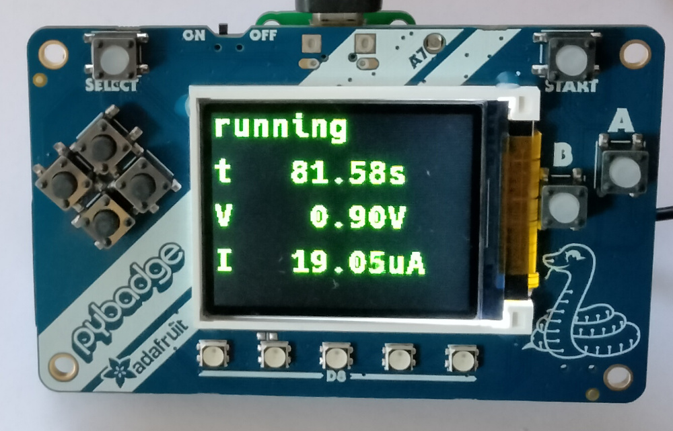
Potentiostat Examples
Cyclic voltammetry example with USB/serial between MCU and PC
- https://github.com/iorodeo/rodeostat_featherwing_example
Stand-alone constant voltage example displaying time, voltage and current

Slide 21
CirctuiPython Resources
https://circuitpython.org/
https://docs.circuitpython.org/en/latest/docs/index.html
https://github.com/todbot/circuitpython-tricks
https://circuitpython.org/awesome

