Slide 1
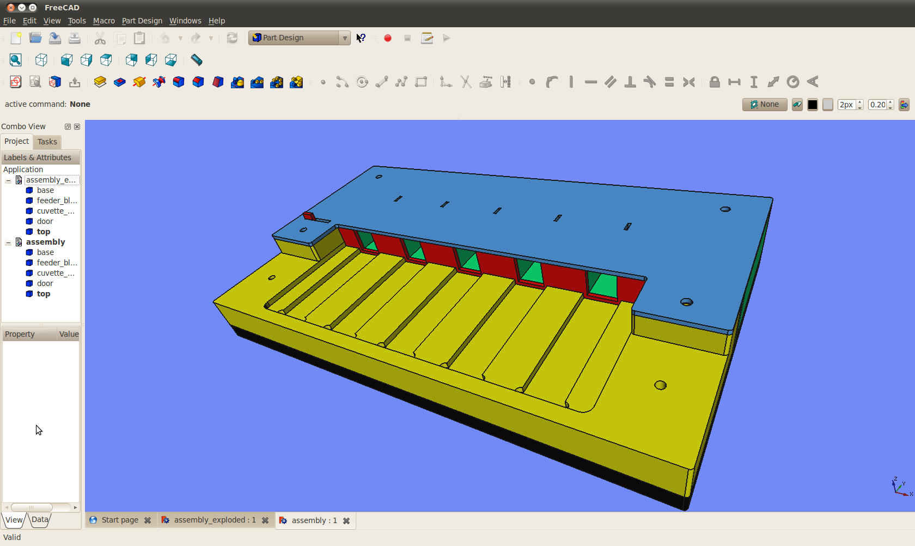
door slider
Slots for capillaries
cuvetter holders

Slide 2
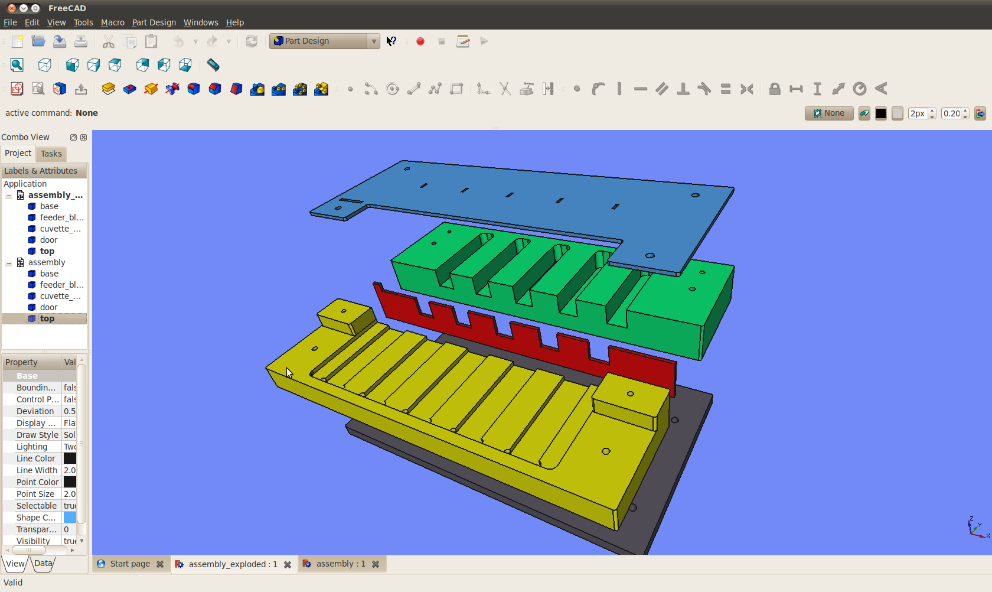
top plate
feeder block
Cuvette block
sliding door
base plate

Slide 3
Notes:
“base plate” lasercut from 1/4” (6mm) white acrylic
“cuvette block” and “feeder block” milled from white delrin (acetal)
“top plate”and “sliding doo” laser cut from 1/16” (1.5mm) clear acrylic.

