Slide 1
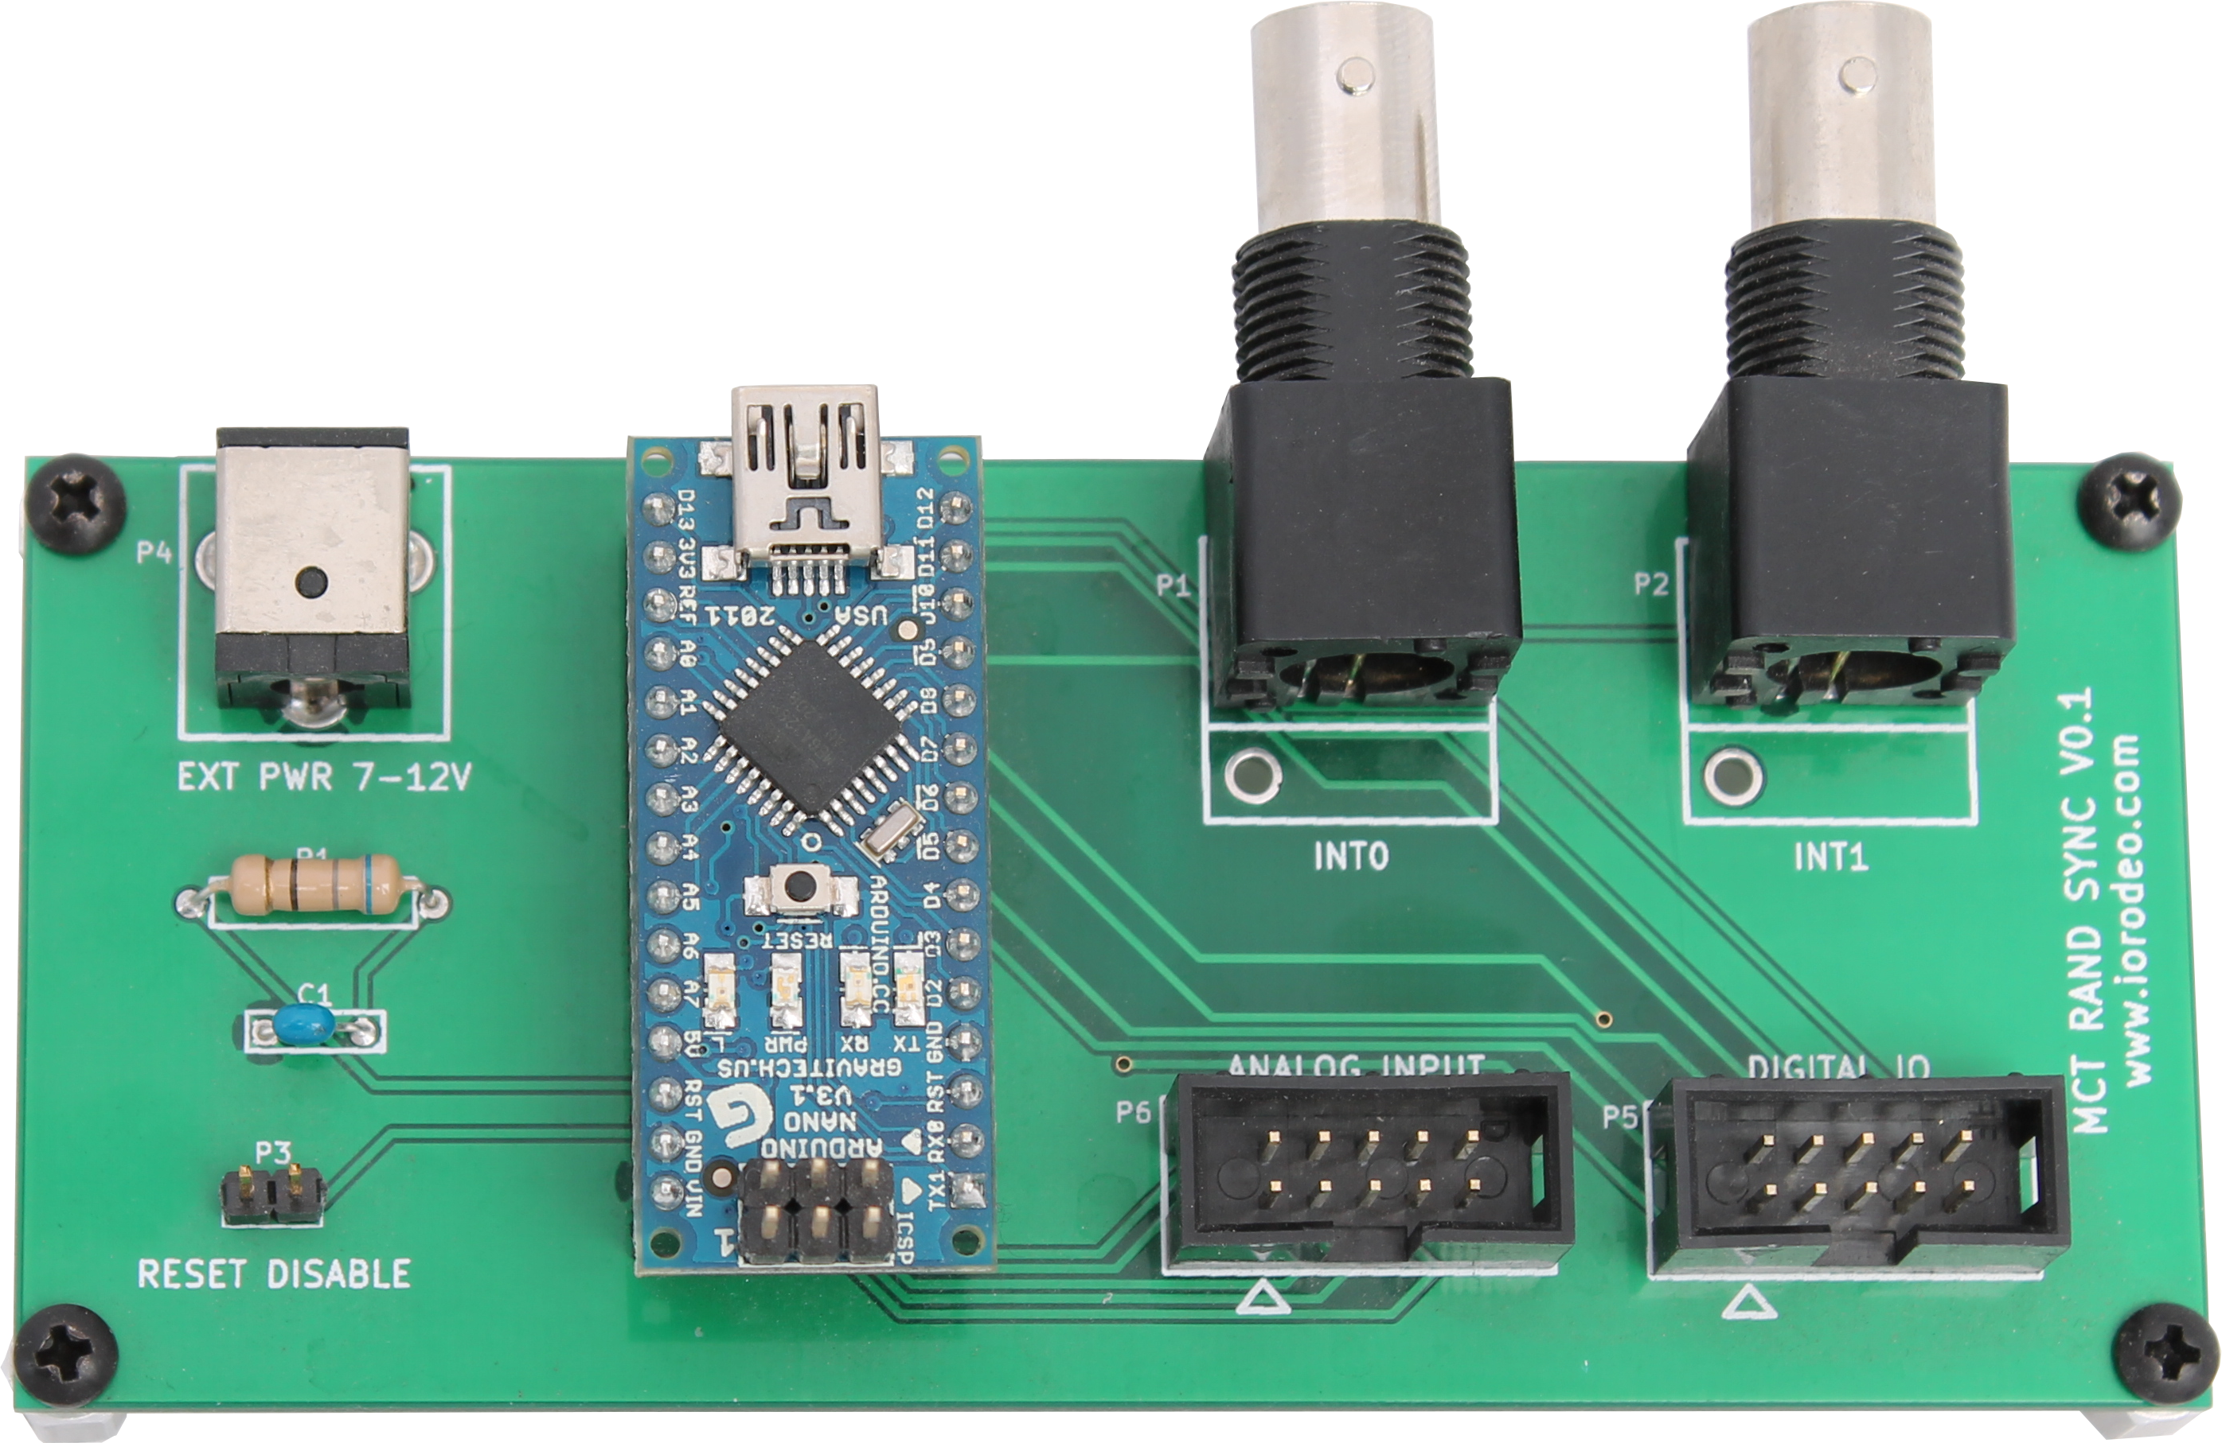
Camera Trigger
Change Signal (Pin 4)
Sync Signal (Pins 5,7,9)

