Slide 1
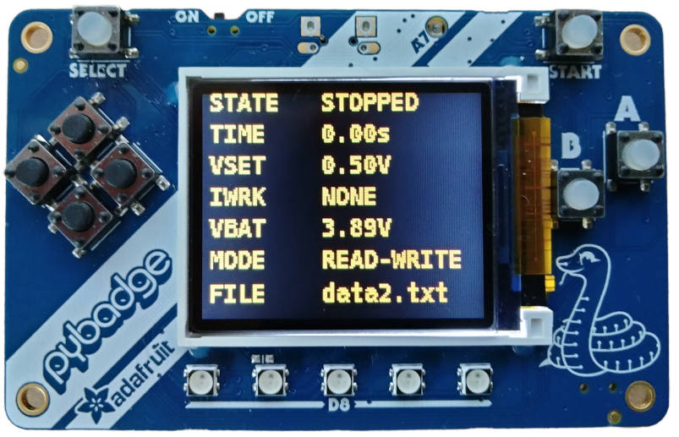
Stop
Start
increase voltage
set-point
Clear Files
decrease voltage
set-point

