Slide 1
QUALITY MANAGEMENT ACTIVITIES
May-June-July 2021
Ipek TANSARIKAYA ÖRS
Senior QA Expert , MSc .

Slide 2
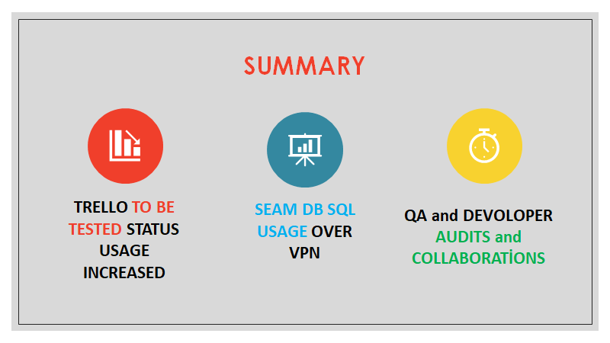

Slide 3
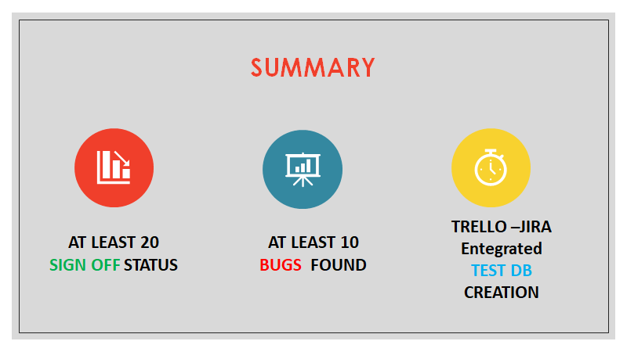

Slide 4
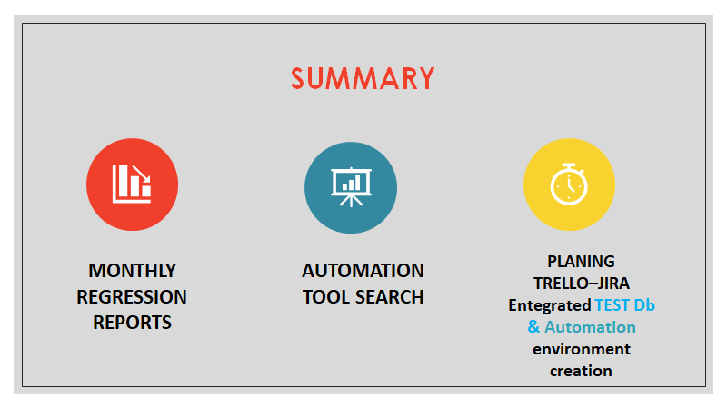

Slide 5
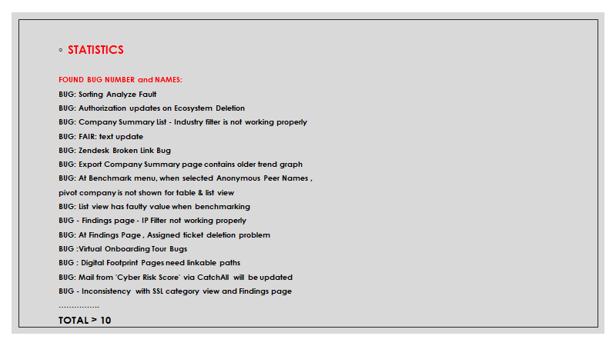

Slide 6
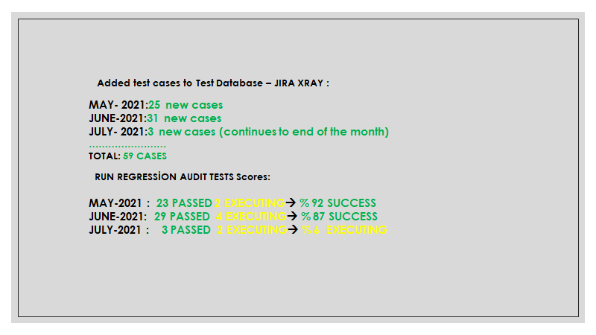

Slide 7
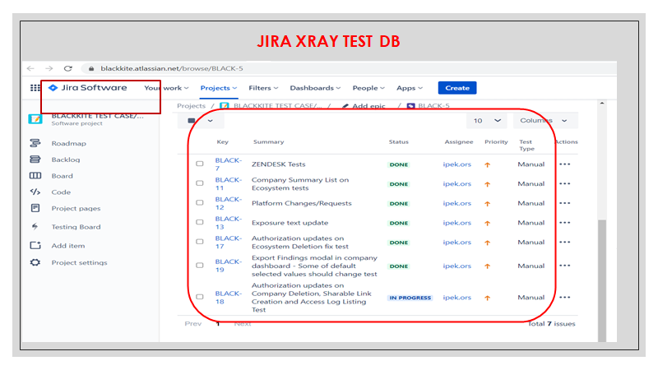

Slide 8
