Slide 1
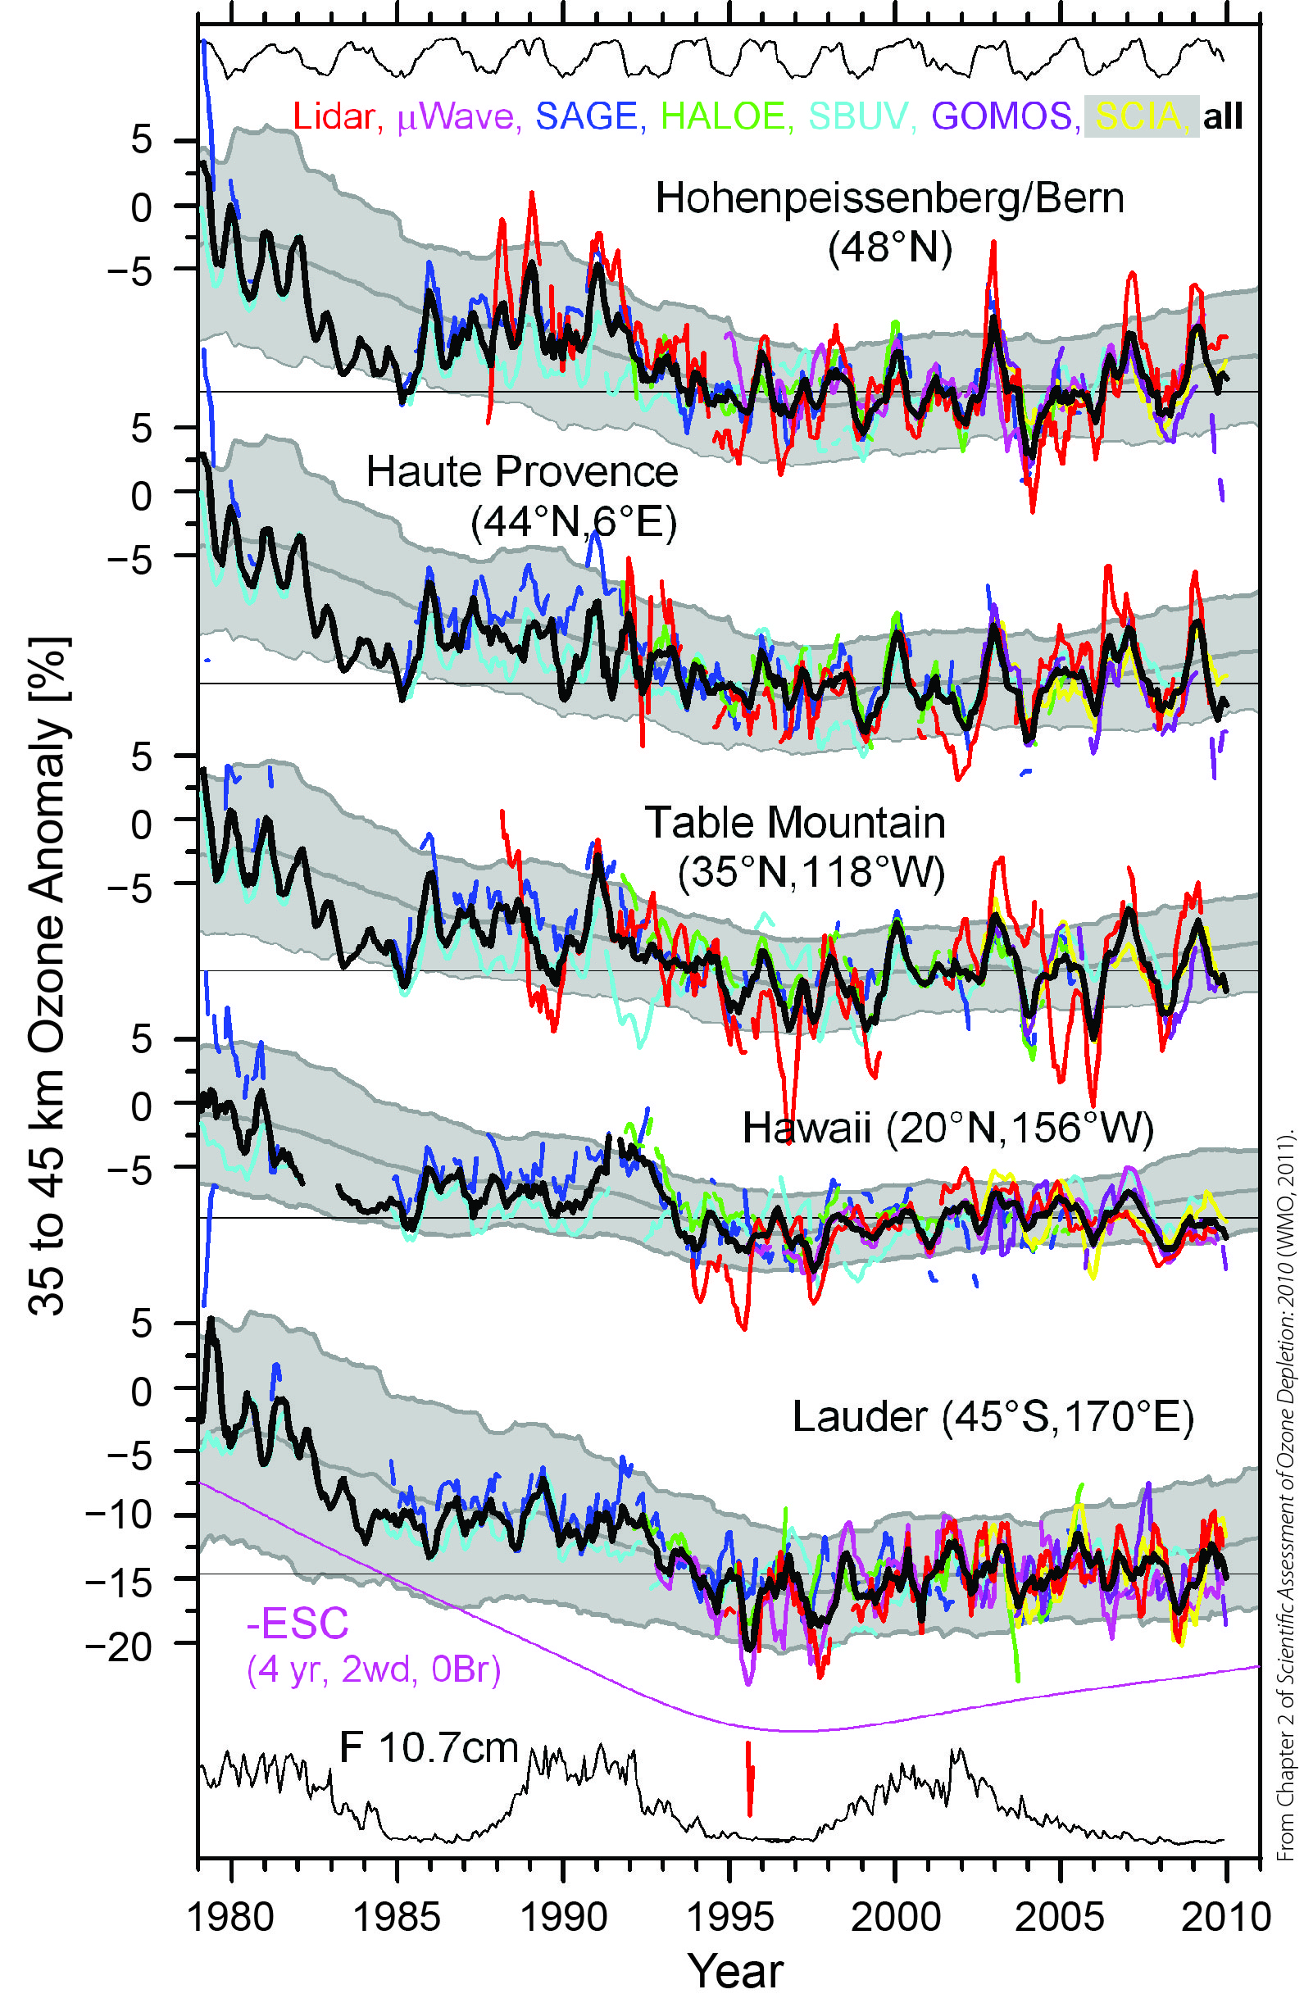
SAGE I/II and NDACC lidars, µwaves
long ozone profile records
document ozone depletion and beginning recovery
key data for ozone assessments
Fig. 2-5
WMO/UNEP Ozone Assessment 2010

Slide 2
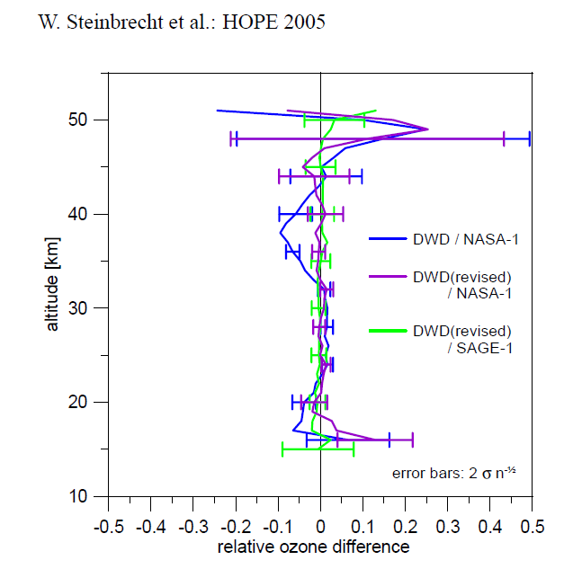
SAGE II and NDACC lidars
campaign in 2005
long-term comparison 1988 to 2003
almost no bias
virtually the same ozone profiles
Fig. 22, Steinbrecht et al. AMT 2008

Slide 3
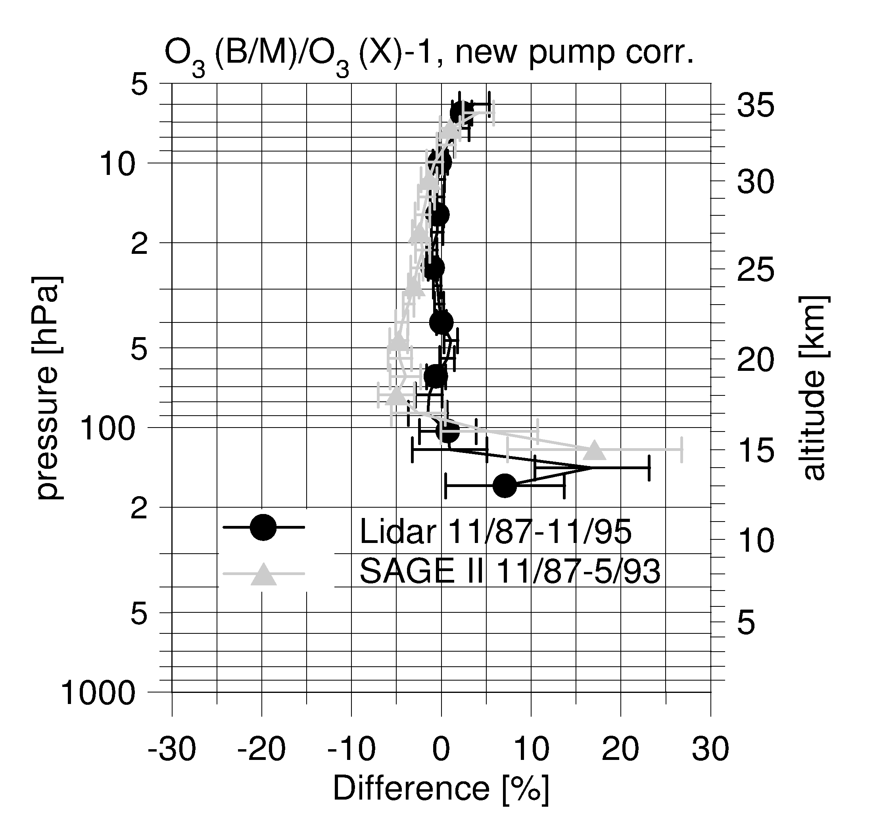
SAGE II, ozone sondes and lidar at Hohenpeissenberg
very similar ozone profiles
bias < 5% at most altitudes
Fig. 10, Steinbrecht et al., J. Atmos. Ocean Tech., 1998

