Slide 1
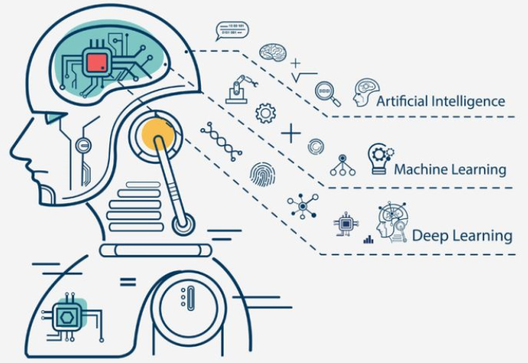
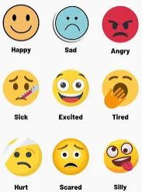
Executive Summary
Emotion Detection Project: Key Insights and Impact
Project Overview:
Developed a deep learning model for real-time and reliable emotion detection, specifically classifying "Happy" and "Not Happy" faces, with the goal of enhancing user experience across sectors like healthcare and customer service.
Key Takeaway:
The Optimized CNN achieved a benchmark performance with 87% accuracy and 0.94 ROC-AUC, demonstrating effectiveness in identifying complex emotional patterns.
Next Steps:
Pilot testing and potential deployment in real-world applications, with scope for further fine-tuning based on specific use cases.
Notes:
Project Overview:
Talking Point: "This project is centered on developing a deep learning model capable of real-time and reliable emotion detection. The model focuses on distinguishing between 'Happy' and 'Not Happy' faces, making it particularly valuable for sectors that require insights into emotional states, such as healthcare and customer service."
Additional Context: "By understanding emotions, businesses and healthcare providers can tailor responses to improve patient support, customer experience, and user engagement. For example, in healthcare, detecting emotions like distress or happiness can help personalize care and monitor mental health."
Key Takeaway:
Talking Point: "Our optimized CNN model achieved an impressive 87% accuracy and a high ROC-AUC score of 0.94, indicating its strong reliability in identifying emotional patterns accurately. This level of performance suggests that the model is well-suited for real-world applications where precision is critical."
Additional Context: "The high accuracy and ROC-AUC score highlight the model’s ability to effectively separate 'Happy' from 'Not Happy' expressions, even in complex scenarios. This makes it a powerful tool for applications that rely on subtle emotional insights to make decisions."
Next Steps:
Talking Point: "Looking forward, the goal is to explore deploying this model in real-world applications, with potential further fine-tuning to adapt to specific use cases. Deployment could involve integrating the model into customer support platforms, telemedicine systems, or other user-facing applications."
Additional Context: "Fine-tuning could include adapting the model to different facial datasets or optimizing it for speed in real-time applications. This will ensure that the model not only performs well in testing but also meets the practical demands of a production environment."

Slide 2


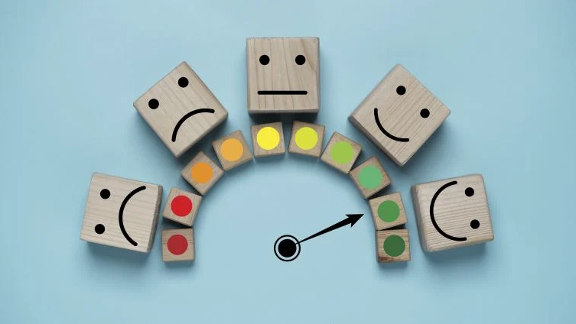

Problem and Solution Summary
Emotion Detection for Enhanced User Engagement and Support
Problem Statement:
- Classify emotions as "Happy" or "Not Happy" to enhance interactions in healthcare and customer service.
- Bridge the gap in real-time emotional insights, allowing for personalized, proactive responses.
Solution Design:
- Built a CNN model for reliable emotion detection, incorporating image preprocessing, normalization, and model optimization.
Solution Validation:
- Achieved 87% accuracy and 0.94 ROC-AUC, indicating strong classification performance.
- Balanced F1-scores for "Happy" (0.86) and "Not Happy" (0.88), ensuring effective precision and recall.
Key Benefits:
- Provides actionable emotional insights, enhancing decision-making and user engagement.
- Ready for scalable deployment in various customer-facing applications with high accuracy.
Notes:
Problem Statement:
Many sectors, especially healthcare and customer service, need reliable, real-time insights into user emotions to improve experiences.
Our project addresses this gap by focusing on detecting emotions classified as "Happy" or "Not Happy" to help organizations deliver tailored, proactive responses.
Solution Design:
We designed a Convolutional Neural Network (CNN) model optimized for emotion detection, focusing on robust preprocessing steps like image normalization and model fine-tuning to achieve higher accuracy.
This approach allows the model to recognize complex emotional patterns in images, providing consistent results.
Solution Validation:
Our optimized CNN achieved an impressive 87% accuracy and a high ROC-AUC score of 0.94, which indicates strong overall performance.
Balanced F1-scores (0.86 for "Happy" and 0.88 for "Not Happy") demonstrate that the model maintains precision and recall across both emotion categories.
Key Benefits:
This model provides actionable emotional insights, enabling better decision-making and user engagement by adapting responses based on detected emotions.
The model is ready for scalable deployment in various applications, ensuring high accuracy in real-world customer-facing scenarios.

Slide 3


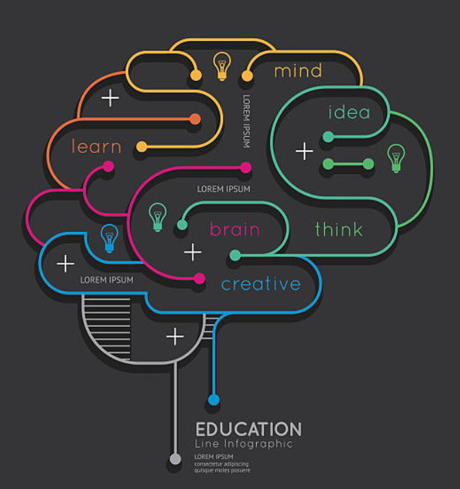

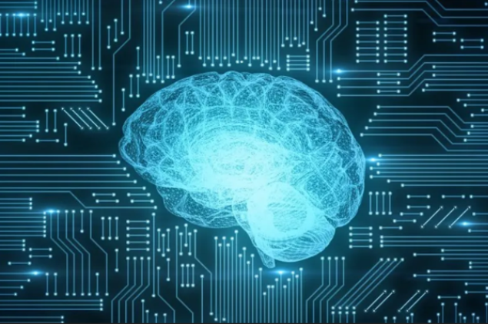
Recommendations for Implementation
Actionable Insights:
- Deploy the emotion detection model in applications for healthcare and customer service for real-time emotional insights.
- Integrate the model into existing customer feedback systems or patient support tools to enhance interaction quality.
Expected Benefits:
- Improved Customer Satisfaction: Enables personalized responses, increasing loyalty and satisfaction.
- Enhanced Patient Care: Provides real-time emotional feedback, supporting empathetic care and improved patient experience.
Key Risks, Challenges and Costs:
- Data Privacy Concerns: Comply with regulations (e.g., HIPAA) to safeguard sensitive data.
- Environmental Diversity: Model may need further fine-tuning for lighting, cultural variations, etc.
- Implementation Cost: Initial deployment and integration may incur moderate costs but yield high long-term benefits.
- Future Exploration:
- Multilingual and Multicultural Adaptation: Fine-tune for diverse user groups for wider accuracy.
- Expand Emotion Range: Include more emotions like sadness, anger, and surprise for broader applications.
Notes:
Actionable Insights: "Deploying this emotion detection model can fundamentally enhance healthcare and customer service interactions. For instance, integrating it into customer feedback systems allows real-time emotional analysis, enabling businesses to respond to feedback more effectively and empathetically. In patient support tools, emotional insights could help healthcare providers better understand patient concerns, enhancing the overall care experience."
Expected Benefits:
"In customer service, proactive emotional insights foster personalized responses, increasing both satisfaction and loyalty. Imagine a customer expressing frustration in feedback — the model could trigger immediate intervention, turning a potential issue into an opportunity to improve service."
"In healthcare, real-time emotion detection means that medical staff can respond more compassionately, creating a supportive environment that improves patient comfort and overall outcomes. Emotion detection aids in personalizing care, making patients feel understood on an emotional level, not just physically."
Key Risks and Challenges:
"Data privacy is paramount, especially when handling sensitive emotional data in healthcare. Compliance with regulations like HIPAA ensures that patient data remains secure, building trust and protecting patient rights."
"Achieving consistent model accuracy across diverse settings requires careful consideration. Factors like lighting, cultural expression differences, and varied environments can impact model performance. Addressing these through fine-tuning and training on diverse datasets is essential for robust deployment."
Future Exploration:
"To ensure this model resonates with a global audience, fine-tuning for multilingual and multicultural contexts is a valuable next step. By adapting to diverse linguistic and cultural cues, the model could enhance accuracy and effectiveness in emotion detection across user groups."
"Extending the model’s emotional range beyond ‘Happy’ and ‘Not Happy’ to include other emotions like sadness, anger, or surprise would broaden its application. This flexibility would allow the model to offer deeper insights into user sentiment, making it applicable in even more scenarios."

